Slide 1
EE691: R&D Project
Modelling and Analysis of PASS-P
Presented by Anubhav, 200070008
Supervisor: Prof. Virendra Singh
Computer Architecture and Dependable Systems Lab
Department of Electrical Engineering, IIT Bombay
1

Slide 2
Multicore System
CORE 1
CORE 2
L1 Cache
L1 Cache
L2 Cache
L2 Cache
BUS
L3 Cache
LLC is shared between the two cores => Vulnerable to side-channel attacks
2

Slide 3
Flush + Reload
Monitored cache lines are flushed from the cache hierarchy
Attacker waits for the victim to access cache lines
Attacker reloads flushed lines
Hit / Miss can be inferred by the access time
If access hits => victim brought the block into the cache
If access misses => victim did not access the line
“Flush+reload: A high resolution, low noise, l3 cache side-channel attack,” in Proceedings of the 23rd USENIX Conference on Security Symposium, SEC’14
3

Slide 4
Prime + Probe
Attacker fills (primes) cache sets with its own data
Attacker wait for the victim to access cache lines
Attacker reloads primed lines
Hit / Miss can be inferred by the access time
If access hits => victim did not access the line
If access misses => victim evicted the line => cache line was accessed
“Last-level cache side-channel attacks are practical,” in 2015 IEEE Symposium on Security and Privacy
4

Slide 5
Cache Security
Cache Randomization
address mapping from main memory to the cache subsystem is randomized => attacker process cannot detect accesses made by the victim process
Cache Partitioning
Static Partitioning: guarantees security, heavy performance penalty, cache lines remain under-utilized
Dynamic Partitioning: performs better than static partitioning, susceptible to side-channel attacks
“Partitioned cache architecture as a side-channel defence mechanism.” Cryptology ePrint Archive, Paper 2005/280
5

Slide 6
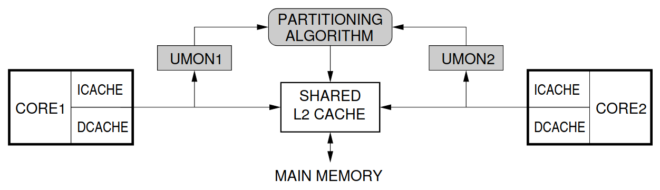
Utility-based Cache Partitioning
UCP allots more lines to the process that has a higher ‘utility’
Utility: increase in cache hit-rate if the process was given an additional cache line
Performs better than Static partitioning in all benchmarks
“Utility-based cache partitioning: A low-overhead, high-performance, runtime mechanism to partition shared caches,” in MICRO 39: Proceedings of the 39th Annual IEEE/ACM International Symposium on Microarchitecture
6

Slide 7
Side-Channel Threat
Reallocated lines can still be accessed by the first process until the second process overwrites them
Any side-channel attack on DCP is possible due to this reallocation
Attacker program can artificially increase or decrease its ‘utility’ to cause reallocation of cache lines to and from itself respectively
7

Slide 8
Flush + Reload on UCP
FLUSH
V0
V0
EXECUTE
V0 | V1 | V2 | V3 | V4 | V5 | V6
RELOAD
V0 | V1 | V2 | V3 | V4 | V5 | V6
8

Slide 9
Prime + Probe on UCP
PRIME
V0 | A1 | A2 | A3 | A4 | A5 | A6 | A7
V0 | A1 | A2 | A3 | A4 | A5 | A6 | A7
EXECUTE
V0 | A1 | V2 | A3 | V4 | V5 | A6 | A7
PROBE
V0 | A1 | V2 | A3 | V4 | V5 | A6 | A7
9

Slide 10
Performance And Security Sensitive DCP
Security with Invalidation
Invalidates all cache lines reallocated from one core to another
Side channel attacks cannot be mounted in such a system:
Flush + Reload: All the lines reallocated to the attacker after the Execute step will be invalidated and the attacker gets a miss for every targeted address in Reload
Prime + Probe: The lines primed by the attacker in the Prime step are invalidated upon reallocation and the attacker gets a miss in the Probe step
Differential timing analysis fails!
“PASS-P: Performance and security sensitive dynamic cache partitioning,” in Proceedings of the 19th International Conference on Security and Cryptography - Volume 1: SECRYPT
10

Slide 11
Flush + Reload on PASS-P
FLUSH
V0
V0
EXECUTE
V0 | V1 | V2 | V3 | V4 | V5 | V6
RELOAD
V0
11

Slide 12
Prime + Probe on PASS-P
PRIME
V0 | A1 | A2 | A3 | A4 | A5 | A6 | A7
V0 |  |  |  |  |  |  | A7
EXECUTE
V0 |  | V2 |  | V4 | V5 |  | A7
PROBE
V0 |  |  |  |  |  |  | A7
12

Slide 13
PASS-P
Modified-LRU Reallocation Policy
UCP: first process can still access reallocated lines until the second process overwrites them
PASS-P: due to invalidation, first process gets additional misses
Dirty reallocated lines must be written to the main memory before invalidation => surge in memory traffic at the start of each UCP phase
PASS-P preferentially re-allocates clean lines over dirty lines
13

Slide 14
Modified-LRU Reallocation Policy
Threshold fraction (f) ∈ [0,1]
Reallocate LRU-Clean line if one exists and is in the ‘f’ fraction of the least recently used lines allocated to the process, else reallocate the LRU-Dirty line
Threshold (thr) => number of cache accesses after which the UCP is called => decides number of ways for each core
14

Slide 15
MRU
LRU
UCP
 | * |  | * | *
LRU
Clean
MRU
LRU
PASS-P
 | * |  | * | *
* represents dirty block
f is assumed to be 0.75
15

Slide 16
Benchmarks
Benchmarks running on two separate cores:
Both benchmarks are memory-intensive (MM pairs)
First benchmark is memory-intensive while the second is compute-intensive (MC pairs)
Distinction is made based on the APKI
MC Pairs | gcc_gromacs, sphinx_gromacs, astar_h264ref, omnetpp_gromacs, bzip_gobmk, wrf_h264ref, libq_sjeng
MM pairs | leslie_sphinx, astar_libq, gcc_lbm, milc_bzip, libq_milc, zeusmp_omnetpp, mcf_zeusmp, bzip_lbm, gcc_milc, omnetpp_libq, gcc_libq, gcc_soplex, leslie_astar, wrf_bwaves
“Memory hierarchy characterization of SPEC CPU2006 and SPEC CPU2017 on the intel xeon Skylake-SP,” PLoS One
16

Slide 17
Simulation Setup
Simulator | Sniper Multicore Simulator
L1-D / L1-I Cache | 32 KB, 4-Way, LRU, Private, 4 cycles
L2 Cache | 256 KB, 8-Way, LRU, Private, 8 cycles
Last Level Cache (L3) | 4MB, 16-way, Shared, 30 cycles
Main Memory Latency | 175 cycles
Baseline Processor | x86 Nehalem microarchitecture, 2.67 GHz, 4-wide fetch,128-entry ROB
17

Slide 18
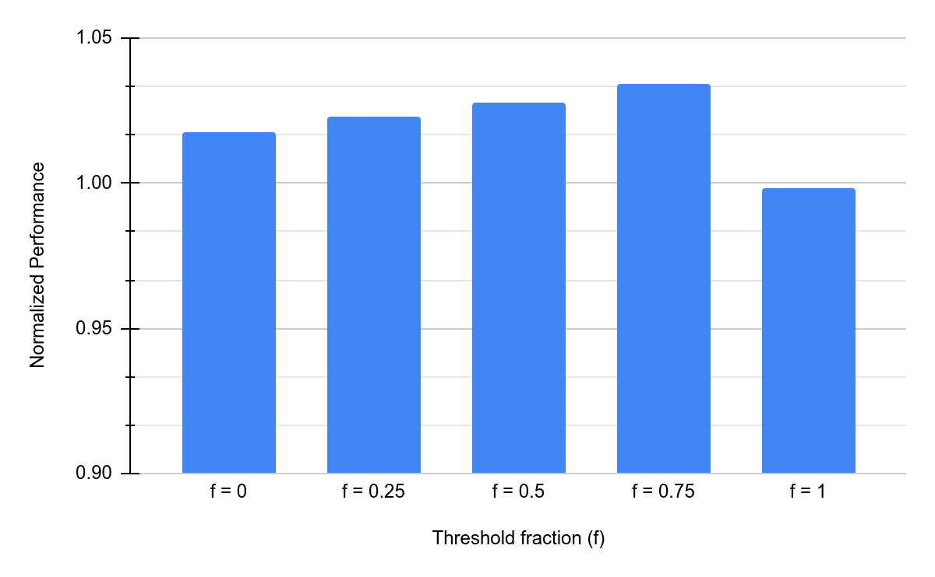
Choosing the threshold fraction (f)
f = 0.75 will be considered for further evaluation
*thr is assumed to be 10k
<number>

Slide 19
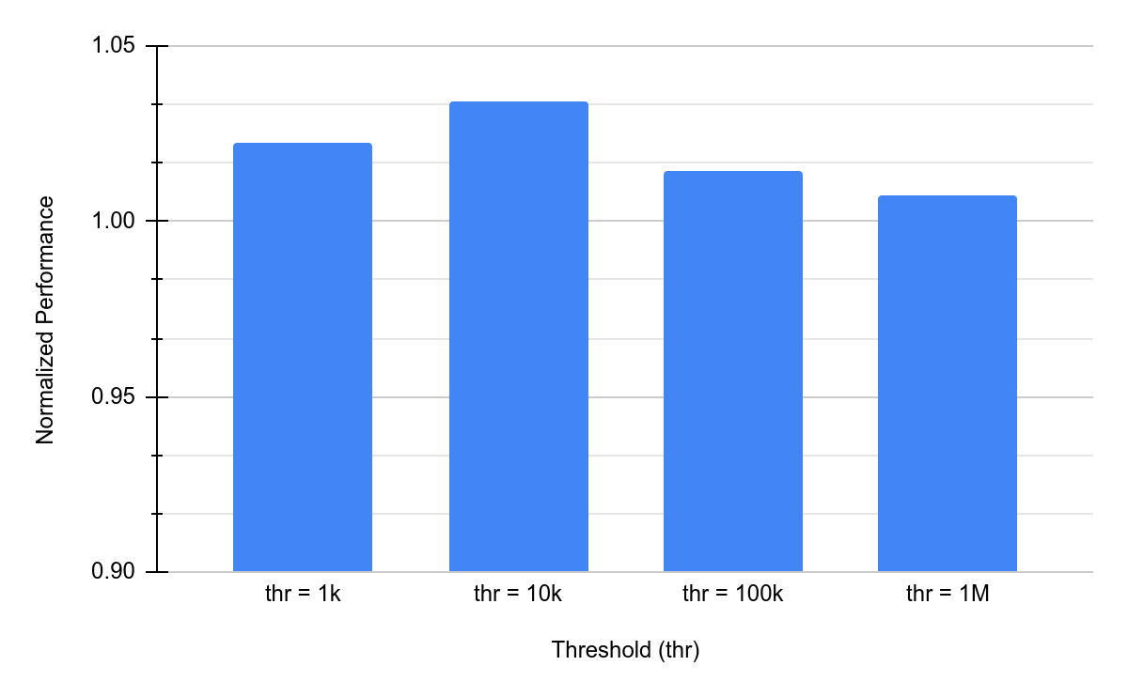
Choosing the threshold (thr)
thr = 10k will be considered for further evaluation
<number>

Slide 20
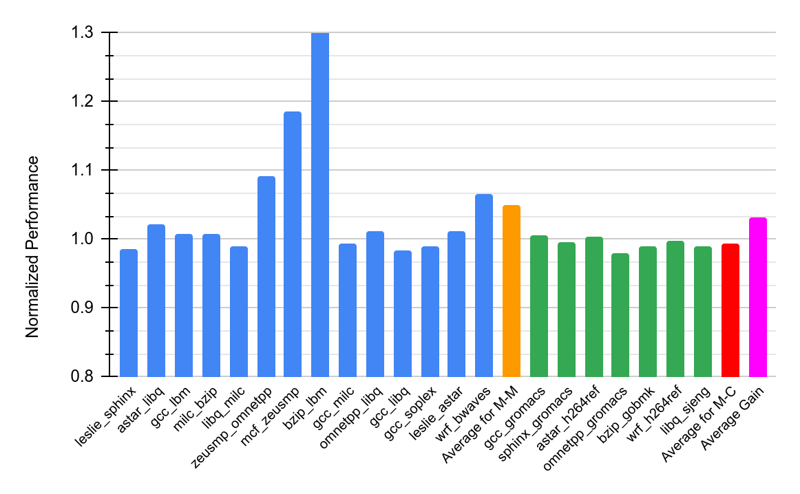

Evaluation
1.43
Performance gain of up to 43% and 5% on average for MM pairs
Choice of partitioning doesn’t affect compute-intensive programs
Overall gain of 3.12%
<number>

Slide 21
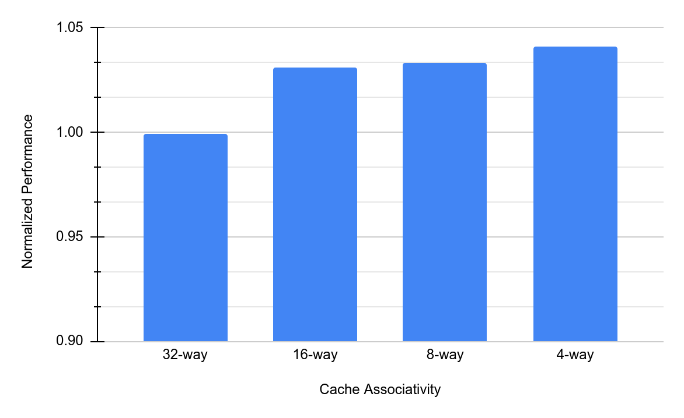
Sensitivity to LLC Associativity
Average performance gain increases to 4.09% for 4 ways
Lower associativity benefits more from PASS-P
=> more efficient utilization of the cache sets
* Associativity is changed while keeping cache size same
<number>

Slide 22
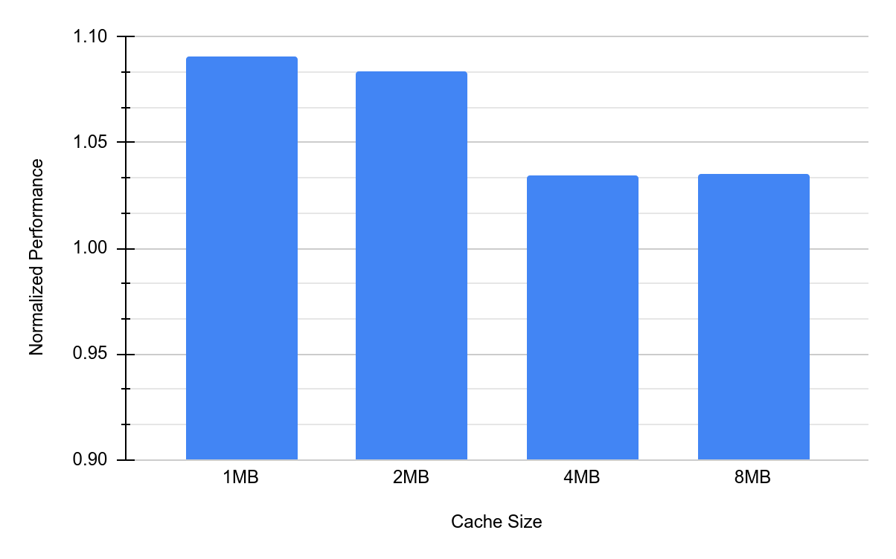
Sensitivity to LLC Size
Performance gain decreases with increasing cache size
Higher cache size => working set fits better => less conflicts
=> less dependence on reallocation policy
* Cache size is changed while keeping associativity same
<number>

Slide 23
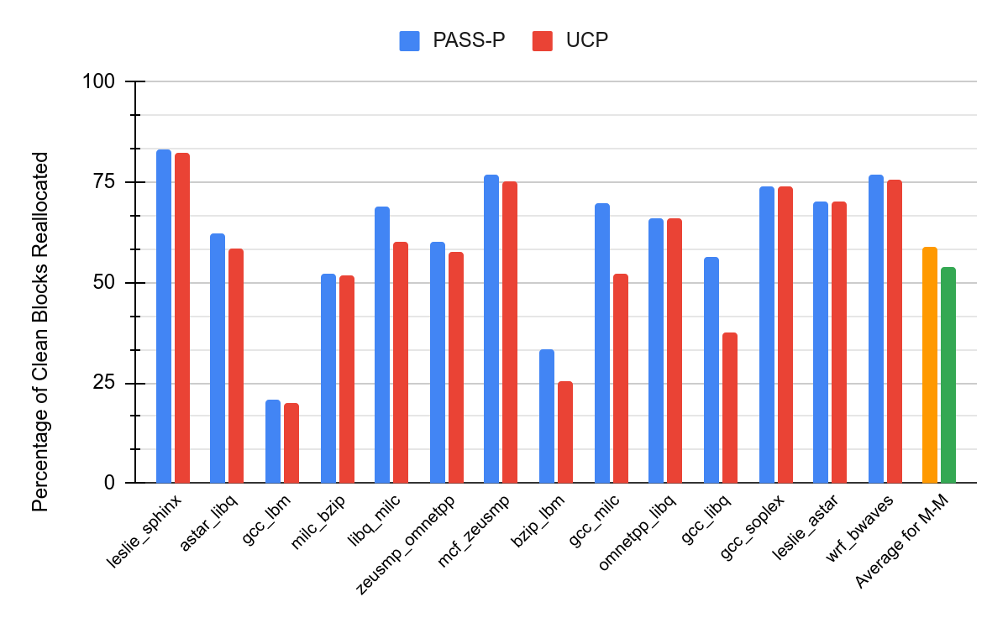
Analysis of Clean Blocks
Percentage of Clean reallocated blocks increases from 53.8% to 59.1%
for M-M pairs as we move from UCP to PASS-P
<number>

Slide 24
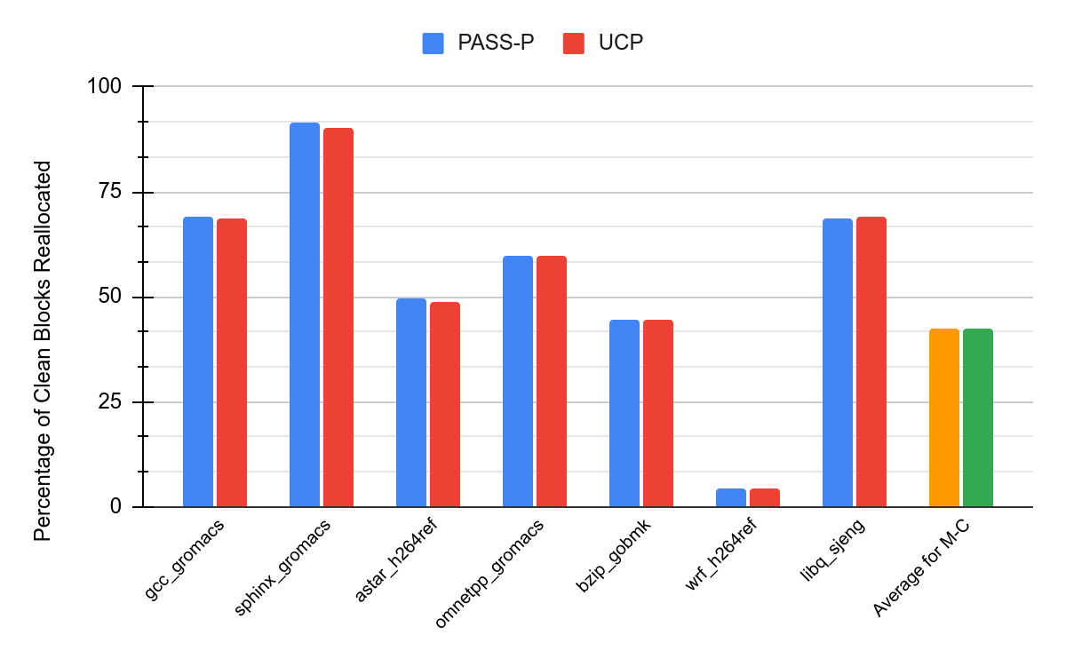
Analysis of Clean Blocks
Percentage of Clean reallocated blocks increases from 42.2% to 42.3% for M-C pairs as we move from UCP to PASS-P => M-C pairs are insensitive
to the reallocation policy used
<number>

Slide 25
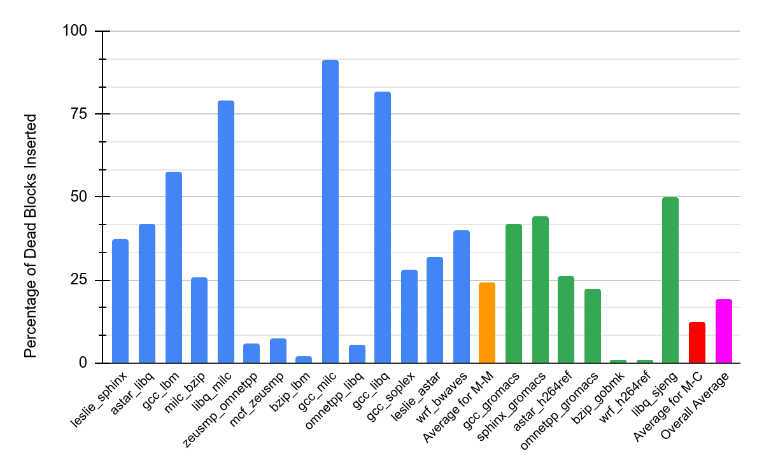
Analysis of Dead Blocks
14 out of the 21 benchmark pairs have a Dead block percentage of
more than 25% => dead blocks can be used for reallocation
=> dead block aware policies such as DAAIP
DAAIP: deadblock aware adaptive insertion policy for high performance caching,” in 2017 IEEE International Conference on Computer Design, ICCD 2017
<number>

Slide 26
Conclusion and Future Work
PASS-P proposes invalidation of reallocated blocks to ensure security => performance loss
Preference to clean blocks helps increase the clean reallocated block percentage => performance increases
Using deadblocks for reallocation
Deadblock Aware Adaptive Insertion Policy (DAAIP)
Preference to dead blocks for reallocation and analyze the performance with respect to PASS-P
<number>

Slide 27
THANK YOU!
<number>

