Slide 1
Modelling and Analysis of PASS-P
EE691: R&D Project
Presented by Anubhav, 200070008
Supervisor: Prof. Virendra Singh
Computer Architecture and Dependable Systems Lab
Department of Electrical Engineering, IIT Bombay

Slide 2
Multicore System
CORE 1
CORE 2
L1 Cache
L1 Cache
L2 Cache
L2 Cache
BUS
L3 Cache
LLC is shared between the two cores => Vulnerable to side-channel attacks

Slide 3
Flush + Reload
Monitored cache lines are flushed from the cache hierarchy
Attacker waits for the victim to access cache lines
Attacker reloads flushed lines
Hit / Miss can be inferred by the access time
If access hits => victim brought the block into the cache
If access misses => victim did not access the line
“Flush+reload: A high resolution, low noise, l3 cache side-channel attack,” in Proceedings of the 23rd USENIX Conference on Security Symposium, SEC’14

Slide 4
Prime + Probe
Attacker fills (primes) cache sets with its own data
Attacker wait for the victim to access cache lines
Attacker reloads primed lines
Hit / Miss can be inferred by the access time
If access hits => victim did not access the line
If access misses => victim evicted the line => cache line was accessed
“Last-level cache side-channel attacks are practical,” in 2015 IEEE Symposium on Security and Privacy

Slide 5
Cache Security
Cache Randomization
address mapping from main memory to the cache subsystem is randomized => attacker process cannot detect accesses made by the victim process
Cache Partitioning
Static Partitioning: guarantees security, heavy performance penalty, cache lines remain under-utilized
Dynamic Partitioning: performs better than static partitioning, susceptible to side-channel attacks
“Partitioned cache architecture as a side-channel defence mechanism.” Cryptology ePrint Archive, Paper 2005/280

Slide 6
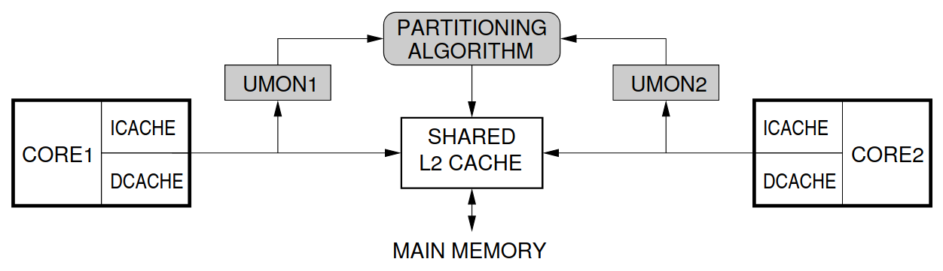
Utility-based Cache Partitioning
UCP allots more lines to the process that has a higher ‘utility’
Utility: increase in cache hit-rate if the process was given an additional cache line
Performs better than Static partitioning in all benchmarks
“Utility-based cache partitioning: A low-overhead, high-performance, runtime mechanism to partition shared caches,” in MICRO 39: Proceedings of the 39th Annual IEEE/ACM International Symposium on Microarchitecture

Slide 7
Side-Channel Threat
Reallocated lines can still be accessed by the first process until the second process overwrites them
Any side-channel attack on DCP is possible due to this reallocation
Attacker program can artificially increase or decrease its ‘utility’ to cause reallocation of cache lines to and from itself respectively

Slide 8
Flush + Reload on UCP
FLUSH
V0
V0
EXECUTE
V0 | V1 | V2 | V3 | V4 | V5 | V6
RELOAD
V0 | V1 | V2 | V3 | V4 | V5 | V6

Slide 9
Prime + Probe on UCP
PRIME
V0 | A1 | A2 | A3 | A4 | A5 | A6 | A7
V0 | A1 | A2 | A3 | A4 | A5 | A6 | A7
EXECUTE
V0 | A1 | V2 | A3 | V4 | V5 | A6 | A7
PROBE
V0 | A1 | V2 | A3 | V4 | V5 | A6 | A7

Slide 10
Performance And Security Sensitive DCP
Security with Invalidation
Invalidates all cache lines reallocated from one core to another
Side channel attacks cannot be mounted in such a system:
Flush + Reload: All the lines reallocated to the attacker after the Execute step will be invalidated and the attacker gets a miss for every targeted address in Reload
Prime + Probe: The lines primed by the attacker in the Prime step are invalidated upon reallocation and the attacker gets a miss in the Probe step
Differential timing analysis fails!
“PASS-P: Performance and security sensitive dynamic cache partitioning,” in Proceedings of the 19th International Conference on Security and Cryptography - Volume 1: SECRYPT

Slide 11
Flush + Reload on PASS-P
FLUSH
V0
V0
EXECUTE
V0 | V1 | V2 | V3 | V4 | V5 | V6
RELOAD
V0

Slide 12
Prime + Probe on PASS-P
PRIME
V0 | A1 | A2 | A3 | A4 | A5 | A6 | A7
V0 |  |  |  |  |  |  | A7
EXECUTE
V0 |  | V2 |  | V4 | V5 |  | A7
PROBE
V0 |  |  |  |  |  |  | A7

Slide 13
PASS-P
Modified-LRU Reallocation Policy
UCP: first process can still access reallocated lines until the second process overwrites them
PASS-P: due to invalidation, first process gets additional misses
Dirty reallocated lines must be written to the main memory before invalidation => surge in memory traffic at the start of each UCP phase
PASS-P preferentially re-allocates clean lines over dirty lines

Slide 14
Modified-LRU Reallocation Policy
Threshold fraction (f) ∈ [0,1]
Reallocate LRU-Clean line if one exists and is in the ‘f’ fraction of the least recently used lines allocated to the process, else reallocate the LRU-Dirty line
Threshold (thr) => number of cache accesses after which the UCP is called => decides number of ways for each core

Slide 15
MRU
LRU
UCP
 | * |  | * | *
LRU
Clean
MRU
LRU
PASS-P
 | * |  | * | *
* represents dirty block
f is assumed to be 0.75

Slide 16
Benchmarks
Benchmarks running on two separate cores:
Both benchmarks are memory-intensive (MM pairs)
First benchmark is memory-intensive while the second is compute-intensive (MC pairs)
Distinction is made based on the APKI
MC Pairs | gcc_gromacs, sphinx_gromacs, astar_h264ref, omnetpp_gromacs, bzip_gobmk, wrf_h264ref, libq_sjeng
MM pairs | leslie_sphinx, astar_libq, gcc_lbm, milc_bzip, libq_milc, zeusmp_omnetpp, mcf_zeusmp, bzip_lbm, gcc_milc, omnetpp_libq, gcc_libq, gcc_soplex, leslie_astar, wrf_bwaves
“Memory hierarchy characterization of SPEC CPU2006 and SPEC CPU2017 on the intel xeon Skylake-SP,” PLoS One

Slide 17
Simulation Setup
Simulator | Sniper Multicore Simulator
L1-D / L1-I Cache | 32 KB, 4-Way, LRU, Private, 4 cycles
L2 Cache | 256 KB, 8-Way, LRU, Private, 8 cycles
Last Level Cache (L3) | 4MB, 16-way, Shared, 30 cycles
Main Memory Latency | 175 cycles
Baseline Processor | x86 Nehalem microarchitecture, 2.67 GHz, 4-wide fetch,128-entry ROB

Slide 18
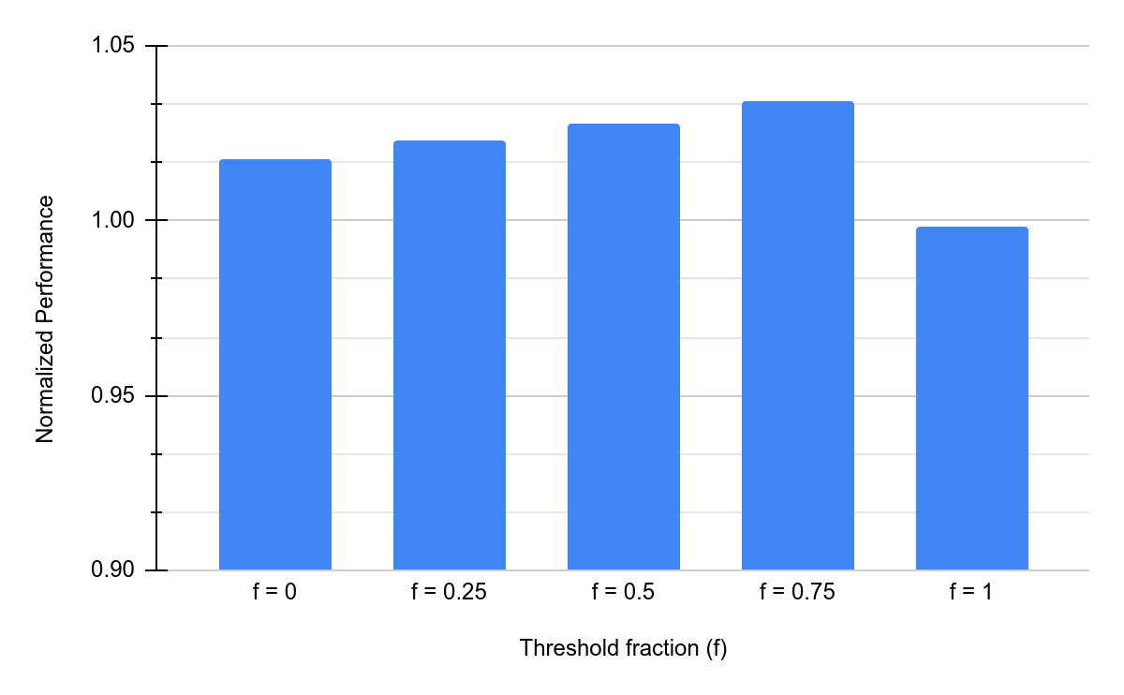
Choosing the threshold fraction (f)
f = 0.75 will be considered for further evaluation
*thr is assumed to be 10k

Slide 19
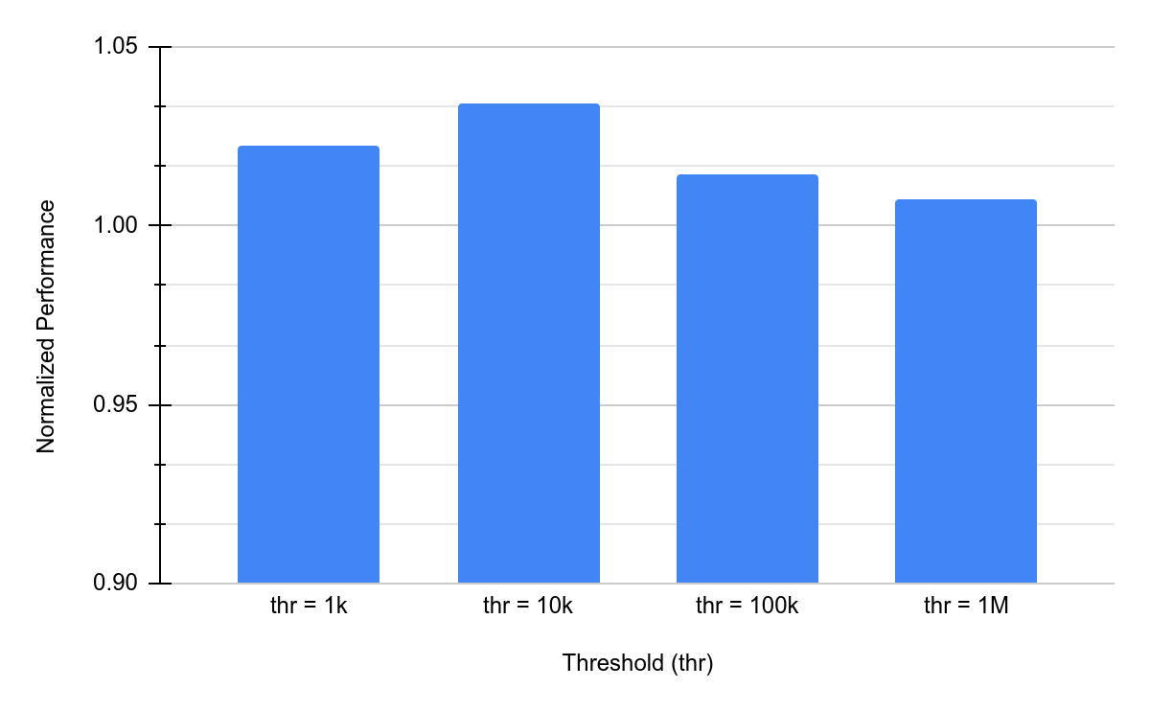
Choosing the threshold (thr)
thr = 10k will be considered for further evaluation

Slide 20
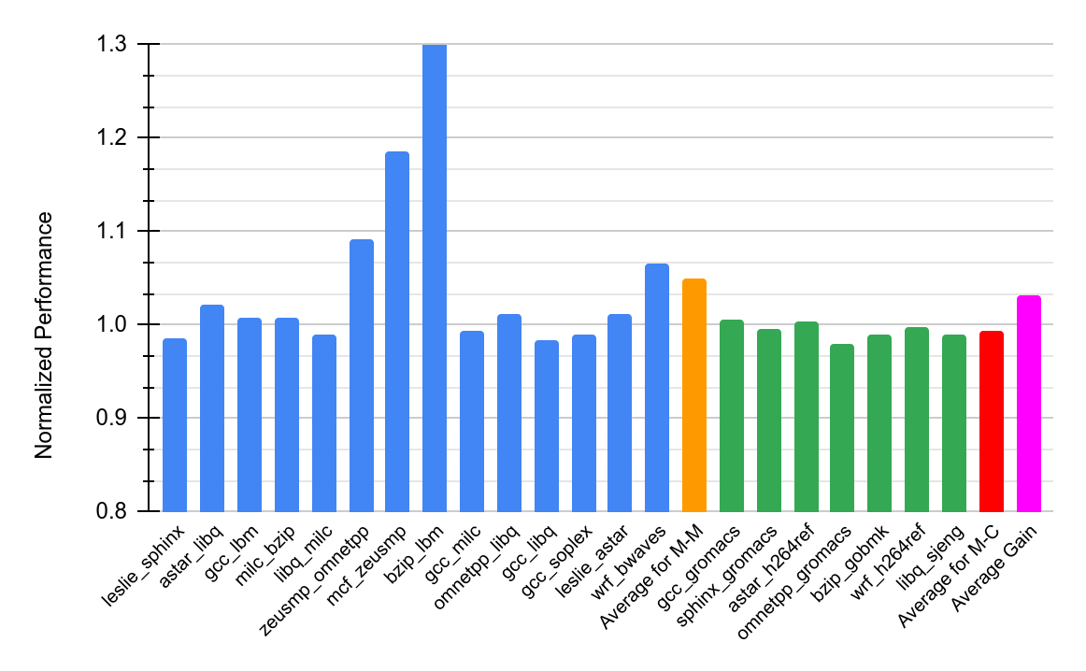

Evaluation
1.43
Performance gain of up to 43% and 5% on average for MM pairs
Choice of partitioning doesn’t affect compute-intensive programs
Overall gain of 3.12%

Slide 21
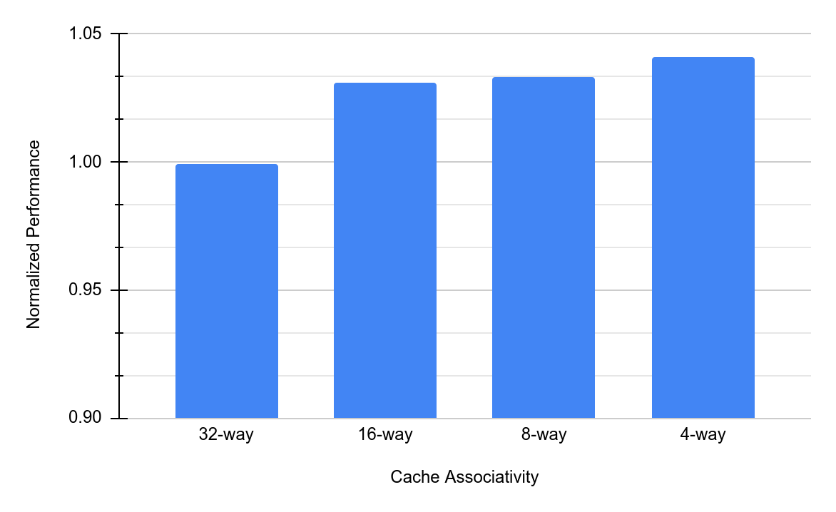
Sensitivity to LLC Associativity
Average performance gain increases to 4.09% for 4 ways
Lower associativity benefits more from PASS-P
=> more efficient utilization of the cache sets
* Associativity is changed while keeping cache size same

Slide 22
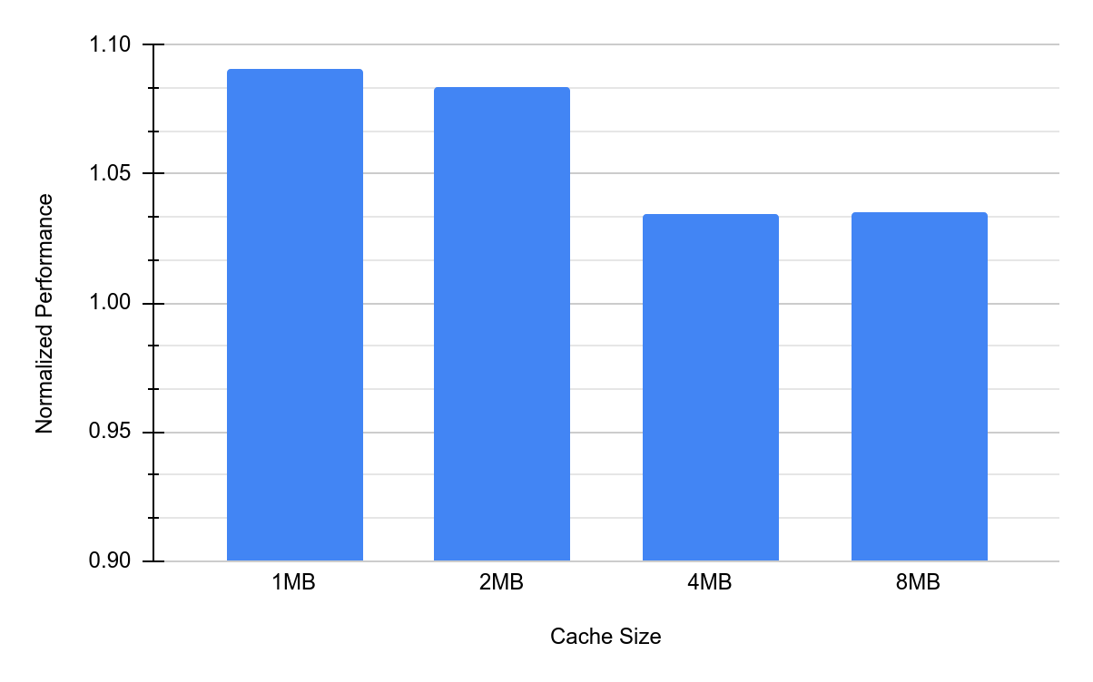
Sensitivity to LLC Size
Performance gain decreases with increasing cache size
Higher cache size => working set fits better => less conflicts
=> less dependence on reallocation policy
* Cache size is changed while keeping associativity same

Slide 23
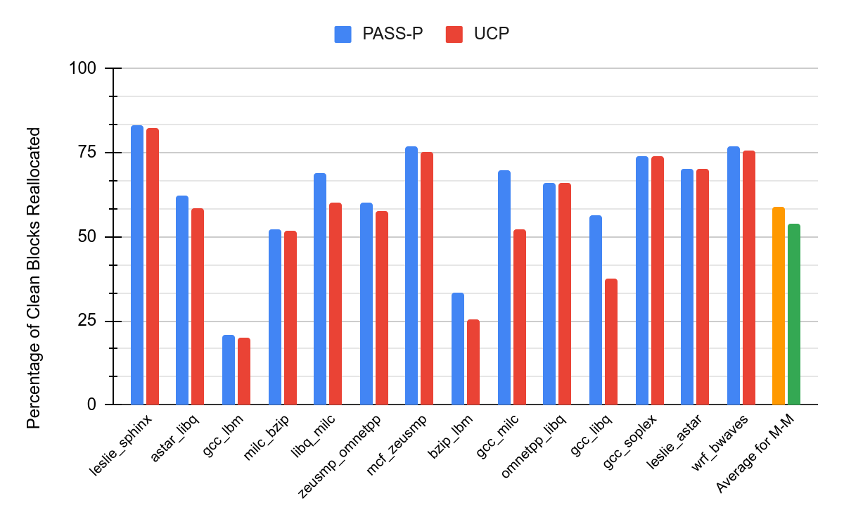
Analysis of Clean Blocks
Percentage of Clean reallocated blocks increases from 53.8% to 59.1%
for M-M pairs as we move from UCP to PASS-P

Slide 24
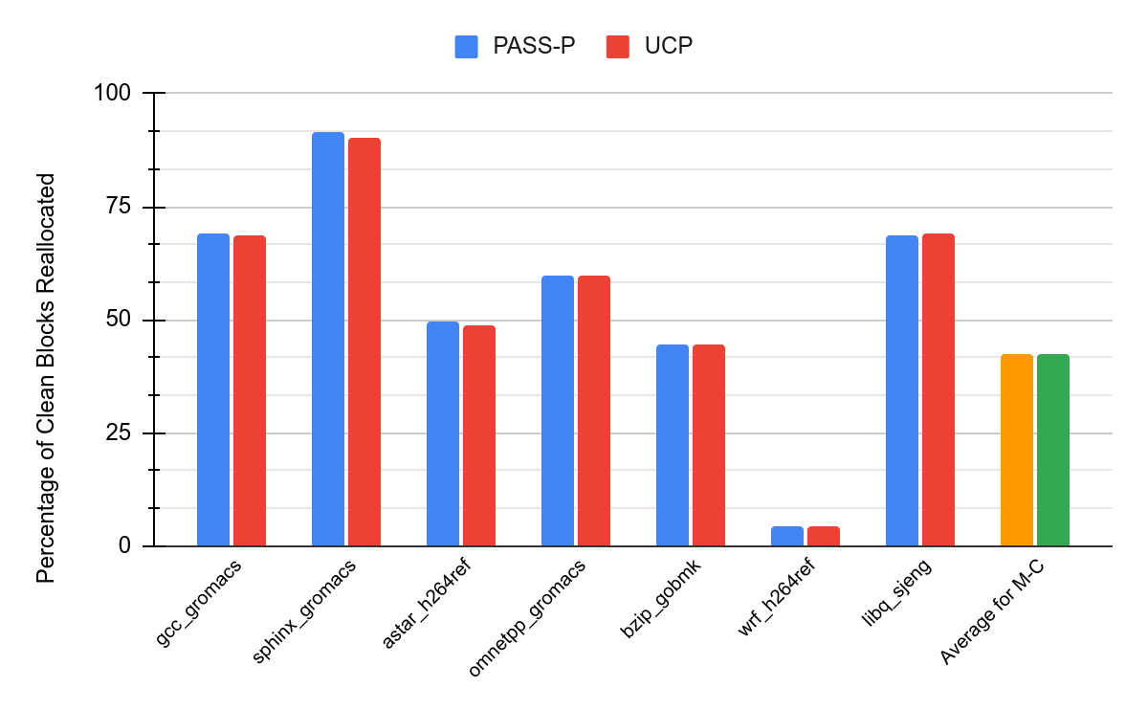
Analysis of Clean Blocks
Percentage of Clean reallocated blocks increases from 42.2% to 42.3% for M-C pairs as we move from UCP to PASS-P => M-C pairs are insensitive
to the reallocation policy used

Slide 25
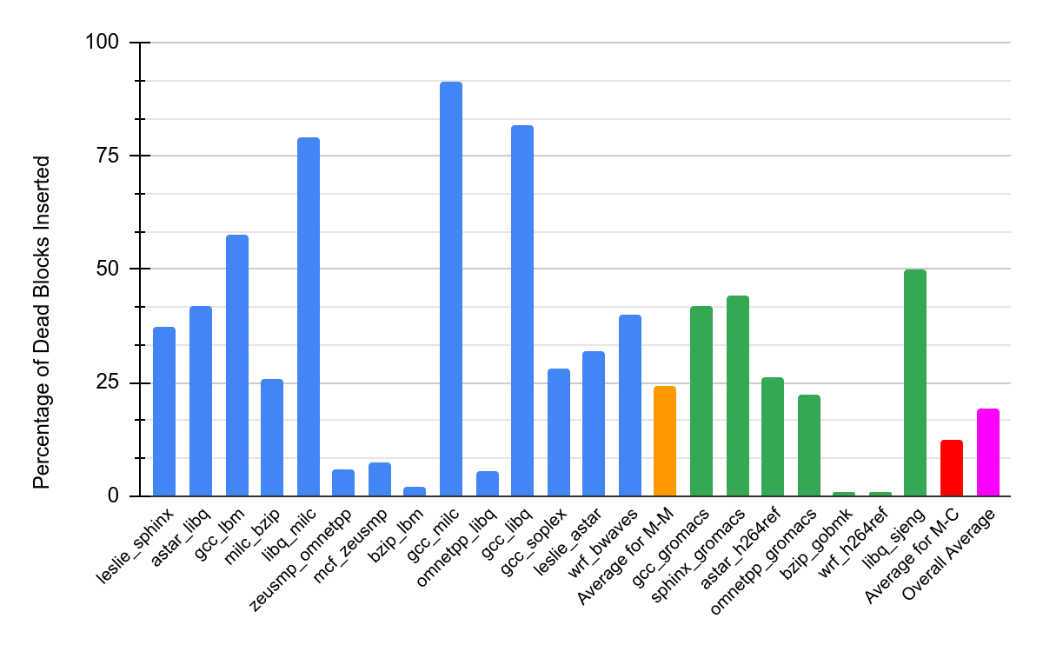
Analysis of Dead Blocks
14 out of the 21 benchmark pairs have a Dead block percentage of
more than 25% => dead blocks can be used for reallocation
=> dead block aware policies such as DAAIP
DAAIP: deadblock aware adaptive insertion policy for high performance caching,” in 2017 IEEE International Conference on Computer Design, ICCD 2017

Slide 26
Conclusion and Future Work
PASS-P proposes invalidation of reallocated blocks to ensure security => performance loss
Preference to clean blocks helps increase the clean reallocated block percentage => performance increases
Using deadblocks for reallocation
Deadblock Aware Adaptive Insertion Policy (DAAIP)
Preference to dead blocks for reallocation and analyze the performance with respect to PASS-P

Slide 27
THANK YOU!

