Slide 1
AMITY SCHOOL OF ENGINEERING AND TECHNOLOGY
PAYMENT BEHAVIOUR &
DIGITAL PAYMENT INTELLIGENCE
Customer segmentation with unsupervised machine learning
Fundamentals of Machine Learning | MLE2503
5th Semester | July-December 2026
PBL
PROJECT
Student: Anubhav Dash UID: A501132524011

Slide 2
The problem: one checkout policy does not fit everyone
01 / PROBLEM FRAMING
Different payment choices
Different behaviours
Business tension
UPI, cards, digital wallets, cash, and EMI/BNPL can reflect different transaction patterns.
Customers differ in spend, frequency, cashback use, discount depth, and channel.
Uniform offers can waste incentive budget; digital-only flows can overlook cash-preferring users.
Project goal
Discover data-driven customer segments, evaluate how much behaviour adds beyond payment method alone, and translate the results into responsible checkout, cashback, and EMI recommendations.
2

Slide 3
Project objectives and success criteria
01 / PROBLEM FRAMING
• Inspect, clean, and document transaction records.
• Aggregate to customer-level payment and behaviour features.
• Standardize features and compare K-Means with Ward agglomerative clustering.
• Compare payment-only features against payment + spend + frequency + offers.
• Evaluate with Elbow, Silhouette, Davies-Bouldin, PCA, and cluster profiles.
Not a prediction task
No labelled outcome is provided; the core task is unsupervised customer segmentation.
Business evaluation
A mathematically clean cluster is useful only if the profile supports a justified action.
Data integrity
All experimental data are synthetic; insights are demonstrations, not population estimates.
3

Slide 4
Why payment intelligence matters
02 / SUPPORTING CONTEXT
99.8%
79.6%
Global view
RBI reported digital transactions accounted for 99.8% of volume of non-cash retail payments in FY 2023-24. [1]
UPI share of retail payment transaction volume in FY 2023-24, according to RBI publication. [2]
World Bank Global Findex 2025 tracks account access and use, payments, borrowing, and digital connectivity. [3]
Method choices
• K-Means provides a scalable centroid-based baseline; Ward clustering provides a hierarchical alternative. [4]
• Silhouette and Davies-Bouldin complement the Elbow curve; PCA helps visualize, but does not prove, separation. [4, 5]
Context figures are external RBI statistics and are not produced by the synthetic project dataset.
4

Slide 5
Dataset: transaction-level inputs → customer-level observations
03 / DATA AND PREPROCESSING
7,535
13
720
2025
raw transaction rows
transaction fields
synthetic customers
observation year
Input variables
Data quality issues injected for practice
• Transaction amount and date
• Payment mode: UPI, card, wallet, cash, EMI/BNPL
• Channel and merchant category
• Cashback, discount, promotion and EMI tenure
• 44 duplicate transaction IDs
• 90 missing payment modes and other missing fields
• 28 non-positive amount rows
• Extreme positive values capped at 99.5th percentile
Generated dataset is reproducible; no real customers or payment credentials are included.
5

Slide 6
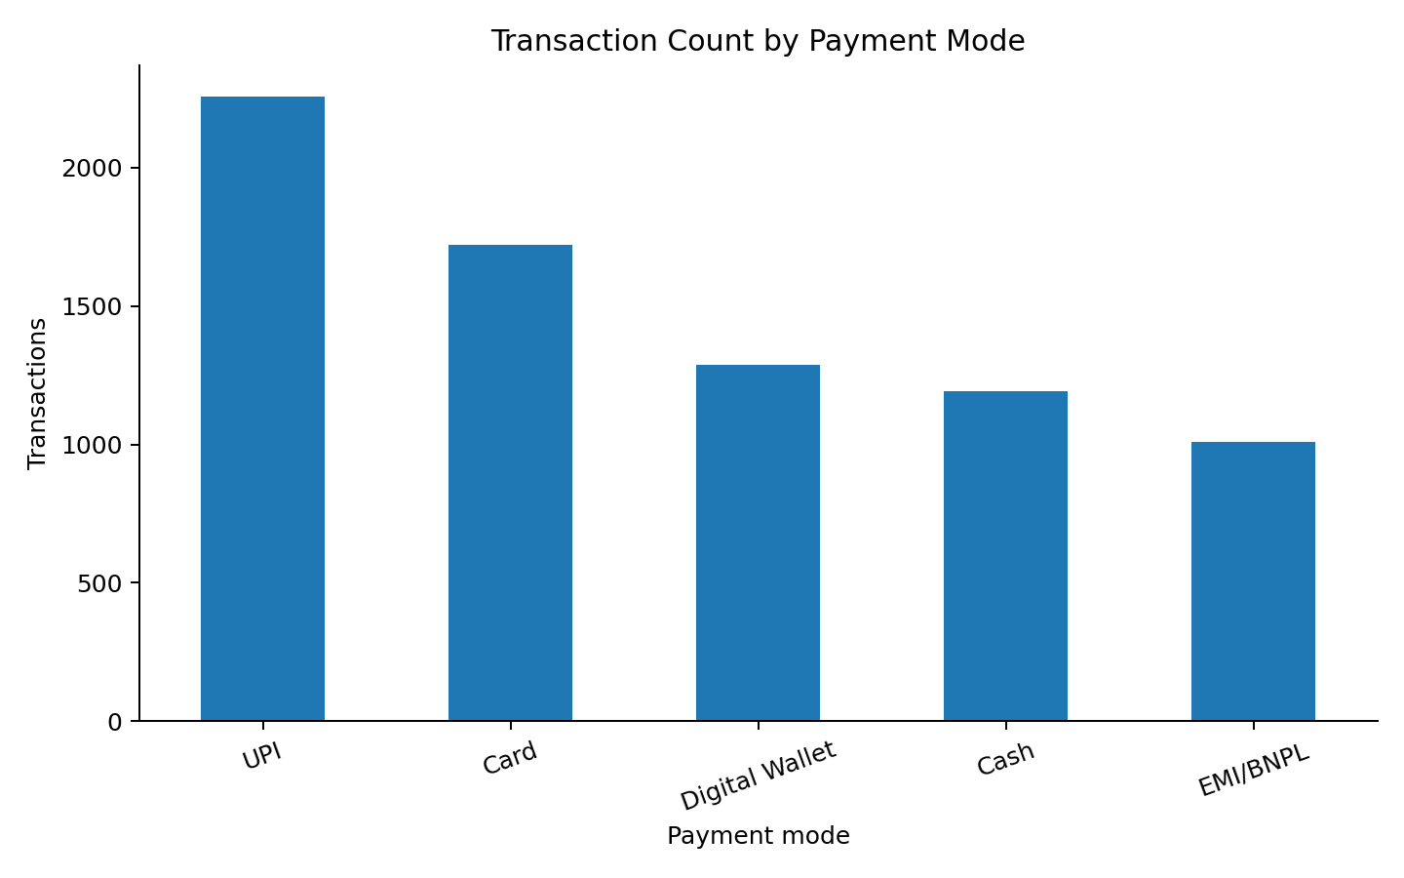
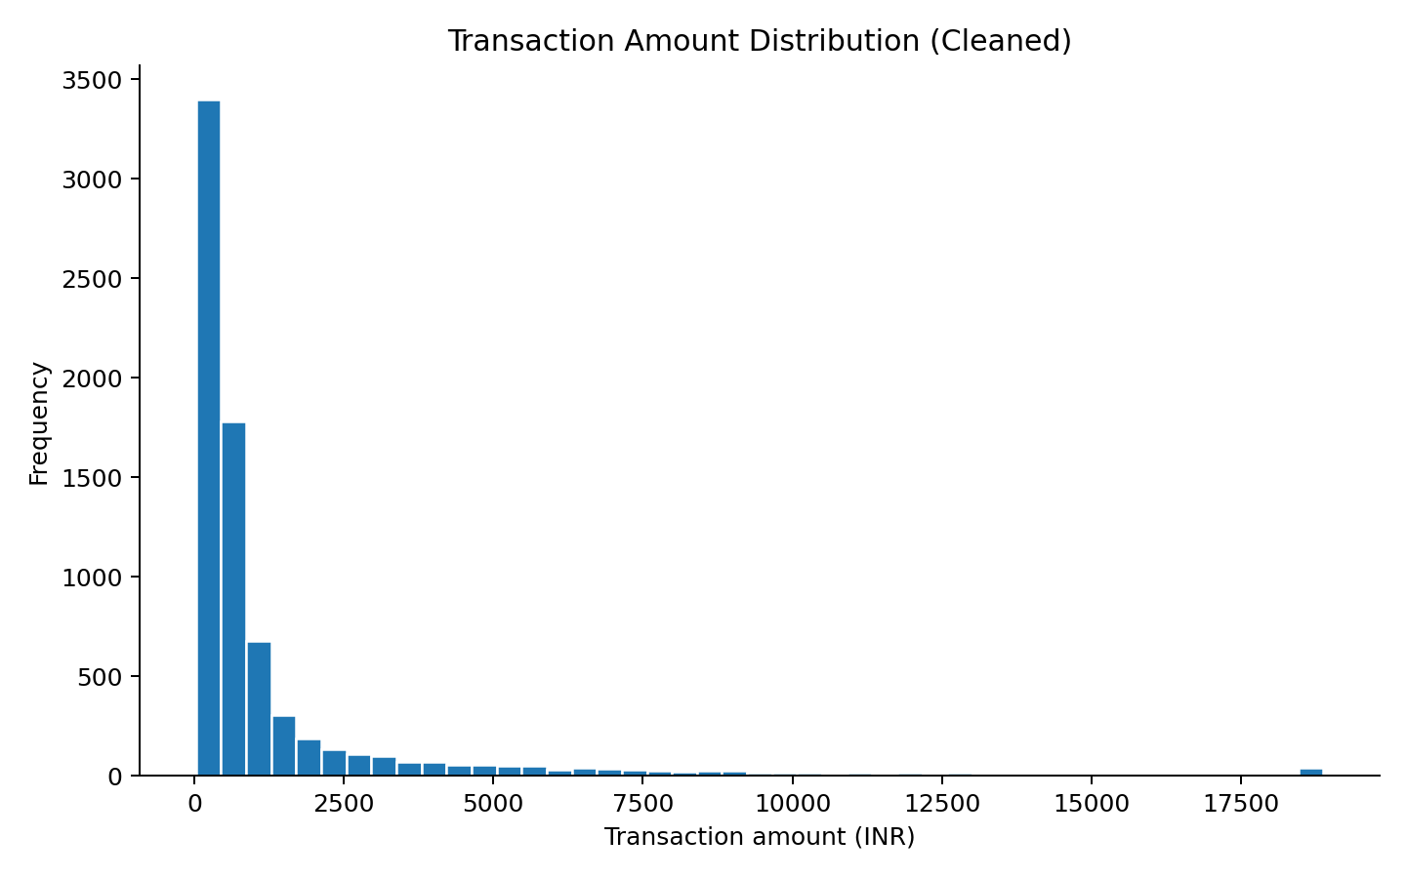
Data cleaning and exploratory analysis
03 / DATA AND PREPROCESSING
Cleaning result
EDA takeaway
7,535 raw rows → 7,463 cleaned rows. Duplicates removed; invalid amounts excluded; missing fields imputed; extreme highs capped.
Mean amount = INR 1,395; median = INR 494. The right-skewed tail motivates log-spend features.
6

Slide 7
Feature engineering and model design
04 / METHODOLOGY
Payment-mode-only (5 features)
Combined behaviour (17 features)
ML pipeline
Share of transactions made using:
• UPI
• Card
• Digital wallet
• Cash
• EMI/BNPL
Payment shares + log spending + average ticket + transaction count/frequency + cashback + discount + promo response + EMI usage + channels + category diversity.
1. Standardize
2. K-Means, k=2..8
3. Agglomerative Ward
4. Internal metrics
5. PCA visualization
6. Profile clusters and recommend
No train-test split is required for the primary descriptive clustering task; temporal / hold-out validation is recommended for any later predictive use.
7

Slide 8
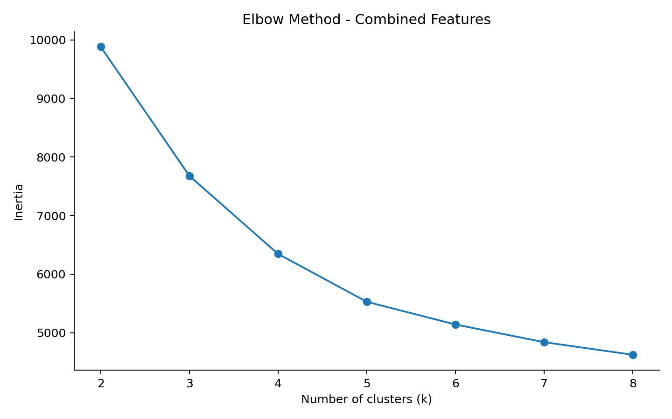
Choosing k: Elbow + internal metrics
04 / METHODOLOGY
Combined feature K-Means by k
k | Inertia | Silhouette | DB index
2 | 9,883 | 0.227 | 1.435
3 | 7,678 | 0.257 | 1.487
4 | 6,346 | 0.276 | 1.346
5 | 5,529 | 0.282 | 1.358
6 | 5,141 | 0.251 | 1.471
7 | 4,839 | 0.240 | 1.565
8 | 4,624 | 0.223 | 1.639
Chosen for profiles: k = 5
Best tested combined-feature silhouette and five readable groups; k=4 has a slightly lower DB index.
8

Slide 9
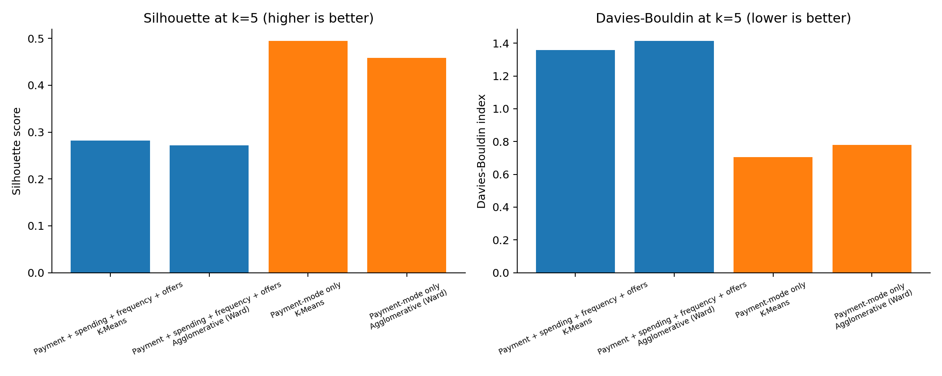
Feature richness versus mathematical separation
05 / RESULTS
Payment-only K-Means
Silhouette 0.4949 | DB index 0.7043
Combined K-Means
Silhouette 0.2821 | DB index 1.3577
Interpretation
Simpler payment preference groups are cleaner. Richer clusters add spend/offer context but overlap more.
9

Slide 10
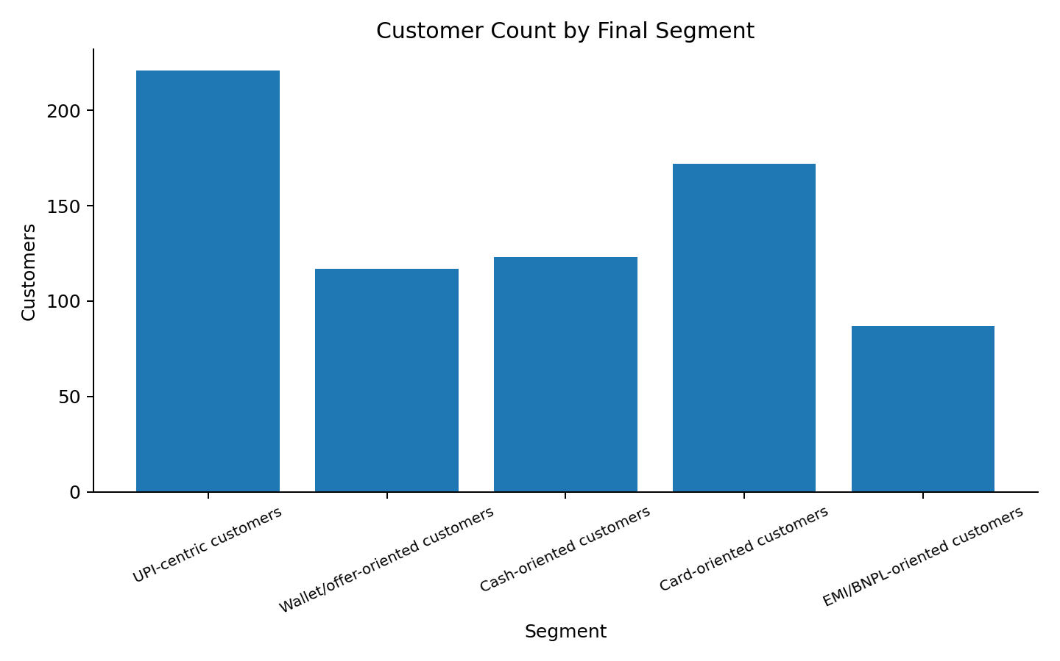
Final five-segment customer profile
05 / RESULTS
Segment | Customers | Avg txn | Cashback rate
UPI-centric | 221 (30.7%) | INR 803 | 27%
Wallet/offer-oriented | 117 (16.2%) | INR 974 | 77%
Cash-oriented | 123 (17.1%) | INR 526 | 3%
Card-oriented | 172 (23.9%) | INR 1,740 | 19%
EMI/BNPL-oriented | 87 (12.1%) | INR 4,754 | 24%
Average spend represents mean customer total across the observed synthetic year; it is not a forecast or verified market estimate.
10

Slide 11
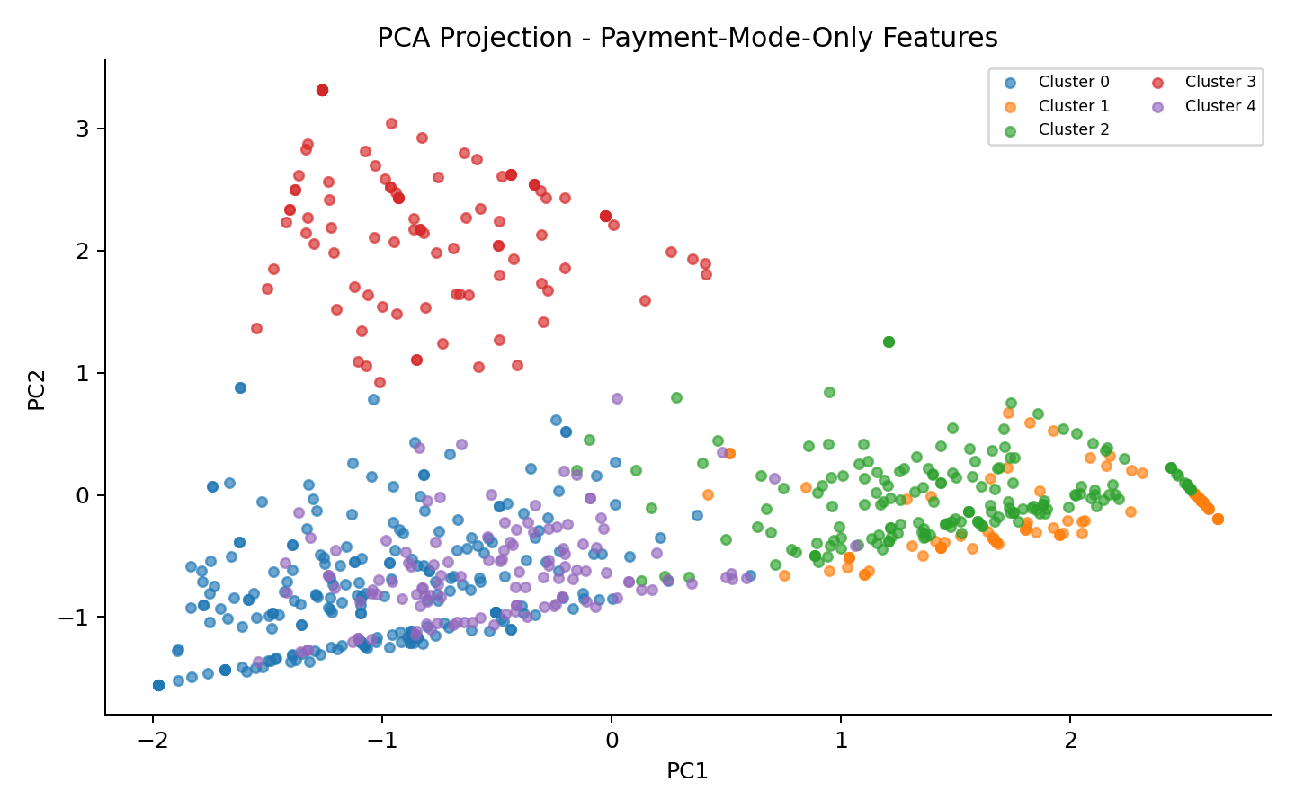
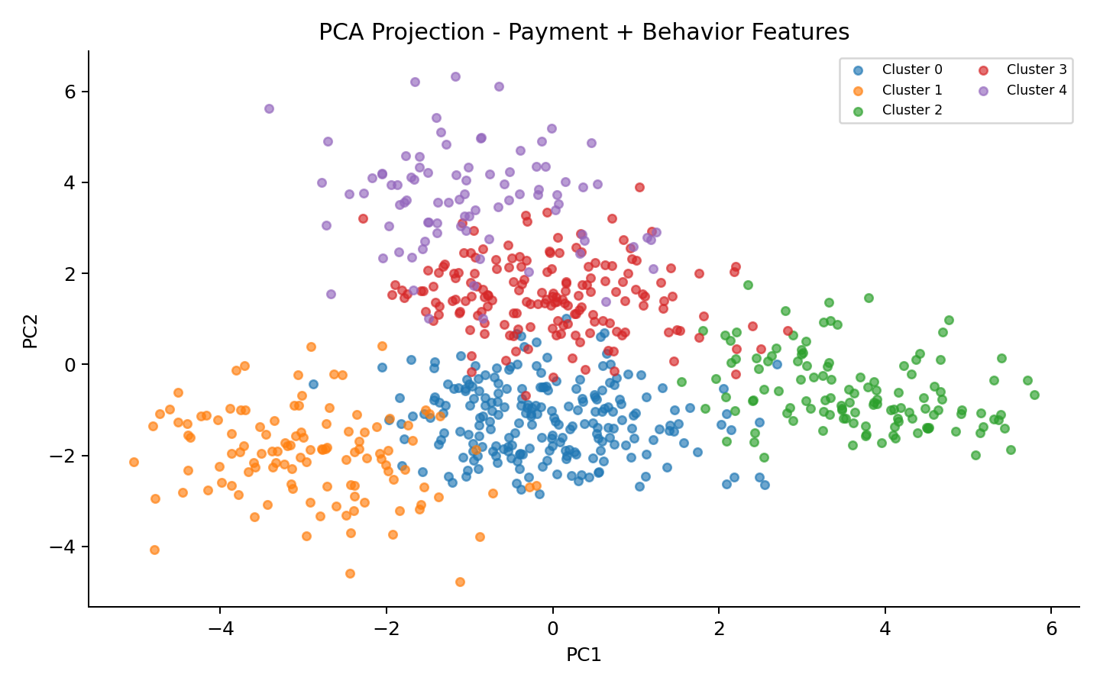
PCA views: overlap is a result, not a defect to hide
05 / RESULTS
Payment-only features preserve cleaner mode preference groups in this synthetic example.
Combined features create richer profiles but PCA shows more overlap; 2D projections also omit dimensions.
11

Slide 12
Turn segments into measurable, responsible actions
06 / RECOMMENDATIONS
UPI-centric
Wallet / offer
Cash-oriented
Make UPI quick to use; test low-cost rewards and repeat-purchase flows.
Run controlled cashback tests; cap rewards and measure incremental margin.
Preserve cash/assisted options; offer optional digital onboarding.
Card-oriented
EMI / BNPL
Test relevant card-linked value before broad discounts.
Show total costs and due dates; build affordability safeguards.
Measure incremental contribution margin, conversion, complaints, and segment stability; do not treat correlations as causal effects.
12

Slide 13
Limitations and deployment guardrails
06 / RECOMMENDATIONS
• Data are simulated; cluster sizes, INR values, and offer rates are not real-world estimates.
• Internal metrics measure geometric separation, not business impact or causal promotional lift.
• Model results depend on feature scaling, selected k, correlation, and the observation period.
• Validate on governed real transaction data; test stability by month and measure interventions using controlled experiments.
• Use access controls, data minimization, security review, and documented purposes.
• Do not infer sensitive traits or make credit/eligibility/punitive decisions from payment behaviour alone.
13

Slide 14
Conclusion
07 / WRAP-UP
What was built
What the metrics say
What to do next
End-to-end data cleaning, EDA, customer aggregation, scaled features, clustering, evaluation and PCA.
At k=5, payment-only K-Means is better separated than the richer combined solution.
Use both segment views as hypotheses; validate them and measure actual business impact.
Final takeaway: the richest feature set is not automatically the best-clustered. Choose the model based on a balance of separation, interpretability, stability, and responsible business value.
Thank you | Questions
14

Slide 15
References
08 / SOURCES
• [1] Reserve Bank of India (2024), Annual Report 2023-24, Department of Payment and Settlement Systems. https://systemhealth.rbi.org.in/Scripts/AnnualReportPublications.aspx_Id%3D1409%281%29.html
• [2] Reserve Bank of India (2024), Chapter III: Digitalisation and Payment Revolution in India. https://rbi.org.in/scripts/PublicationsView.aspx?id=22459
• [3] World Bank (2025), The Global Findex Database 2025. https://www.worldbank.org/en/publication/globalfindex/report
• [4] scikit-learn documentation, Clustering (K-Means, agglomerative clustering and metrics). https://scikit-learn.org/stable/modules/clustering.html
• [5] scikit-learn documentation, PCA. https://scikit-learn.org/stable/modules/decomposition.html#pca
• [6] Rousseeuw (1987), Silhouettes: A Graphical Aid to the Interpretation and Validation of Cluster Analysis, Journal of Computational and Applied Mathematics, 20, 53-65.
External references inform context and method definitions; quantitative model results are from the synthetic dataset only.
15

