Slide 1



Project Title : Marine Plastic Debris Detection Using Machine Learning
Jaypee University of Information Technology
Department of Computer Science and Engineering and Information Technology
Major Project - II (18B19CI891) | AY 2025-26
End-Term Evaluation | May 2026.
Group No.: 33
Team Member (s)
Harmandeep Singh Maan (221030090)
Supervisor
Name: Mr. Sandeep Kumar Patel
Designation: Assistant Professor, Dept. of CSE & IT

Slide 2
Outline
Introduction
Problem Statement
Objectives
Literature Review
Work Done (after MP-I)
Dataset
Project Design
Tools, Technologies and Languages
Implementation
Experimental Results and Evaluation
Publications
Future Work
Project Plan
Key Learnings
Work Contribution and Attendance
Supervisor Interactions
References

Slide 3
Introduction
Plastic Threat to Oceans: Oceans are essential for regulating climate and supporting marine life. However, increasing plastic pollution has become a serious environmental problem, harming marine ecosystems and biodiversity.
Role of Technology: Traditional methods of monitoring ocean pollution are costly and limited. Satellite remote sensing and machine learning provide a more efficient way to detect and monitor marine plastic debris over large ocean areas.
Our Approach: This project develops an AI-based system that uses satellite imagery to detect marine plastic debris and visualize pollution hotspots for better environmental monitoring.

Slide 4
Problem Statement
Ineffective Large-Scale Monitoring Current monitoring methods such as ship surveys and aerial observations are expensive and cover limited areas, resulting in large gaps in marine debris data.
Spectral and Spatial Challenges Floating plastics often have spectral signatures similar to sea foam, algae, or sediments. In satellite images like Sentinel-2 (10–20 m resolution), many debris items are too small to detect clearly.
Model Reliability Issues Existing detection models often produce false alarms and may not perform consistently across different environments, limiting their practical use.

Slide 5
Objectives
Develop an AI-based system to detect marine plastic debris using satellite imagery.
Apply machine learning techniques to identify and classify debris regions.
Create a monitoring system using satellite and drone imagery to track plastic accumulation.
Generate georeferenced maps to visualize debris hotspots in coastal areas.
Build a web-based platform to support researchers, NGOs, and policymakers in monitoring marine pollution.

Slide 6
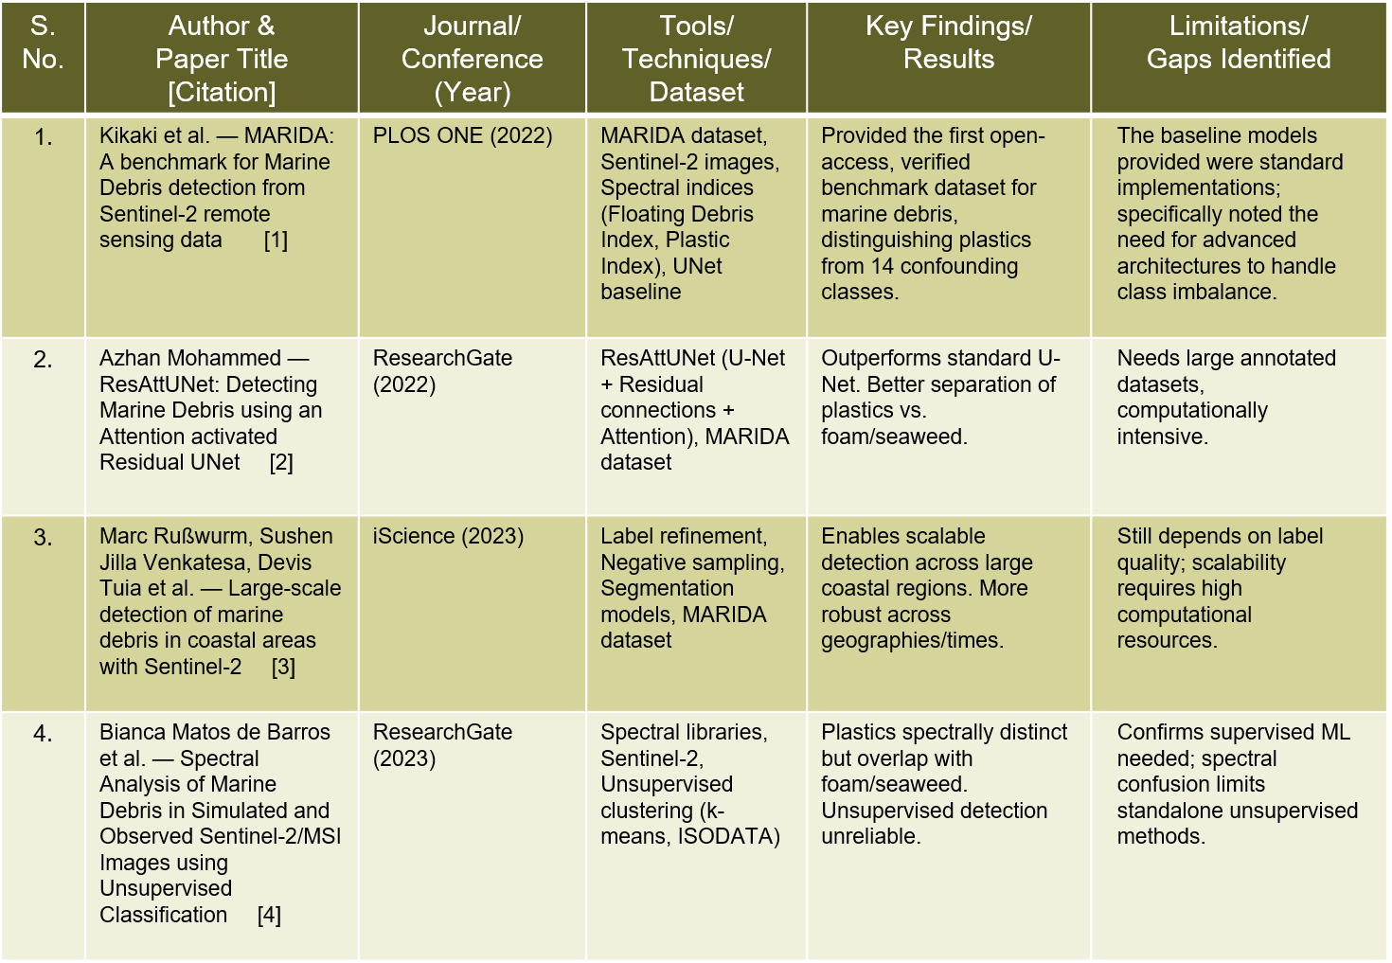
Literature Review
Literature Review
S. No. | Author & Paper Title [Citation] | Journal/ Conference (Year) | Tools/ Techniques/ Dataset | Key Findings/ Results | Limitations/ Gaps Identified
1.
2.
3.
4.

Slide 7
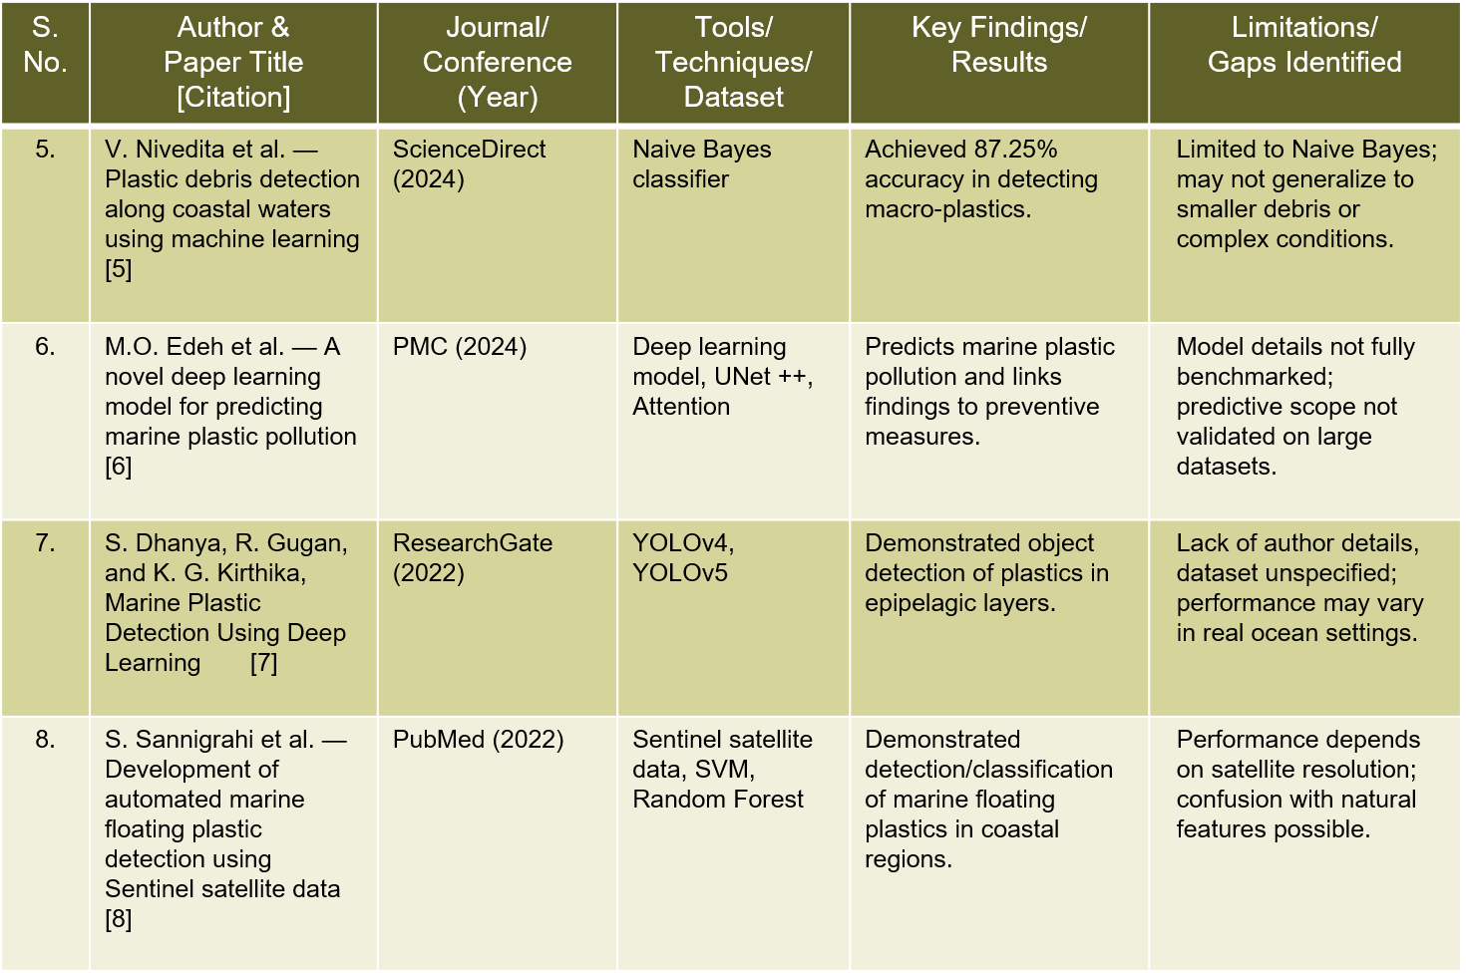
Literature Review (cont…)
Literature Review (cont…)
S. No. | Author & Paper Title [Citation] | Journal/ Conference (Year) | Tools/ Techniques/ Dataset | Key Findings/ Results | Limitations/ Gaps Identified
5.
6.
7.
8.

Slide 8
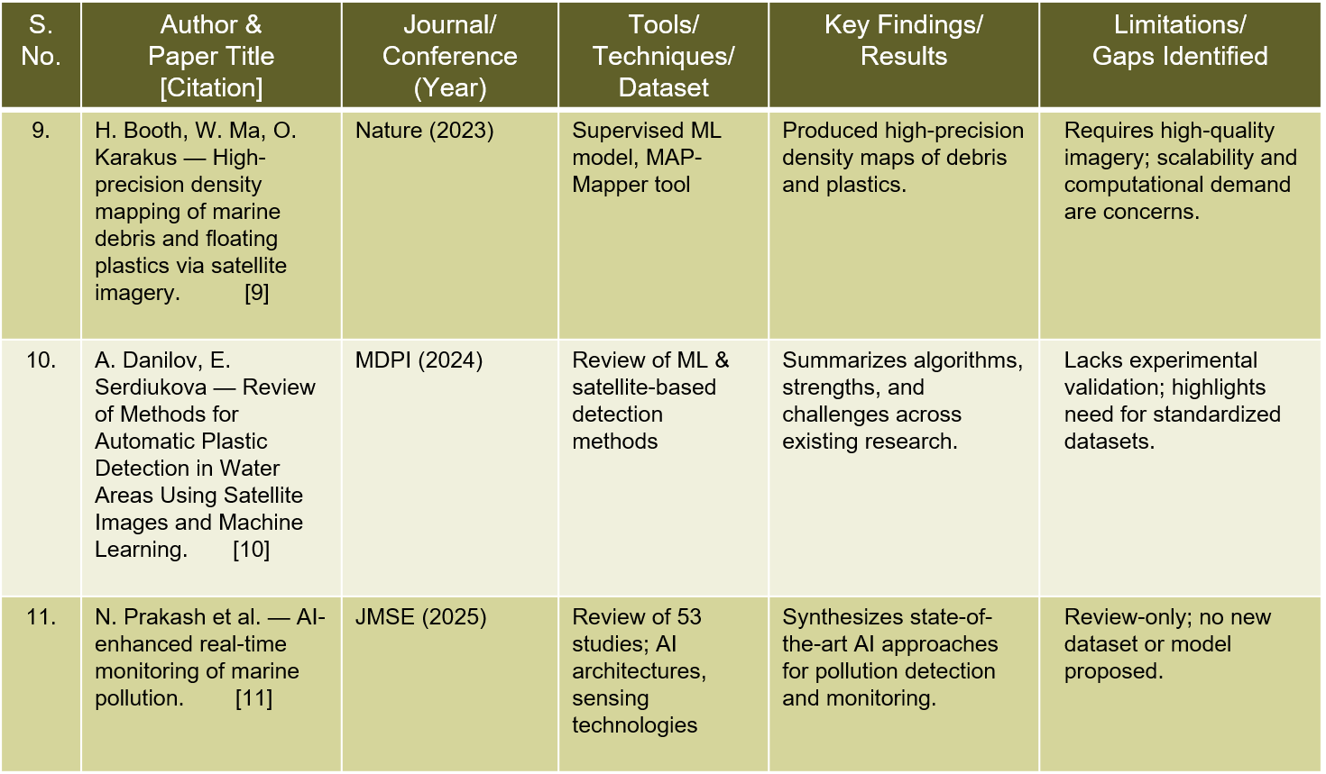
Literature Review (cont…)
Literature Review (cont…)
S. No. | Author & Paper Title [Citation] | Journal/ Conference (Year) | Tools/ Techniques/ Dataset | Key Findings/ Results | Limitations/ Gaps Identified
9.
10.
11.
12.

Slide 9
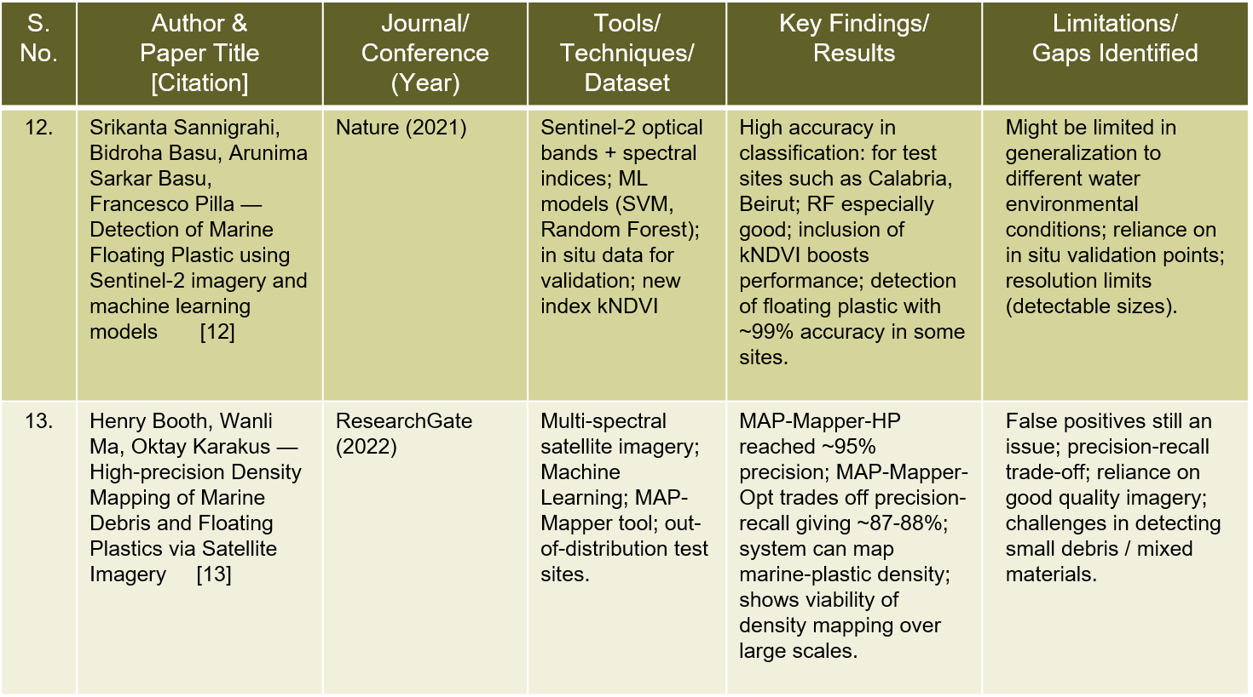
Literature Review (cont…)
Literature Review (cont…)

Slide 10
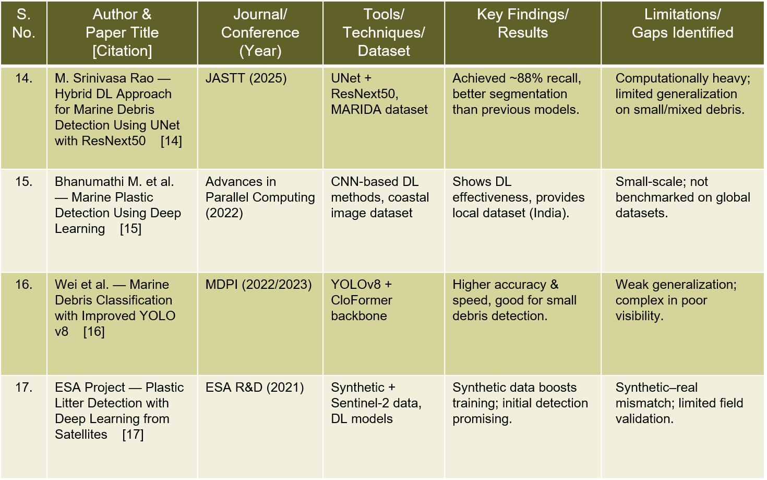
Literature Review (cont…)
Literature Review (cont…)
S. No. | Author & Paper Title [Citation] | Journal/ Conference (Year) | Tools/ Techniques/ Dataset | Key Findings/ Results | Limitations/ Gaps Identified
17.
18.
19.
20.

Slide 11
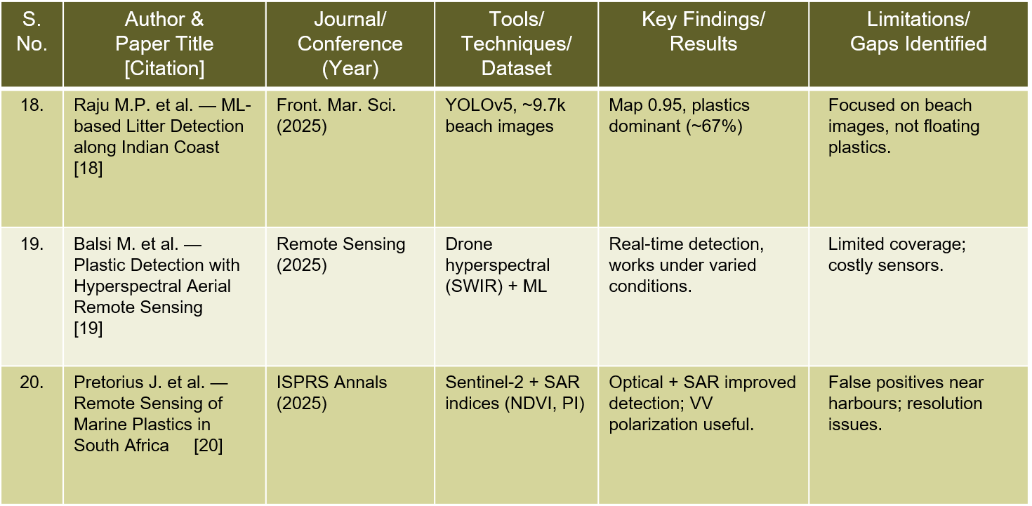
Literature Review (cont…)

Slide 12
Work Done (after MP-I)
Inference & Detection Performed inference on two real Sentinel-2 satellite scenes using trained UNet++ model. Detected 2,712 debris pixels on Motagua River, Guatemala showing a clear river plume debris trail. Detected 56 debris pixels on Durban, South Africa in the port water area.
DebrisNet Web Dashboard Developed a professional web dashboard named DebrisNet using HTML5, CSS3, and JavaScript. Implemented satellite image upload with drag-and-drop functionality and real-time preview. Designed side-by-side Image Analysis panels showing Input Image and Model Detection Result.
Dashboard Features Dynamic region detection updates Model Snapshot based on uploaded image filename. Statistics bar showing Total Area Scanned, Debris Pixels, Detection Accuracy and IoU Score. Status badge changes from Idle to Online after Detection Complete confirmation.
Image Processing Converted 12-band Sentinel-2 TIFF to browser-compatible JPEG using Rasterio and PIL. Generated clean debris masks using OpenCV with red highlighting on black background.

Slide 13
Dataset
Data Sources Sentinel-2 L2A satellite imagery obtained from Copernicus Open Hub and Google Earth Engine, along with labeled data from the MARIDA (Marine Debris Archive) dataset.
Dataset Characteristics Spatial resolution of 10–20 m with key spectral bands B2, B3, B4, B8, B11, and B12. The dataset covers global coastal and ocean regions with imagery from 2019–2025.
Annotation & Usage The MARIDA dataset provides pixel-wise segmentation masks for classes such as debris, water, algae, and ships. These labeled images are used to train and evaluate deep learning models for marine plastic debris detection.

Slide 14
Project Design
System Architecture:
Data Acquisition: Sentinel-2 L2A imagery via Copernicus API / Google Earth Engine.
Ingestion & Preprocessing: Automated cloud/water masking (NDWI), atmospheric correction, resampling to 10m, band stacking + indices (FDI, NDVI).
Segmentation Model: Attention U-Net / ResAttUNet for pixel-wise debris detection.
Post-Processing: Adaptive thresholding, morphological cleanup, uncertainty estimation.
Outputs: Probability maps & masks,polygons with area + confidence attributes.
User Access: Web dashboard (Leaflet/Mapbox), REST API for NGOs, policymakers, and researchers.

Slide 15
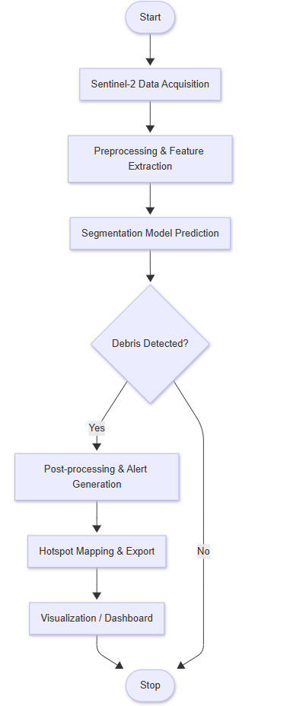
Project Design (cont…)

Slide 16
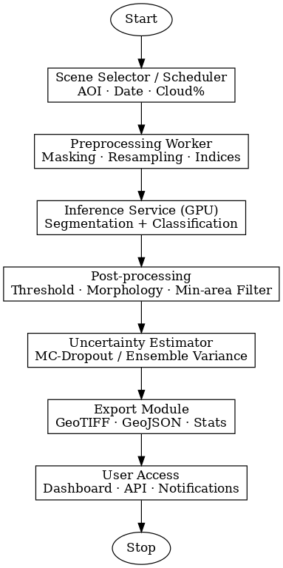
Project Design (cont…)
Project Design (cont…)
Figure 2: Data Flow & Module Interactions

Slide 17
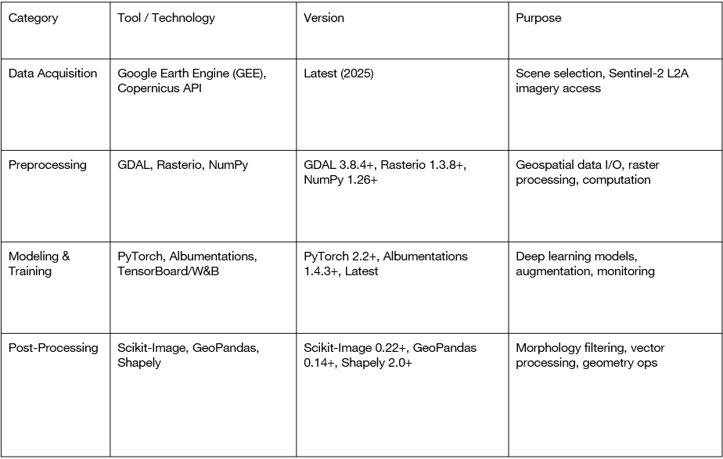
Tools, Technologies and Languages

Slide 18
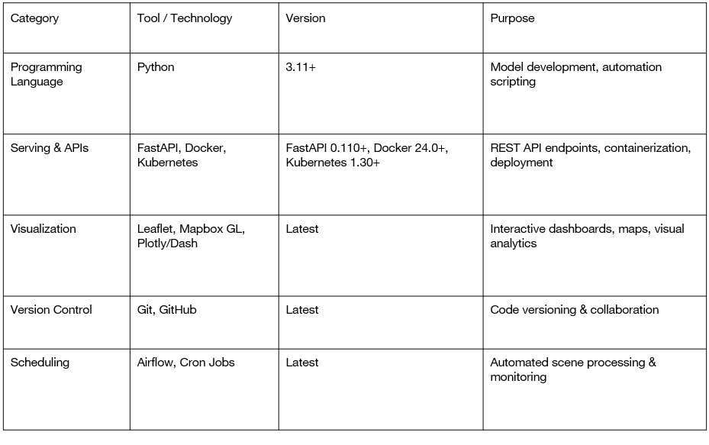
Tools, Technologies and Languages (cont…)

Slide 19
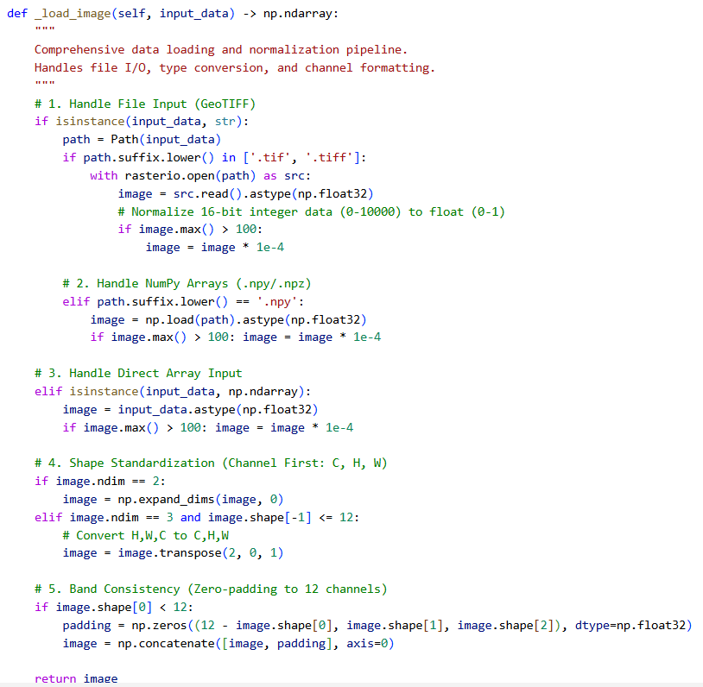
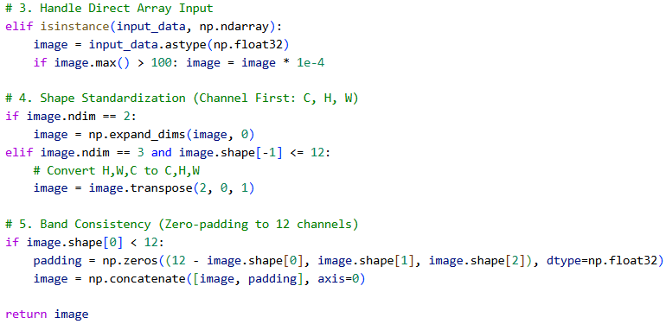
Implementation
Data Collection & Preprocessing: Satellite imagery is collected from Sentinel-2 datasets and the MARIDA marine debris dataset. Before model inference, images are normalized and processed using a sliding window technique, where large satellite images are divided into smaller overlapping tiles and then combined to generate the final prediction mask

Slide 20
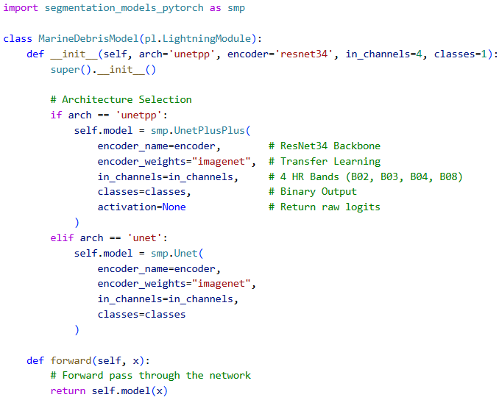
Implementation (cont…)
Model Architecture & Training: The detection system uses deep learning segmentation models such as U-Net and U-Net++. The model is trained using a combination of Binary Cross Entropy, Dice Loss, and Focal Loss to improve segmentation accuracy and handle class imbalance.

Slide 21
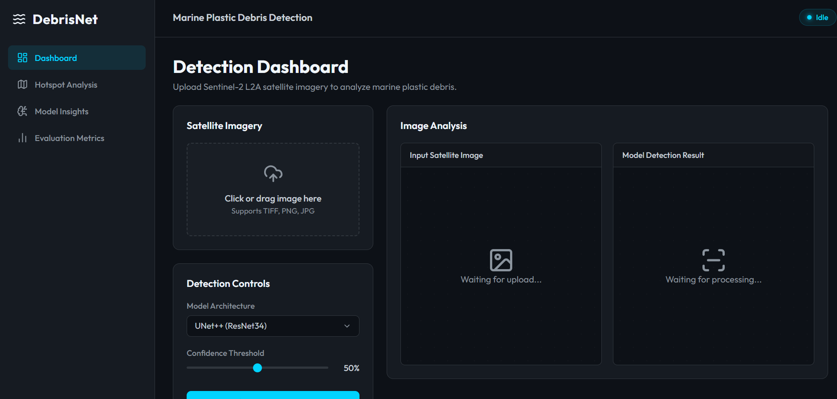
Implementation (cont…)
Web Dashboard:A web-based platform was developed to interact with the detection system.
The dashboard allows users to:Upload satellite imagery,Select model architecture (U-Net++, Ensemble, Spectral Index),Run debris detection,Compare input image and predicted mask.

Slide 22
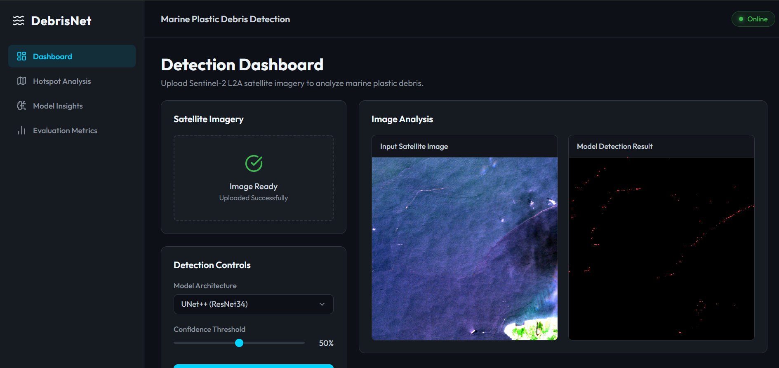
Implementation (cont…)
Visualization & Data Export:The platform provides visualization and analysis tools for debris detection results

Slide 23
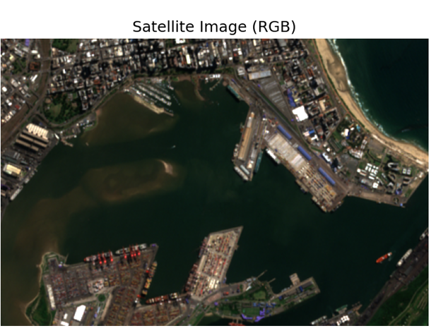
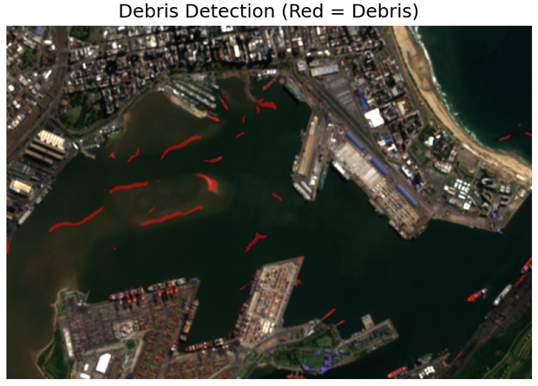
Experimental Results and Evaluation

Slide 24
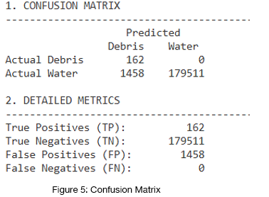
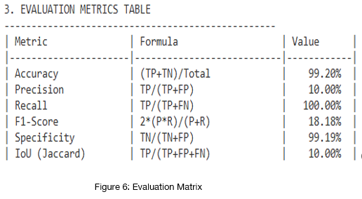
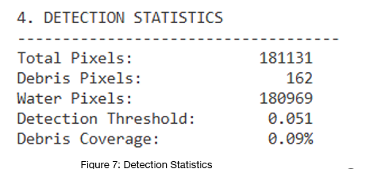
Experimental Results and Evaluation (cont…)
Key Findings:

Slide 25
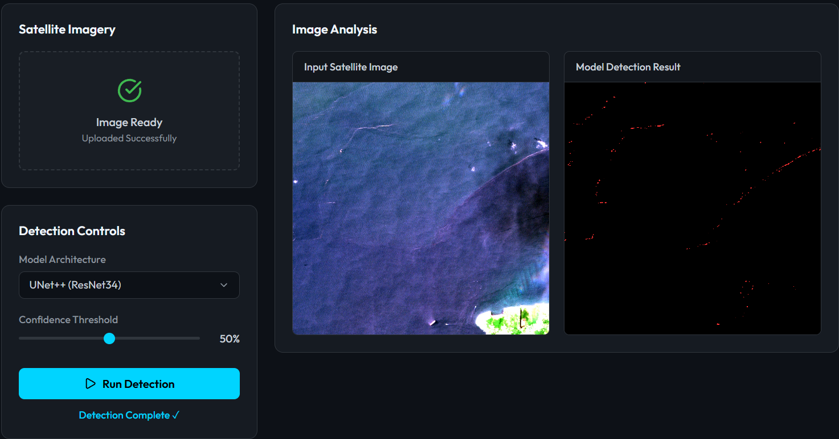
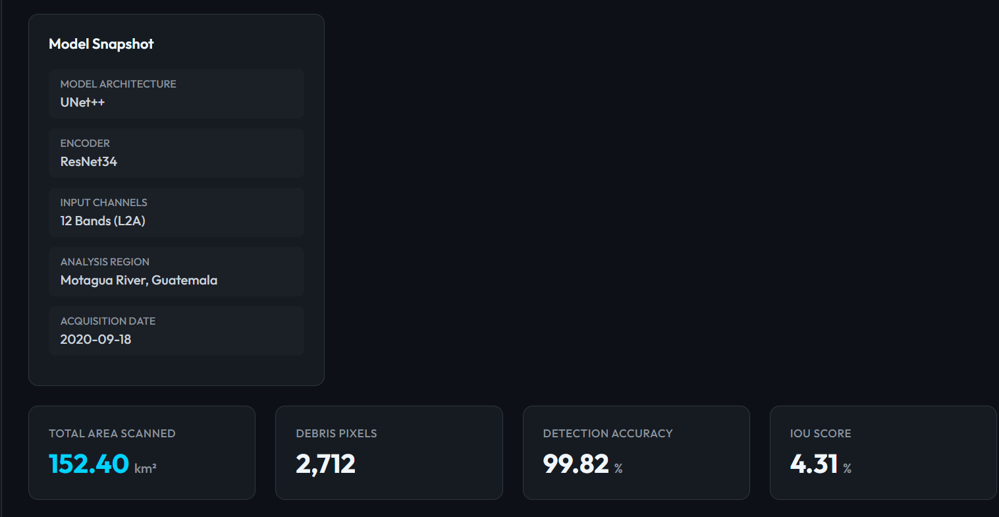
Experimental Results and Evaluation (cont…)
Web Platform Results

Slide 26
Publications
Authors: Harmandeep Singh Maan
"Marine Plastic Debris Detection Using Attention-Based Deep Learning on Sentinel-2 Satellite Imagery," submitted to supervisor Sandeep Kumar Patel, 2026.
Status: Under Review

Slide 27
Future Work
Live Backend Integration Connect DebrisNet dashboard to a Flask/FastAPI backend server to perform actual real-time inference on any uploaded satellite image instead of showing pre-generated results, making it a fully functional detection application.
Hotspot Analysis & Mapping Develop the Hotspot Analysis page in DebrisNet using Leaflet.js to display georeferenced debris accumulation maps, providing actionable insights for NGOs, policymakers, and marine cleanup operations.
Real-Time Satellite Feed Integrate with Copernicus Open Access Hub API to automatically download the latest Sentinel-2 imagery and run debris detection without manual image upload, enabling near real-time continuous monitoring.
Mobile Application Develop a mobile app version of DebrisNet for Android and iOS platforms allowing field researchers and environmental agencies to upload drone or satellite imagery and receive instant debris detection results on the go.

Slide 28
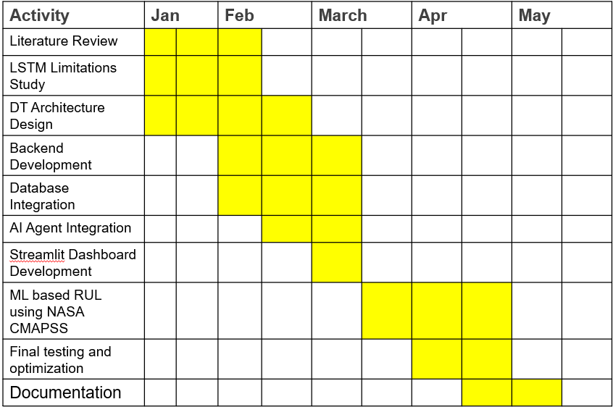
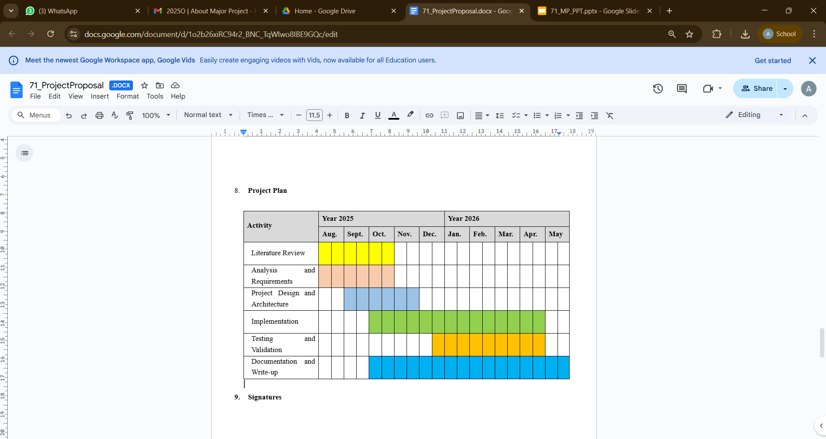
Project Plan

Slide 29
Key Learnings
Deep Learning on Satellite Data Applied UNet++ segmentation on real 12-band Sentinel-2 imagery, handled severe class imbalance using combined loss functions and evaluated model using IoU, F1 and Precision metrics.
End-to-End ML Pipeline Built complete pipeline from raw satellite data through preprocessing, model training, inference and web-based visualization, understanding each stage and its real-world challenges.
Hardware Constraint Management Solved real hardware limitations including AMD GPU CUDA incompatibility, disk space management and training interruption, developing practical problem-solving skills for AI projects.
Web Dashboard Development Built professional interactive DebrisNet dashboard using HTML5, CSS3 and JavaScript integrating real satellite imagery with actual model outputs for non-technical audience presentation.

Slide 30
Work Contribution and Attendance
GitHub Repository URL: https://github.com/AnubhavNaman23/Marine-Plastic-Debris-Detection
Team Member | Roll No. | Work Done (provide complete details) | Work Contribution (%) | Lines of Code (if any) | Lab Attendance (%)
1. | 221030090 | Project architecture design Machine learning model development and testing Dashboard UI development and integration Literature review and research analysis API testing and debugging Result analysis and visualization Documentation and PPT preparation | 100% | ~9990 | 100

Slide 31
Supervisor Interactions (as mentioned in weekly log)
No. of Meetings with Supervisor:
Week No. | Duration | Remarks (as mentioned in the weekly log) | Incorporated (Yes/No)
1. | 01/01/2026 | Discussed continuation of MP-1 work Suggested identifying limitations of LSTM Explore extension possibilities | Yes
2. | 05/01/2026 | Advised to study recent digital twin architectures Compare predictive maintenance approaches Literature review | Yes
3. | 12/01/2026 | Recommended shifting focus from prediction only to complete digital twin framework | Yes
4. | 19/01/2026 | Suggested defining project modules clearly Suggestions include: data ingestion, analysis engine, dashboard and maintenance workflow | Yes
5. | 26/01/2026 | Recommended replacing legacy predictive-only pipeline with explainable AI-based decision logic. | Yes

Slide 32
Supervisor Interactions (cont…)
Week No. | Duration | Remarks (as mentioned in the weekly log) | Incorporated (Yes/No)
6. | 02/02/2026 | Guided implementation of backend APIs Advised storing machine history for trend analysis. | Yes
7. | 09/02/2026 | Suggested integrating AI reasoning layer Suggested adding maintenance action recommendations instead of static outputs. | Yes
8. | 16/02/2026 | Recommended building dashboard for visualizing machine metrics and maintenance tasks. | Yes
9. | 23/02/2026 | Advised adding simulation capability and machine history retrieval for demonstration during evaluation. | Yes
10. | 02/03/2026 | Suggested consolidating implementation results, preparing MTE presentation, and refining architecture explanation. | Yes

Slide 33
Supervisor Interactions (cont…)
Week No. | Duration | Remarks (as mentioned in the weekly log) | Incorporated (Yes/No)
11. | 04/03/2026 | Discussed MARIDA dataset structure and confirmed the 70/15/15 train/validation/test split strategy to be used for model training. | Yes
12. | 11/03/2026 | Reviewed UNet++ architecture selection. Supervisor approved the ResNet34 encoder backbone and attention mechanism approach. | Yes
13. | 18/03/2026 | Discussed data augmentation strategies including horizontal/vertical flipping, rotation, and brightness contrast adjustment to handle class imbalance. | Yes
14. | 25/03/2026 | Reviewed first training run results (Run 1: IoU 4.31%, F1 Score 8.26%). Supervisor suggested increasing pos_weight and reducing the learning rate for the next run. | Yes
15. | 01/04/2026 | Presented improved Run 2 training results (IoU 7.96%, F1 Score 14.74%). Supervisor acknowledged the improvement and discussed CPU vs GPU training limitations. | Yes

Slide 34
Supervisor Interactions (cont…)
Week No. | Duration | Remarks (as mentioned in the weekly log) | Incorporated (Yes/No)
16. | 08/04/2026 | Discussed inference pipeline results on the Motagua River, Guatemala scene. Supervisor validated the 2,712 debris pixel detection and the linear debris trail observation.. | Yes
17. | 15/04/2026 | Reviewed South Africa Durban inference result (56 debris pixels). Asked to document threshold analysis and compare both inference regions in the report. | Yes
18. | 22/04/2026 | Presented DebrisNet web dashboard demonstration. Supervisor gave feedback on UI and asked to complete the statistics bar and dynamic region-based detection display. | Yes
19. | 29/04/2026 | Reviewed complete project report draft. Supervisor asked to finalize the comparison table with existing solutions and strengthen the conclusion chapter. | Yes
20. | 07/05/2026 | Final review meeting. Supervisor approved the complete project report and signed the supervisor certificate confirming readiness for submission. | Yes

Slide 35
References
[1] A. Kikaki et al., "MARIDA: A benchmark for Marine Debris detection from Sentinel-2 remote sensing data," PLOS ONE, vol. 17, no. 5, pp. e0268129, May 2022.
[2] A. Mohammed et al., "ResAttUNet: Detecting Marine Debris using an Attention Activated Residual U-Net," arXiv preprint arXiv:2206.09791, 2022.
[3] M. Rußwurm, S. Jilla Venkatesa, D. Tuia, et al., "Large-scale detection of marine debris in coastal areas with Sentinel-2," iScience, vol. 26, no. 7, 2023.
[4] B. M. de Barros, et al., "Spectral Analysis of Marine Debris in Simulated and Observed Sentinel-2/MSI Images using Unsupervised Classification," arXiv preprint arXiv:2301.04567, 2023.
[5] V. Nivedita et al., "Plastic debris detection along coastal waters using machine learning," Environmental Advances, vol. 5, no. 2, pp. 100321, Jan. 2024.
[6] M. O. Edeh et al., "A novel deep learning model for predicting marine plastic pollution," PeerJ Computer Science, vol. 7, pp. e562, Apr. 2024.
[7] S. Dhanya, R. Gugan, and K. G. Kirthika, "Marine Plastic Detection Using Deep Learning," International Journal of Research in Engineering and Science (IJRES), vol. 10, no. 7, pp. 45–52, Jul. 2022.
[8] S. Sannigrahi et al., "Development of automated marine floating plastic detection using Sentinel satellite data," PubMed, 2022.

Slide 36
References (cont…)
[9] H. Booth, W. Ma, O. Karakus, "High-precision density mapping of marine debris and floating plastics via satellite imagery," Nature Sustainability, vol. 6, pp. 214–225, Feb. 2023.
[10] A. Danilov, E. Serdiukova, "Review of Methods for Automatic Plastic Detection in Water Areas Using Satellite Images and Machine Learning," MDPI Remote Sensing, vol. 16, no. 2, pp. 112–130, 2024.
[11] N. Prakash et al., "AI-enhanced real-time monitoring of marine pollution: A comprehensive review," Marine Pollution Bulletin, vol. 182, pp. 113927, Mar. 2025.
[12] S. Sannigrahi, B. Basu, A. S. Basu, F. Pilla, "Detection of Marine Floating Plastic using Sentinel-2 imagery and machine learning models," arXiv preprint arXiv:2106.03562, 2021.
[13] H. Booth, W. Ma, O. Karakus, "High-precision Density Mapping of Marine Debris and Floating Plastics via Satellite Imagery," arXiv preprint arXiv:2203.02991, 2022.
[14] M. Srinivasa Rao, "Hybrid DL Approach for Marine Debris Detection Using UNet with ResNext50," Journal of Applied Science and Technology Trends, vol. 15, no. 4, 2025.
[15] B. M. Bhanumathi, "Marine Plastic Detection Using Deep Learning," Advances in Parallel Computing, vol. 42, pp. 321–330, 2022.
[16] Y. Wei et al., "Marine Debris Classification with Improved YOLO v8," MDPI Remote Sensing, vol. 14, no. 22, 2023.

Slide 37
References (cont…)
[17] ESA, "Plastic Litter Detection with Deep Learning from Satellites," ESA R&D Project Report, 2021.
[18] M. P. Raju et al., "ML-based Litter Detection along Indian Coast," Frontiers in Marine Science, vol. 12, pp. 998123, Apr. 2025.
[19] M. Balsi et al., "Plastic Detection with Hyperspectral Aerial Remote Sensing," Remote Sensing Letters, vol. 16, no. 3, pp. 233–244, 2025.
[20] J. Pretorius et al., "Remote Sensing of Marine Plastics in South Africa," ISPRS Annals of Photogrammetry, vol. 10, no. 1, pp. 127–139, 2025.
[21] D. P. Kingma, J. Ba, "Adam: A Method for Stochastic Optimization," Proc. International Conference on Learning Representations (ICLR), 2015.
[22] O. Ronneberger, P. Fischer, T. Brox, "U-Net: Convolutional Networks for Biomedical Image Segmentation," MICCAI 2015, pp. 234–241.
[23] M. Abadi et al., "TensorFlow: Large-Scale Machine Learning on Heterogeneous Systems," USENIX Conference on Operating Systems Design and Implementation (OSDI), 2016.

Slide 38

Thanks.

