Slide 1


Team Members 1. Adarsh Dixit - Roll No. 11 2. Ashish Kumar - Roll No. 56 3. Anubhav Singh - Roll No. 40 4. Ayushi Mishra - Roll No. 69 5. Akshat Anand - Roll No. 22
“MBTI Personality Type Dataset”
SESSION 2024-25
CSE(AIML) A

Slide 2

What is MBTI?
MBTI stands for "Myers-Briggs Type Indicator".
It classifies personalities into 16 types based on 4 dichotomies:
Introversion (I) / Extraversion (E)
Sensing (S) / Intuition (N)
Thinking (T) / Feeling (F)
Judging (J) / Perceiving (P)

Slide 3
About the Dataset
- Contains ~8,600 entries
- Each entry includes:
• MBTI type (e.g., INFP, ESTJ)
• 50 online posts per person (text format, separated by '|||')
- Hosted on Kaggle by datasnaek

Slide 4
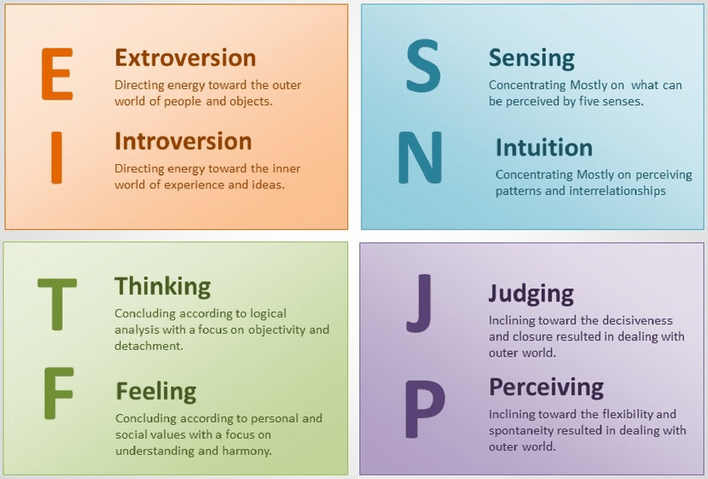
MBTI 4 Key dimensions
Introversion (I) vs Extraversion (E)
Sensing (S) vs Intuition (N)
Thinking (T) vs Feeling (F)
Judging (J) vs Perceiving (P)

Slide 5
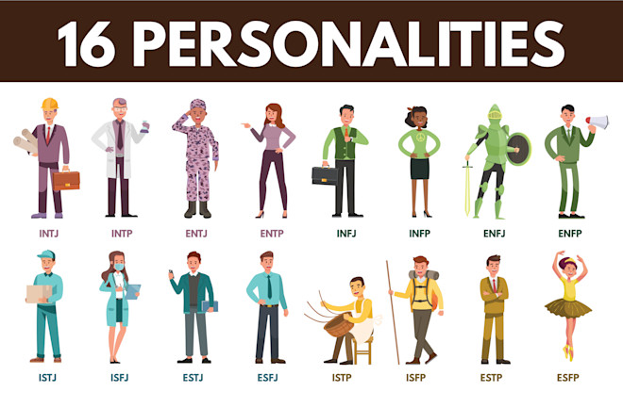
MBTI 16 Personalities Type

Slide 6
Applications of the Dataset
- Natural Language Processing (NLP)
- Personality prediction from text
- Sentiment & linguistic analysis
- Psychological and behavioral research

Slide 7
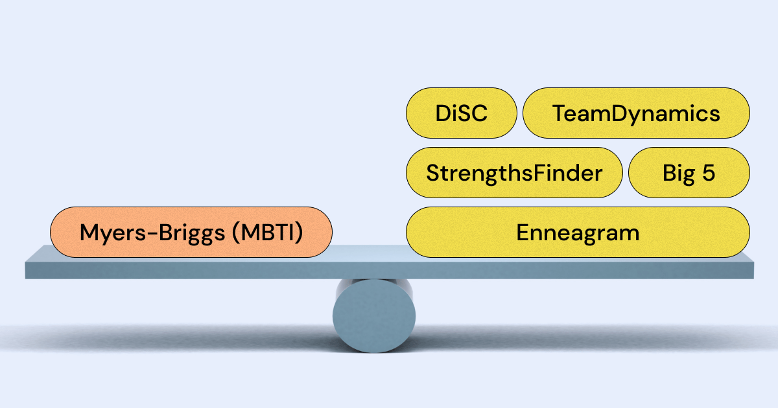
MBTI VS Others

Slide 8
Considerations & Limitations
- Self-reported MBTI types may introduce bias
- MBTI lacks strong scientific validation
- Text data may be noisy or informal
- Ideal for experimental and educational use

