Slide 1
RESTAURANT RATING PREDICTION
Written By | Priyanka Garach, Shivansh Jayara, Anubhav Srivastav, Abhinai Alavelli
Document Version | 1.0
Last Revised Date | 22-Oct-2021

Slide 2
Objective:
The main goal of this project is to perform extensive Exploratory Data Analysis(EDA) on the Zomato Dataset and build an appropriate Machine Learning Model that will help various Zomato Restaurants to predict their respective Ratings based on certain features.
Benefits:
Detection the features heavily responsible for high ratings of restaurants.
Gives better insight of ratings of the restaurant.
Helps in easy flow for identifying ratings of restaurants.
Manual inspection of what action needed to hike the ratings.

Slide 3
Data Description
Given is the variable name, variable type, the measurement unit, and a brief description. The restaurant rating prediction is the regression problem. The order of this listing corresponds to the order of numerals along the rows of the database.
Name | Data Type | Description
online_order | Integer | whether online ordering is available in the restaurant or not
book_table | Integer | table book option available or not
votes | Integer | contains total number of rating for the restaurant as of the above mentioned date
rest_type | Integer | restaurant type
location | String | contains the neighborhood in which the restaurant is located
cost | Float | cost of food

Slide 4
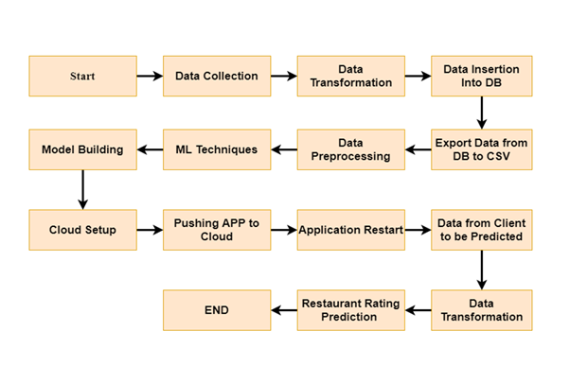
Architecture

Slide 5
Architecture Description
3.1 Data Description
Given is the variable name, variable type, the measurement unit, and a brief description. The Restaurants rating prediction is the regression problem. The order of this listing corresponds to the order of numerals along the rows of the database.
3.2 Data Gathering
Name | Data Type | Measurement
url | String | URL of the restaurant
address | String | Address of the restaurants
name | String | Name of the restaurants
online_order | String | Online order option is there or not in restaurants.
book_table | String | Table Booking option is there or not in restaurants.
rate | Float | Rating of the restaurents.
votes | String | Total number of votes restaurants have.
phone | Integer | Phone number of restaurants.
location | String | Location of restaurants.
rest_type | String | This column shows which type of dinning services restaurants provide.
dish_liked | String | This column shows most liked dishes of the restaurants.
cuisines | String | This column shows which type of continental dinning services restaurants provide.
approx_cost(for two people) | Float | This column shows approximate cost for two people.
reviews_list | String | Review of the restaurants.
menu_item | String | List of menu items of restaurants.
listed_in(type) | String | Type of dinning style is listed in this column.
listed_in(city) | String | City in which restaurant is present is listed here.

Slide 6
3.2 Data Gathering
Data source: https://www.kaggle.com/himanshupoddar/zomato-bangalore-restaurants Train and Test data are stored in .csv format.
3.3 Raw Data Validation
After data is loaded, various types of validation are required before we proceed further with any operation. Validations like checking for zero standard deviation for all the columns, checking for complete missing values in any columns, etc. These are required because The attributes which contain these are of no use. It will not play role in contributing to the sales of an item from respective outlets.
Like if any attribute is having zero standard deviation, it means that’s all the values are the same, its mean is zero. This indicates that either the sale is increasing or decrease that attribute will remain the same. Similarly, if any attribute is having full missing values, then there is no use in taking that attribute into an account for operation. It’s unnecessary increasing the chances of dimensionality curse.
3.4 Data Transformation
Before sending the data into the database, data transformation is required so that data are converted into such form with which it can easily insert into the database. Here, the ‘Item Weight’ and “Outlet Type’ attributes contain the missing values. So they are filled in both the train set as well as the test set with supported appropriate data types.

Slide 7
3.5 Database Insertion
Both train and test data set are inserted into the database. Here MongoDB database is used to store the data set. Separate collections were created for both train and test sets.
3.6 Export as `CSV` from Database
From the database both the train and test data set are exported into the local system and stored into CSV files. Now this CSV file will have proceeded for further processing.
3.7 Data Preprocessing
In data preprocessing all the processes required before sending the data for model building are performed. Like, here the rate column was having rating as eg:4.5/5, therefore we have removed /5 from the rating of the rate column. After that there were missing values in rate , cost , location and rest_type column which we have dropped.
3.8 Feature Engineering
After preprocessing it was found that some of the attributes are not important to the item sales for the particular outlet. So those attributes are removed. Even level encoding is also performed to convert the categorical features into numerical features.
3.9 Parameter Tuning
Parameters are tuned using Randomized searchCV. Two algorithms are used in this problem, Random Forest, and Extra tree regressor. The parameters of all these 2 algorithms are tunned and passed into the model.

Slide 8
3.10 Model Building
After doing all kinds of preprocessing operations mention above and performing scaling and hyperparameter tuning, the data set is passed into all two models, Random Forest, and Extra tree regressor. It was found that Extra tree regressor performs best with the smallest RMSE value i.e and the highest R2 score equals 0.93. So ‘Extra tree regressor’ performed well in this problem.
3.11 Model Saving
Model is saved using pickle library in `.pkl` format.
3.12 Flask Setup for Data Extraction
After saving the model, the API building process started using Flask. Web application creation was created here. Whatever the data user will enter and then that data will be extracted by the model to predict the prediction of sales, this is performed in this stage.
3.13 GitHub
The whole project directory will be pushed into the GitHub repository.
3.14 Deployment
The cloud environment was set up and the project was deployed from GitHub into the Heroku cloud platform.

Slide 9
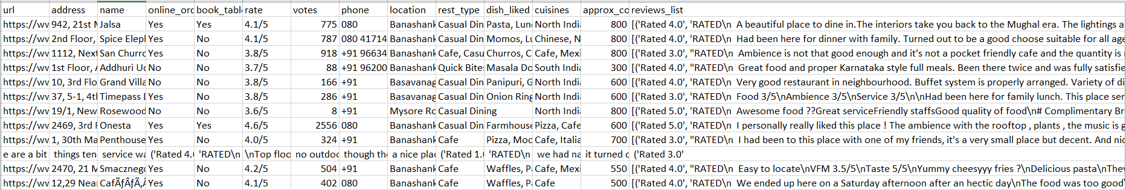
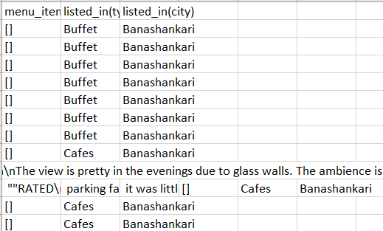
Data set description
Zomato collected data of various restaurants from bangalore city and showing ratings.
Using all the observations it is inferred what role certain properties of an item play and how they affect their sales. The dataset looks like as follow:

Slide 10
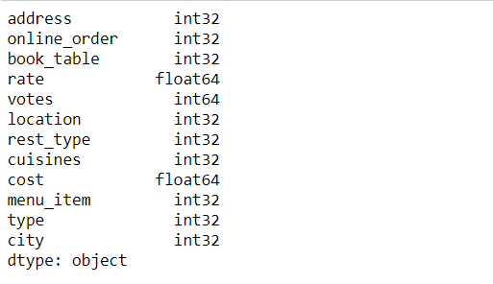
The data set consists of various data types from integer to float to object as shown in Fig.

Slide 11
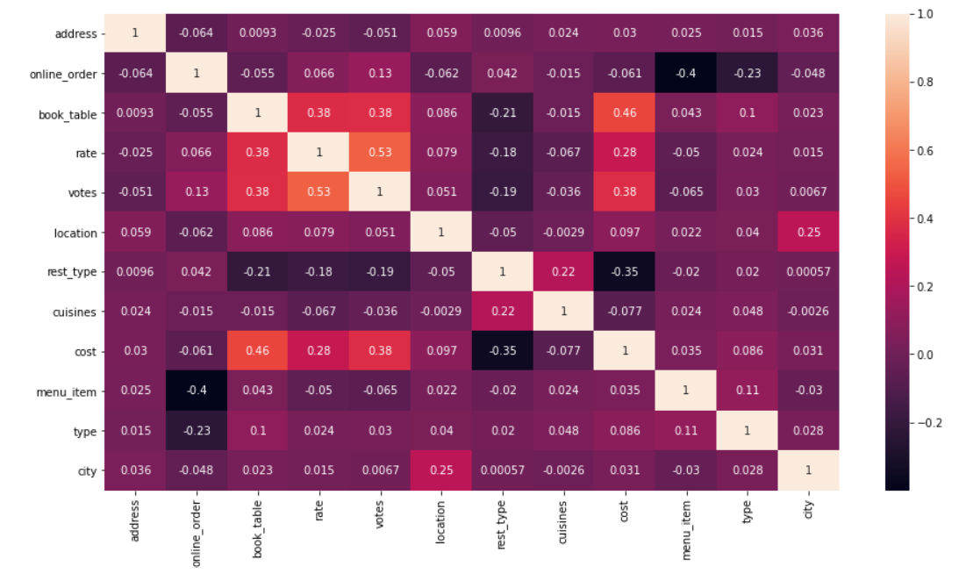
Observations
Correlation is used to understand the relation between a target variable and predictors. In this work, rate is the target variable and its correlation with other variables is observed. Considering the case of rest_type, the feature rest_type is shown to have a low correlation with the target variable rate in below Fig.

Slide 12
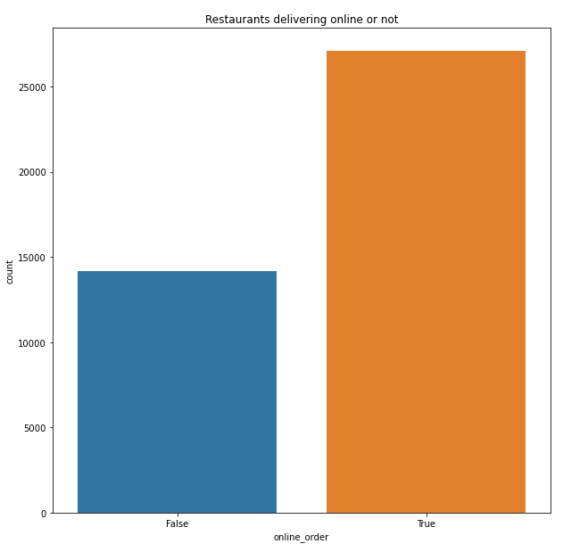
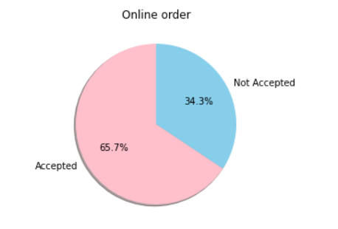
As can be seen from below Fig. there are more online orders compared to offline orders, and the online orders are accepted more.

Slide 13
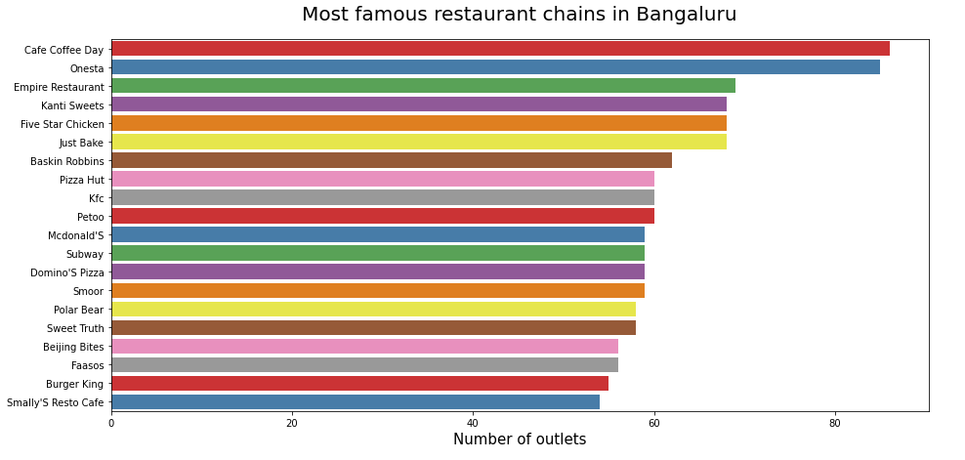
This shows places of famous restaurants in Bangalore.

Slide 14
Metrics for Data Modelling
The coefficient of determination R² (R-squared) is a statistic that measures the goodness of a model’s fit i.e., how well the real data points are approximated by the predictions of regression. Higher values of R² suggest higher model accomplishments in terms of prediction along with accuracy, and the value 1 of R² is indicative of regression predictions perfectly fitting the real data points. For further better results, the use of adjusted R² measures works wonders. Taking logarithmic values of the target column in the dataset proves to be significant in the prediction process. So, it can be said that on taking adjustments of columns used in prediction, better results can be deduced. One way of incorporating adjustment could also have included taking square root of the column. It also provides better visualization of the dataset and target variable as the square root of target variable is inclined to be a normal distribution.
The error measurement is an important metric in the estimation period. Root mean squared error (RMSE) and Mean Absolute Error (MAE) are generally used for continuous variable’s accuracy measurement. It can be said that the average model prediction error can be expressed in units of the variable of interest by using both MAE and RMSE. MAE is the average over the test sample of the absolute differences between prediction and actual observation where all individual differences have equal weight. The square root of the average of squared differences between prediction and actual observation can be termed as RMSE. RMSE is an absolute measure of fit, whereas R² is a relative measure of fit. RMSE helps in measuring the variable’s average error and it is also a quadratic scoring rule. Low RMSE values obtained for linear or multiple regression corresponds to better model fitting.

Slide 15
With respect to the results obtained in this work, it can be said that there is no big difference between our train and test sample since the metric RMSE ratio is calculated to be equal to the ratio between train and test sample. The results related to how accurately responses are predicted by our model can be inferred from RMSE as it is a good measure along with measuring precision and other required capabilities. A considerable improvement could be made by further data exploration incorporated with outlier detection and high leverage points. Another approach, which is conceptually easier, is to combine several sub-models which are low dimensional and easily verifiable by domain experts, i.e., ensemble learning can be exploited.

Slide 16
Prediction results
The largest votes did not produce the highest rates. The online_order, book_table, rest_type, location and cost also affects the final target variable that is rate of the restaurant.
The median of the target variable rate was calculated to be 3.7.
Adjusted R-squared and R-squared values are higher for ExtraTreeRegressor model than average. Also its RMSE value is low as compared to other model with highest CV score. Therefore, the ExtraTreeRegressor model fits better and exhibits accuracy.

Slide 17
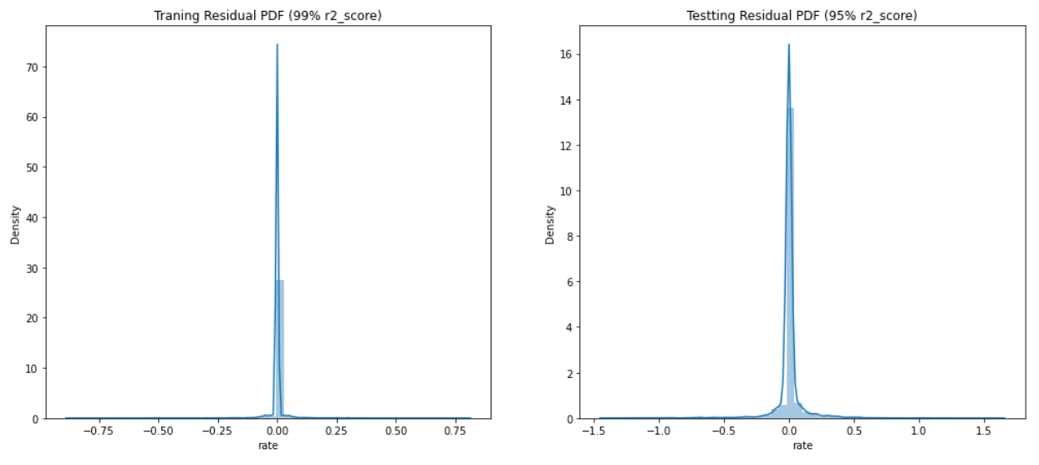
Conclusion
In this project, basics of machine learning and the associated data processing and modeling algorithms have been described, followed by their application for the task of Restaurant Ratings Prediction at different locations. On implementation, the prediction results shows an appropriate Machine Learning Model that will help various Zomato Restaurants to predict their respective Ratings based on certain features.

Slide 18
Q & A:
Q1) What’s the source of data?
Ans. The data for training is provided by the client from:
https://www.kaggle.com/himanshupoddar/zomato-bangalore-restaurants
Q 2) What was the type of data?
Ans. The data was the combination of numerical and Categorical values.
Q 3) What’s the complete flow you followed in this Project?
Ans. Refer the Architecture section for this.
Q 4) After the File validation what you do with incompatible file or files which didn’t pass the validation?
Ans. Files like these are moved to the Achieve Folder and a list of these files has been shared with the client and we removed the bad data folder.
Q 5) How logs are managed?
Ans. We are using different logs as per the steps that we follow in validation and modeling like validation log, database operation log, preprocessing log, model training log, etc..

Slide 19
Q 6) What techniques were you using for data pre-processing?
Removing unwanted attributes
Visualizing relation of independent variables with each other and output variables
Removing outliers
Cleaning data and imputing if null values are present.
Converting categorical data into numeric values.
Scaling the data
Q 7) How training was done or what models were used?
Before diving the data in training and validation set we performed clustering over fit to divide the data into clusters. As per cluster the training and validation data were divided. The scaling was performed over training and validation data
Algorithms like Linear regression, Gradient boost, Random forest and XGBoost were used .
Q 8) How Prediction was done?
Ans. The testing files are shared by the client. We pass its data to the best model which we have saved in pickle format and get the prediction.
Q 9) Where the model was deployed?
Ans. When the model is ready, we deploy it in Heroku platform. This model is an web application where user can enter the data and these data gets extracted in the backend and user gets the prediction result.

Slide 20
Thank You

