Slide 1
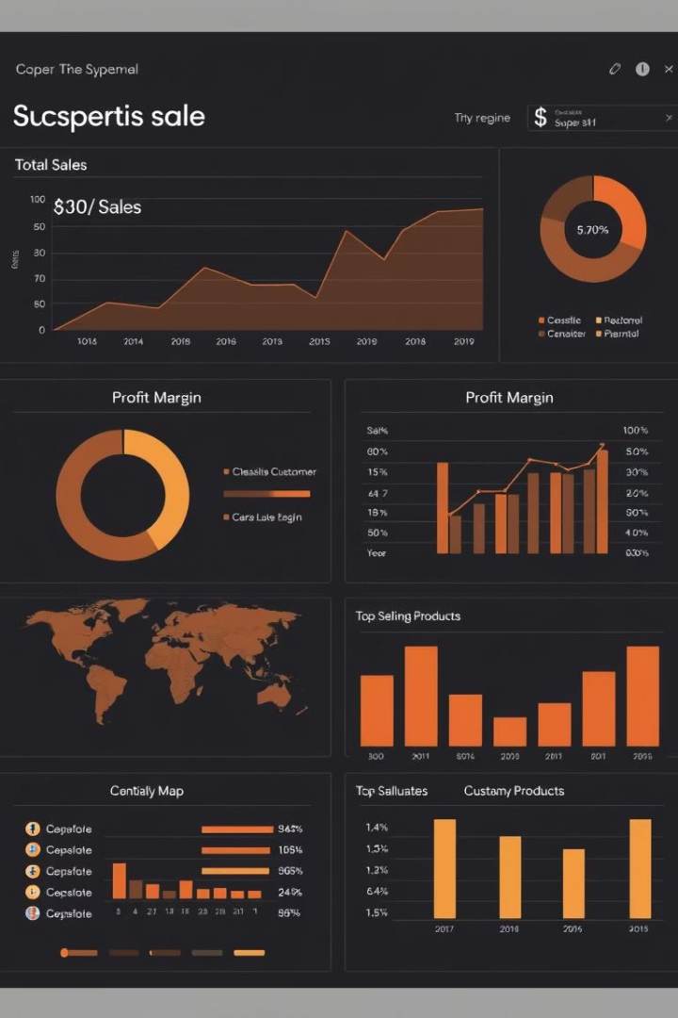
Superstore Sales Analysis Dashboard
This presentation outlines the design and key features of a Superstore Sales Dashboard, developed as part of an internship task. Leveraging Power BI, this dashboard transforms raw transactional data into actionable insights, empowering stakeholders to make informed, data-driven decisions. We will explore its objectives, design principles, and the valuable business insights it uncovers.
by Anubhuti Anurag

Slide 2





Objective & Overview
Core Objective
To create an interactive business dashboard for stakeholders that enables data-driven decision-making. This central goal guides every aspect of the dashboard's development, ensuring its utility and impact.
Scope of Work
Our work involved analyzing sales, profits, trends, and performance using real-world transactional data. We applied visual storytelling through Power BI to highlight key business insights, making complex data accessible and understandable.
Tools Utilized
The primary tool for this project was Microsoft Power BI Desktop, chosen for its robust data visualization capabilities. The dataset used was the Superstore Sales data, sourced from Kaggle, providing a rich foundation for analysis.

Slide 3
Dataset Summary
Key Attributes
Dataset Stats
Order ID, Customer ID
Approximately 10,000 rows
Category, Sub-Category
Time Range: 2015–2018
Region, State, City
Multi-dimensional data
Order Date, Ship Date
Geographic, timeline, product segmentation
Sales, Profit, Discount, Quantity
Rich transactional details
The Superstore Sales dataset is a comprehensive transactional record, offering a rich foundation for in-depth business analysis. It encompasses nearly 10,000 rows of data from 2015 to 2018, providing a multi-year perspective. This multi-dimensional dataset combines geographical information (Region, State, City), temporal elements (Order Date, Ship Date), and detailed product segmentation (Category, Sub-Category), alongside crucial financial metrics like Sales, Profit, Discount, and Quantity. Its breadth allows for a holistic view of the superstore's operations.

Slide 4





KPI Metrics Selected
Total Sales
Total Profit
Total Quantity Sold
Represents the aggregate revenue generated, a primary indicator of overall business volume and market penetration.
Indicates the net financial gain after all costs, crucial for assessing the financial health and efficiency of operations.
Measures the sheer volume of products moved, offering insights into inventory management and customer demand.
Average Discount
Sales vs Profit Ratio
Reveals the typical level of price reduction applied, important for evaluating pricing strategies and their impact on margins.
Highlights the efficiency with which sales translate into profit, a key metric for operational optimization.

Slide 5
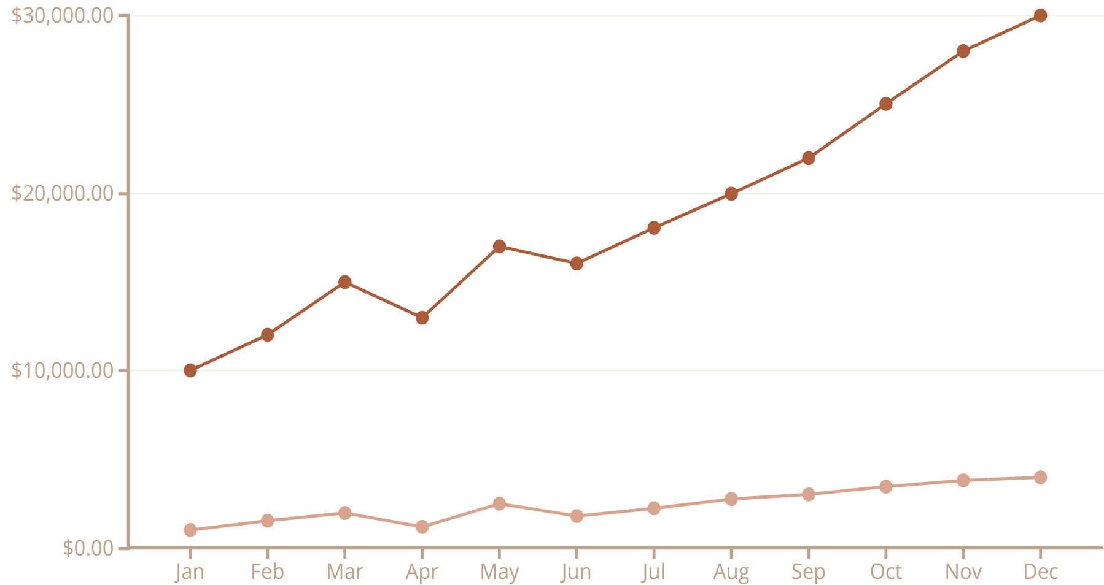
Sales & Profit Trend Analysis
Sales
Profit
An analysis of sales and profit trends reveals critical seasonal patterns and the impact of pricing strategies. The line chart for Monthly Sales & Profit consistently shows a surge in sales during Quarter 4, indicating peak shopping seasons. However, the combo chart highlighting Profit vs Discount Impact uncovers a critical insight: deep discounts, while boosting sales volume, frequently lead to loss-making transactions, disrupting the direct correlation between high sales and high profitability. This suggests a need to re-evaluate promotional strategies to safeguard margins, emphasizing targeted marketing efforts in Q4 while ensuring discounts remain profitable.

Slide 6
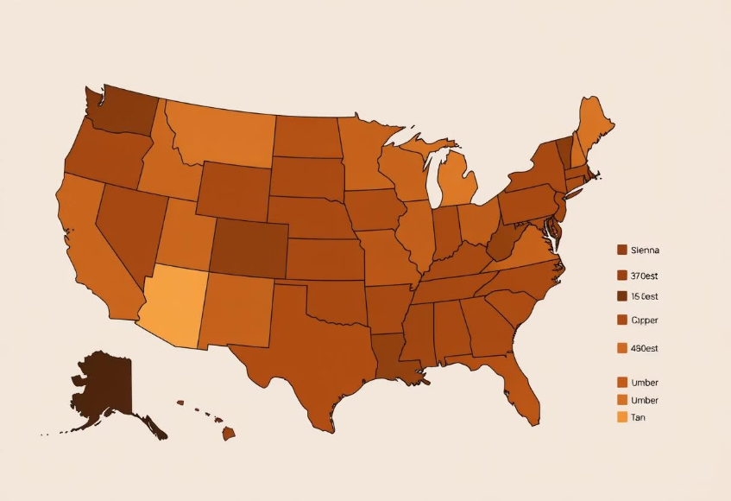
Regional & Segment Performance
Regional Sales Insights
Segment Profitability
A geographical map view of sales by region clearly identifies the Central and West regions as top performers, contributing the most significantly to overall sales volume. This concentrated performance indicates strong market presence and customer demand in these areas.
A bar chart detailing profit by segment highlights the Consumer segment as the primary driver of revenue. While the Corporate segment may not lead in sheer profit volume, it consistently demonstrates a higher average order value, indicating a different but valuable customer behavior.
Based on these insights, scaling operations and resource allocation in the high-performing Central and West regions is recommended. Additionally, tailoring product offerings and marketing strategies specifically to the Enterprise (Corporate) clients can capitalize on their higher average order values, further optimizing revenue streams.

Slide 7



Category & Sub-Category Deep Dive
Technology Dominance
The Tree Map reveals Technology as a top contributor, with Phones and Accessories driving significant sales and profit. This highlights the strong market demand and high margins within these sub-categories.
Consistent Office Supplies
Office Supplies maintain moderate but consistent sales, suggesting a stable market but less growth potential compared to technology.
Underperforming Segments
Conversely, a Column Chart shows that Tables and Bookcases consistently lead to losses, indicating potential issues with pricing, procurement, or demand.
A deep dive into category and sub-category performance provides actionable insights for product portfolio optimization. It is recommended to either phase out or implement significant cost improvements for underperforming sub-categories like Tables and Bookcases. Conversely, expanding popular, high-margin product lines within Technology, such as Phones and Accessories, will leverage existing market strengths and boost overall profitability.

Slide 8
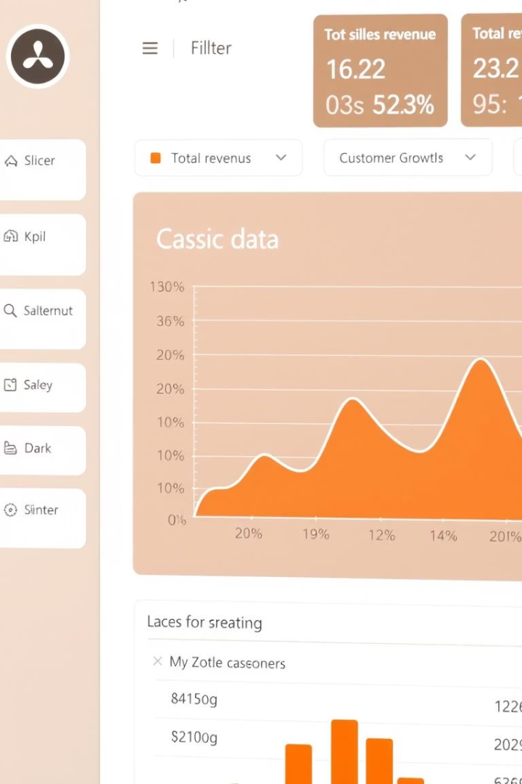




Interactivity & Design Features
Dynamic Slicers
Timeline Filters
Drill-through Navigation
Region, Segment, Category, and Year slicers allow for granular data filtering, empowering users to explore specific dimensions of the sales data with ease.
Interactive timeline filters enable precise analysis of trends and performance over custom date ranges, providing flexibility in historical review.
This feature allows users to seamlessly navigate from high-level summaries to detailed underlying data, supporting deeper investigation into specific metrics.
Visual Harmony
The dashboard boasts a consistent layout, color-coded categories for intuitive data interpretation, and minimal clutter, ensuring a clean and user-friendly experience.

Slide 9






Learnings & Reflections
Data Storytelling Mastery
Learned that effective data visualization transforms raw data into compelling narratives, making insights more impactful than mere numbers.
Visual Hierarchy & Filters
Discovered the critical importance of a logical visual hierarchy and intuitive filter design for enhancing user experience and data accessibility.
Aesthetics Meets Function
Achieved a balance between dashboard aesthetics and core functionality, ensuring it's both visually appealing and highly effective for decision-making.
The journey of developing this Superstore Sales Dashboard offered invaluable lessons, particularly in the art of data storytelling and designing for optimal user experience. Challenges such as handling missing data, resolving duplicates, and optimizing performance for large datasets were successfully overcome, leading to the creation of a robust, user-friendly dashboard. This project reinforced the principle that a well-crafted dashboard is a powerful tool, ready for real business use and driving informed strategic decisions.

Slide 10

Submission & Thank You
Project Repository
Deliverables Included
Gratitude
The complete project, including all relevant files and documentation, is available on GitHub at: [Insert GitHub Repo URL]
Power BI File (.pbix)
Thank you for providing this invaluable opportunity to apply and enhance my skills in data analysis and dashboard design. It has been a rewarding experience.
Cleaned Dataset (.csv)
Final PowerPoint Summary
ReadMe Documentation

