Slide 1
Container Security & Anubis
John Cunniff
github/wabscale

Slide 2
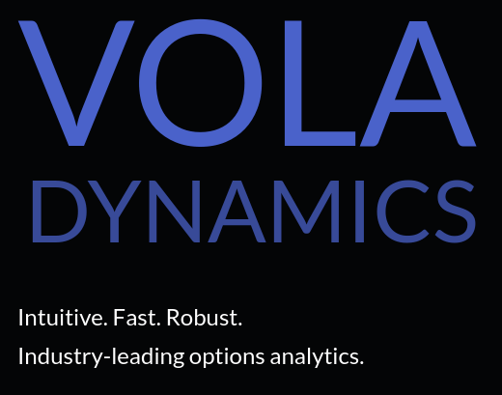
whoami
Graduated from NYU 2 years ago
Was president of the OSIRIS Lab
Senior Engineer at Vola Dynamics
Created & maintaining Anubis LMS

Slide 3
Applied Containers & Orchestration
I may be teaching a class next semester!
Applied Containers & Orchestration
github/AnubisLMS/Course

Slide 4

Container Security & Anubis
Container Basics
Container Security 101
Anubis

Slide 5
Container Basics
What are they exactly?
Sort of like chroot on steroids
They are implemented through user level Container Engines / Runtime, not by the kernel itself
You probably already know Docker
  containerd / runc for the actual containers
Notes:
chroot is an operation that changes the aparent root directory for the current running process and it’s children. A program that is run in such a modified environment cannot name (and therefore normally cannot access) files outside the designated directory tree.

Slide 6
Containers
On GNU/Linux you are always in a container!
Linux starts in a container with no limits that can see everything
So if you think you’re getting a performance benefit by not using containers you’re wrong!

Slide 7
Namespacing
Provide a layer of isolation. Limits what you can see/affect/use
Implemented within the kernel
Multiple types of resource namespaces
  pid net mnt uts ipc user

Slide 8
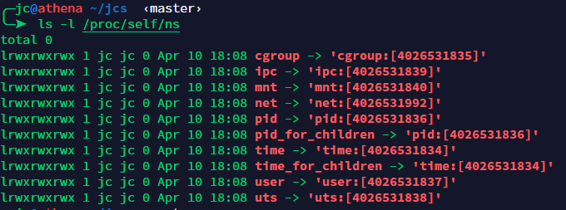
Namespacing
ls -l /proc/self/ns to see what namespaces you are in
This ugly long number is what pid namespace the current process is in

Slide 9
PID Namespacing
Processes within a PID namespace only see processes in the same PID namespace
Those namespaces are nested

Slide 10
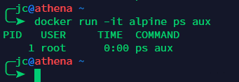
PID Namespacing
What happens when you run ps in a container?
PIDs start at 1
Only the ps process visible

Slide 11
Cgroups
Control Group
Implemented within the kernel
limits what resources you are allowed to use
cpu and memory cgroups very common with containers
It is up to your container runtime to use cgroup

Slide 12
CPU Cgroups
CPU cgroup Keeps track of user/system
CPU time Keeps track of usage per CPU Allows to set weights
Because of variations in things like core clock speed, and instruction time execution, there is no 100% precise way to limit CPU

Slide 13
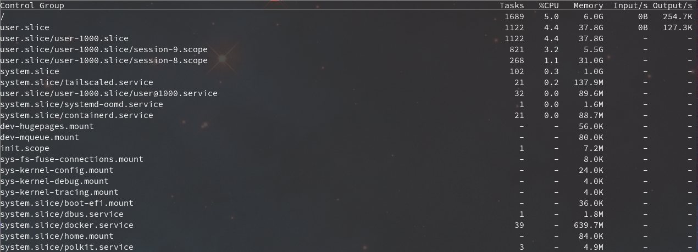
CPU Cgroups
Try systemd-cgtop to see cgroup usage!

Slide 14
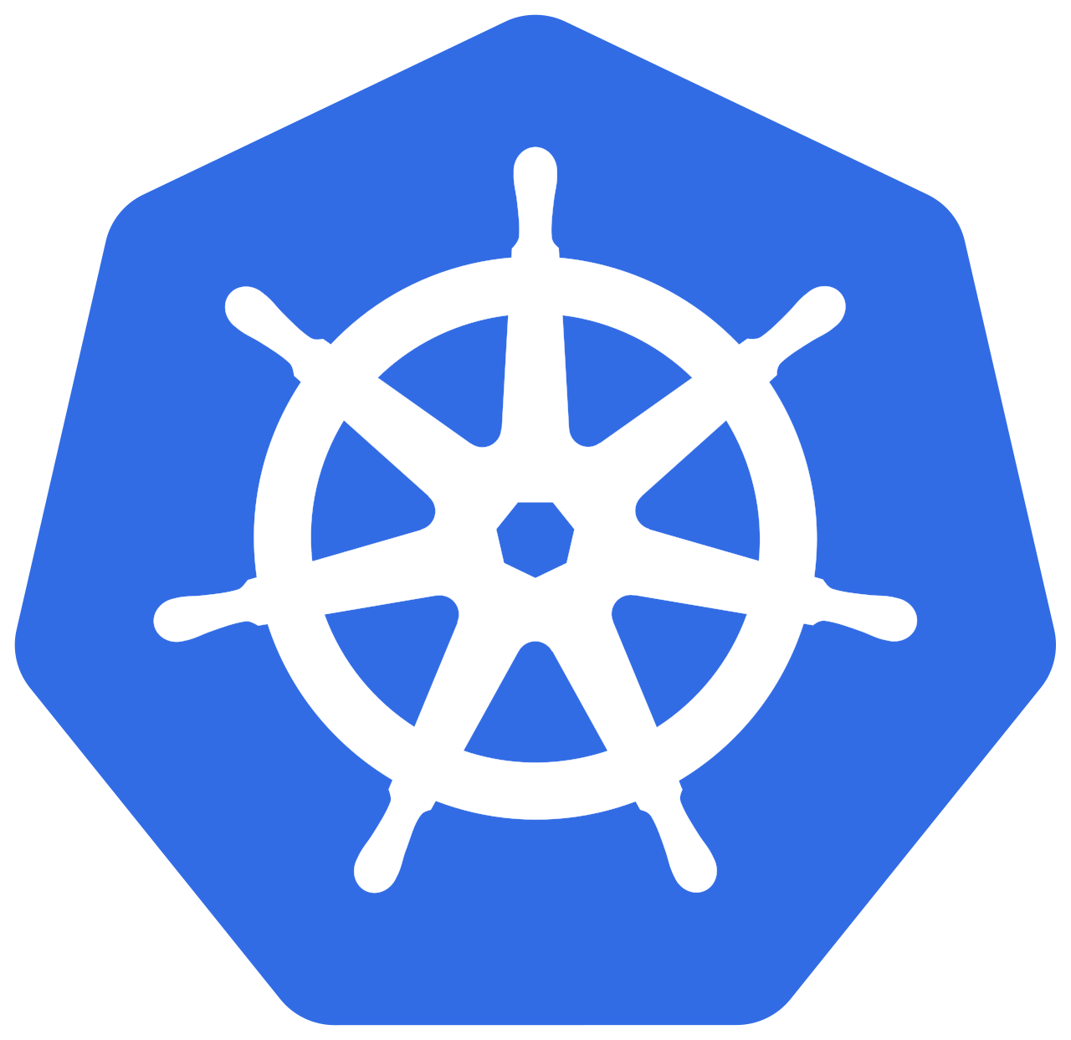
Kubernetes
Anubis runs on a container orchestration tool called Kubernetes or k8s (the 8 is for the number of letters in between k and s)
Kube allows for things like CNI (container networking interfaces) and CSI (container storage interface) to be extended to many, many machines connected on a network
This lets us design and easily implement large systems that rely on many many individual containers communicating at once

Slide 15
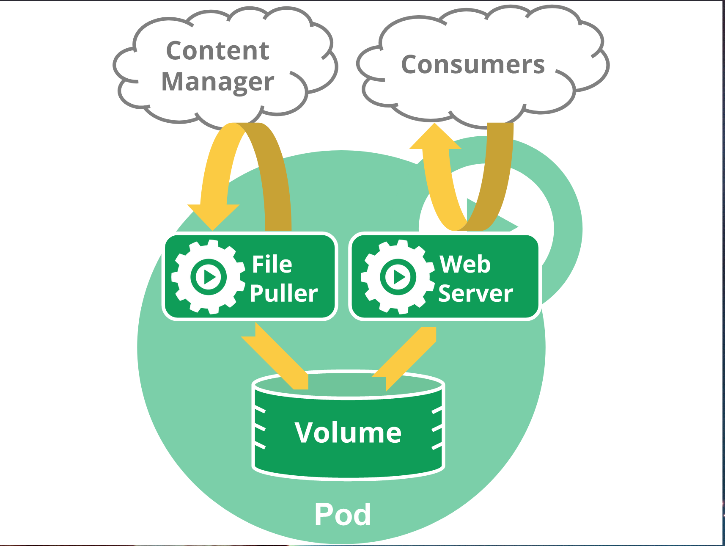
Kubernetes Pod
A single unit of work in kubernetes
Pods contain containers, volumes, config-maps, secrets, …
Designed to be easy to share resources between containers in a pod

Slide 16
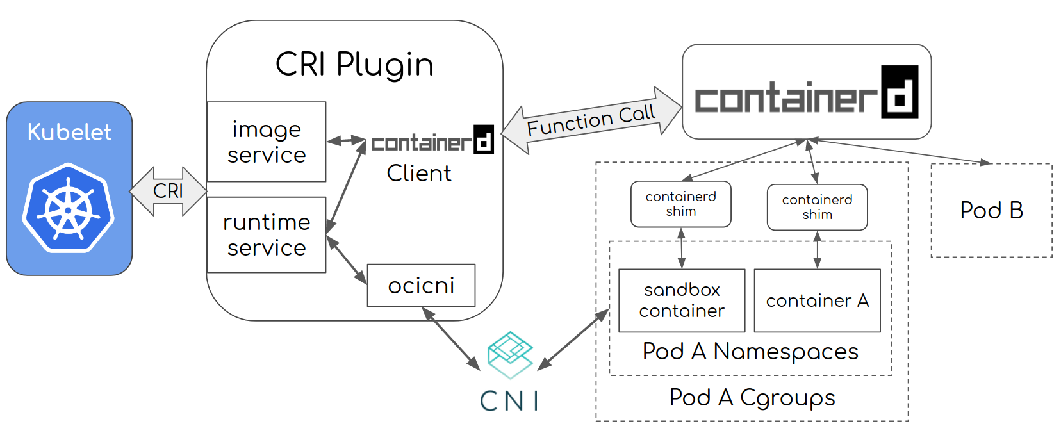
Kubernetes Pod
Containerd
Container Resource Interface Plugin
Containerd Creates Pod Containers
Primary K8S Node Agent

Slide 17

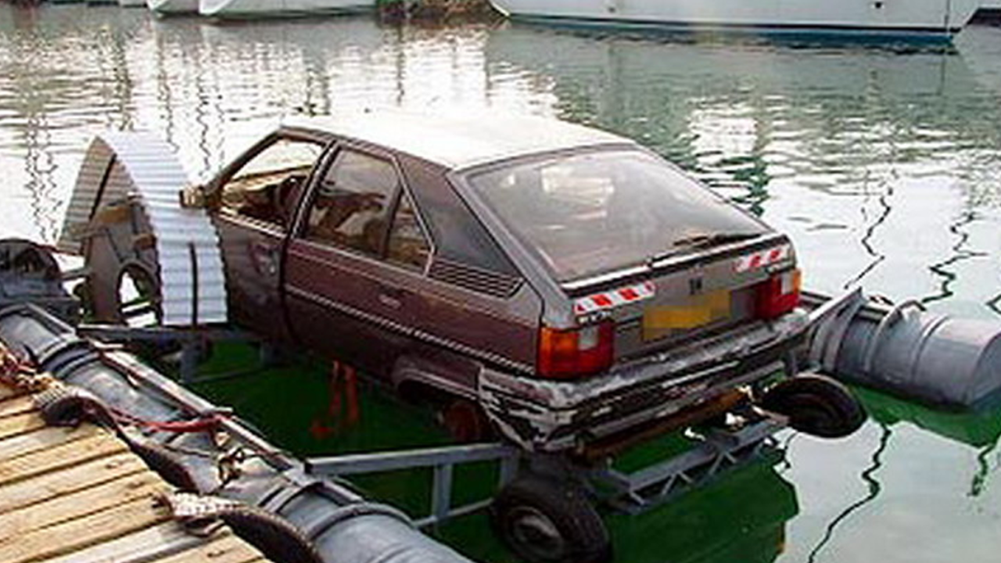

Docker on Linux
Docker on Mac
Docker on Windows

Slide 18
Container Security & Anubis
Container Basics
Container Security 101
Anubis

Slide 19
Container Security 101
Primer
Capabilities
AppArmor
Selinux
Seccomp
Linuxkit

Slide 20
Primer
Definition
Container Escape
  When you are able to escape from the intended isolation of a container

Slide 21
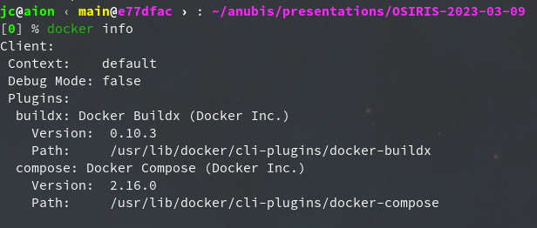
Primer docker info

Slide 22
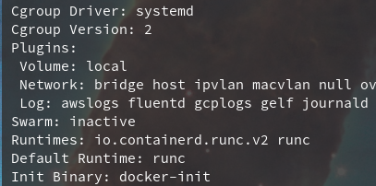
Primer docker info
cgroups v2 enabled
runc for runtime

Slide 23
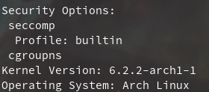
Primer docker info
default seccomp profile
Newish feature for namespacing container cgroups

Slide 24
Capabilities
Splitting root on linux into more fine grained permissions
The root you get in a docker container does not have the same caps!
Example: NET_BIND_SERVICE capability lets you bind to ports below 1024

Slide 25
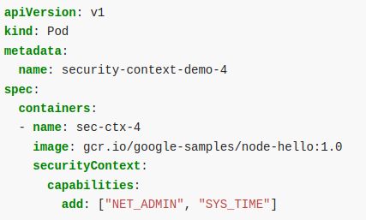
Capabilities

Slide 26
Capabilities
When you run a container with --privileged, you are giving everything to that container
It is trivially easy to container escape from a container with --privileged

Slide 27
AppArmor
AppArmor is a system for making fine grained permissions for specific programs
It has been being somewhat phased out in favor of alternatives
AppArmor is no longer included in the .deb distributions

Slide 28
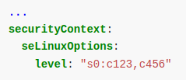
Selinux - Security-Enhanced
Mandatory Access Control system
Writing your own policies is not something I would recommend

Slide 29
Seccomp - Secure computing mode
This is the standard way container runtimes will box you in
Similar to Capabilities, but for syscalls
Default docker seccomp profile blocks a lot of syscalls
https://docs.docker.com/engine/security/seccomp/#significant-syscalls-blocked-by-the-default-profile

Slide 30
LinuxKit
“A toolkit for building custom minimal, immutable Linux distributions”
Takes the container isolation model, and applies it to virtual machines
The idea is that the kernel runs in a separate container as services

Slide 31
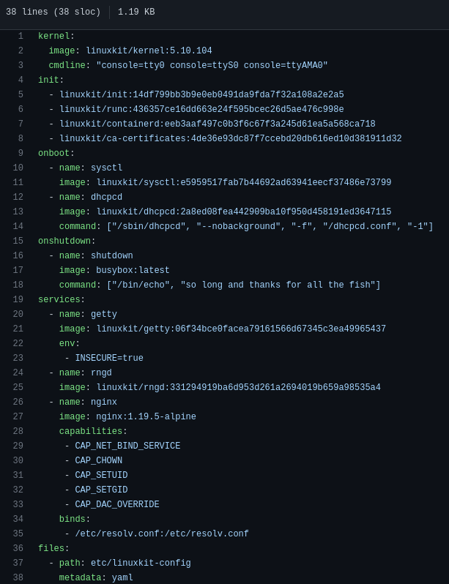
LinuxKit
Need a nginx VM server?
Here you go

Slide 32
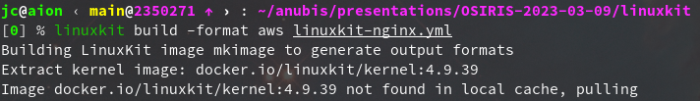
LinuxKit
Need it on aws?
Need it as an iso?

Slide 33
LinuxKit
Want to run it locally?
Want to run it on azure?

Slide 34
LinuxKit
Docker-desktop is built with linuxkit
They provide a kubernetes node specific images
It is really stunning that this is not just the standard

Slide 35
Container Security & Anubis
Container Basics
Container Security 101
Anubis

Slide 36

Anubis
Anubis is a large system split up into microservices
  Example: the web static (html and js) is separate from the python api
There can be many containers within those microservices
At peak usage (usually before a deadline) there may be up to 500+ containers running at any one time
Last Month (2023-02-07) there were ~366 IDEs concurrent active IDEs

Slide 37
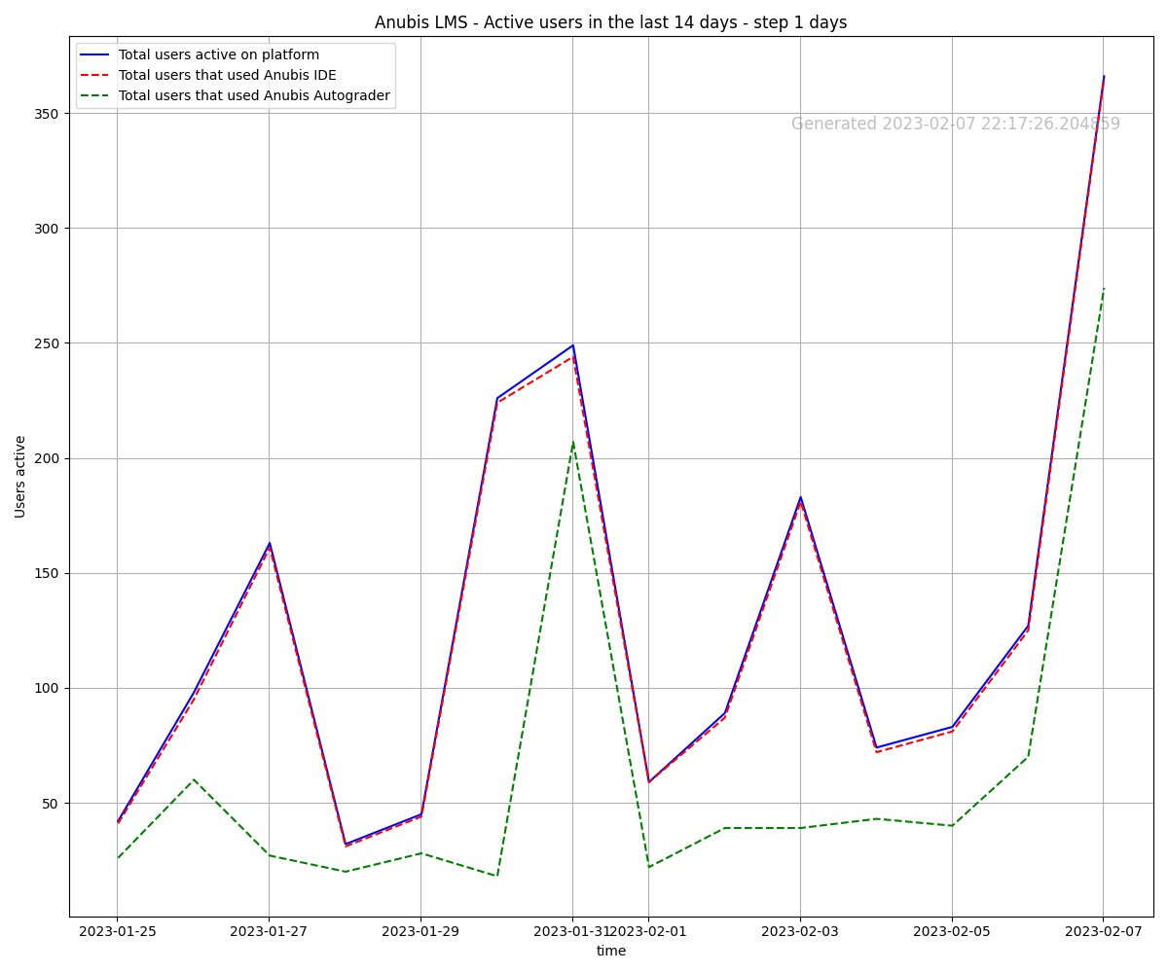
Anubis

Slide 38
Anubis IDEs
Anubis Cloud IDEs are made up of individual containers
Each student gets their own IDE pod (and therefore separate environment/filesystem)
The IDEs have CPU and Memory limits handled by cgroups
  Specifically, 2 vCPUs and 1GiB of memory by default

Slide 39
Anubis IDEs
Each Anubis Cloud IDE is itself made up of 3 containers
  An “init container” that clones your repo
  Container that runs the IDE server
  Container that handles the autosave
The containers work together to make the Cloud IDEs possible

Slide 40
Anubis IDEs
Init Container
clones the git repo (has the
fixes any permission issues
Home Volume
/home/anubis
mounted over the nfs
mounted in each container
Theia IDE Server Sidecar
Container Container
Runs webserver you connect to Handles autosave
When you open a shell it
opens here
Shared localhost

Slide 41
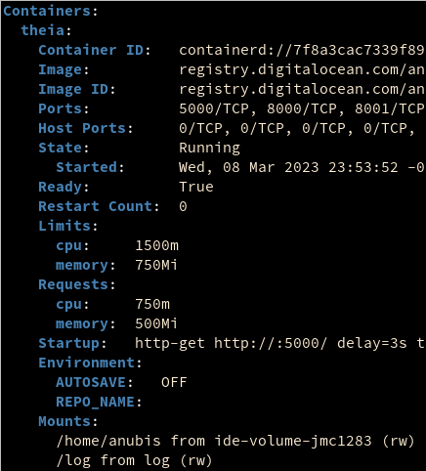
Anubis IDEs
Boxing Students In - CPU/Mem
We primarily use k8s resource limits
Set “requests” and “limits” for cpu and mem

Slide 42
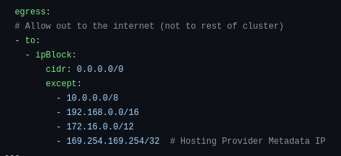
Anubis IDEs
Boxing Students In - Networking
Specific and granular network policies block students from connecting to anything internal
169.254.169.254 special cloud metadata address

Slide 43
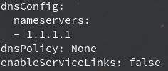
Anubis IDEs
Boxing Students In - Discovery
K8s has an elaborate service discovery system
Disable default kube-dns and turn off service links

Slide 44

Anubis IDEs
Boxing Students In - Priv-Esc
K8s Security Context to disable priv-esc & lock processes user
This means students cannot get root, even if they had sudo

Slide 45

Anubis IDEs
Boxing Students In - RBAC
K8s has an elaborate RBAC and service account system
Disable even though the default account has nothing

Slide 46
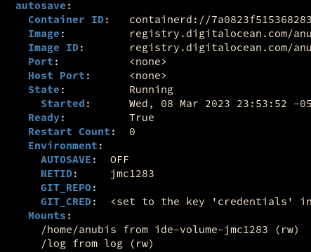
Anubis IDEs
Securely Interacting w/ Github
Shared Home

Slide 47
Anubis IDEs
Securely Interacting w/ Github
Git Creds in sidecar

Slide 48
Anubis IDEs
Securely Interacting w/ Github
This enables the sidecar to perform git remote actions in the shared directory

Slide 49
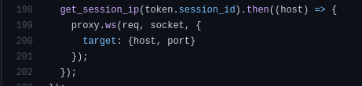
Anubis Security
Proxy Cache Incident
Proxy cache incident: https://anubis-lms.io/blog/proxy-vuln
Service that forwards http requests to IDEs

Slide 50
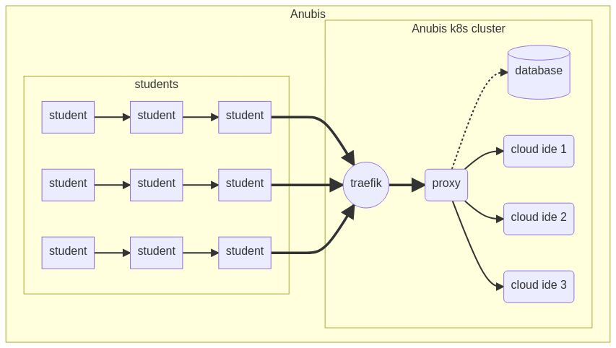
Anubis Security
Proxy Cache Incident

Slide 51
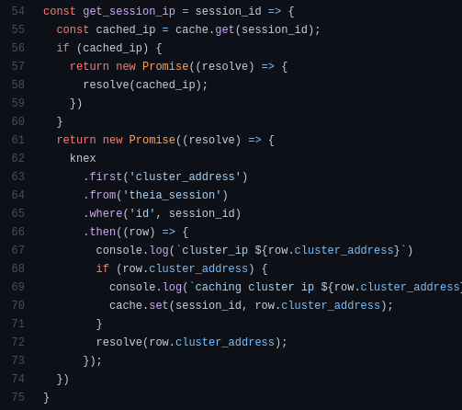
Get the cached IP address of IDE server
Only ever get the IP address once, then save in cache forever

Slide 52
Limited number of addresses
Does not check if IDE still exists
Eventually someone was forwarded to someone else’s IDE

Slide 53
Anubis Security
Git Autosave
Git autosave: https://anubis-lms.io/blog/git-vuln
Found by a lab member!
Alan Cao github/ex0dus-0x
Go give him a follow

Slide 54
Anubis Security
Git Autosave
Git has a wonderful feature called hooks
Scripts in .git/hooks/ will execute on specific actions ( like commit, push, … )
There are obscure options, and inconsistent options for disabling this behavior

Slide 55
Anubis Security
Git Autosave
Alan created a pre-commit hook that would essentially do this:
cat $HOME/.git-credentials

Slide 56
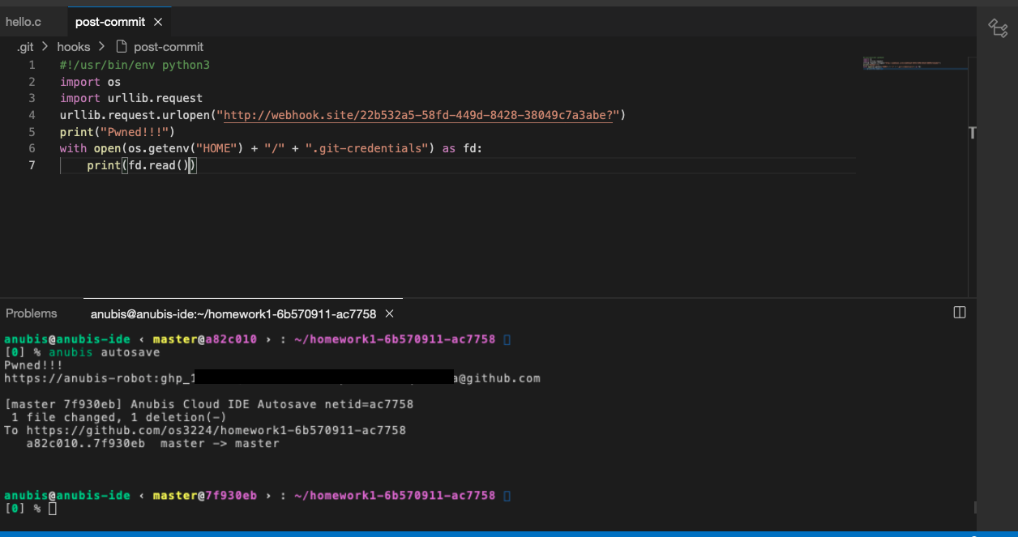
Anubis Security
Git Autosave
Alan created a post-commit hook that would do this:

Slide 57
Anubis Security
Git Autosave
I was aware that a git hook could be exploited in this way, and was using git commit with the --no-verify option
The git documentation made it sound like this option disabled all hooks
It only disables pre-commit hooks!

Slide 58
Anubis Security
Git Autosave
The fix was to run all git commit commands with:
git
-c core.hooksPath=/dev/null
-c alias.commit=commit
commit --no-verify …
Git aliases could also be overwritten for RCE into autosave container!

Slide 59
Future Readings
Container Security by Liz Rice
  github/lizrice
Basically everything by Jess Frazelle
  github/jessfraz
Presentations by Jérôme Petazzoni
  github/jpetazzo

Slide 60
Code to Read (All in Go)
runC - OCI container spawning tool
  github/opencontainers/runc
containerd - container runtime
  github/containerd/containerd
kubernetes
  github/kubernetes/kubernetes

Slide 61
Jobs Jobs Jobs
Vola Dynamics is hiring! (SWEs & Options Quants)
Send your resumes to me or to resumes@voladynamics.com

