Slide 1
Lecture 18:
Containers & Virtualization
John Cunniff
github/wabscale
Some slides derived from: G. Sandoval, Tanenbaum/Bo,
Jérôme Petazzoni, and Brendan Dolan-Gavitt
Thanks !!

Slide 2
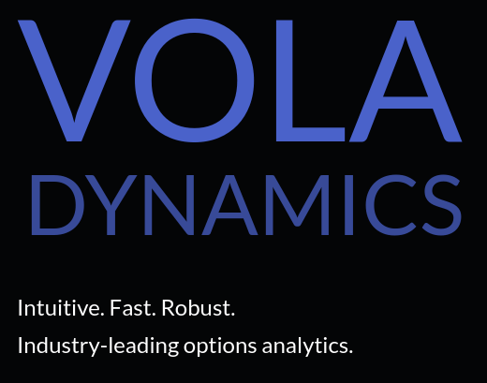
whoami
Graduated from NYU 2 years ago
Was president of the OSIRIS Lab
Senior Engineer at Vola Dynamics
Created & maintaining Anubis LMS

Slide 3
What is Vola Dynamics?
“Swiss army knife” for options analytics
100x faster, robust & accurate option pricer & volatility fitter

Slide 4
Jobs Jobs Jobs
Vola Dynamics is also hiring! (SWEs & Options Quants)
Send your resumes to resumes@voladynamics.com

Slide 5
Applied Containers & Orchestration
I may be teaching a class next semester!
Applied Containers & Orchestration
Put in your course reviews that you want a modern containers course!

Slide 6

Virtualization in VMs
Virtualization in VMs
Containers
  Namespacing
  Cgroups
Where containers run
Cloud / k8s / Anubis

Slide 7
Virtualization in VMs
Until today we’ve been talking about operating systems running on physical machines: a collection of
real hardware resources,
that the operating system has exclusive access to
through hardware interfaces (instruction set architectures, device I/O ports, etc.

Slide 8
Virtualization in VMs
Operating systems can also run inside virtual machines (VMs).
We refer to an operating system running inside a virtual machine as a guest OS.
Virtual machines differ from physical machines in important ways.
They do not provide the guest OS with exclusive access to the underlying physical machine.
Equivalently, they do not provide the guest OS with privileged (or fully-privileged) access to the physical machine.

Slide 9
Virtualization in VMs
Virtualization adds a new layer to the software stack: the hypervisor (aka Virtual Machine Monitor or VMM). The VMM mediates shared access to hardware by the different OSes and is:
a piece of software running on an operating system (the host OS)
that can allow another operating system (the guest OS) to be run as an application
alongside other applications.

Slide 10
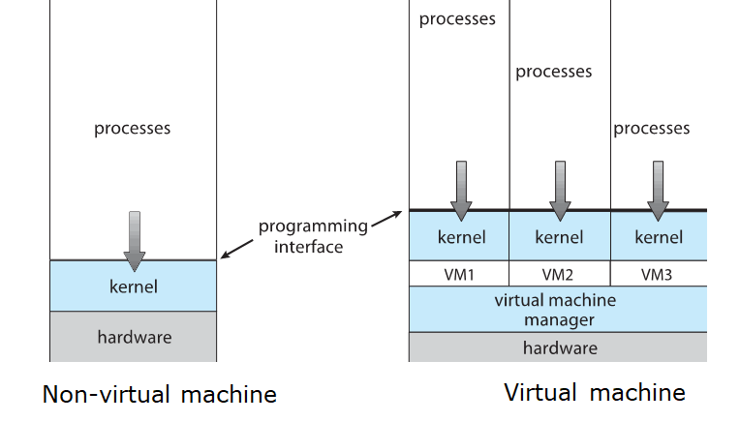
No-VM vs VM
Silberschatz, Galving and Gagne. 2018

Slide 11
Why Virtualize?
Flexibility: virtual machines are easier to instantiate and tear down, can be migrated between physical hosts
Stability: by splitting services across different virtual machines, if one crashes it will not affect the others
Security: virtual machines are isolated from one another, so (e.g.) the web server can't access data on the email server

Slide 12
Some Terminology for VMs
The running hypervisor is known as the host
The virtual machines running under the hypervisor are guests
If there is a special guest VM that is used for managing the rest, it is usually called domain 0 or the control domain

Slide 13
Three approaches to Virtualization
Full virtualization. Should be able to run an unmodified guest OS. Example: VirtualBox, VMWare.
Paravirtualization. Includes small changes to the guest operating system to improve interaction with the virtual machine monitor. Example: Xen, Amazon EC2.
Container virtualization. Namespace and other isolation techniques performed by the operating system to isolate sets of applications from each other. Example: Docker

Slide 14
Requirements for Virtualization
On most CPUs, there are sensitive instructions –those that behave differently in kernel vs user mode
  Performing I/O, changing MMU mappings, etc.
There are also privileged instructions – those that cause a trap into kernel mode
Popek and Goldberg showed that an architecture is virtualizable only if the sensitive instructions are a subset of the privileged instructions

Slide 15
x86 Hardware Virtualization
In 2005 Intel fixed these issues by introducing VT-x
  Around the same time AMD also fixed them... with an incompatible set of virtualization extensions 😑
VT-x introduced two new processor modes: root mode and non-root mode
When the processor is running in non-root mode, sensitive instructions cause a vmexit – aka, a trap to the hypervisor

Slide 16
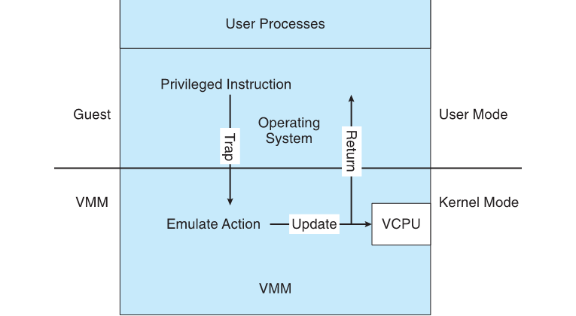
Virtualization Implementation
Priv. Instruction
Trap
Emulate Action
Update VCPU
Return
Silberschatz, Galving and Gagne. 2018

Slide 17
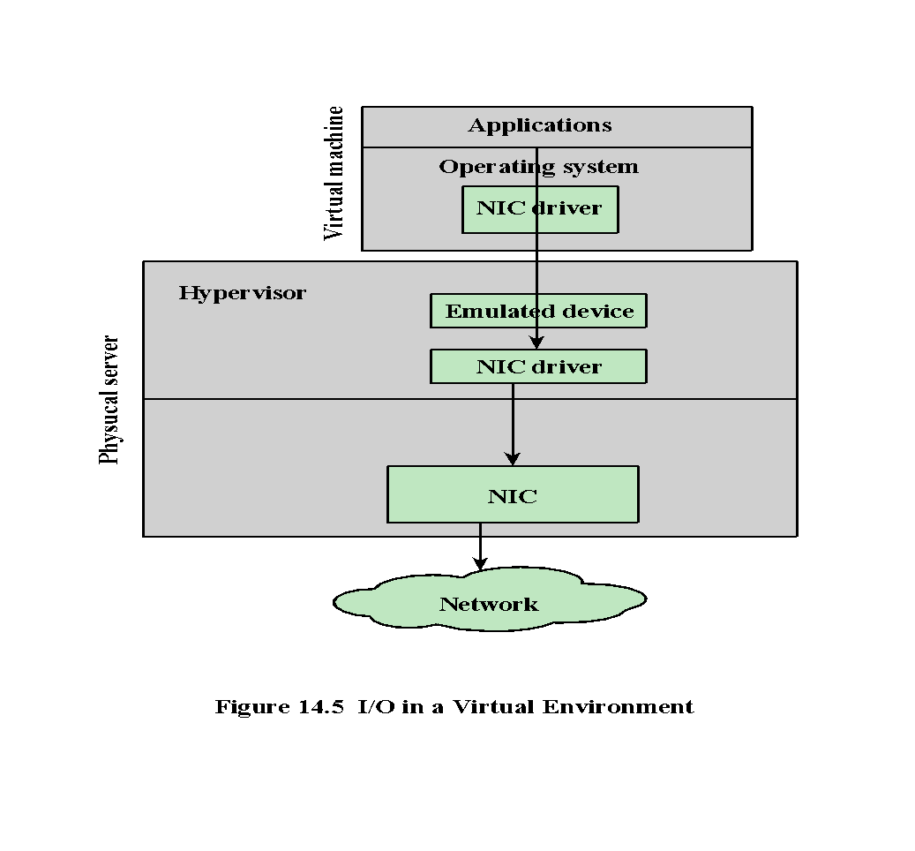
Virtual Machine
Physical Machine
Notes:
Application performance is often directly linked to the bandwidth that a server
has been allocated. Whether it is storage access that has been bottlenecked or constrained
traffic to the network, either case will cause an application to be perceived
as underperforming. In this way, during the virtualization of workloads, I/O virtualization
is a critical item. The architecture of how I/O is managed in a virtual environment
is straightforward (Figure 14.5). In the virtual machine, the operating system
makes a call to the device driver as it would in a physical server. The device driver
then connects with the device; though in the case of the virtual server, the device is
an emulated device that is staged and managed by the hypervisor. These emulated
devices are usually a common actual device, such as an Intel e1000 network interface
card or simple generic SGVA or IDE controllers. This virtual device plugs into
the hypervisor’s I/O stack that communicates with the device driver that is mapped
to a physical device in the host server, translating guest I/O addresses to the physical
host I/O addresses. The hypervisor controls and monitors the requests between
the virtual machine’s device driver, through the I/O stack, out the physical device,
and back again, routing the I/O calls to the correct devices on the correct virtual
machines. There are some architectural differences between vendors, but the basic
model is similar.

Slide 18
I/O Virtualization
Two final issues exist with virtualized I/O: DMA and interrupts
For DMA, the problem is that the DMA hardware will be programmed with physical addresses, which must be remapped by the hypervisor
  (~2009) Intel added an IOMMU that allows device memory accesses to be remapped without hypervisor intervention
Interrupts from devices must also be remapped – the interrupt number seen by the guest virtual machine may not be the same as the interrupt number seen by the host

Slide 19
Review: Virtualization
How did we create a virtual machine (VM)?
Start with a physical machine
Create software (hypervisor) responsible for isolating the guest OS inside the VM
VM resources (memory, disk, networking, etc.) are provided by the physical machine but visibility outside of the VM is limited

Slide 20
Review: Virtualization
What were the implications?
VM and physical machine share same instruction set, so must the host and guest
Guest OS can provide a different application binary interface (ABI) inside the VM
Lots of challenges in getting this to work because guest OS expects to have privileged hardware access

Slide 21
Containers
Virtualization in VMs
Containers
  Namespacing
  Cgroups
Where containers run
Cloud / k8s / Anubis

Slide 22
OS Virtualization => Containers
How do we create a virtual operating system (container)?
Start with a real operating system.
Create software responsible for isolating guest software inside the container
(That software seems to lack a canonical name—​and today it’s actually a bunch of different tools.)
  runc, rkt, lxc, and docker to name a few
Container resources (processes, files, network sockets, etc.) are provided by the real operating system but visibility outside the container is limited

Slide 23
Containers
What are they exactly
Sort of like chroot on steroids
They are implemented through user level Container Engines / Runtime, not by the kernel itself
You probably already know Docker
  Docker itself uses containerd/runc for the actual containers
There is also lxc, rkt (pronounced rocket), and runc for example
Notes:
chroot is an operation that changes the aparent root directory for the current running process and it’s children. A program that is run in such a modified environment cannot name (and therefore normally cannot access) files outside the designated directory tree.

Slide 24
Containers
What are the implications?
Container and real OS share same kernel
So applications inside and outside the kernel must share the same ABI (Application Binary Interface)
Challenges is getting this to work are due to shared OS namespaces

Slide 25
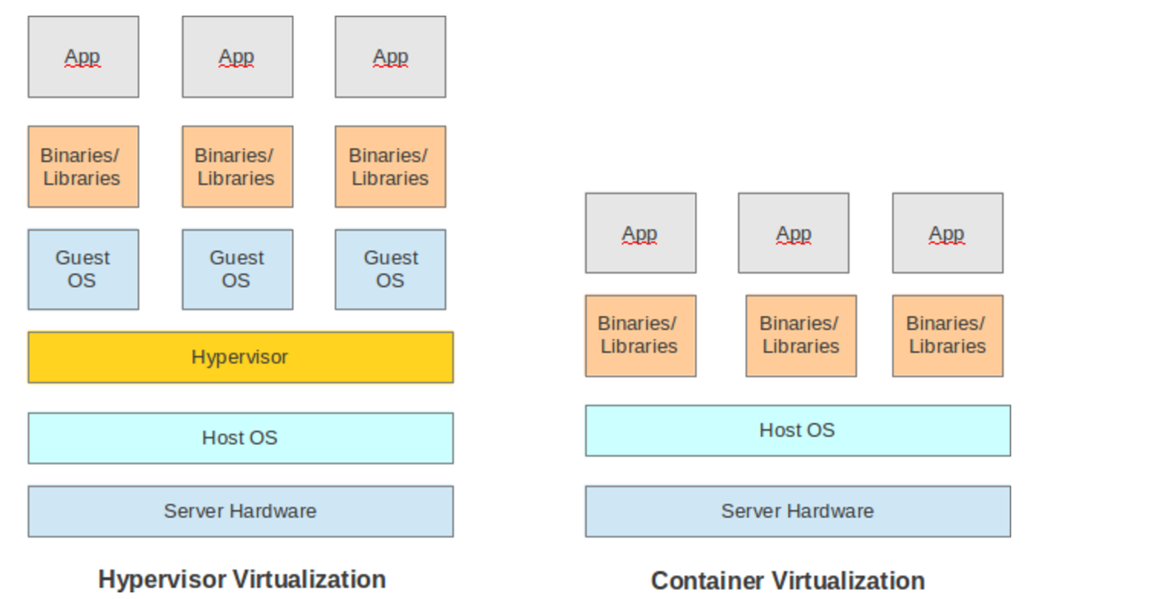
VM vs Container
Notes:
What are the implications?
Container and real OS share same kernel
So applications inside and outside the kernel must share the same ABI

Slide 26
Containers vs VMs (T/F)
You can run a Windows container on GNU/Linux.
False. Container shares the kernel with the host.
You can run a Debian container from Glorious Arch Linux.
True. As long as the container uses the same kernel

Slide 27
Containers vs VMs (T/F)
Running ps inside the container will show all processes running on the machine.
False. Container process namespaces is isolated from the host.

Slide 28
Why use containers at all?
Shares many (but not all) of the benefits of hardware virtualization with much lower overhead.
Can package a program / service into something that will run exactly the same on most any machine.
Can adjust / limit hardware container resources to system needs.
Can split a system up into microservices, then use a CNI (container networking interface) to let them connect to each other.

Slide 29
Why use containers at all?
Isolation
Container should not leak information inside and outside the container
Can isolate all of the configuration and software dependencies a particular application needs to run

Slide 30
Containers
Container system call path:
Application inside the container makes a system call
Trap to the host OS
It is then up to the kernel to consider resource namespacing

Slide 31
Containers
On GNU/Linux you are always in a container!
Linux starts in a container with no limits that can see everything
So if you think you’re getting a performance benefit by not using containers you’re wrong!

Slide 32
Containers
Virtualization in VMs
Containers
  Namespacing
  Cgroups
Where containers run
Cloud / k8s / Anubis

Slide 33
Namespacing
When you run a container, your container runtime creates a set of namespaces for that container
Provide a layer of isolation. Limits what you can see/affect/use
Implemented within the kernel
Multiple types of resource namespaces

Slide 34
Types of Namespaces
  pid
  net
  mnt
  uts
  ipc
  user

Slide 35
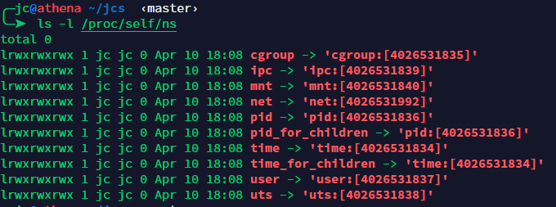
Namespacing
ls -l /proc/self/ns to see what namespaces you are in
Number is what pid namespace the current process is in

Slide 36
PID Namespacing
Processes within a PID namespace only see processes in the same PID namespace
Each PID namespace has its own numbering starting at 1
If PID 1 exits, the whole namespace is killed

Slide 37
PID Namespacing
Those namespaces can be nested
A process ends up having different PIDs depending on namespace

Slide 38
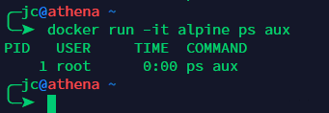
PID Namespacing
What happens when you run ps in a container?
Only the ps process visible
PIDs start at 1

Slide 39
Net Namespacing
Net namespace in practice
Typical use-case: use virtual ethernet (veth) pairs (two virtual interfaces acting as a cross-over cable)
  eth0 in container network namespace
  paired with vethXXX in host network namespace
  all the vethXXX are bridged together
But also: the magic of --net host shared localhost (and more!)

Slide 40
Net Namespacing
Let’s think about what this lets us do
Create a virtual interface with its own network
Use net namespace in multiple containers
You then have multiple docker containers that are connected to each other on a virtual network
This is where things get really powerful

Slide 41
Containers
Virtualization in VMs
Containers
  Namespacing
  Cgroups
Where containers run
Cloud / k8s / Anubis

Slide 42
Cgroups
Control Group
Implemented within the kernel
limits what resources you are allowed to use
cpu and memory cgroups very common with containers
It is up to your container engine to handle the cgroup

Slide 43
CPU Cgroups
CPU cgroup Keeps track of user/system
CPU time Keeps track of usage per CPU Allows to set weights
Because of variations in things like core clock speed, and instruction time execution, there is no 100% precise way to limit CPU

Slide 44
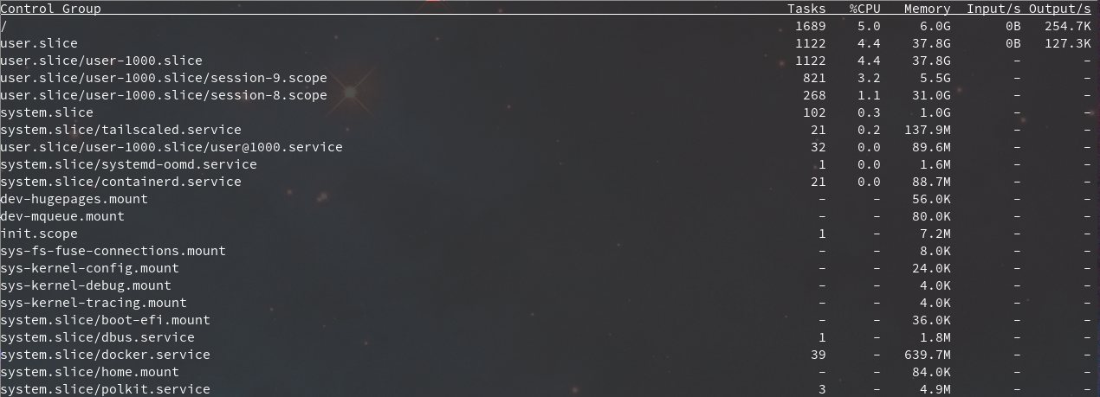
CPU Cgroups
Try systemd-cgtop to see cgroup usage!

Slide 45
There’s so much more!
Some stuff we’re not covering but is very cool
  Linuxkit
  Storage drivers
  Overlay networks
  Copy-on-Write!
  Container registries
  selinux + capabilities
  Rootless docker
  Build-kit
  Breaking security

Slide 46
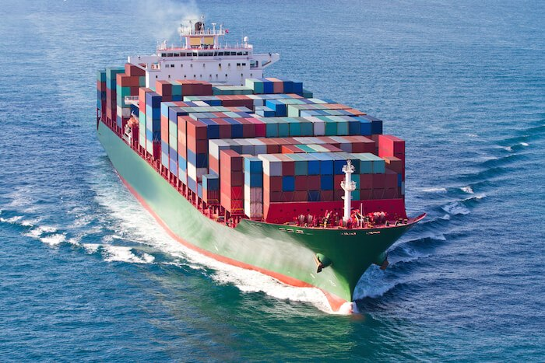
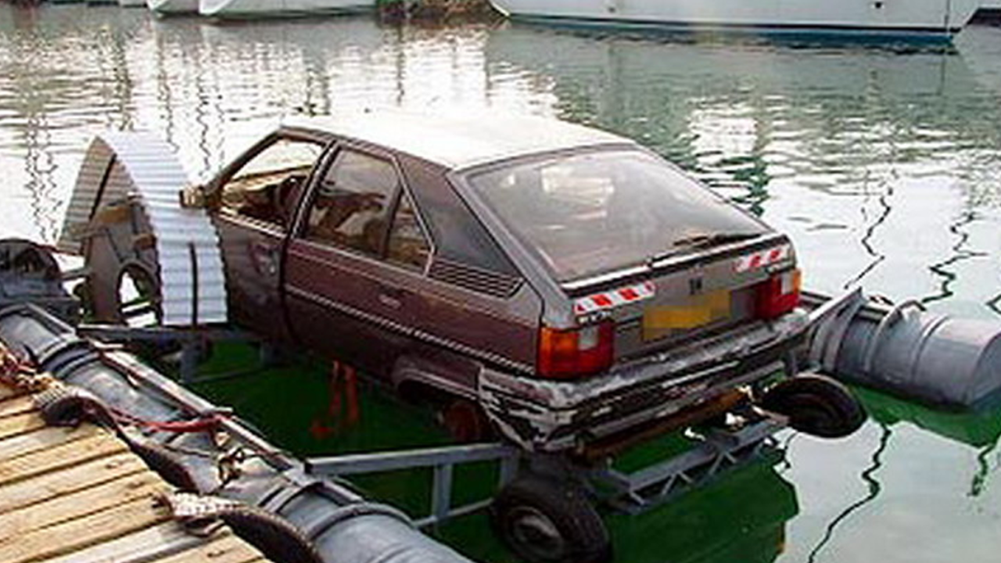
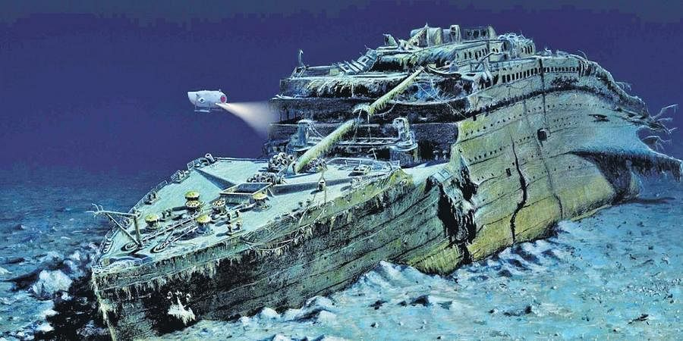
Docker on Linux
Docker on Mac
Docker on Windows

Slide 47
Containers
Virtualization in VMs
Containers
  Namespacing
  Cgroups
Where containers run
Cloud / k8s / Anubis

Slide 48
Where containers run
LXC (or linux containers) were initially released in 2008
Since then there have been many more engines / container runtimes that have come about
containerd, rkt, podman, etc…

Slide 49
Where containers run
They all revolve around Linux
There has since been windows containers added (but they are awful)

Slide 50
Where containers run
You may be asking how docker works on MacOS and Windows since it’s kernel is not GNU/Linux
It doesn’t
Docker for MacOS runs a linux virtual machine that then runs docker
The networking and volumes do not always work as expected

Slide 51
Where containers run
Some of you may have only used docker on MacOS or Windows and hate it
The things you hate are all from docker-desktop not from docker itself!
Docker runs like a dream on GNU/Linux
On GNU/Linux it has barely any overhead

Slide 52
Containers
Virtualization in VMs
Containers
  Namespacing
  Cgroups
Where containers run
Cloud / k8s / Anubis

Slide 53
The Cloud
With the resurgence of virtualization, it has become popular to talk about the cloud
This somewhat nebulous concept traces back to old network diagrams
Usually used a buzzword

Slide 54
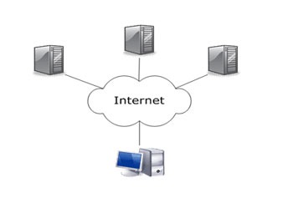
The Cloud

Slide 55
The Cloud
In modern usage, the cloud refers to a large number of physical servers that rent out virtual machines for various services
Clients get access to a full virtual machine
Billing usually works according to how and what resources you use

Slide 56
The Cloud
Importantly, creating and destroying virtual servers can be accomplished without human interaction
This ability to flexibly acquire computing resources can allow services to scale in response to changes on demand

Slide 57
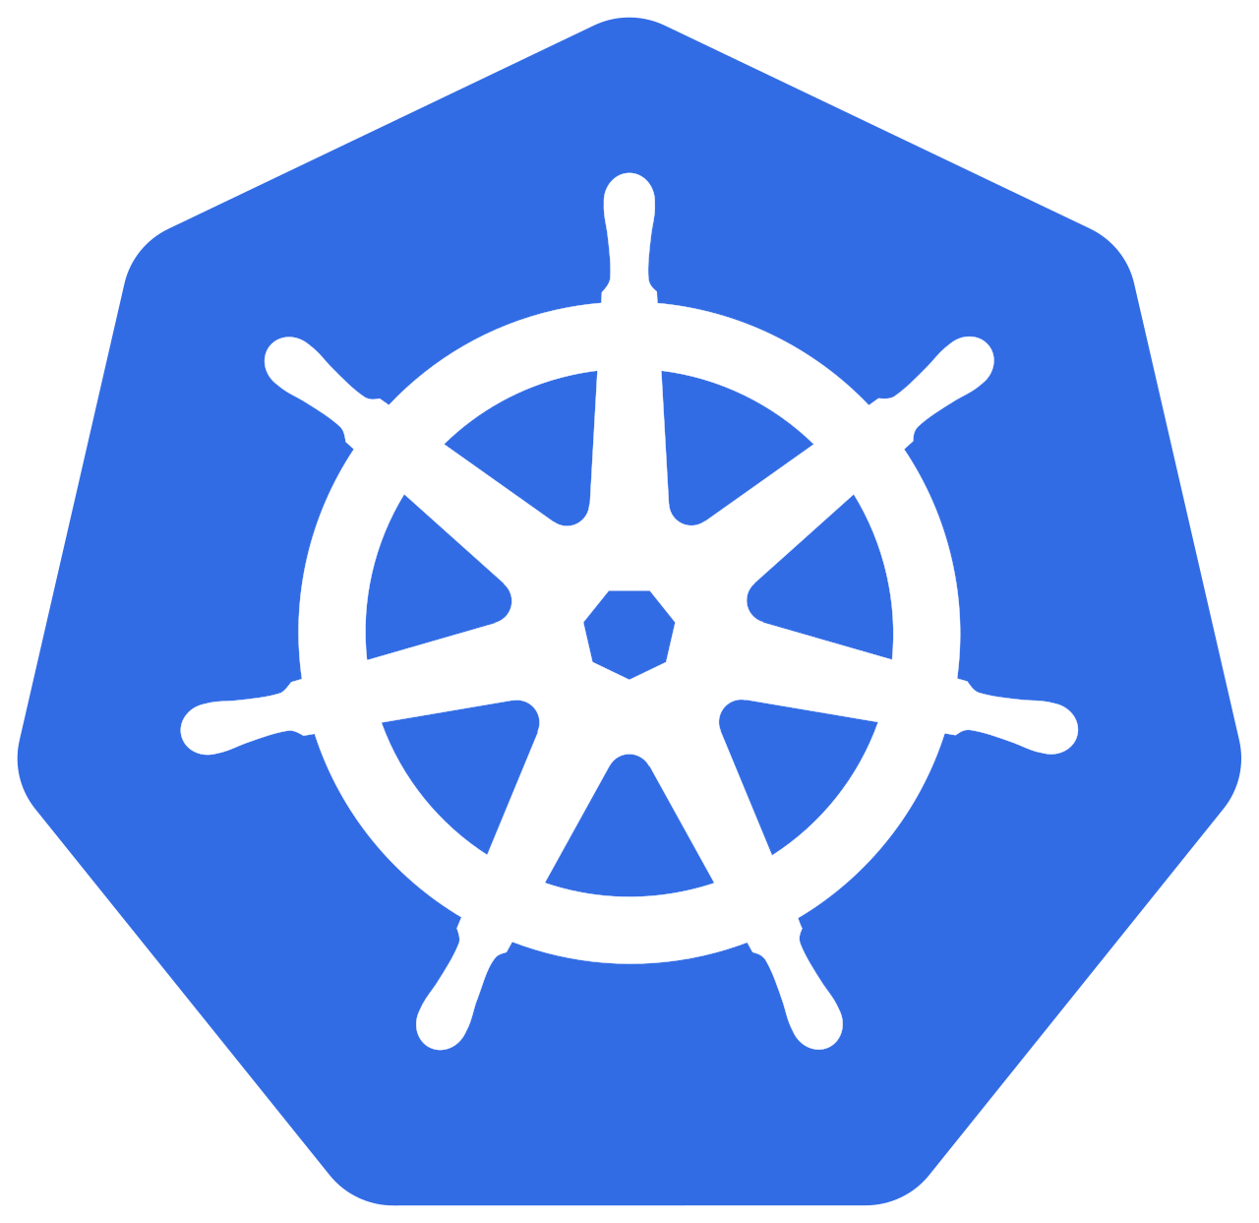
Kubernetes
Anubis runs on a container orchestration tool called Kubernetes or k8s (the 8 is for the number of letters in between k and s)
Kube allows for things like CNI (container networking interfaces) and CSI (container storage interface) to be extended to many, many machines connected on a network
This lets us design and easily implement large systems that rely on many many individual containers communicating at once

Slide 58
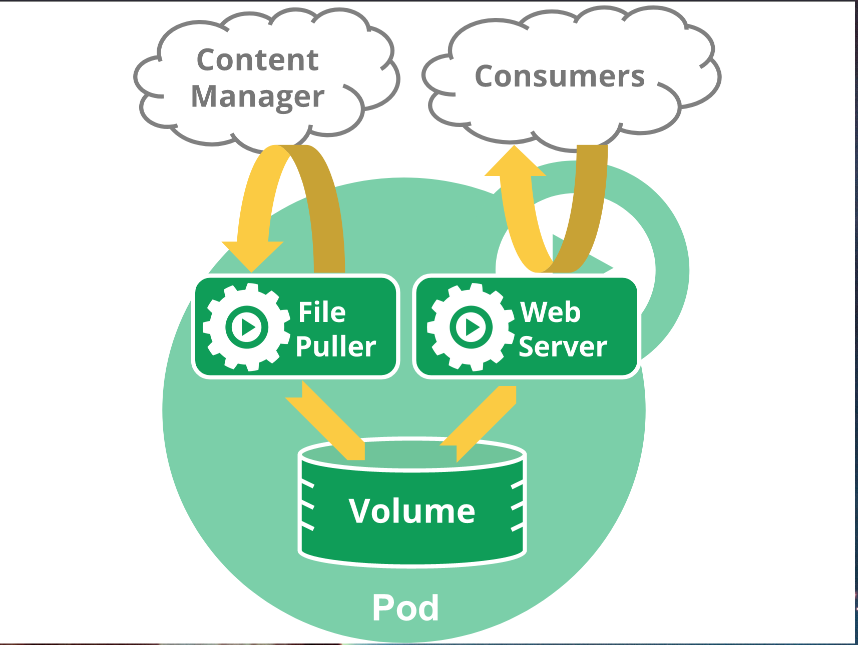
Kubernetes Pod
A single unit of work in kubernetes
Pods contain containers, volumes, config-maps, secrets, …
Designed to be easy to share resources between containers in a pod

Slide 59
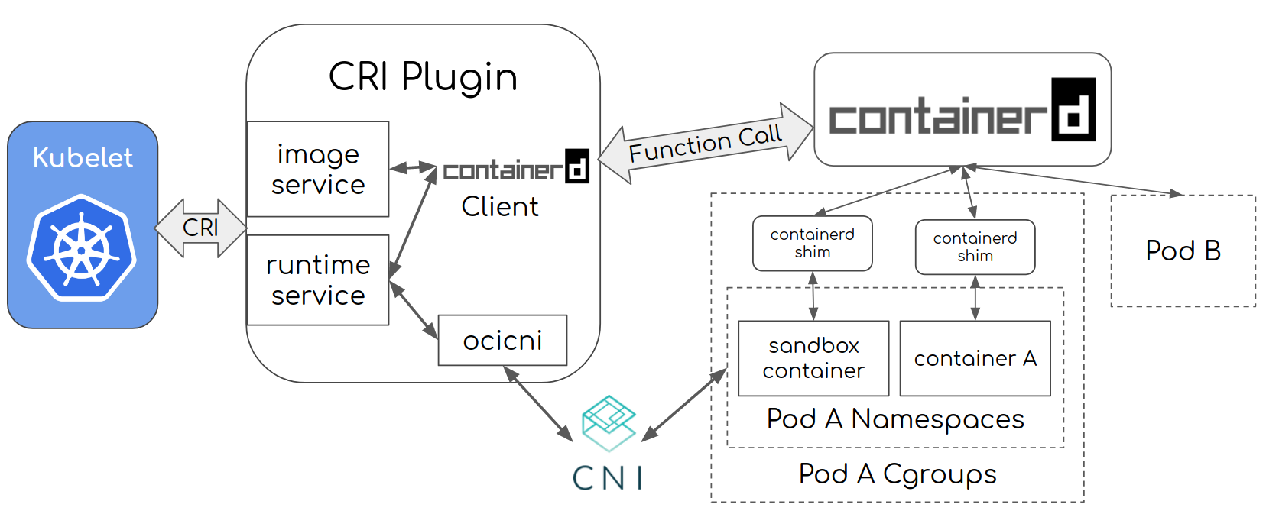
Kubernetes Pod
Containerd
Container Resource Interface Plugin
Containerd Creates Pod Containers
Primary K8S Node Agent

Slide 60

Anubis
Anubis is a large system split up into microservices
  Example: the web static (html and js) is separate from the python api
There can be many containers within those microservices

Slide 61
Anubis
There may be up to 1000+ containers running at any one time
(2022-05-01) there were ~535 IDEs that were opened over the day

Slide 62
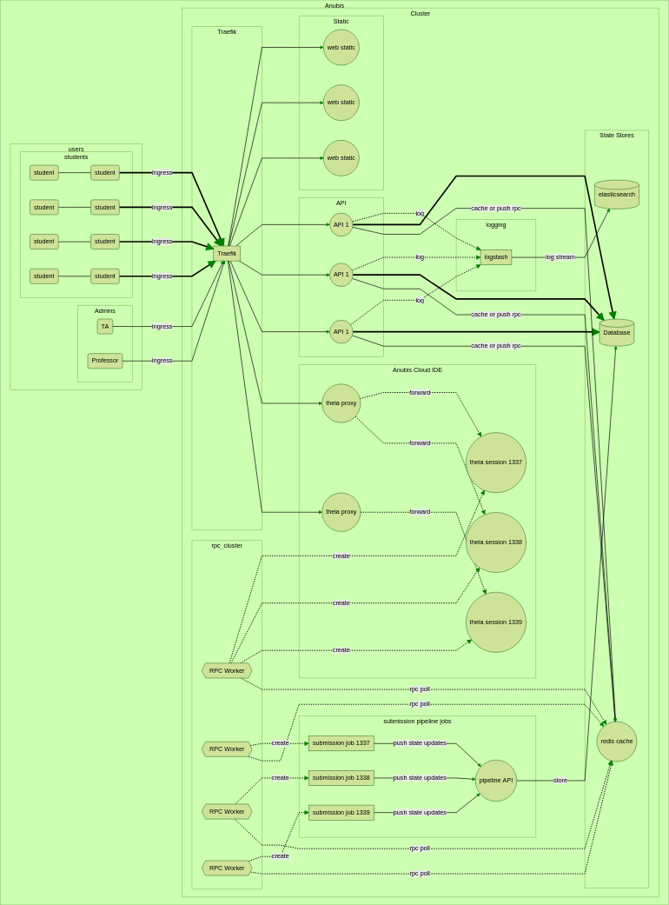
Anubis

Slide 63
Anubis IDEs
Anubis Cloud IDEs are made up of individual containers
Each student gets their own IDE pod (and therefore separate environment/filesystem)
The IDEs have CPU and Memory limits handled by cgroups

Slide 64
Anubis IDEs
Each Anubis Cloud IDE is itself made up of 3+ containers
  An “init container” that clones your repo
  IDE server
  Autosave “sidecar”
The containers work together to make the Cloud IDEs possible

Slide 65
Anubis IDEs
Init Container
clones the git repo (has the
fixes any permission issues
Home Volume
/home/anubis
mounted over the nfs
mounted in each container
Theia IDE Server Sidecar
Container Container
Runs webserver you connect to Handles autosave
When you open a shell it
opens here
Shared localhost

Slide 66
Anubis IDEs
The containers work together to make the Cloud IDEs possible
It is all about breaking up responsibilities

Slide 67
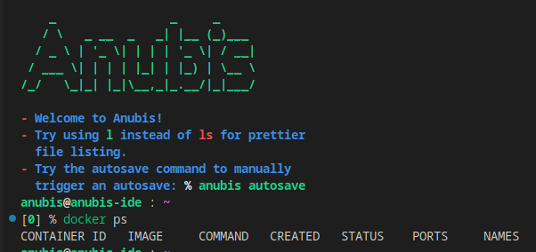
Anubis IDEs
Recently I have added a dockerd sidecar container
This means docker in IDEs!

Slide 68
Containers
DEMO Up to you!
Create raw container from command line
Take a look at container security in Anubis

Slide 69
Containers
DEMO
From Jérôme Petazzoni: https://www.youtube.com/watch?v=sK5i-N34im8

Slide 70
Future Readings
Container Security by Liz Rice
  github/lizrice
Basically everything by Jess Frazelle
  github/jessfraz
Presentations by Jérôme Petazzoni
  github/jpetazzo

Slide 71
Code to Read (All in Go)
runC - OCI container spawning tool
  github/opencontainers/runc
containerd - container runtime
  github/containerd/containerd
kubernetes
  github/kubernetes/kubernetes

