Slide 1
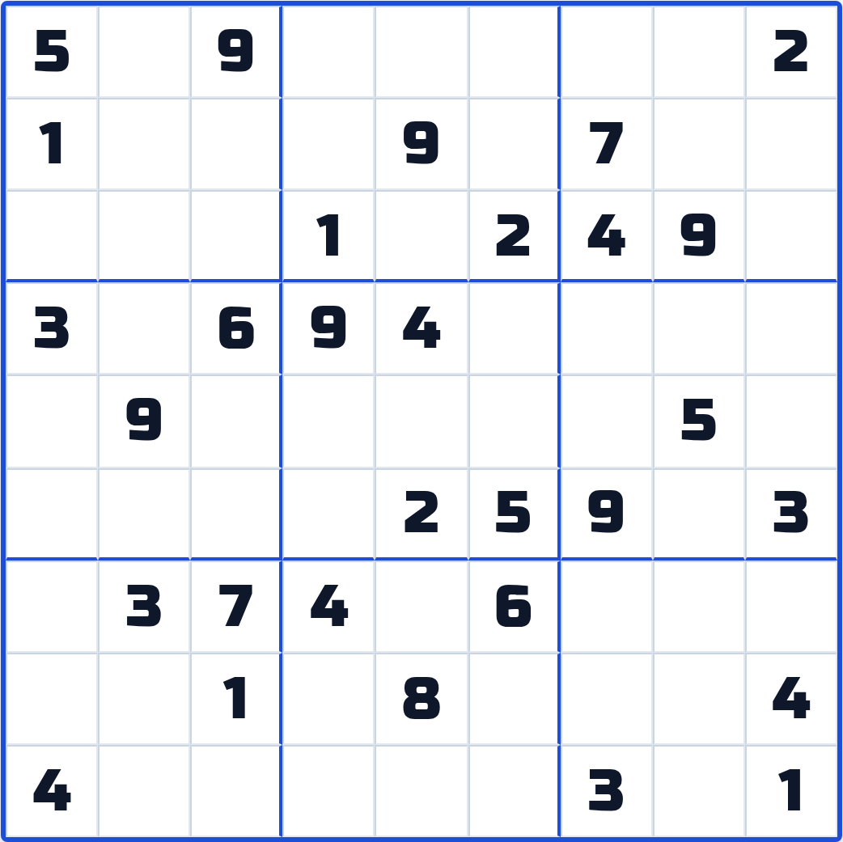
Sudoku Generator
&
Solver
A Python logic engine that runs fully in the browser
Anubothu Aravind
Reg. No. 2601050069, M.Tech CSE
26CS5101E - Computational Thinking and Programming (CTP), Sec 1
Faculty: Raju Anitha madam
Notes:
Good morning madam. My assigned topic is the Sudoku Generator and Solver. I built it as a web app where the whole engine is written in Python and runs inside the browser.

Slide 2
Problem Statement
Sudoku is a constraint-based puzzle that requires filling a 9×9 grid so that every row, column, and 3×3 subgrid contains the digits 1–9 exactly once. Developing a reliable system that can both generate puzzles with a guaranteed unique solution at different difficulty levels and solve arbitrary valid Sudoku puzzles is challenging because of the large search space and the need to maintain puzzle validity.
This project aims to develop a Sudoku Generator and Solver that creates valid Sudoku puzzles with a unique solution across different difficulty levels and efficiently solves any given valid puzzle. The system will use backtracking with branch-and-bound pruning to reduce unnecessary search and improve solving efficiency. It will follow Object-Oriented Programming (OOP) principles to provide a modular, reusable, and maintainable architecture. The correctness, uniqueness, and reliability of the generator and solver will be validated using Pytest and property-based testing, covering a wide range of automatically generated test cases and edge conditions.
Notes:
Read the statement once, then point at the four boxes. Everything in the talk maps to one of these four: generate, solve, design, validate.

Slide 3

Why Is Sudoku Hard?
BRUTE FORCE: I WILL JUST TRY EVERY FILLING
NP-complete: checking a finished answer is quick, but no fast method is known for finding one.
Analogy: a jigsaw puzzle. One glance tells you it is complete, yet completing it takes hours.
The numbers: there are 6.67 × 10²¹ valid Sudoku grids. That is roughly 900 times the grains of sand on Earth.
So: the solver must be clever about what it does not try.
9⁵⁵ TRIES LATER: THE UNIVERSE HAS ENDED
Notes:
Give the simple definition, then the sand comparison. The meme makes the point that trying everything is not an option.

Slide 4
Project Goals and Key Contributions
Goals
Generate
Top-down carving, symmetric clues
Generate puzzles with exactly one solution, in five difficulty levels.
Solve any valid puzzle in milliseconds.
Let the user watch the solver think, step by step.
Prove correctness with automated tests.
Run everything in the browser, with no server.
Solve
CSP solver, plus GHB for comparison
Explain
Watch Solver replay and hints
Test
Pytest, Hypothesis, DLX cross-check
Deploy
GitHub Actions to GitHub Pages
Notes:
Left side is what I set out to do. Right side is the path a puzzle takes through my project, and what I built at each stage.

Slide 5
Tech Stack
Layer | Technology | Think of it as a restaurant
Frontend | React.js | The dining hall: everything the customer sees and touches.
Backend | Python (Pyodide) | The chef: does the real work of solving and generating.
Database | IndexedDB | The notebook: remembers your progress on your own device.
Threading | Web Worker | A separate kitchen, so the dining hall never gets blocked.
Deploy | GitHub Actions + Pages | The delivery van: ships every new version automatically.
The twist: this restaurant has no building. The kitchen is inside your browser tab.
Notes:
Use the restaurant picture. The only unusual thing is that the kitchen, which is Python, sits inside the customer's own browser.

Slide 6

What is Pyodide?
Pyodide: the real Python interpreter (CPython) compiled to WebAssembly.
WebAssembly (WASM): a compact binary format that browsers run at close to native speed.
Analogy: a translator who lives inside the browser, so the browser can understand Python.
Trade-off: the first load is heavier, so I load it in a Web Worker.
WHERE IS YOUR BACKEND SERVER?
ME: IT IS ALREADY RUNNING IN YOUR BROWSER TAB
Notes:
Pyodide is the full Python interpreter compiled to WebAssembly. That is how Python can be my backend without any backend machine. Be honest about the trade-off: the first load is heavier.

Slide 7
System Architecture
React UI (main thread)
IndexedDB
1. The user asks for a puzzle, a hint or a solve.
2. React posts a message to the Web Worker.
3. The worker calls the Python function through Pyodide.
4. Python returns the result with a trace of every step.
5. React replays the trace on the board and saves progress.
postMessage
Web Worker
Pyodide runtime (WASM)
The worker is what keeps the screen from freezing during a long search.
Python core
solver, generator, grader
Notes:
Walk down the diagram. React never talks to Python directly. Everything goes through the worker, which is why the board stays responsive even when the slow solver is running.

Slide 8
Object-Oriented Design
Encapsulation: the board hides its bitmasks. Other code only asks which digits fit in a cell.
Abstraction: every solver offers the same two actions: solve, and count solutions.
Polymorphism: CSP and GHB are interchangeable, so the app switches between them with one tab.
Modularity: solver, generator and grader are separate modules, each tested on its own.
Board
Generator
Solver (interface)
Grader
CSP solver
GHB solver
Analogy: you drive any car with the same steering wheel and pedals, whatever engine is inside.
Notes:
The problem statement asks for OOP. Each responsibility is its own class. The important one is the common solver interface, because it lets the UI swap CSP and GHB with one tab.

Slide 9
Backtracking with Branch and Bound
Backtracking: make a choice and move on. If you get stuck, undo the last choice and try the next one.
Branch: each digit that can go into a cell is one branch of the search tree.
Bound (pruning): cut a branch as soon as it clearly cannot lead to a solution.
Analogy: a maze. A dead end sends you back to the last junction. A "No Exit" board saves you from entering at all.
Empty cell
try 3
try 6
try 8
never needed
A neighbour has 0 digits left: cut here
Solved
In my solver the bound is simple: if any cell has zero candidates, stop and go back.
Notes:
This is the method named in the problem statement. Backtracking is try, fail, undo. Branch and bound adds one idea: cut a branch the moment you can prove it is useless.

Slide 10
Sudoku as a CSP
CSP (Constraint Satisfaction Problem): give every variable a value so that no rule is broken.
Variables: the 81 cells.
Domains: the digits 1 to 9 that a cell may take.
Constraints: no digit repeats in any row, column or 3×3 box.
Analogy: an exam seating plan. Students are variables, seats are values, and "no two friends side by side" is a constraint.
81
variables
9
values in each domain
27
all-different constraints (9 rows + 9 columns + 9 boxes)
Notes:
CSP stands for Constraint Satisfaction Problem. Once Sudoku is written this way, standard AI search techniques apply directly.

Slide 11
Bitmask State Representation
Bitmask: one small number whose binary digits work as yes/no flags.
Analogy: nine light switches for each cell. Switch 7 ON means 7 is still possible there.
Placing a digit turns that switch OFF for every cell in the same row, column and box.
Why: checking a digit becomes one AND operation instead of searching a list.
Cell R1C2 can hold 4, 6, 7 or 8
9
8
7
6
5
4
3
2
1
0
1
1
1
0
1
0
0
0
011101000 in binary = 232
Four switches ON, so four candidates.
Notes:
Keep this simple: nine switches per cell. The example is a real cell from the Medium puzzle in my screenshots.

Slide 12
MRV Heuristic
MRV (Minimum Remaining Values): always work on the empty cell that has the fewest candidates.
Analogy: in an exam, first answer the question where only two options are left.
Why it helps: a wrong guess is found sooner, and the saving multiplies at every level of the tree.
Row order starts at R1C2
MRV starts at R3C3
R1C2
R3C3
4
6
7
8
3
8
4 branches
2 branches
Notes:
MRV means Minimum Remaining Values. On this same Medium board, row order would start with a four-way guess. MRV starts with a two-way guess.

Slide 13
Sole Candidate
Level 1, row 5
Sole candidate: a cell where only one digit is still possible. It is also called a naked single.
Analogy: one empty chair left in the room, so the last person has no choice.
Chain reaction: placing it removes that digit from its neighbours, which often creates the next sole candidate.
9
4
5
6
3
1
8
7
Row 5 already has 1, 3, 4, 5, 6, 7, 8
Column 1 already has 2, 4, 5, 7
Only 9 is left for R5C1
Notes:
A sole candidate is a cell with only one possible digit. This example is Level 1 of my campaign, row 5. The row and the column together remove eight digits.

Slide 14
Hidden Singles
Hidden single: a digit that fits in only one cell of a row, column or box.
Analogy: only one person on the team holds the key, so that person must open the door, whatever else they could do.
Here: R7C5 can be 1 or 5, but no other cell in row 7 can take a 1.
Medium puzzle, row 7
2 8 9
3
7
4
1
6
2 5 8
2 8
5 8 9
Small digits are the candidates of empty cells.
1 appears in none of them, so it must go in R7C5.
Notes:
A hidden single is harder to see. The cell itself has two candidates, but one of those digits has no other place in the row. Again this is from my own Medium board.

Slide 15

GHB Baseline
GHB: Greedy Heuristic + Backtracking.
Greedy: take the next empty cell and the first digit that fits, without looking ahead.
Baseline: the simple method that a better method is measured against.
Analogy: trying every key on a bunch, one by one, without reading the labels.
GHB AFTER 180,011 WRONG TURNS:
MAYBE THE NEXT KEY IS THE ONE
Notes:
GHB is my deliberately simple solver. I kept it so there is something honest to compare against. On the Hard puzzle it needs about a full second.

Slide 16
CSP vs GHB Benchmark
Puzzle | CSP nodes | GHB nodes | Faster
Easy | 1 | 1,530 | 6.3×
Hard | 3 | 180,011 | 92.3×
AI Escargot | 39 | 80,491 | 9.6×
Node: one cell-and-digit attempt made by the solver.
Analogy: if the CSP search were a 1 minute walk, the GHB search on Hard would take about 41 days.
Speed: a typical puzzle solves in 1.8 ms. A minimal 17-clue puzzle takes 14 ms.
Notes:
These are measured numbers from the project. The axis is logarithmic because the Hard puzzle would flatten everything else. On Easy the CSP solver makes zero guesses.

Slide 17
DLX (Dancing Links Algorithm X)
Exact cover: from a list of options, choose some so that every item is covered exactly once.
Analogy: a duty roster. Every shift must go to exactly one person, with no gaps and no clashes.
Algorithm X (Knuth): pick an uncovered item, try each option that covers it, remove the options that now clash, and repeat. It is backtracking on a table.
 | A | B | C | D
Option 1 | 1 | 1
Option 2 |  |  | 1 | 1
Option 3 |  | 1 | 1
Option 4 | 1
Options 1 and 2 together cover A, B, C and D exactly once. Option 3 would clash with both.
Notes:
Before Dancing Links, explain the problem it solves. Exact cover: choose options so every item is covered exactly once. The small table is a toy example.

Slide 18
DLX (Dancing Links Algorithm X)
Sudoku as exact cover: an option is one digit placed in one cell. An item is one rule that must hold once.
DLX (Dancing Links): the table is stored as doubly linked lists, so a node can be unlinked and linked back instantly.
Analogy: a dancer steps out of the line and later steps back into the same gap, because the neighbours kept the place.
729 × 324
9 × 9 × 9 options, and 4 rules × 81 items (cell filled, row has digit, column has digit, box has digit)
# step out
x.left.right = x.right
x.right.left = x.left
# step back in
x.left.right = x
x.right.left = x
Notes:
Now the Sudoku mapping and the trick behind the name. A removed node still remembers its neighbours, so undoing a choice costs two assignments.

Slide 19
DLX for Uniqueness Checking
Generated puzzle
Role: DLX is my reference solver. It shares no code with the CSP solver.
Rule: a puzzle is accepted only when both solvers count exactly one solution.
Analogy: two examiners mark the same paper separately. If the marks match, we trust the result.
Result: 200 puzzles in a row, all valid and unique, in 10.1 s.
Count solutions, stop at 2
0
invalid
1
unique
2
ambiguous
Notes:
Why a second solver? DLX works in a completely different way from my CSP solver, so it acts as an independent referee. A puzzle passes only if both agree there is exactly one solution.

Slide 20
Why Top-Down, Not Bottom-Up
Bottom-up: start with an empty grid, add clues, and hope the puzzle turns out solvable. It usually does not.
Top-down: start with a complete solved board and remove clues one step at a time.
Analogy: a sculptor starts with a full block and chips stone away. Nobody builds a statue by throwing pebbles together.
Full solved board (81 digits)
Remove clues, check after each removal
Puzzle with exactly one solution
A solution exists from the very first step.
Notes:
Bottom-up means placing clues on an empty grid and hoping it works. Top-down starts from a finished valid board, so a solution always exists and I only check uniqueness.

Slide 21
Phase 1 Build a Full Solved Board
5
3
4
6
7
8
9
1
2
1. Start with an empty 9×9 grid.
2. Go to the next empty cell and try the digits in a shuffled order.
3. If no digit fits, backtrack to the previous cell.
4. When all 81 cells are filled, the board is ready.
6
7
2
1
9
5
3
4
8
1
9
8
3
4
2
5
6
7
8
5
9
7
6
1
4
2
3
4
2
6
8
5
3
7
9
1
7
1
3
9
2
4
8
5
6
9
6
1
5
3
7
2
8
4
Analogy: shuffling cards before a deal. Same rules, a different game every time.
Seed: the same seed always gives the same board, so results can be repeated.
2
8
7
4
1
9
6
3
5
3
4
5
2
8
6
1
7
9
A complete valid board: the answer key
Notes:
Phase 1 gives me a random but valid solved board. The shuffle is what makes every puzzle different. The seed is what makes it repeatable for tests.

Slide 22
Phase 2 Pair Cells by Symmetry
180° rotational symmetry: turn the board upside down and the pattern of clues looks the same.
Rule: cell (r, c) is paired with cell (8 - r, 8 - c).
Maths: 81 cells minus the centre leaves 80, so there are 40 pairs.
Analogy: fold a paper, cut once, and both halves match.
Then: the 40 pairs are shuffled to decide the removal order.
A
A
(2, 1) pairs with (6, 7)
Notes:
Phase 2 decides which cells are removed together. Cells are removed in mirrored pairs, which is why the finished puzzles look balanced like newspaper Sudoku.

Slide 23
Phase 3 Carve Out the Clues
1. Take the next mirrored pair and remember its two digits.
2. Erase both cells.
3. Count the solutions, but stop counting at 2.
4. If the count is not exactly 1, put both digits back.
5. Stop when the clue target for the level is reached.
Measured: 0.08 to 0.35 s per puzzle.
for a, b in shuffled_pairs:
if clues <= target:
break
saved = board[a], board[b]
board[a] = board[b] = 0
n = count_solutions(board, limit=2)
if n != 1:
board[a], board[b] = saved
Analogy: to learn whether a lock opens with more than one key, you can stop at the second key that works.
Notes:
This is the heart of the generator. Remove a pair, check whether the puzzle is still unique, and put the pair back if it is not. Stopping the count at 2 is what makes it fast.

Slide 24
Phase 4 Grade the Difficulty
The finished puzzle is solved once more, and the solver's trace is scored.
Tier | What the solver needs
Beginner | Sole candidates, many clues
Easy | Sole candidates, fewer clues
Medium | Hidden singles, still no guessing
Hard | First guesses and backtracks
Expert | Deeper search, fewest clues
How many cells are empty
How many steps needed a hidden single
How many guesses and backtracks were needed
score = w1 * empty + w2 * hidden
+ w3 * guesses
Analogy: an exam paper is rated hard by the toughest steps needed, not by how long it is.
From my benchmarks: Medium needed 0 backtracks, Hard needed 2.
Notes:
The puzzle is graded by solving it again and looking at what the solver had to do. My benchmarks agree with the tiers: Medium needed no guesses, Hard needed two backtracks.

Slide 25
Testing
Browser tests (Playwright)
Idea: test the small pieces first and the whole app last.
Analogy: inspecting a building. First the bricks, then the walls, then the whole house.
Bottom: 95 Pytest tests cover at least 95% of the Python code.
Middle: the soak test generates 200 puzzles in 10.1 s, all unique.
Top: a real browser plays the app, and checks that Python in the browser gives the same answers as normal Python.
Frontend tests (Vitest, 16)
Soak test: 200 puzzles
Property-based tests (Hypothesis)
Pytest unit tests + DLX cross-check (95)
Notes:
Tests are stacked like a pyramid. Many small fast tests at the bottom, a few slow full-app tests at the top. The bottom layer is the one the problem statement asks for.

Slide 26
Pytest and Property-Based Testing
Pytest: a Python testing tool. I give an input and the answer I expect.
Property-based testing: I state a rule that must always hold. The Hypothesis library then tries hundreds of random inputs to break it.
Maths analogy: an example test checks that 2 + 3 = 3 + 2. A property test checks that a + b = b + a for every a and b it can think of.
Property | Rule that must always hold
Round trip | parse(serialize(G)) = G
Determinism | Same seed gives the same puzzle
Soundness | Solution is valid and keeps every clue
Uniqueness | count_solutions(P, limit=2) = 1
Contradiction | A wrong digit gives no solution
Notes:
An example test checks one case I thought of. A property test states a rule and lets the library attack it with hundreds of random cases. Uniqueness is the property that matters most.

Slide 27

Deploy : What is CI/CD?
CI (Continuous Integration): every time I push code, it is built and tested automatically.
CD (Continuous Deployment): if all tests pass, the new version is published automatically.
Analogy: a factory line with a quality check. A packet leaves the gate only after it passes inspection.
Tool: GitHub Actions runs the line. GitHub Pages hosts the site.
DEVELOPER: BUT IT WORKS ON MY MACHINE
CI PIPELINE: LET ME CHECK THAT ON MINE
Notes:
CI means every push is built and tested automatically. CD means that if the tests pass, the new version goes live automatically. Nobody uploads files by hand.

Slide 28
My GitHub Actions Workflow
Workflow: a YAML file in the repository that tells GitHub what to do.
Trigger: every push to main or master, or a manual run.
Runner: a fresh Ubuntu machine that GitHub lends for each run.
Permissions: read the code, write to Pages, and an id-token to sign the deploy.
Concurrency: one deploy at a time. A running deploy is never cancelled halfway.
git push to main
Job 1: Build & Test
Job 2: Deploy to GitHub Pages
No manual upload at any point.
Notes:
This is the overview of my workflow file. Two jobs. Deploy only runs if build and test pass.

Slide 29
Pipeline
Job 1: Build & Test
Job 2: Deploy
1. Check out the repository
2. Set up Python 3.12
3. Install the Python core (pip install -e .)
4. Set up Node.js 22 with npm cache
5. Install frontend dependencies (npm ci)
6. Package Python core for Pyodide
7. Run linter and unit tests
8. Build the frontend for production
9. Upload the dist folder as an artifact
Publish the artifact to GitHub Pages
npm ci: a clean install that follows the lock file exactly.
Lint: reads the code for mistakes and bad style without running it.
Artifact: the built website, zipped and handed to the next job.
needs: build means Deploy waits for Job 1, so a failed test blocks the release.
Notes:
These are the exact steps from my workflow file. Step 6 is the unusual one: it packages the Python core so Pyodide can load it. If lint or tests fail in step 7, nothing is deployed.

Slide 30
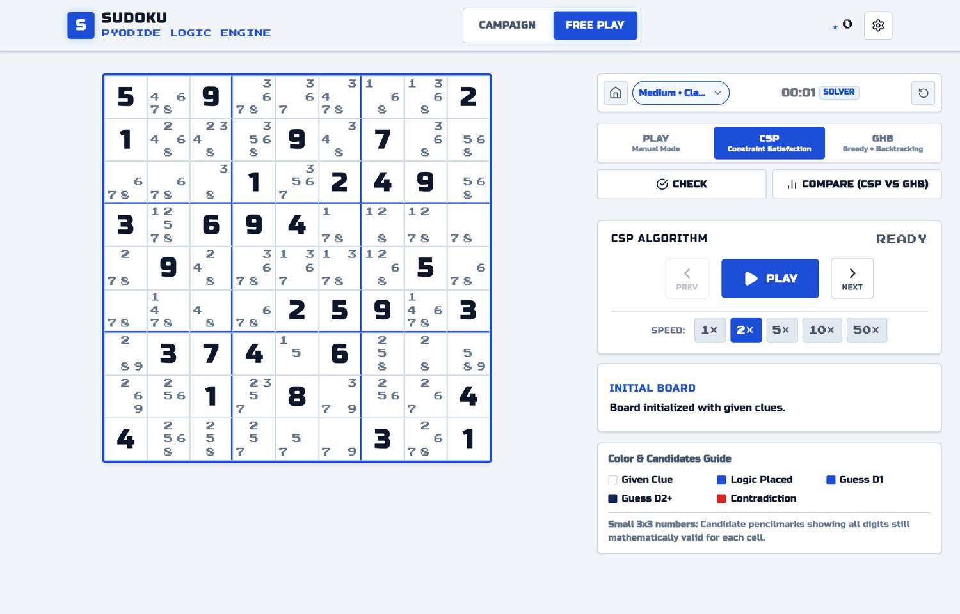
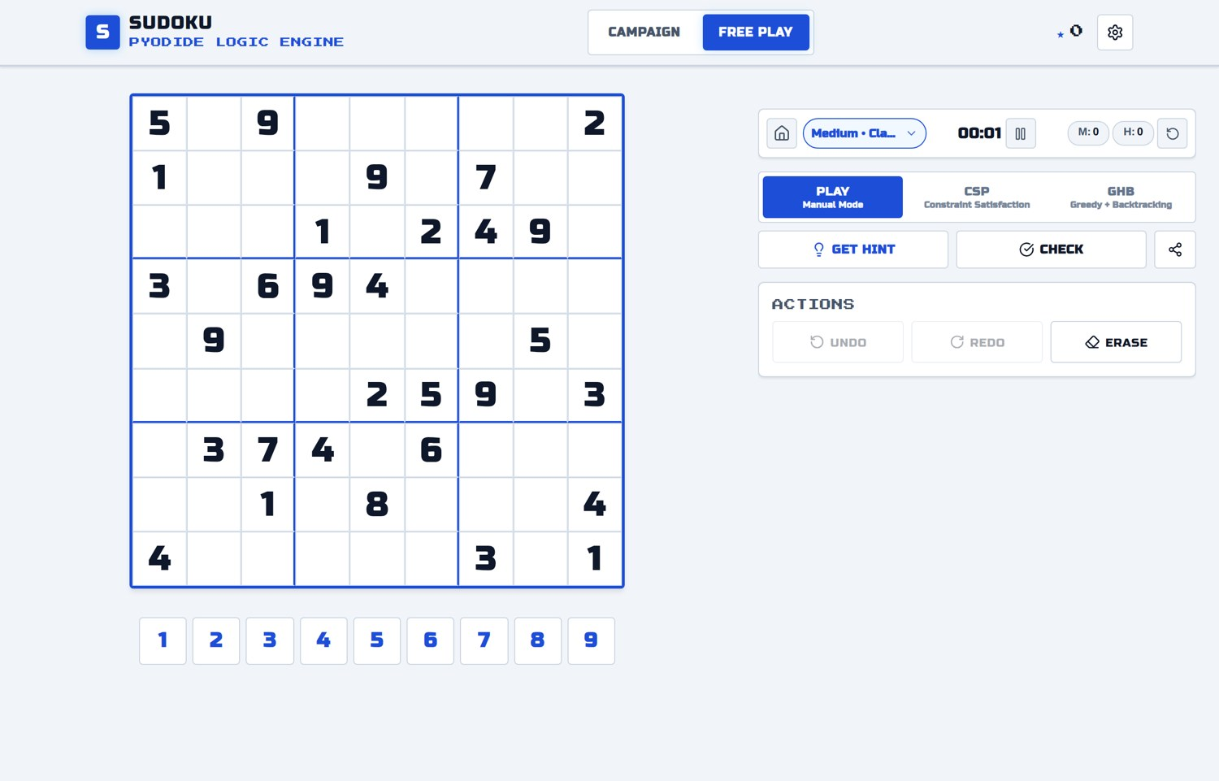
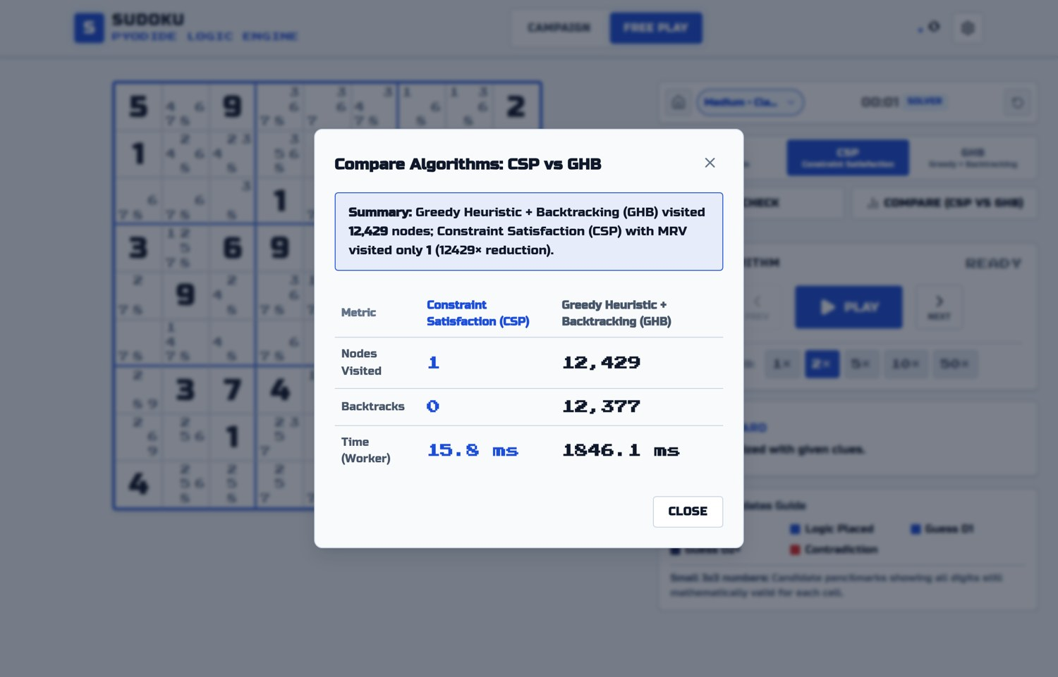
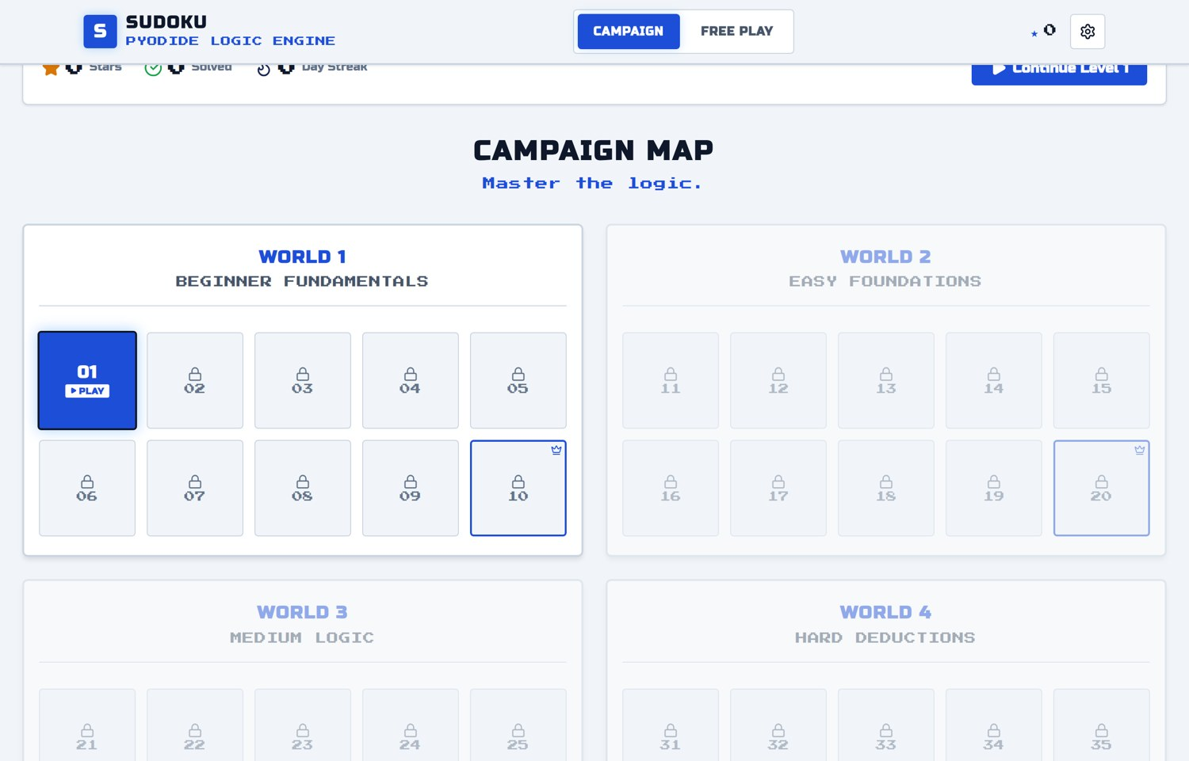
App Screenshots
Watch Solver (top left)
Step through the CSP solver with live candidates.
Free Play (top right)
Pick a difficulty, play, ask for hints.
Compare (bottom left)
CSP against GHB on the same puzzle.
Campaign (bottom right)
Worlds of levels that unlock in order.
Notes:
Quick tour of the deployed app. If there is time, open the live link here and run the Watch Solver on a Medium puzzle.

Slide 31
Conclusion and Future Scope
What the project shows
Future scope
Backtracking with pruning cut the search by up to 60,000 times against the plain version.
Top-down carving gives unique, symmetric puzzles in under 0.35 s.
OOP design let two solvers share one interface.
95 Pytest and property tests back every claim.
More human techniques in hints: naked pairs, X-Wing.
Larger boards such as 16×16.
Installable offline version (PWA).
Notes:
Close with the results against the four parts of the problem statement, then what I would add next.

Slide 32
Thank you
Questions are welcome.
Live demo
anubothu-aravind.github.io/pyodide-sudoku
Notes:
Thank madam and the class, then open the live demo.

