Slide 1
Secure Data Hiding in Image Using Steganography
CAPSTONE PROJECT
Presented By: Anu B Prashanth
Student Name : Anu B Prashanth
College Name : Sri Siddhartha Institute Of Technology
Department : Artificial Intelligence and Machine Learning

Slide 2
OUTLINE
Problem Statement
Technology used
Wow factor
End users
Result
Conclusion
Git-hub Link
Future scope

Slide 3
Problem Statement
The need for secure communication has increased due to cyber threats. Traditional encryption makes data transmission detectable, raising security concerns. This project utilizes steganography to embed secret data within images using the Least Significant Bit (LSB) technique, ensuring undetectability while maintaining image quality. To enhance security, encryption is applied before embedding, making unauthorized extraction difficult.

Slide 4
Technology used
Programming Language: Python
Libraries: OpenCV, NumPy, Pillow
Steganography Techniques: Least Significant Bit (LSB)
Encryption Algorithm: AES (Advanced Encryption Standard)

Slide 5
Wow factors
Dual-layer security: Combines encryption with steganography for enhanced protection.
Minimal distortion: Ensures hidden data is undetectable to the human eye.
User-friendly GUI: Allows users to hide and extract data easily.
Robust detection resistance: Difficult to detect or extract without the encryption key.

Slide 6
End users
Government & Defense Organizations for secure message transmission.
Corporate Sectors for protecting confidential data.
Journalists & Whistleblowers for safe information sharing.
Individuals seeking secure personal communication.

Slide 7
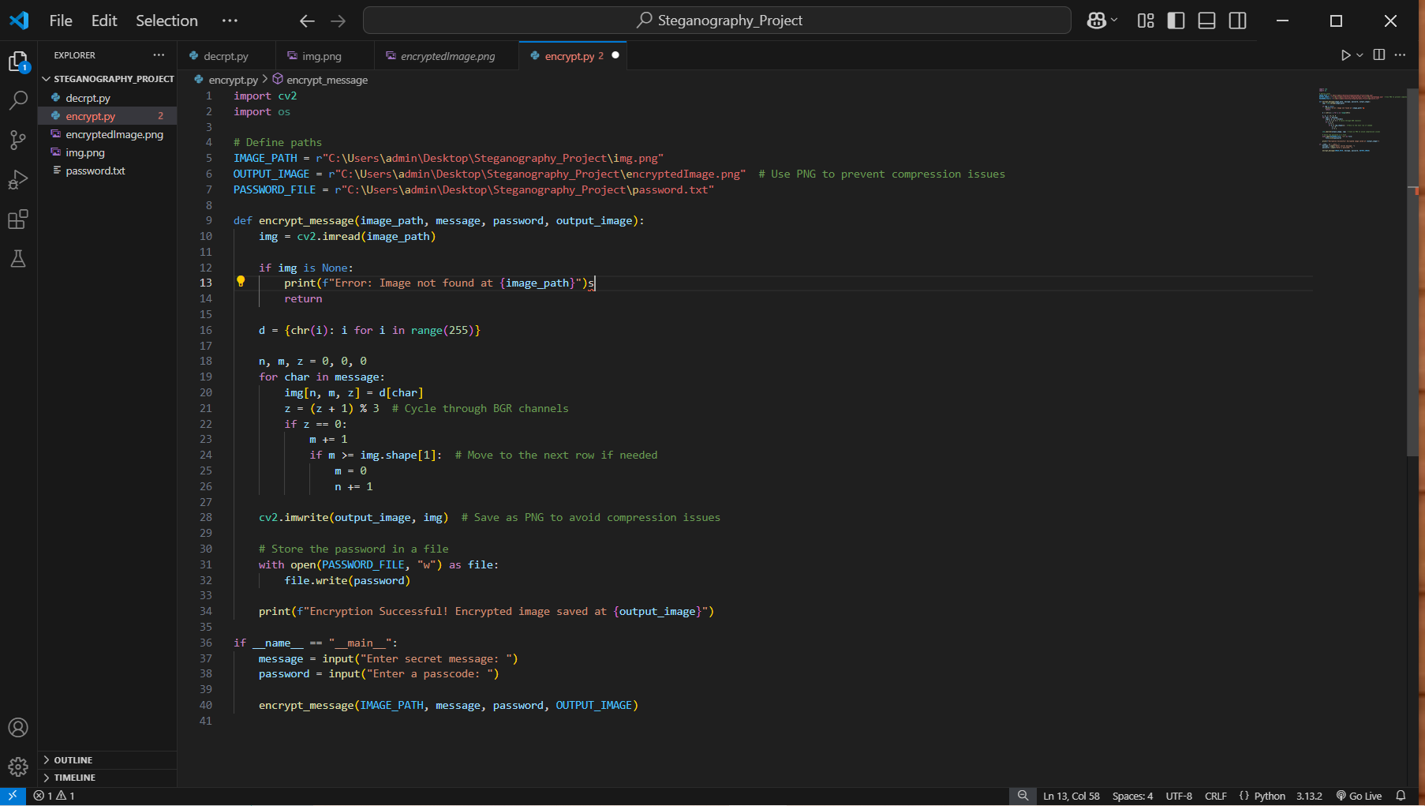

Results
Figure1 : Code for Encryption
Figure2 : Code for Decryption

Slide 8
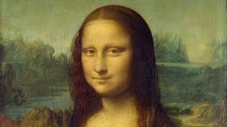
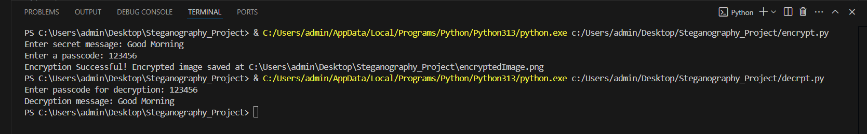
Encrypted Image
Output for Encryption and Decryption

Slide 9
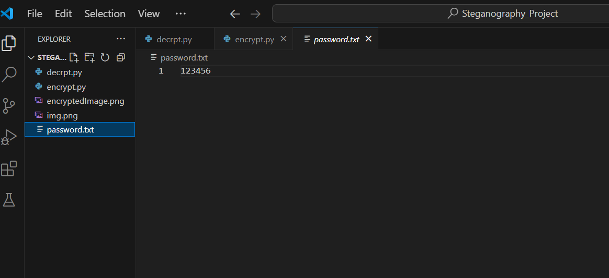
Passcode stored in a text file

Slide 10
Conclusion
This project successfully enhances secure data transmission by embedding encrypted data in images using steganography. The combination of encryption and LSB technique ensures high security while maintaining image integrity. The method is efficient, lightweight, and suitable for various secure communication applications.

Slide 11
GitHub Link
https://github.com/Anubprashanth/Secure-Data-Hiding-in-Image-Using-Steganography

Slide 12
THANK YOU

