Slide 1
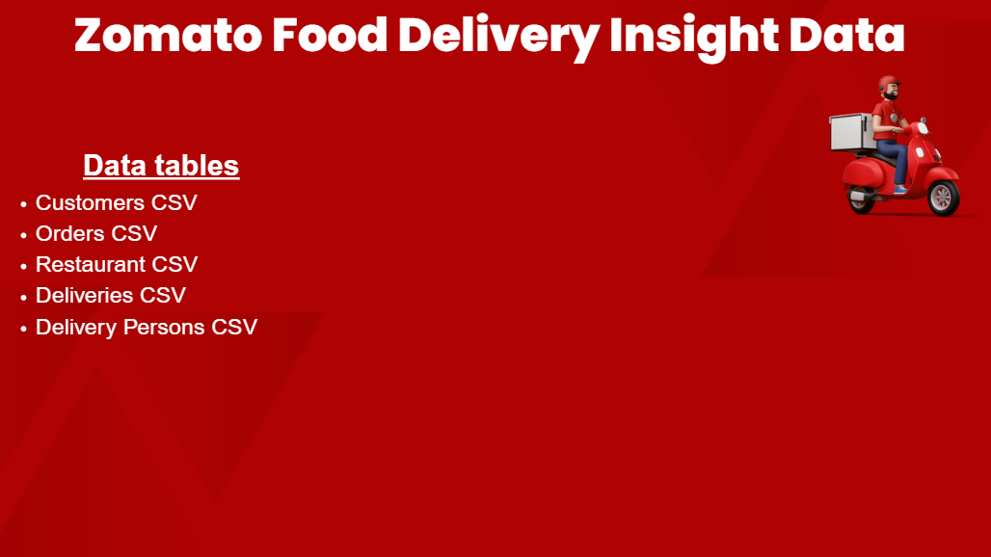
Kaggle dataset Link : www.kaggle.com/datasets/ivasanthp/zomato-food-delivery-insight-data

Slide 2

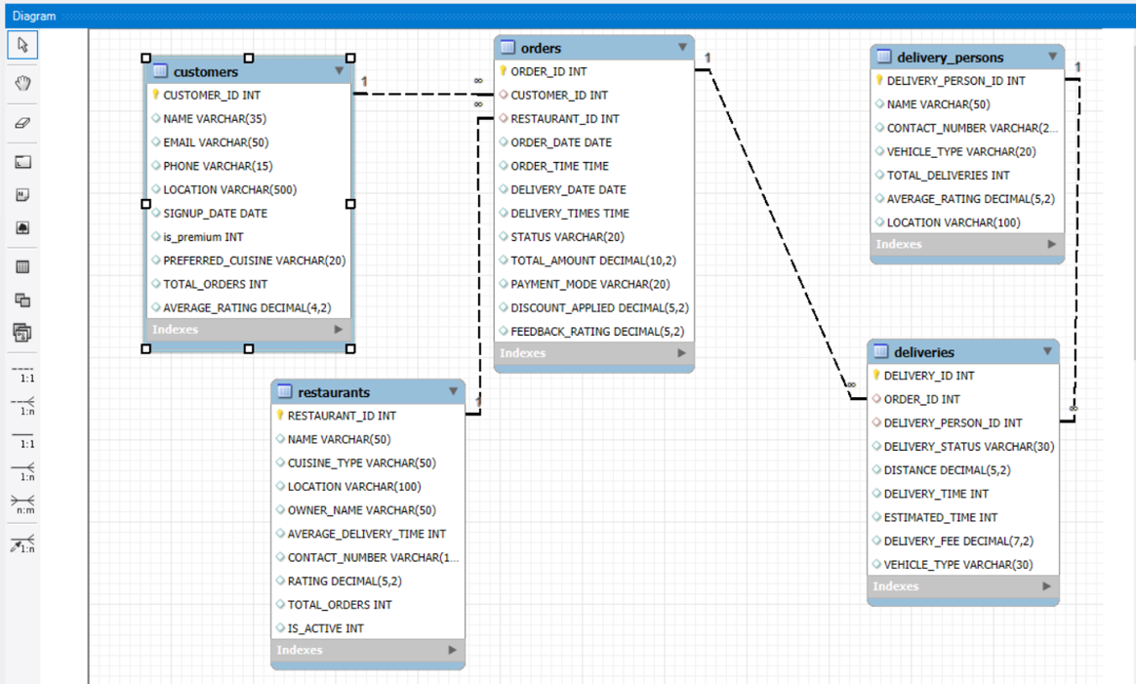
ER-Diagram

Slide 3

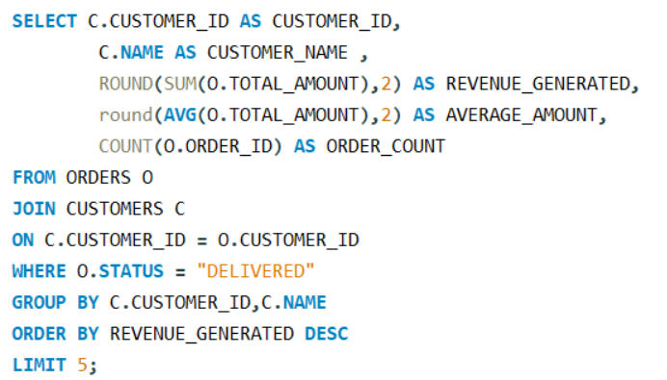
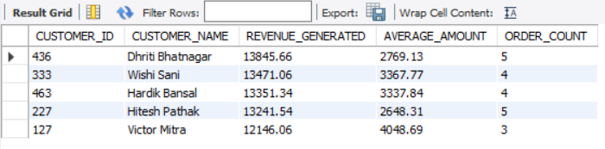
1.Which customers generate the highest revenue?
-- Customer 436 generated the highest revenue of ₹13,845.66 from 5 delivered orders, with an average order value of ₹2,769.13.

Slide 4

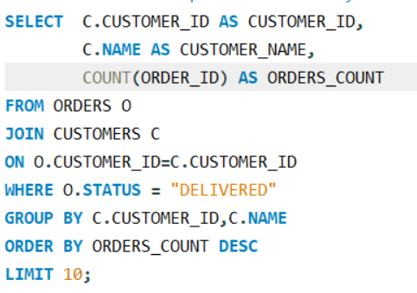
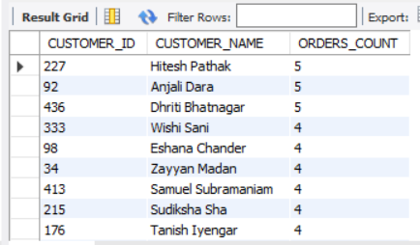
2.Who are the top 10 customers by number of orders?
The most active customers were Customer IDs 227,92 AND 436.
Also, customer_id 436 appeared in top 1 highest revenue generate list with frequently orders

Slide 5
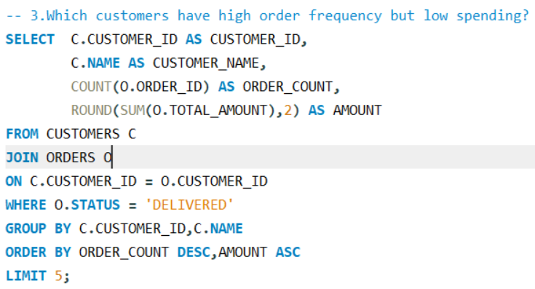
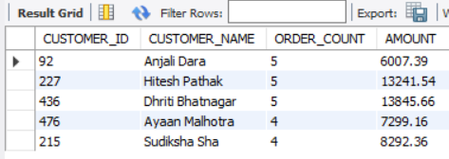
3.Which customers have high order frequency but low spending?
Customer_id 92 have high frequency in ordering but customer is low spending . We can attract her with more campaigns
Customer_id 436 stand outs again with high frequency of orders with high revenue along side with customer_id 227

Slide 6
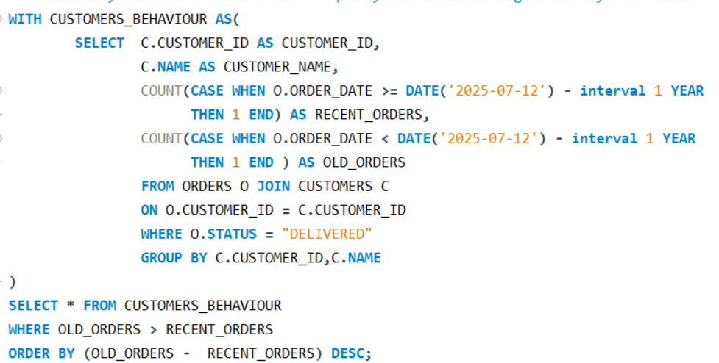
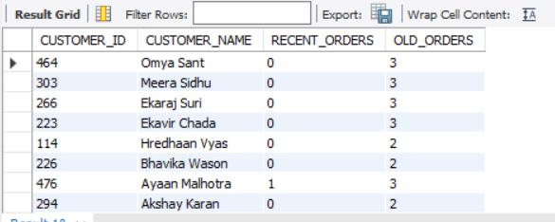
4.Identify customers whose order frequency has declined significantly over time.
Customer_id 464,303,266,223 didnot order any orders in last 1 year

Slide 7
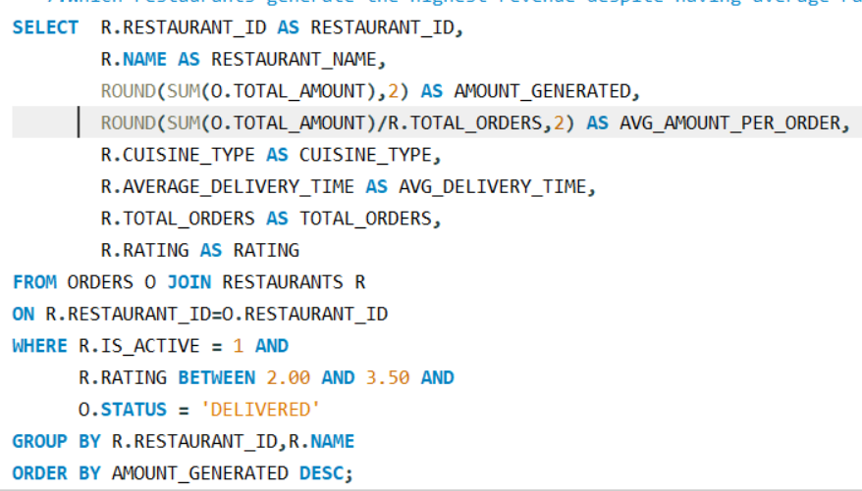
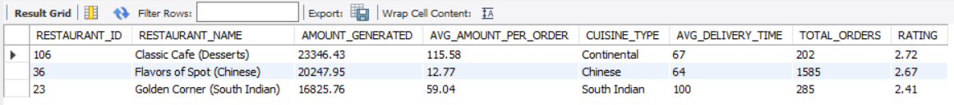
Which restaurants generate the highest revenue despite having average ratings?(TOP 3)
Out of 28 restaurants, 24 restaurants are having less avg_delivery_time(100).This indicates people are preferring more for fast deliveries than good rating.

Slide 8
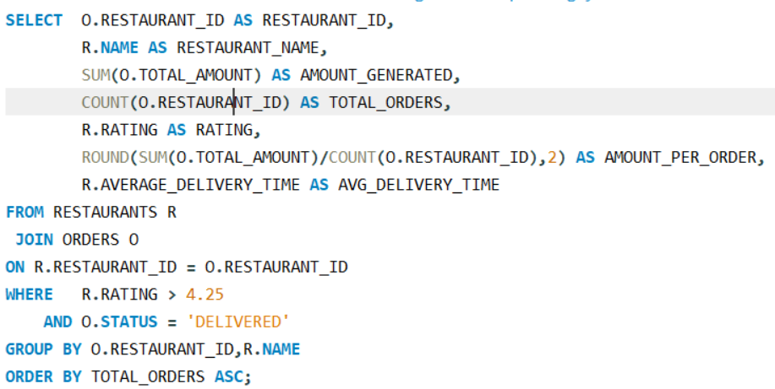
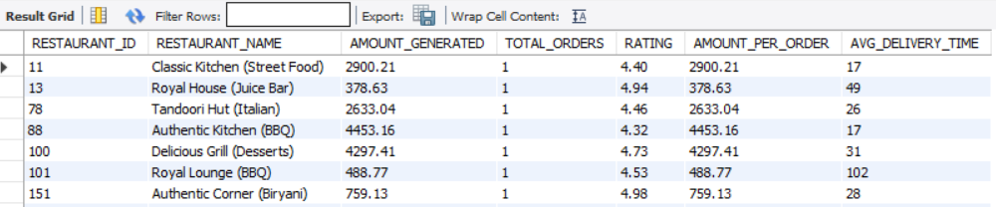
Which restaurants have excellent ratings but surprisingly low order volumes?
These are the Restaurants generating less revenue despite having excellent rating
Amount_per_order and Avg_delivery_time can be reasons for less revenue.

Slide 9
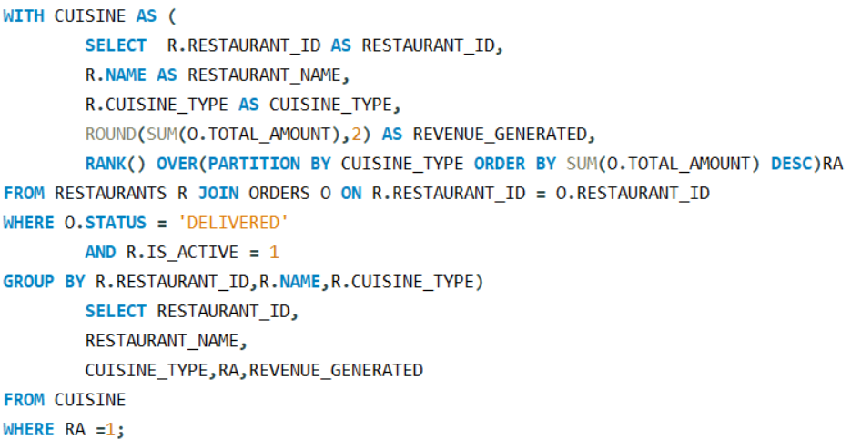
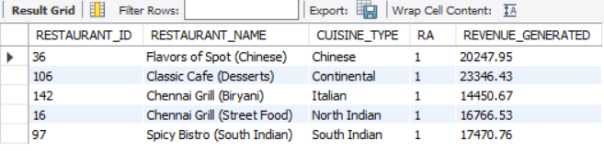
Rank restaurants within each cuisine category based on revenue generated.
These are Restaurants Tops 1 in their respective Cuisine_type.

Slide 10
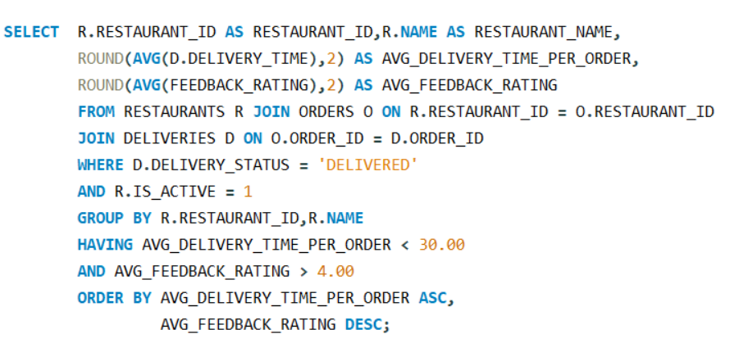
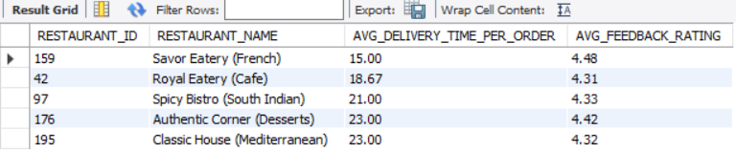
Which restaurants receive the highest customer ratings while maintaining fast delivery times?
These restaurants maintain fast delivery times while achieving high customer ratings.
Savor Eatery (French) and Royal Eatery (Cafe) show the best balance between delivery speed and customer satisfaction

Slide 11
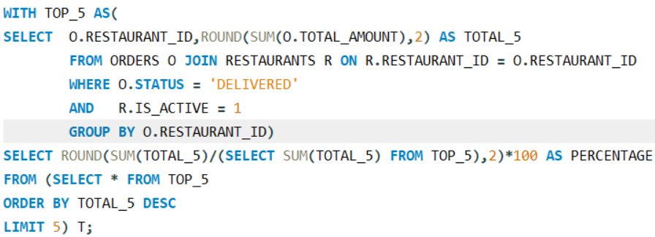

What percentage of total platform revenue is contributed by the top 5 restaurants?
Top 5 Restaurants are generating 14% of revenue from overall revenue

Slide 12
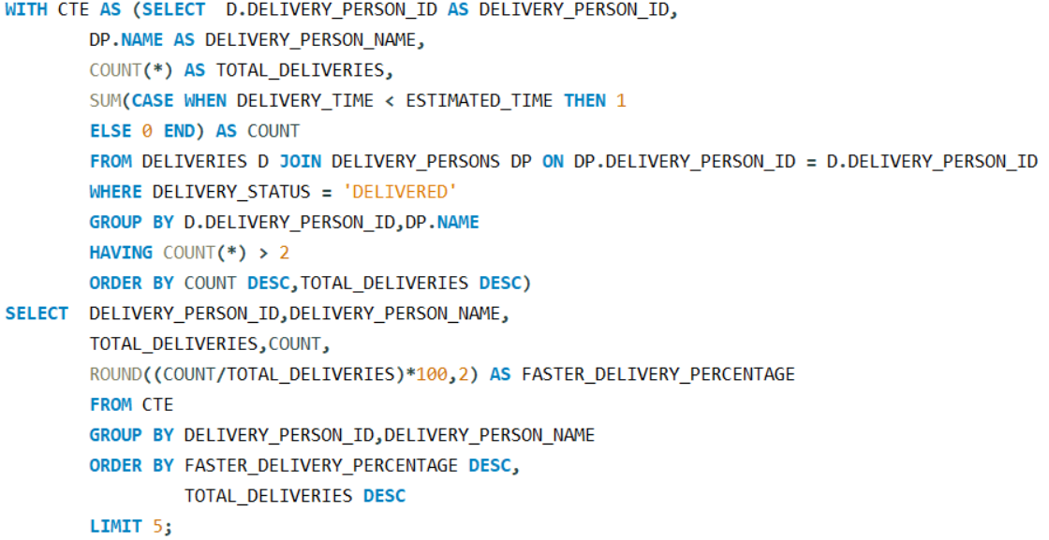
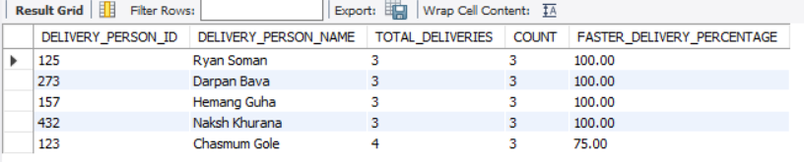
Which delivery partners consistently complete deliveries faster than estimated time?

Slide 13
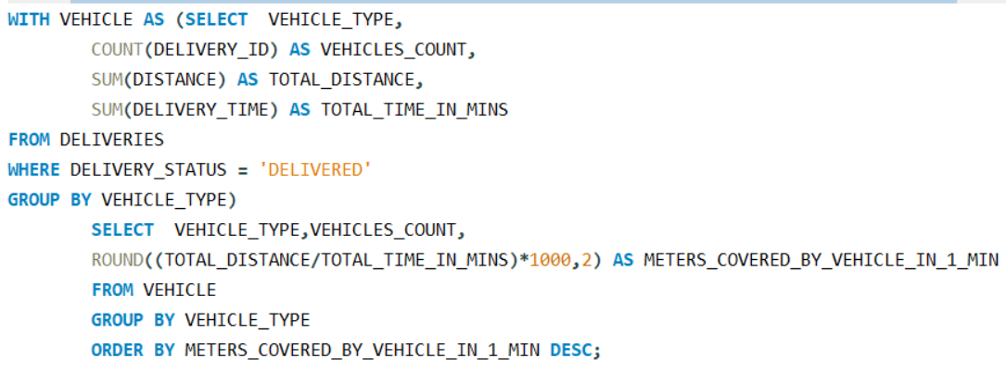
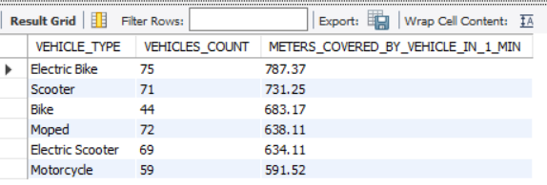
Which vehicle type provides the most efficient deliveries based on distance and time?
Electric Bikes demonstrate the highest delivery efficiency, covering 787 meters per minute on average

Slide 14
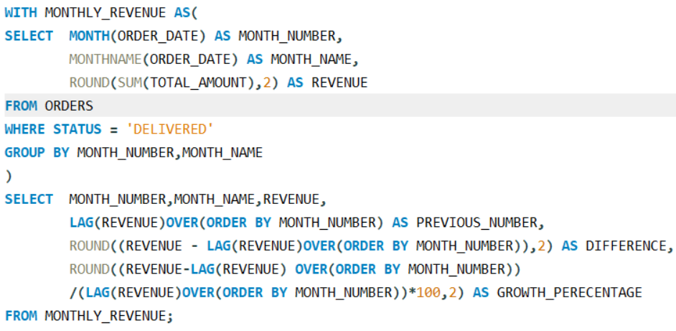
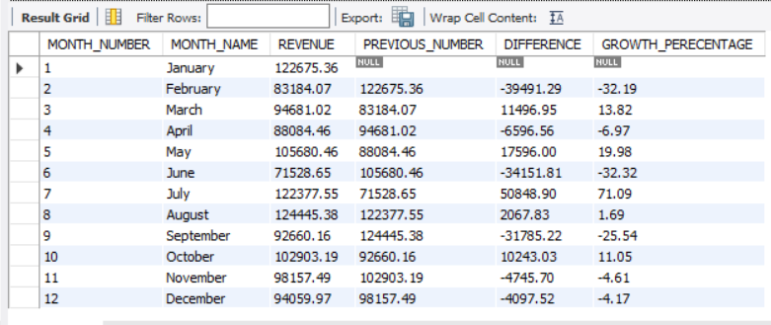
How does monthly revenue trend over time and what months show significant growth or decline?
July month major growth in revenue apporx.71% increase in the revenue
Wherever february and June got approx. 30% dip in the revenue
January,July and August have most of the revenue

Slide 15
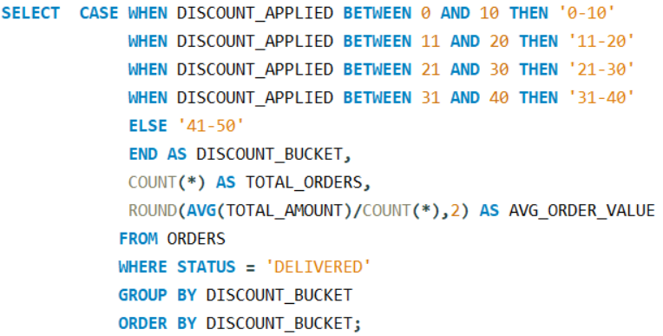
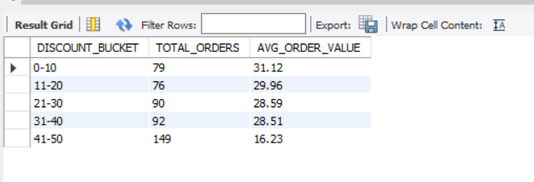
What is the impact of discounts on customer spending behavior?

Slide 16
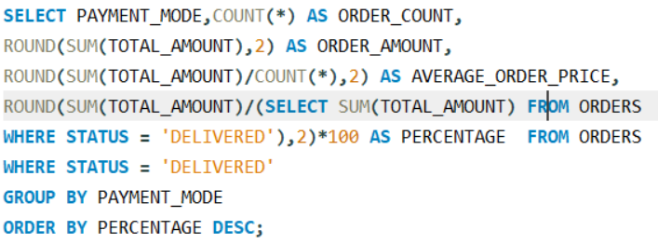
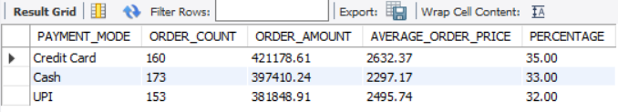
Which payment methods are associated with the highest average order values?

Slide 17
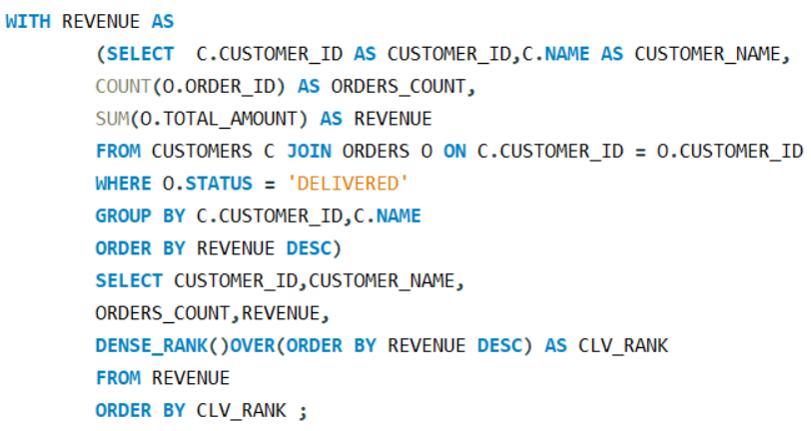
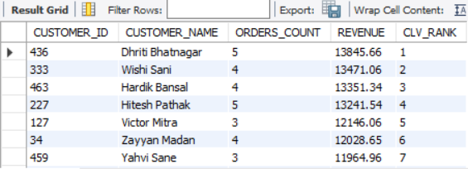
Customer Lifetime Value (CLV) Ranking

Slide 18
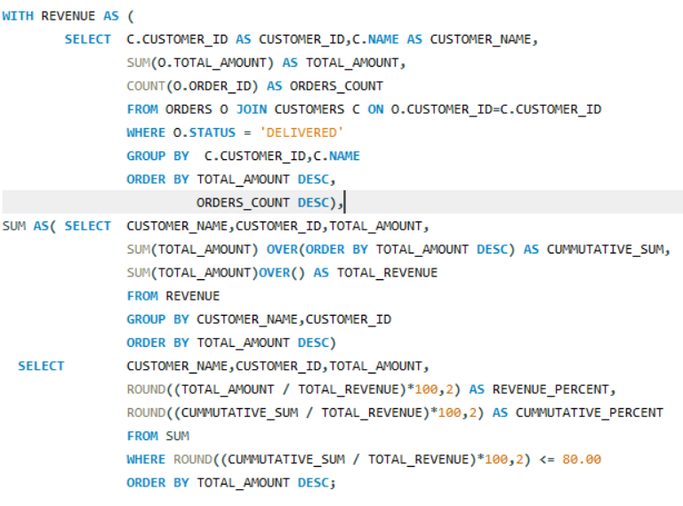
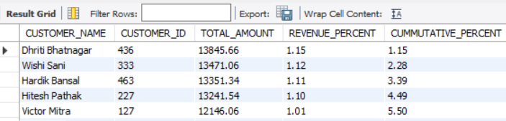
Identify the top 20% of customers contributing approximately 80% of total revenue (Pareto Analysis).

Slide 19
FINAL RECOMMENDATIONS:
Retain High-Value Customers:
Top CLV customers contribute a significant share of revenue.
Introducing loyalty rewards, exclusive discounts, Combo packs and membership benefits to increase retention.
Increase Spending from Frequent Low-Value Customers:
Customers such as Customer ID 92 place orders frequently but spend less per order.
Encourage larger basket sizes through combo offers and minimum-order discounts.
Promote High-Rated but Low-Order Restaurants:
Some restaurants have excellent ratings but receive very few orders.
Improve visibility through featured listings and targeted promotions.
Reward Top Delivery Partners:
Certain delivery partners consistently complete deliveries ahead of estimated times.
Implement incentive programs to maintain service quality and customer satisfaction.
Focus on Delivery Efficiency:
Electric Bikes showed the highest delivery efficiency in terms of distance covered per minute.
Expanding efficient vehicle usage can reduce delivery times and operational costs.
Optimize Discount Strategy:
Higher discount levels did not necessarily lead to higher average order values.
Use targeted discounts rather than blanket promotions to protect profit margins.
Encourage High-Value Payment Methods:
Credit Card users generated the highest average order value.
Partner with payment providers to offer cashback and reward-based promotions.

