Slide 1
Image Captioning Project
Generating captions for images using Deep Learning and MS COCO dataset

Slide 2
Objective
Build a deep learning model that generates natural language captions for images.
Use a subset of the MS COCO dataset for faster training.
Deploy the model using a Streamlit web application.
Train a machine learning or deep learning model using the prepared dataset.
Ensure end-to-end workflow automation so the system can be retrained and updated with minimal effort.
Process and prepare data by cleaning, tokenizing, and normalizing input text or other data types.

Slide 3
Project Structure
data/: Contains images and annotations
utils/: Dataset, vocabulary, and preprocessing scripts
models/: EncoderCNN and DecoderRNN implementation
train.py: Training script
inference.py: Caption generation script
streamlit_app.py: Web app for inference

Slide 4
Project Directory Structure
image_captioning_project/
│
├── data/
│ ├── train2017/ ← Image subset from MS COCO
│ ├── val2017/
│ └── annotations/
│ └── captions_subset_cleaned.json ← Cleaned annotations
│
├── utils/
│ ├── dataset.py ← Custom PyTorch Dataset
│ ├── vocab.py ← Vocabulary class (token to index mapping)
│ └── build_vocab.py ← Script to build vocab from captions
│
├── models/
│ └── caption_model.py ← EncoderCNN + DecoderRNN
│
├── caption_model_epoch_X.pth ← Trained model checkpoint
│
├── train.py ← Training script
├── inference.py ← Caption generation script
├── streamlit_app.py ← UI app for uploading and captioning
├── requirements.txt ← Python dependencies
└── README.md ← Project description and usage

Slide 5
Model Architecture
EncoderCNN: ResNet-50 pretrained on ImageNet, outputs feature embeddings.
DecoderRNN: LSTM network generates captions from image features.
Vocabulary: Maps words to indices and vice versa.
Input Layer: Accepts raw text from dataset or user input in the Streamlit app.
Hidden Layers (Feature Extraction)
RNN-based: LSTM / GRU layers for sequence learning.
CNN-based: 1D Convolutions for local feature extraction.
Transformer-based: Self-attention layers for contextual understanding.

Slide 6
Data Pipeline
1. Load and clean captions from MS COCO annotations.
2. Build vocabulary from captions.
3. Preprocess images and captions for training.
4. Pad sequences for batch processing.

Slide 7
Vocabulary Building
Captions tokenized using NLTK.
Rare words removed (min word frequency threshold).
Special tokens added: <start>, <end>, <pad>, <unk>.
Vocabulary saved in JSON for consistent loading.

Slide 8
Training Process
Loss function: CrossEntropyLoss
Optimizer: Adam
Save checkpoints after each epoch
Train on a small COCO subset for faster iterations
Build Vocabulary – Create a list of all unique words/tokens and map them to numbers.
Preprocess Data – Clean and prepare the data (remove noise, tokenize, etc.).
Save Model – Store the trained model for later use in the Streamlit app.

Slide 9
Training Setup
Hardware: CPU or GPU supported (PyTorch).
Batch size, learning rate tuned for subset dataset.
Gradient clipping used to avoid exploding gradients.
Checkpointing after each epoch to resume training if interrupted.

Slide 10
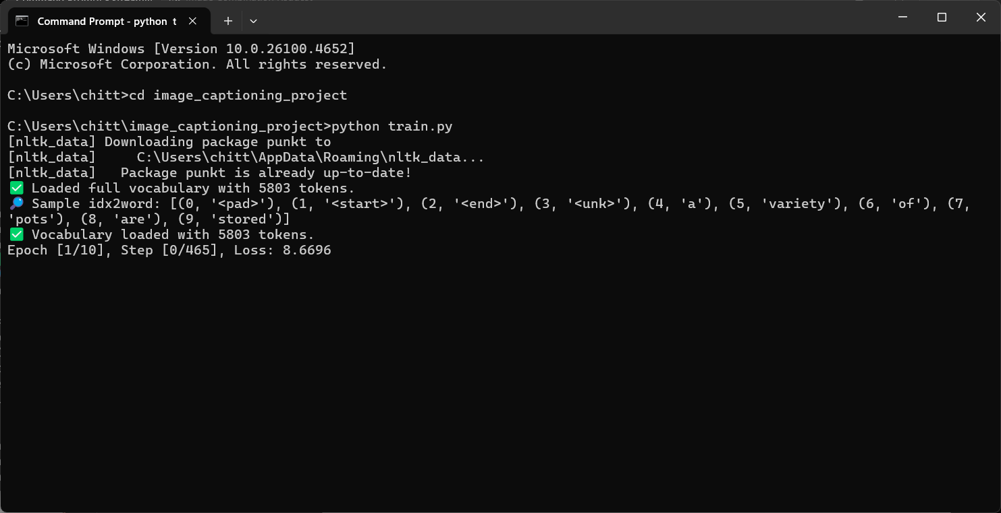

Slide 11
Dataset Details
Using MS COCO dataset subset (5000 images) for faster training.
Each image has 5 human-annotated captions.
Annotations stored in JSON format (captions_subset_cleaned.json).
Images preprocessed: resized, normalized, and converted to tensors.

Slide 12
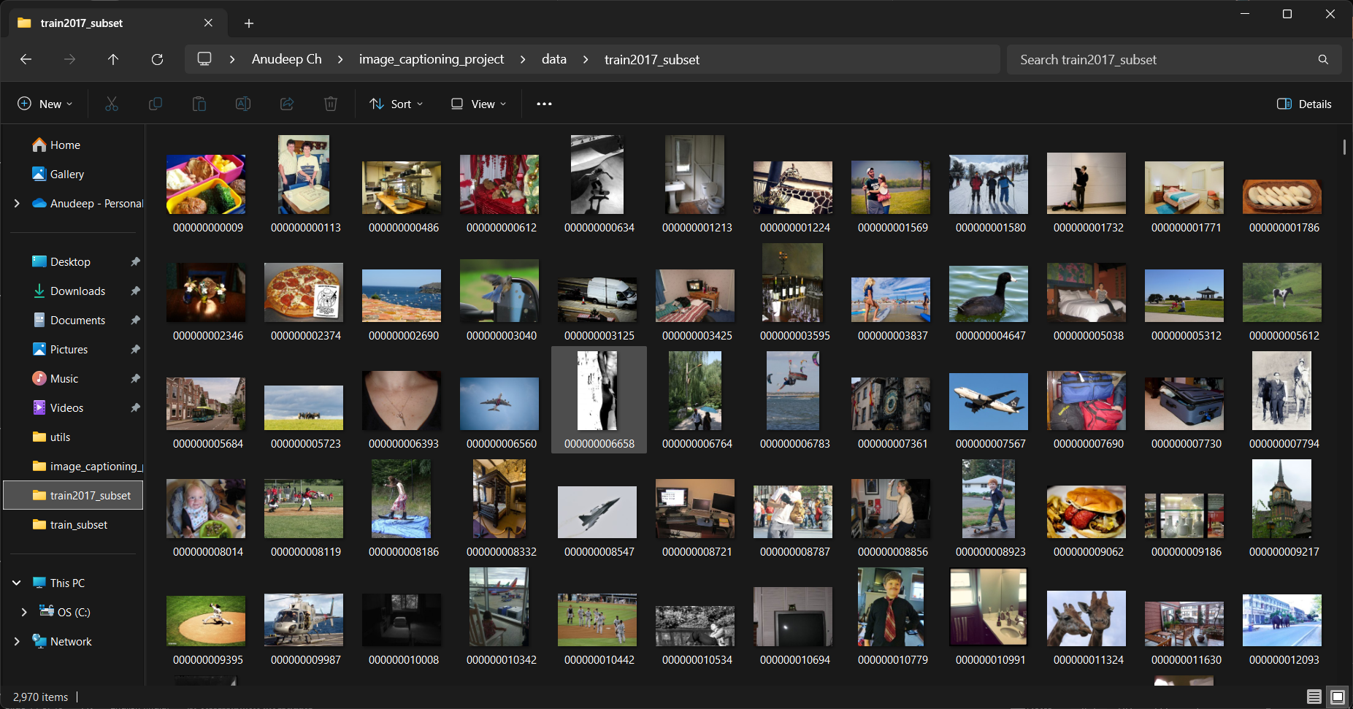

Slide 13
Inference
Load trained Encoder and Decoder models
Extract features from image using Encoder
Generate captions word-by-word using Decoder's sample method
Can be run via inference.py or Streamlit app
User gives input in the Streamlit app
The result is shown to the user in a simple format.
he model processes the input and gives a result.

Slide 14
Streamlit App
Upload image and generate captions instantly
Displays image and predicted caption
Simple and user-friendly web interface
App cleans and prepares the text.
Model reads it and gives a prediction.

Slide 15
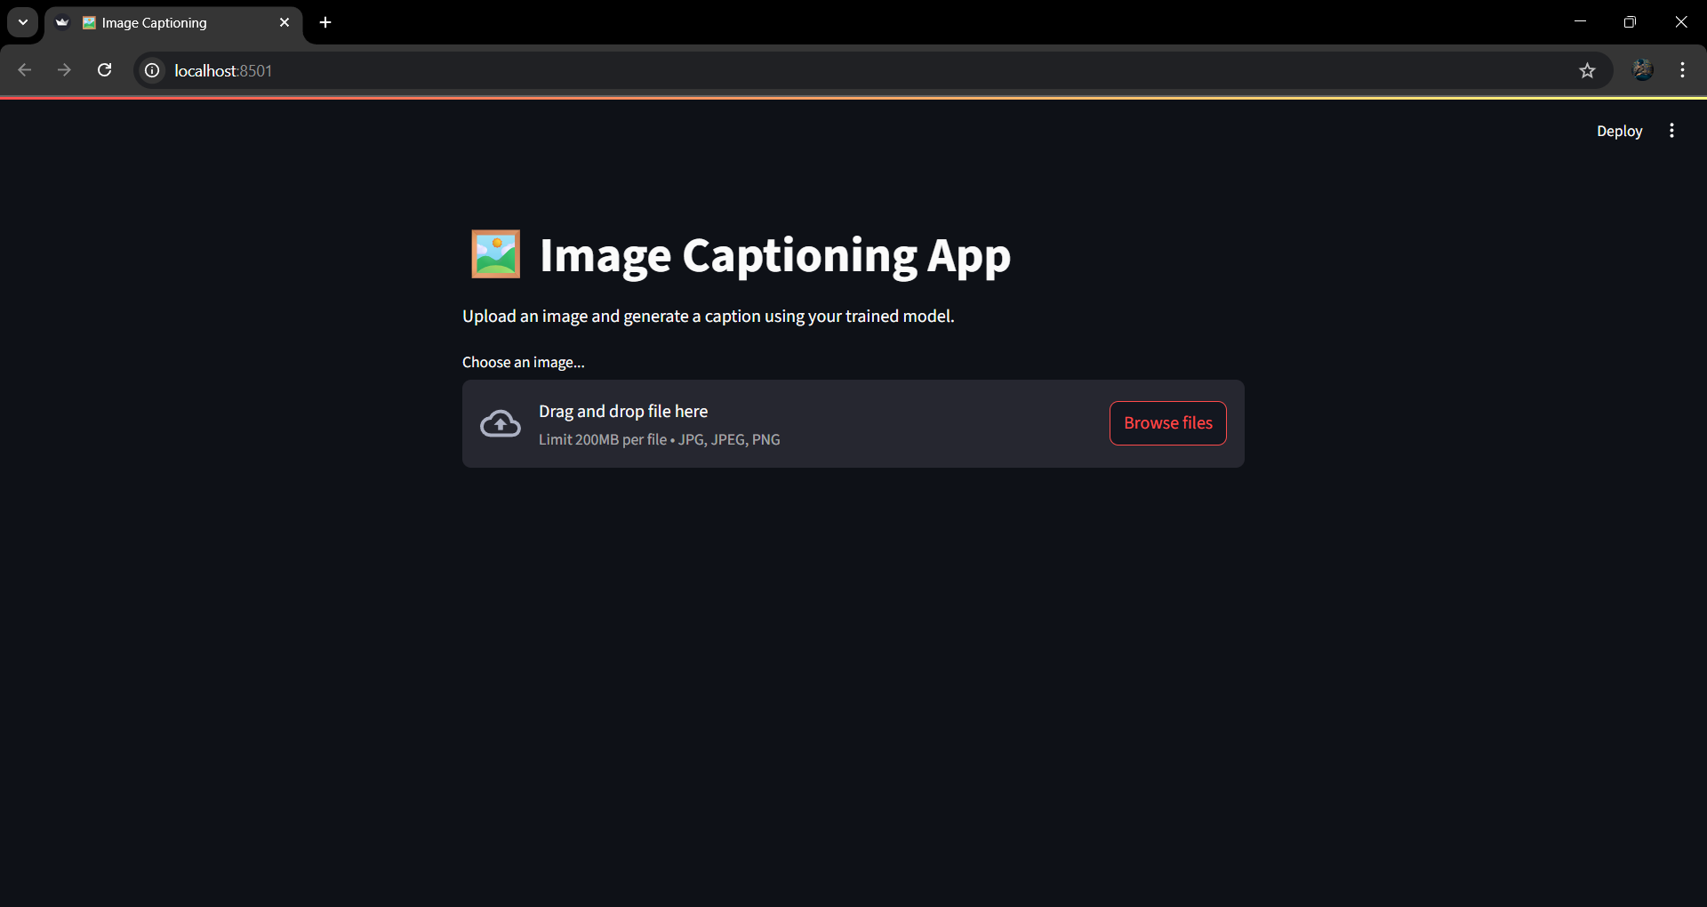

Slide 16
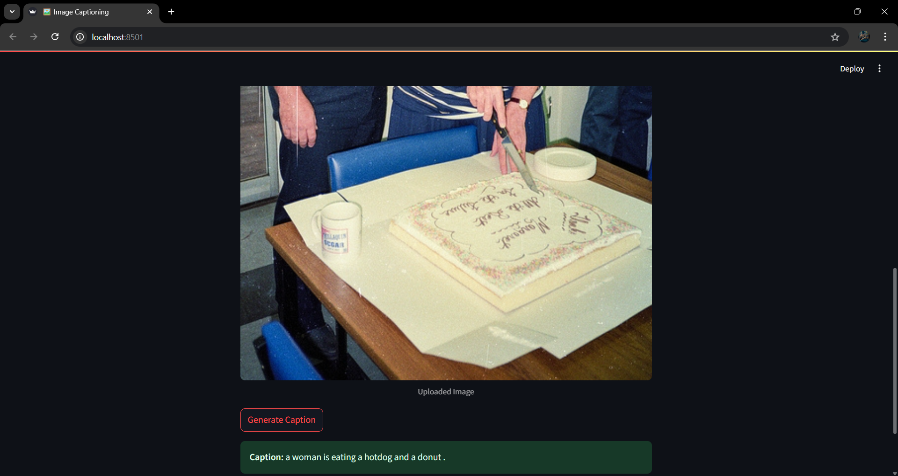

Slide 17
Model Deployment
Streamlit app serves as the deployment interface.
Model and vocabulary loaded from saved checkpoints.
User uploads an image, model generates and displays caption.
Runs locally or can be hosted on cloud platforms.

Slide 18
Challenges Faced
Vocabulary mismatch between training and inference.
Model checkpoint key inconsistencies.
Dataset file path issues during training.
Ensuring compatibility between Encoder and Decoder across scripts.

Slide 19
Future Improvements
Use full MS COCO dataset for training
Implement attention mechanism for better captions
Add BLEU score evaluation
Use beam search for better caption generation

