Slide 1

Product Recommendation system
Presented by
Anudeep Gunukula

Slide 2
What are Recommendation Systems?
Every day we view and purchase products on Amazon, browse Netflix, stream music on Spotify. Have you ever wondered how accurately they know your tastes and preferences and make Recommendations based on your interests ?
The answer is they have personalized Recommendation Engines which uses advanced algorithms to recommend products to you... When you want to watch a new movie, you usually ask your friends for suggesting movies, they know your interests and accordingly they suggest you a good movie.
So, Recommendation Systems work the same way, they are nothing but data filtering tools that uses algorithms to recommend most relevant items to a particular user.

Slide 3
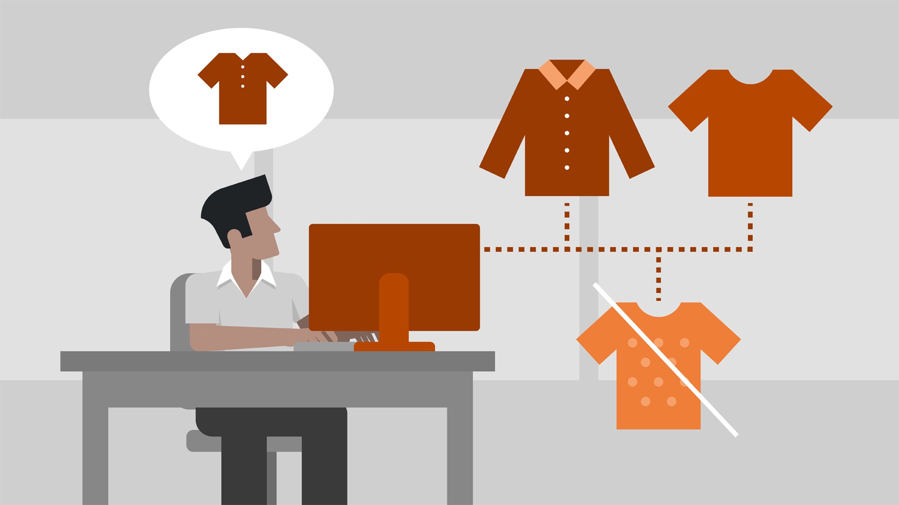
Internet is a vast ocean of Information, it consists of millions of items, a large catalogue of products. There are some Users that know what they are looking for whereas others have no idea what to look for in such a large library of resources, and thus, Recommendation Systems play a vital role.
There are some products which may be good but have not gained Popularity since they have not been advertised, so recommendation systems help such items gain popularity by bringing such items to one's notice.

Slide 4
Problem Statement :
Building recommendation system for products electronics and clothing
Description :
Online E-commerce websites like Amazon, Flipkart uses different recommendation models
to provide different suggestions to different users. ecommerce sites currently uses
item-to-item collaborative filtering, which scales to massive data sets and produces
high-quality recommendations in real time. This type of filtering matches each of the
user's purchased and rated items to similar items, then combines those similar items
into a recommendation list for the user. In this project we are going to build
recommendation model with the similar kind of approach.

Slide 5
1. Predict the rating that a user would give to a Product that he has not yet rated.
2. Minimize the difference between predicted and actual rating (RMSE)
Objectives :

Slide 6
ipython-notebook - Python Text Editor
sklearn - Machine learning library
numpy, scipy- number python library
pandas - data handling library
seaborn, matplotlib.pyplot, - Visualization libraries
Prerequisites:
1. Python 3
2. Anaconda

Slide 7
Steps Followed :
Read and explore
Read and explore the given dataset.
Take
Take a subset of the dataset to make it less sparse/ denser.
Split
Split the data randomly into train and test dataset.
Build
Build Popularity Recommender model.
Build
Build Collaborative Filtering model.
Evaluate
Evaluate both the models.
Get
Get top - N ( N = 5) recommendations.
Summarise
Summarise your insights.

Slide 8
I have referred many blogs while making of this project
* https://medium.datadriveninvestor.com/how-to-built-a-recommender-system-rs-616c988d64b2
* https://towardsdatascience.com/introduction-to-recommender-systems-6c66cf15ada
* https://www.analyticssteps.com/blogs/what-are-recommendation-systems-machine-learning
*https://en.wikipedia.org/wiki/Singular_value_decomposition
*https://towardsdatascience.com/understanding-singular-value-decomposition-and-its-application-in-data-science-388a54be95d
References :

Slide 9

Thank You

