Slide 1


AI-Powered ECR Intelligent Agent
for IETMS Testing

Slide 2

Agenda
01
Background & POC Scope
02
Technical Details and Block Diagram
03
ECR-1 and ECR-2 Analysis
04
Demo
05
Q&A
Capgemini engineering and rail capabilities in India
2 / 10

Slide 3

01 | BACKGROUND & POC SCOPE
Problem Statement
When an Engineering Change Request (ECR) arrives - for example ECR-1 (departure test reported as Failed) or ECR-2 (horn state not updating on the Brake/Horn interface screen) - a tester has to work out by hand what it affects and which tests to run.
1
Information Spread Across Many Sources
2
Manual Impact Analysis
Linked requirements, affected test cases, past defects and attachments sit in different files and tools, so gathering them for a single ECR takes time.
Working out which onboard components an ECR touches (such as the Departure Test Module for ECR-1) depends on memory and experience.
3
Unclear Test Scope
4
Need for an Intelligent Agent
Without a clear, ordered test list, teams either miss key tests or re-run far more than needed.
An AI agent that reads one ECR, uses only its own data and explains what to test can save time and reduce errors.
ECR Intelligent Agent | POC
3 / 10

Slide 4
01 | BACKGROUND & POC SCOPE
POC Objectives
1
2
3
4
ECR Analysis Agent
ECR-Scoped Results
Integration with Capgemini Generative Engine Platform
Human in the Loop
Develop an AI agent that, given an ECR ID:
Gathers its linked requirements, test cases and attachments, finds the impacted components and recommends an ordered test list (P0-P3), each test with a reason.
Use only the ECR's own data - for ECR-1: L2R26, L2R35 and 5 test cases; for ECR-2: L2R01, L2R05 and 7 test cases.
Validate three short AI calls per analysis through the GEP, with a rule-based fallback if it is unavailable.
Let a tester approve or reject the analysis before the report is published, and ask follow-up questions about the ECR.
ECR Intelligent Agent | POC
4 / 10

Slide 5
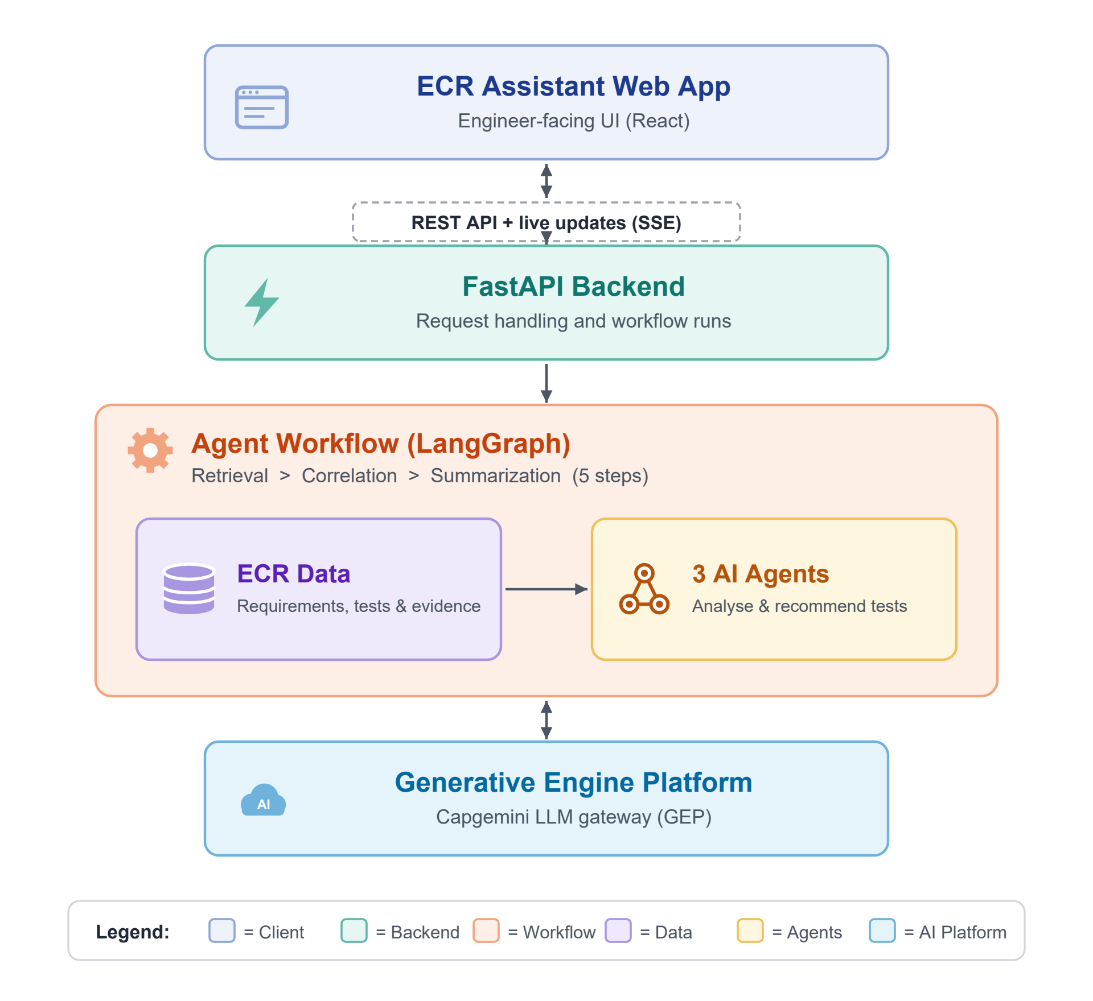
02 | TECHNICAL DETAILS AND BLOCK DIAGRAM
Proposed Solution
1
Web-Based User Interface
Testers pick ECR-1 or ECR-2 and press Analyze; the page shows live progress, results in simple tables and Ask a Question.
2
FastAPI Backend Service
Checks each request, starts the analysis, handles the optional human approval and builds the report.
3
Three-Agent Workflow
Retrieval, Correlation and Summarization agents run 5 steps using only the ECR's own requirements, tests and evidence.
4
Generative Engine Platform Integration
Sends short, ECR-only requests to Capgemini's GEP and returns AI-written explanations, with a rule-based fallback.
ECR Intelligent Agent | POC
5 / 10

Slide 6
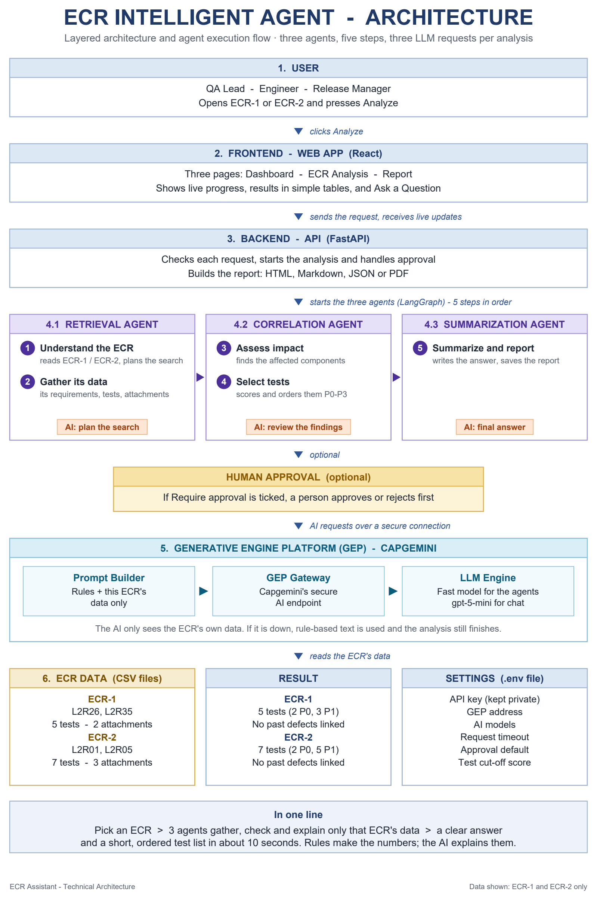
02 | TECHNICAL DETAILS AND BLOCK DIAGRAM
Technical Architecture Overview
How to read it
Top to bottom: User > Frontend > Backend > 3 agents (5 steps) > optional approval > GEP > ECR data.
Three agents, five steps
Retrieval (1 Understand the ECR, 2 Gather its data) > Correlation (3 Assess impact, 4 Select tests) > Summarization (5 Summarize and report).
ECR-1 result
L2R26, L2R35 - 5 tests (2 P0, 3 P1) - Departure Test Module changes directly - no past defects linked.
ECR-2 result
L2R01, L2R05 - 7 tests (2 P0, 5 P1) - Brake System Interface changes directly - no past defects linked.
AI through Capgemini GEP
3 short AI calls per analysis; the AI sees only the ECR's own data; rule-based fallback if unavailable.
ECR Intelligent Agent | POC
6 / 10

Slide 7
DEMO
7 / 10

Slide 8
ENHANCEMENTS
Future Roadmap
1
2
3
Live Tool Integration
Test Execution Feedback
Wider Rollout and Analytics
Read ECRs, requirements and test results directly from the change-tracking and test management tools instead of CSV exports.
Feed the results of the recommended tests for ECRs like ECR-1 and ECR-2 back into the agent to refine test priorities.
Record approvals and rejections to improve future recommendations.
Extend to more ECRs and builds, with a view of analysis time and test coverage per ECR.
ECR Intelligent Agent | POC
8 / 10

Slide 9
Q & A
9 / 10

Slide 10
About Capgemini
Capgemini is a global leader in partnering with companies to transform and manage their business by harnessing the power of technology. The Group is guided everyday by its purpose of unleashing human energy through technology for an inclusive and sustainable future. It is a responsible and diverse organization of 360,000 team members in more than 50 countries. With its strong 55-year heritage and deep industry expertise, Capgemini is trusted by its clients to address the entire breadth of their business needs, from strategy and design to operations, fueled by the fast evolving and innovative world of cloud, data, AI, connectivity, software, digital engineering and platforms. The Group reported in 2022 global revenues of €22 billion.
Get The Future You Want | www.capgemini.com

