Slide 1
DXC Digital Explorer Journey Map
David Stevens
DXC Distinguished Architect Digital Explorer Product Owner & Architect davidstevens@dxc.com

Slide 2
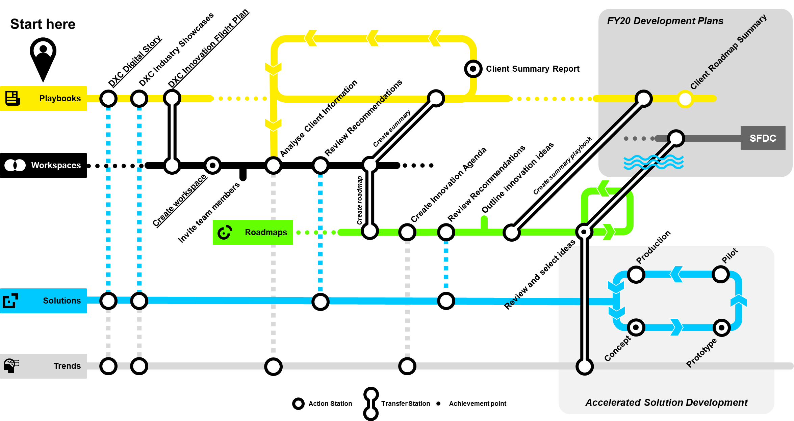
DXC Digital Explorer Journey Map
The DXC Digital Explorer Journey map shows a highly connected pathway through the Digital Explorer platform to support a client’s Digital Transformation journey.
From the initial framing of DXC’s position and showcase solutions to analysing a client challenges to ultimately deliver Digital Solutions.
Next Slide for the complete Map

Slide 3
DXC Digital Explorer
Start here
FY20 Development Plans
DXC Innovation Flight Plan
DXC Industry Showcases
Client Roadmap Summary
DXC Digital Story
Client Summary Report
Playbooks
Review Recommendations
Analyse Client Information
Create summary
SFDC
Workspaces
Create summary playbook
Outline innovation ideas
Review Recommendations
Create Innovation Agenda
Create workspace
Create roadmap
Invite team members
Roadmaps
Production
Accelerated Solution Development
Pilot
Review and select ideas
Solutions
Concept
Prototype
Trends
Action Station
Transfer Station
Achievement point
Notes:
DXC Digital Story : https://digitalexplorer.dxc.com/pb/playbook/597635
DXC Industry Showcases : WIP
DXC innovation flight plan : https://digitalexplorer.dxc.com/pb/playbook/597055
Connecting line (box) 0.3

Slide 4
The Client
The right demo
DXC Digital Enablement Lab
Envision the art of the possible
DXC Envision
Digital Blueprint
DXC Digital Explorer
Hackathon
DXC Innovation Flight Plan
Analyse Client Requirements
The Client
DXC Kings Cross Innovation Centre
The Client
DXC Design Studio
Design Session
Live
Design Thinking
DXC Digital Transformation Centre
Pre-Discovery
DXC Partners
The Client

Slide 6
The right demo
DXC Digital Enablement Lab
Digital Blueprint
DXC Digital Explorer
Introduction
Hackathon
Analyse Client Requirements
DXC Design Studio
Design Session
Live
Hackathon
DXC Digital Transformation Centre
Pre-Discovery

Slide 7
Augmented Search Engine
A highly intelligent search engine for DXC employees to find and access the right content anytime, anywhere in a secure manner
ASE

Slide 8
DXC Digital Explorer Journey Map Plus ASE
Start here
Action Station
DXC Innovation Flight Plan
DXC Industry Showcases
Transfer Station
DXC Digital Story
Client Summary Report
Playbooks
Action Station with achievement
Review Recommendations
Analyse Client Information
TRANSFER TO
SEND TO
Workspaces
Review Recommendations
Create Innovation Agenda
Outline innovation ideas
Create workspace
SEND TO
Invite team members
Review and select ideas
Roadmaps
Production
Pilot
Accelerated Solution Development
SEND IDEA
Solutions
Concept
Prototype
Trends
ASE

Slide 9
DXC Digital Explorer Journey Map Plus ASE
Start here
Action Station
DXC Innovation Flight Plan
DXC Industry Showcases
Transfer Station
DXC Digital Story
Client Summary Report
The Digital Explorer recommendation engine “digs deeper” into the DXC ASE Dataset – extending suggested recommendations.
Playbooks
Action Station with achievement
Review Recommendations
Analyse Client Information
TRANSFER TO
SEND TO
Workspaces
Review Recommendations
Create Innovation Agenda
Outline innovation ideas
Create workspace
SEND TO
Invite team members
Review and select ideas
Roadmaps
Production
Pilot
Accelerated Solution Development
SEND IDEA
Solutions
Concept
Prototype
Trends
ASE

