Slide 1
DXC Digital Explorer Journey Maps
David Stevens
DXC Distinguished Architect Digital Explorer Product Owner & Architect davidstevens@dxc.com

Slide 2
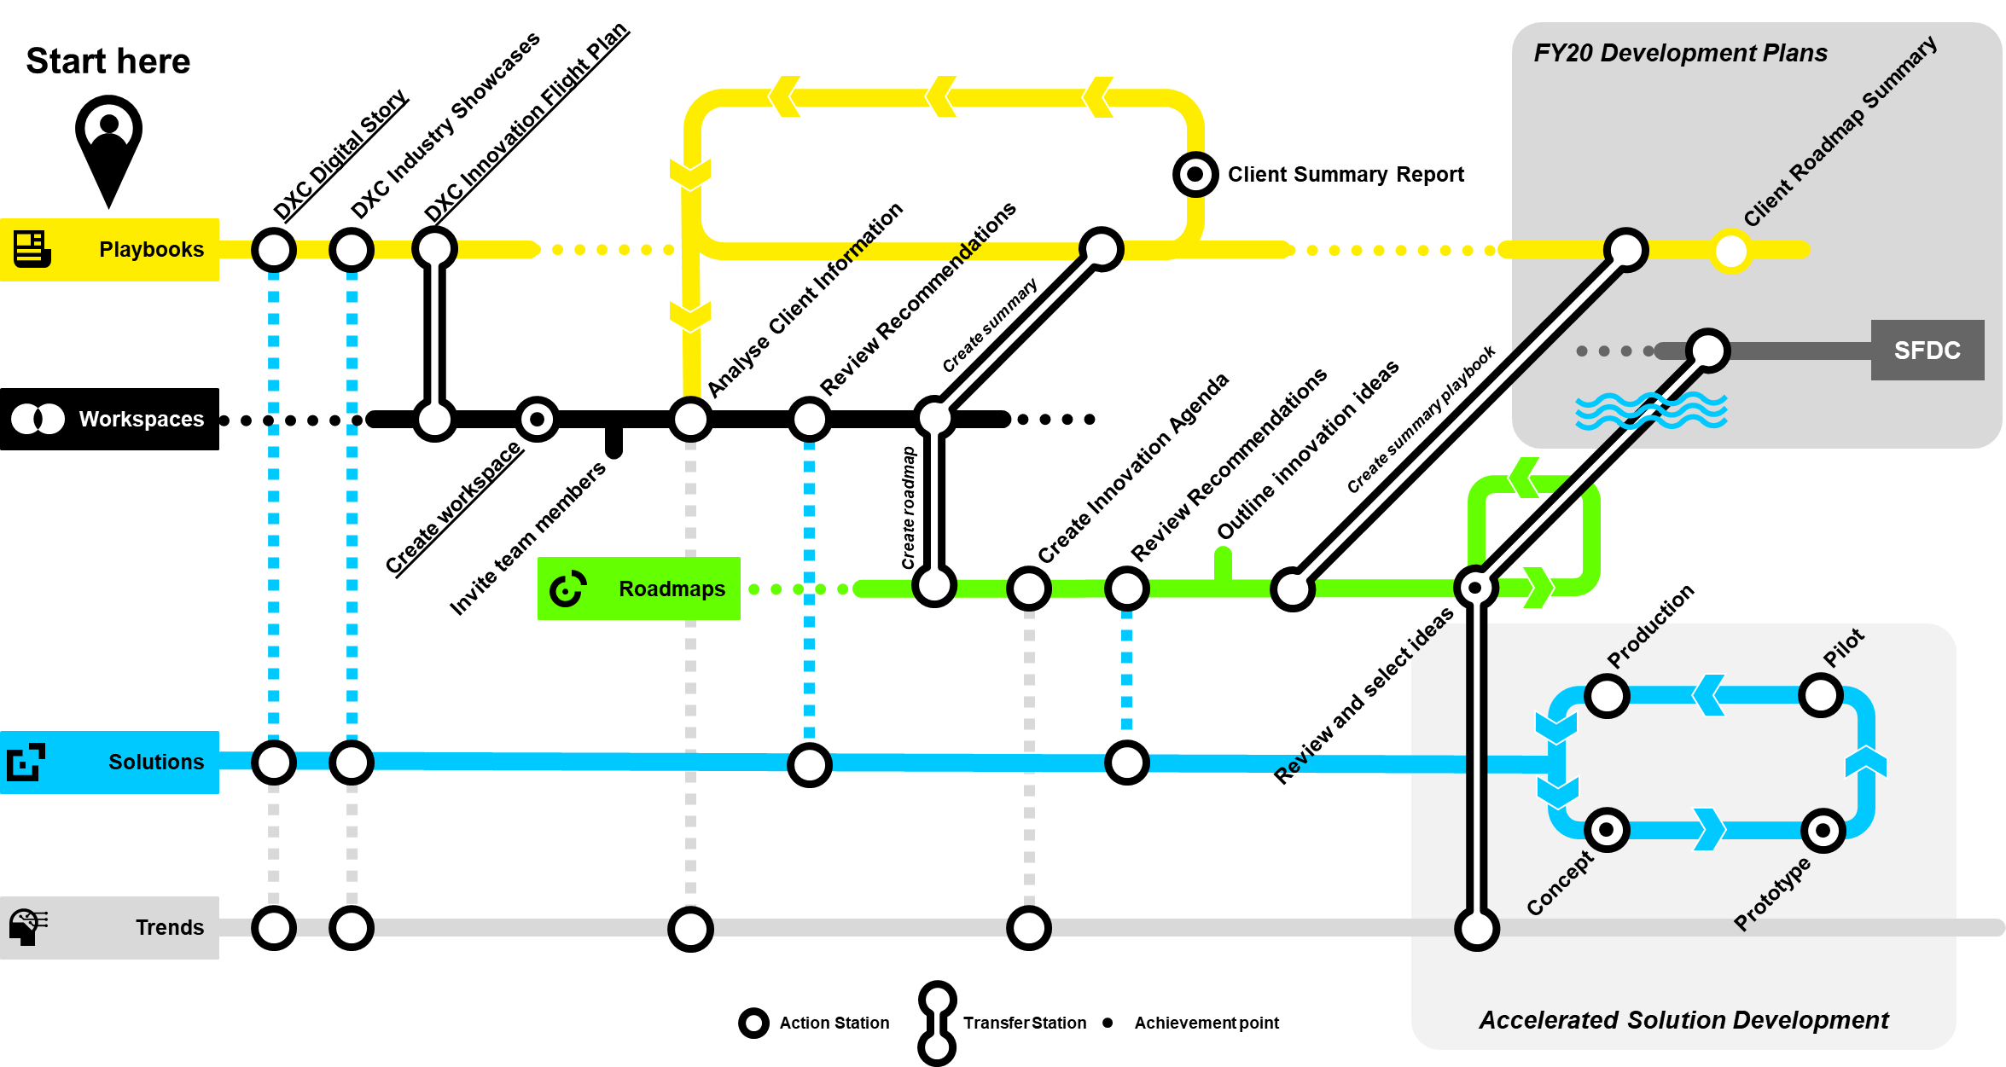
DXC Digital Explorer Journey Map
The DXC Digital Explorer Journey maps show potential routes through the Digital Explorer platform to support a client’s Digital Transformation journey.
From the initial framing of DXC’s position and showcase solutions to analysing a client challenges to ultimately deliver Digital Solutions.
Next Slide for the complete Map

Slide 3
FY20 Development Plans
DXC Innovation Flight Plan
Client Roadmap Summary
DXC Industry Primers
DXC Digital Story
Client Summary Report
Playbooks
Review Recommendations
Create Challenge
Analyse Client Information
Create summary
Spark
Workspaces
Create summary playbook
Outline innovation ideas
Review Recommendations
Create Innovation Agenda
Create Challenge
Create workspace
Create roadmap
Invite team members
Roadmaps
Production
Accelerated Solution Development
Pilot
Review and select ideas
Solutions
Concept
Prototype
Trends
Action Station
Transfer Station
Achievement point
Notes:
Smaller versions being created to support focused client/dxc use cases and develop Digital Explorer yellow belt training.

Slide 4

Digital Journeys ~ Mini Maps
DXC Digital Viewpoints
The Clients Digital Challenge
Client analyse to playbook
Find solutions
Client analyse to digital blueprint (roadmap)
Digital blueprint to Accelerated Solution Development
Creating your Client’s overall summary report
Inviting your client to view and vote
Contributor journeys
Add new trends
Add new solutions
Create reference playbooks

Slide 5

Expedition - Scouting ahead
The scouting ahead expedition starts to layout the potential innovation DXC and make with it’s client.
Target roles
Sales
AGM
DGM
DSD
CT
Industry PODS
1
Use the Digital Explorer Playbooks to introduce the DXC Digital Story
2
Use the Digital Explorer Workspaces to analyse your clients digital challenges
3
Create a dedicated Digital Explorer Playbook based on your clients challenges

Slide 6
Digital Journey: DXC Digital Viewpoints
Scenario
On demand Interactive presentations to outline and present DXC’s Digital viewpoint and industry aligned capabilities
Kit list
You bring
No personal kit required
Provided for you
DXC digital Story playbook
Industry primers from DXC Knowledge team
Industry showcases reference
Potential awards
None
Estimated Journey time : 15-30 minutes
DXC Industry Y Primer
DXC Industry Y Primer
Playbooks
DXC Digital Story
DXC Industry X Primer

Slide 7


Digital Journey: The Clients Digital Challenge
Scenario
Analyse Client Information
Realtime analyse of client requirements to fast track your understanding of their digital challenges
Review Recommendations
Kit List
Workspaces
You bring
Key client strategic documentation
Provided for you
DXC industry primers
DXC digital trends
Create workspace
Invite team members
Referenced only
Potential awards
Solutions
Onboard workspaces
Workspace membership
Trends
Estimated Journey time : 20-45 minutes
Action Station
Transfer Station
Achievement point
Notes:
DXC Digital Story : https://digitalexplorer.dxc.com/pb/playbook/597635
DXC Industry Showcases : WIP
DXC innovation flight plan : https://digitalexplorer.dxc.com/pb/playbook/597055
Connecting line (box) 0.3

Slide 8
Analyse Client Information
Potential client material to pack
Annual reports (client and competitors)
Investor reports
Request for Proposal (RFP)
Step-by-Step Guide :
Video overview :
Analyse a document
Analyse a website
Compare
Workspaces
Workspaces
Local Files
External Sources

Slide 9
Digital Journey: The Client Digital Challenge ~ Extended Journey
Scenario
Create an interactive Digital Challenges client summary report from your workspace
Kit list
You bring
WIP/Completed client Digital Explorer Workspace
Markdown formatting skills (optional)
Provided for you
Playbook platform
Potential awards
Digital Writer
Playbook industry badges
Estimated Journey time : 30-45 minutes
Review Playbook Creator Journey
Client Summary Report
Playbooks
Workspaces
Action Station
Transfer Station
Achievement point
Notes:
DXC Digital Story : https://digitalexplorer.dxc.com/pb/playbook/597635
DXC Industry Showcases : WIP
DXC innovation flight plan : https://digitalexplorer.dxc.com/pb/playbook/597055
Connecting line (box) 0.3

Slide 10
Contributor Journeys

Slide 11
Scenario
Create a new playbook following smart document analytics within the digital explorer workspace module.
Kit list
You bring
Support content to help shape your target playbook
Estimated Journey time : 30-60 minutes
Start here
Review Recommendations
Workspaces
Create workspace
Import required content (e.g. existing primers)
Send to Playbook
Create Pages see next slide
Add Contacts
Review Trends
Add Industry details
Playbooks
Add Solutions
Save and publish
Enter title and subtitle
Set private/public flag

Slide 12
Create Pages
Supporting tools
https://typora.io/ – markdown editor
Add Page
Add Text
Add Image
Local Files

Slide 13
Rapid Journeys

Slide 14
Digital Journey: Find Solutions
Scenario
Find and discover existing DXC industry solutions
Kit list
You bring
Business or technical requirements
Provided for you
DXC digital solution catalogue
Estimated Journey time : 10-45 minutes
DXC Solution Datasheet
DXC Solution Datasheet
Solutions
DXC Solution Datasheet
Action Station
Transfer Station
Achievement point
Notes:
DXC Digital Story : https://digitalexplorer.dxc.com/pb/playbook/597635
DXC Industry Showcases : WIP
DXC innovation flight plan : https://digitalexplorer.dxc.com/pb/playbook/597055
Connecting line (box) 0.3

Slide 15
Digital Journey: Find Solutions ~ Extended Journey
DXC Solution Datasheet
Scenario
Add discovered solutions to a playbook or workspace
Kit list
You bring
Existing workspace (existing or new)
Existing playbook (existing only)
Estimated Journey time : 5-10 minutes
DXC Industry Y Primer
Solutions
Add to…
Playbooks
Add to…
Workspaces
Action Station
Transfer Station
Achievement point
Notes:
DXC Digital Story : https://digitalexplorer.dxc.com/pb/playbook/597635
DXC Industry Showcases : WIP
DXC innovation flight plan : https://digitalexplorer.dxc.com/pb/playbook/597055
Connecting line (box) 0.3

Slide 16
London Innovation Centre

Slide 17
The Client
The right demo
DXC Digital Enablement Lab
Envision the art of the possible
DXC Envision
Digital Blueprint
DXC Digital Explorer
Hackathon
DXC Innovation Flight Plan
Analyse Client Requirements
The Client
DXC Kings Cross Innovation Centre
The Client
DXC Design Studio
Design Session
Live
Design Thinking
DXC Digital Transformation Centre
Pre-Discovery
DXC Partners
The Client

Slide 18
The right demo
DXC Digital Enablement Lab
Digital Blueprint
DXC Digital Explorer
Introduction
Hackathon
Analyse Client Requirements
DXC Design Studio
Design Session
Live
Hackathon
DXC Digital Transformation Centre
Pre-Discovery

Slide 19
Augmented Search Engine
A highly intelligent search engine for DXC employees to find and access the right content anytime, anywhere in a secure manner
ASE

Slide 20
DXC Digital Explorer Journey Map Plus ASE
Start here
Action Station
DXC Innovation Flight Plan
DXC Industry Showcases
Transfer Station
DXC Digital Story
Client Summary Report
Playbooks
Action Station with achievement
Review Recommendations
Analyse Client Information
TRANSFER TO
SEND TO
Workspaces
Review Recommendations
Create Innovation Agenda
Outline innovation ideas
Create workspace
SEND TO
Invite team members
Review and select ideas
Roadmaps
Production
Pilot
Accelerated Solution Development
SEND IDEA
Solutions
Concept
Prototype
Trends
ASE

Slide 21
DXC Digital Explorer Journey Map Plus ASE
Start here
Action Station
DXC Innovation Flight Plan
DXC Industry Showcases
Transfer Station
DXC Digital Story
Client Summary Report
The Digital Explorer recommendation engine “digs deeper” into the DXC ASE Dataset – extending suggested recommendations.
Playbooks
Action Station with achievement
Review Recommendations
Analyse Client Information
TRANSFER TO
SEND TO
Workspaces
Review Recommendations
Create Innovation Agenda
Outline innovation ideas
Create workspace
SEND TO
Invite team members
Review and select ideas
Roadmaps
Production
Pilot
Accelerated Solution Development
SEND IDEA
Solutions
Concept
Prototype
Trends
ASE

Slide 22
Innovation Journey

Slide 23
Run the Challenge
Spark
Start here
Added to Reuse Shop
Develop Workspace
Send to Challenge
NEW
Create Challenge
DE Workspaces
NEW
Develop Innovation Agenda
Create Solution
NEW
Create workspace
Send to Roadmap
Invite team members
DE Roadmaps
Review and select ideas
DE Solutions
Notes:
DXC Digital Story : https://digitalexplorer.dxc.com/pb/playbook/597635
DXC Industry Showcases : WIP
DXC innovation flight plan : https://digitalexplorer.dxc.com/pb/playbook/597055
Connecting line (box) 0.3

