Slide 1
Acquisition Scorecard Model
Presented By :
Anudnya Ware Gifty Reji
Soham Pawar Vaishnavi Mayekar
Notes:
ID=d924773e-9a16-4d6d-9803-8cb819e99682 Recipe=text_billboard Type=TextOnly Variant=0 FamilyID=AccentBoxWalbaum_Zero

Slide 2
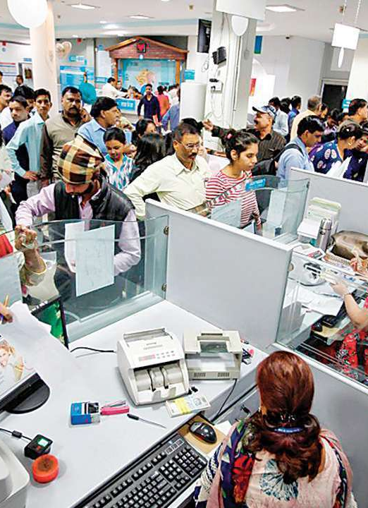
Index
Background
Methodology
Model Interpretation

Slide 3

Background
Banks acquire two types of Customers
CASA & Loan
Why?
It is used to determine the creditworthiness of the customer.
How?
It predicts the probability of default for a customer based on the information collected.
What?
Acquisition scorecard is a risk assessment tool which helps the bank to identify customers who are likely to default.
Eg : Credit Bureau

Slide 4

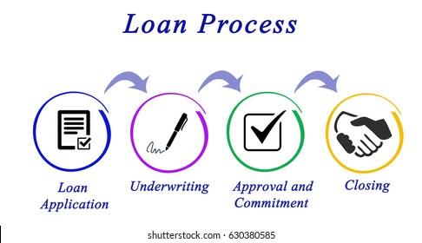
Process Flow
Traditional Approach
Modern Approach
QDE
DDE
DDE + Ascore
One-to-one Discussion
Approval and Commitment
Loan Disbursement
Approve
Reject
In Operation

Slide 5
How it will help the bank
Avoid loosing potential customers.
Minimal Credit Risk
Reduces operating expenditure and increases the profit margin.
Low processing cost, while reducing turnaround time for customers.
Different Acquisition Scorecard for different loans
Different products are available in a bank (Personal, Home, Property loan, etc)
Different Acquisition scorecard are applicable for different products and different product segments.

Slide 6
Ideal Data (Sources and Nature)
Data Required to build a model:
Data available with bank.
Additional Details of Customer.
Third Party Data
Categories of Variables
Income | Customer
Previous History | Credit Bureau
Investment Details | Groww/ CAMs
Spending habits | Visa/ MasterCard/ Cred
Demographics | Customer
Social Media | Google/ Facebook
Mobile data | Telecom (Jio/ Airtel)

Slide 7
Categories of Variables
Income | YES (Partial)
Previous History | YES (Partial)
Investment Details | NO
Spending habits | NO
Demographics | YES (Partial)
Social Media | NO
Mobile data | NO
No. of observations : 3980
No. of variables : 35
Missing values
Variable creation
Numerical Data :
Age
Bank balance
Income
Enquires
Account
No of Defaults
Categorical Data :
Customer Type
Marital Status
SEX
Industry, Organization Type
Target
0 ( Non- Delinquent)
1 ( Delinquent )

Slide 8
Pre-processing
Duplicate ID (Primary key) was dropped.
Replacing NULL values:
1) Age : Mean
2) SEX, Marital status : not specified.
3) Type of industry : Mode
4) Bank balance : -999.99
Dropped columns Months in city and Months in current job.

Slide 9
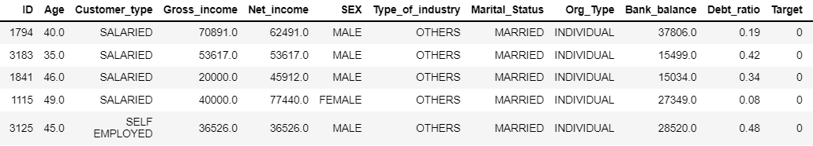
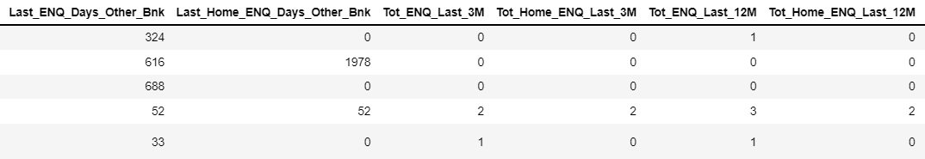
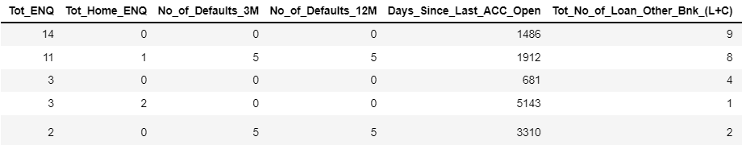
Glimpse of data
. . . AND SO ON

Slide 10
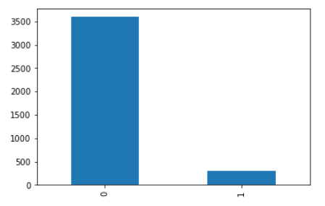
Target Count
Defaulter = 7.6 %
Non- defaulter = 92.34 %

Slide 11

Methodology
Techniques used to identify, select, process and analyze information.

Slide 12
Dimensionality Reduction
Train Test split (70:30)
Logistic Regression

Slide 13
Dimensionality Reduction
RandomForest
IV and WOE
Clustering
Lasso Regression
( Reduced 15 Variables)
10 variables

Slide 14
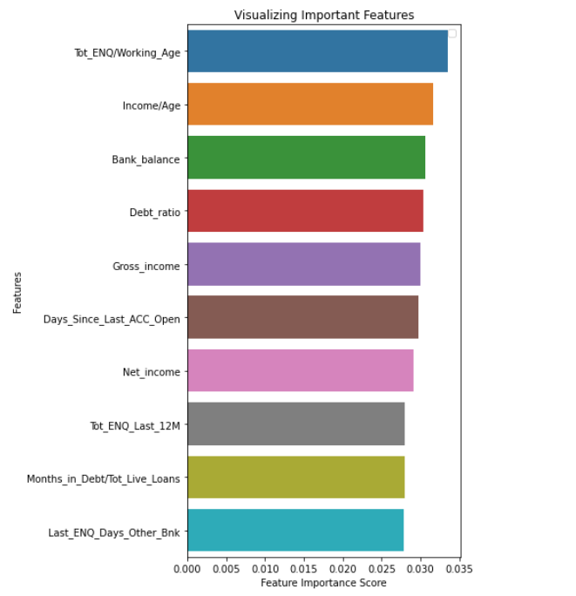
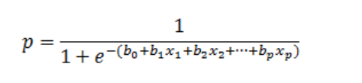
Random Forest Top 10 variables
Lasso Regression
Selected Variables
Tot_ENQ/Working_Age
Days_Since_Last_ACC_Open
Last_ENQ_Days_Other_Bnk Avg_No_of_Days_In_Debt Tot_ENQ_12M/Tot_ENQ Tot_ENQ_Last_3M Tot_No_of_Loan_Other_Bnk_(L+C) Tot_Home_ENQ_Last_12M o/s_Amt_UNSEC/Tot_o/s Customer_type_SALARIED
70:30
Information Value > 0.02
Clustering ( VarClus )
RS_RATIO = (1- RS_OWN_CLUSTER) /
(1- RS_NEXT_CLOSEST_CLUSTER)
Logistic Regression

Slide 15

Model
Lift Table, ROC curve and Trend Interpretation.

Slide 16
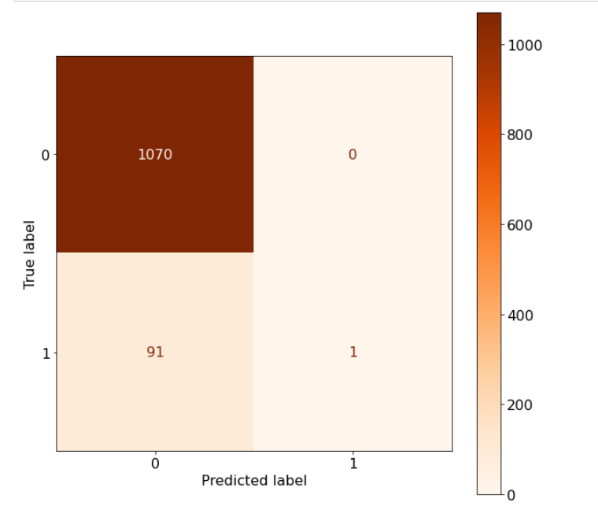
PD > 0.5 : Defaulter
PD < 0.5 : Non-defaulter
92.08 %
Evaluate Threshold value
0.09 %
LIFT TABLE
Model Accuracy for Train: 92.43%
Model predicts every single customer as
Non-defaulter !!
Model Accuracy for Test: 92.17%

Slide 17
Lift Table for Train

Slide 18
Lift Table for Test

Slide 19
Lift = (0.1956/0.075) = 2.58 %

Slide 21
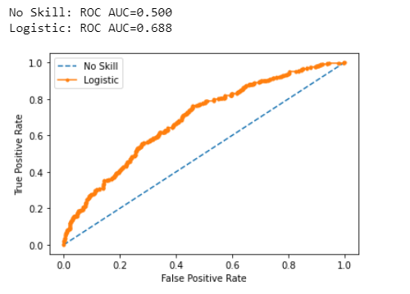
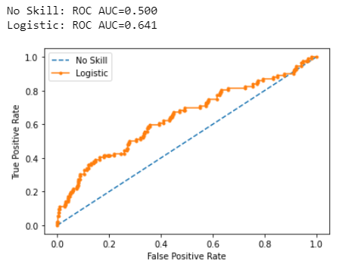
Receiver Operating Characteristic Curve
Train ROC curve
Test ROC curve

Slide 22
Trend Interpretation

Slide 25
Conclusion
Selected variables were based on No. of enquires, how much the applicant is in Debt , outstanding amount and whether the customer is salaried or not.
Detection of defaulters is identified in early stage because of the Acquisition Scorecard which was depicted in Lift table.
Train > 67.8 %
Test > 41.3 %.
With threshold values (KS) 0.3 and 0.23 respectively.
Model will allow credit underwriter to focus more on distinctive decisions and difficult accounts.

Slide 26
Thank you

