Slide 1

RULE OUT
THE GENDER GAP
PRESENTED BY : ANUDNYA WARE

Slide 2

Gender equality is intrinsically linked to sustainable development and is vital to the realization of human rights for all.
The overall objective of gender equality is a society in which women and men enjoy the same opportunities, rights and obligations in all spheres of life.

Slide 3
Overview of the Data
Objective:
To study or focus on the some parameters which result into equality/inequality among male & female.
Societal, organizational & personal issues often lead to inequality.
Throughout the study will
Understand some visualizations, conditional probabilities and perform chi-squared independence test/Fisher’s test for categorical variables.

Slide 4
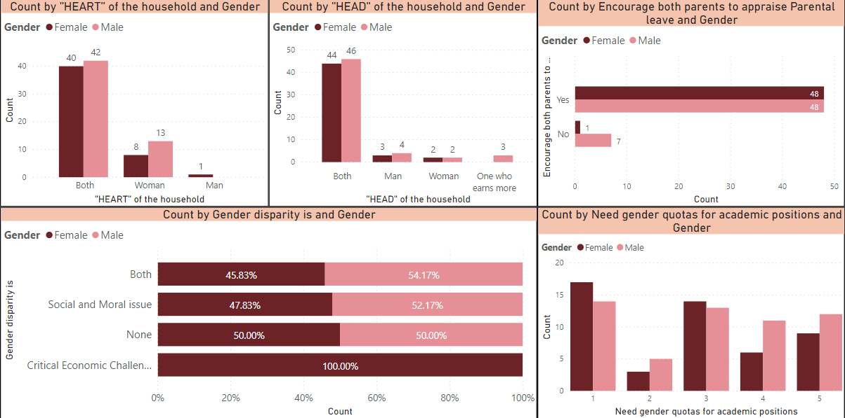
Some of the basic Visualizations to get the overview of data.

Slide 5
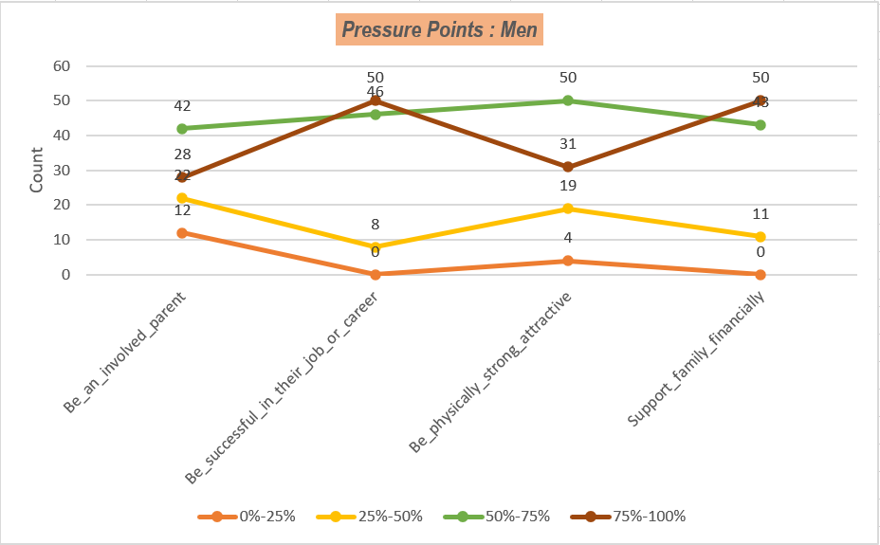
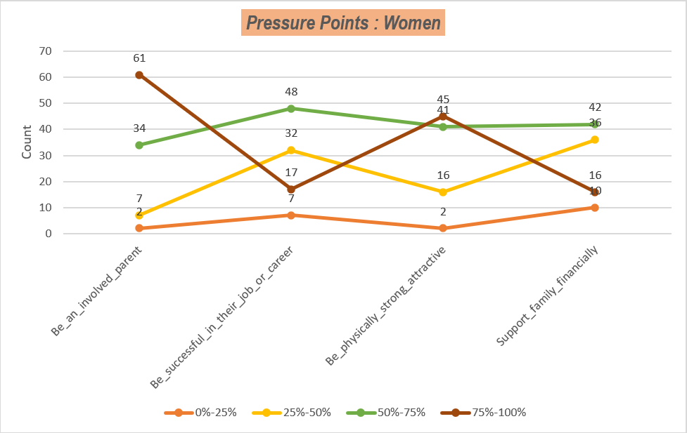
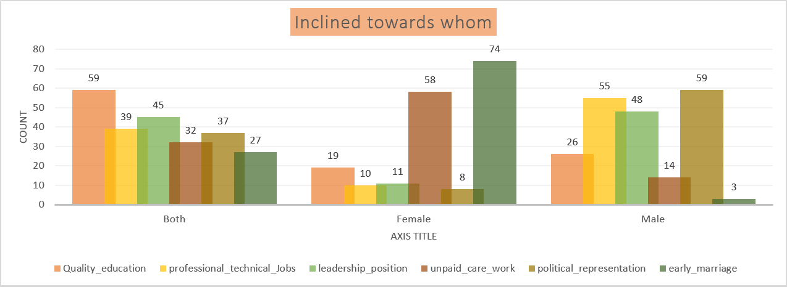
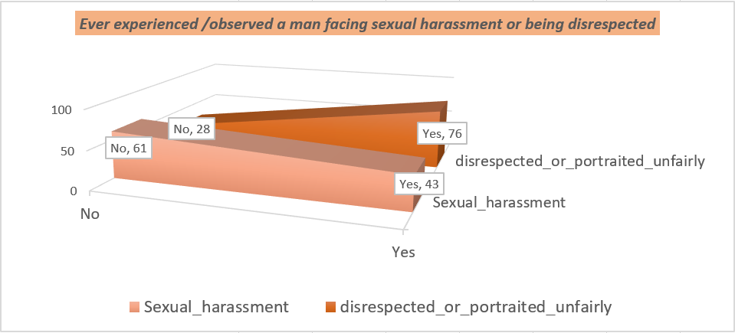
Comparative Graphs

Slide 6
Inclined towards whom (Conditional Probability)
PIVOT TABLE :
CONDITIONAL PROBABILITIES : X (ROWS) & Y(COLUMNS)
Generally for Professional technical jobs, Leadership position or Political representation, Men candidates are mostly chosen.
Given that the parameters are Unpaid care work or Early marriage, Women are highly inclined towards these.
Both men and women equally achieve Quality education.

Slide 7
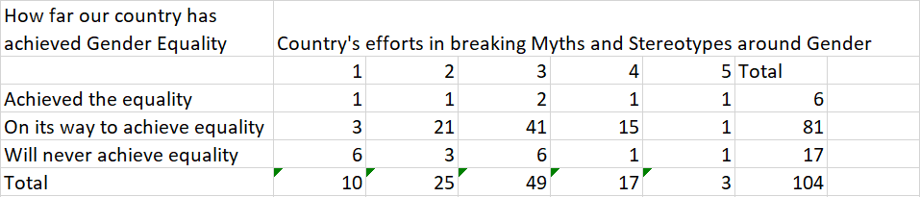

Hypothesis Testing : Non-Parametric Fisher’s Test & Independent Chi-squared Test.
HOW FAR OUR COUNTRY HAS ACHIEVED EQUALITY VS COUNTRY’S EFFORTS IN BREAKING MYTHS & STEREOTYPES.
Hypothesis :
H0 : For people who experienced Equality say that if Country is overcoming gender discrimination doesn't mean it is breaking all the myths and stereotypes.
H1 : For people who experienced Equality say that if Country is overcoming gender discrimination do mean it is breaking all the myths and stereotypes.
Filtered Data :
g <- gender %>% filter(Experienced.Gender.Inequality.in.your.institution == "No")
R codes :
fisher.test(table(g$How.far.our.country.has.achieved.Gender.Equality, g$Country.s.efforts.in.breaking.Myths.and.Stereotypes.around.Gender.), conf.int = T,conf.level = 0.95)
Decision Criterion :
Fisher's Exact Test for Count Data
p-value = 0.04562
alternative hypothesis: Two Sided
Rejecting H0 : People who experienced Equality mean to say that country overcoming discrimination do have some relation in breaking the myths and stereotypes.
Scale : 1(Min Efforts) – 5(Max Efforts)

Slide 8
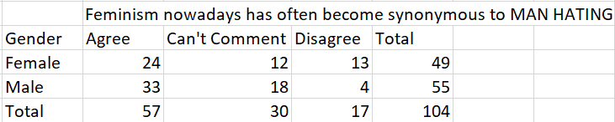
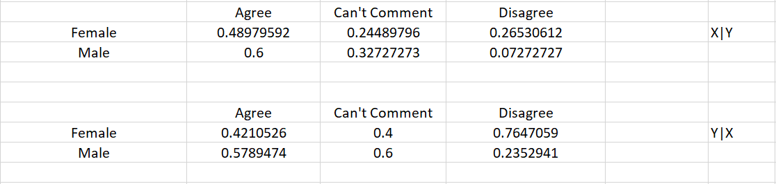
GENDER VS FEMINISM BECOMING SYNONYMOUS TO “MAN HATING”.
Hypothesis :
H0 : The thought of feminism becoming synonymous to MAN HATING don’t depend on gender.
R codes :
chisq.test(table(gender$Gender, gender$Feminism.nowadays.has.often.become.synonymous.to..MAN.HATING.), correct = FALSE)
Decision Criterion :
X-squared = 7.0631, df = 2, p-value = 0.02926
Rejecting H0 :
The thought of feminism becoming synonymous to “MAN HATING” depends on whether the voter is male or female.
Conditional Probability :
table(gender$Gender, gender$Feminism.nowadays.has.often.become.synonymous.to..MAN.HATING.) %>% prop.table(margin = 1)
table(gender$Gender, gender$Feminism.nowadays.has.often.become.synonymous.to..MAN.HATING.) %>% prop.table(margin = 2)
Given that the voter is a Female, Disagree with the thought of feminism becoming synonymous to “MAN HATING”.
Male show the highest proportion of A.

Slide 9
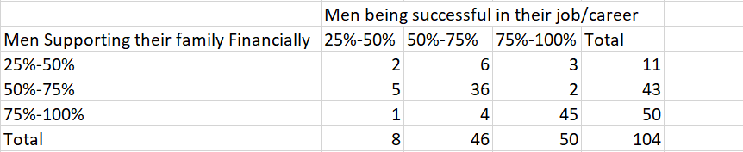
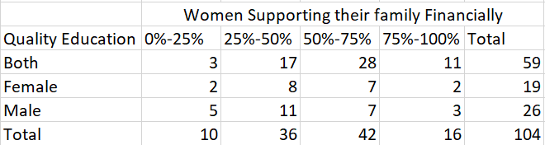
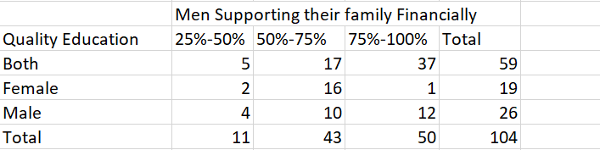
Hypothesis :
H0 : Men being successful in their job/career not necessarily support their family financially.
H1 : Men being successful in their job/career do support their family financially.
R Codes and Test statistic :
fisher.test(table(gender$Support.their.family.Financially.Men, gender$Be.successful.in.their.job.or.career.Men))
Fisher's Exact Test for Count Data
p-value < 2.2e-16
alternative hypothesis: two.sided
Decision Criterion :
Under H0 , If p-value <0.05 then reject H0
Rejecting H0 :
Men being successful in their job/career do support their family financially.
Hypothesis :
H0 : Educated Men not necessarily support their Family financially.
H1: Educated Men do support their Family financially.
Test statistic :
Fisher's Exact Test for Count Data
p-value = 6.695e-05
alternative hypothesis: two.sided
Decision Criterion :
Under H0 , If p-value <0.05 then reject H0
Rejecting H0 :
Educated Men do support their Family financially.
Hypothesis:
H0 : Educated Women not necessarily support their Family financially.
H1 :Educated Women do support their family financially.
Test statistic :
Fisher's Exact Test for Count Data
p-value = 0.2398
alternative hypothesis: two.sided
Decision Criterion :
Under H0 , If p-value > 0.05 then reject H0
Do not Reject H0 :
Educated Women not necessarily support their Family financially.

Slide 10
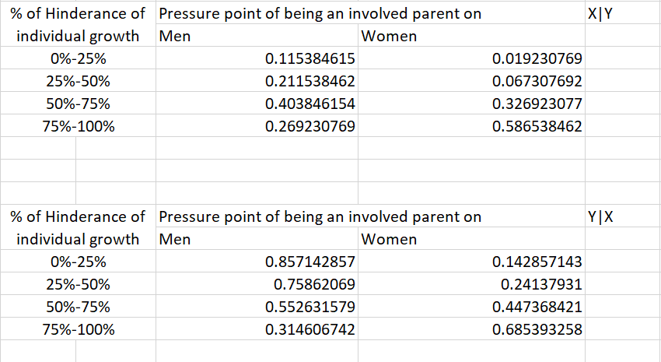


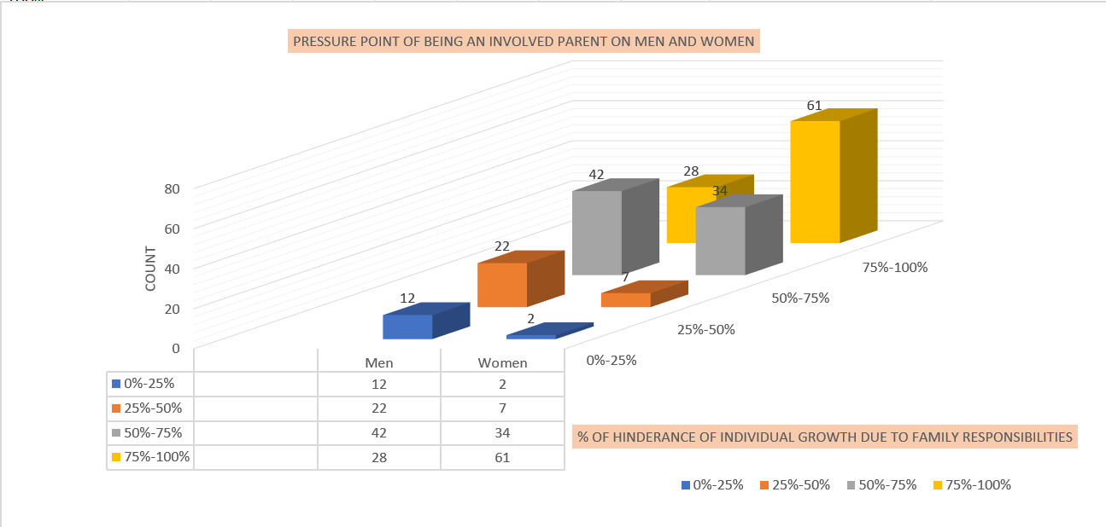


6/10
Given that Women is an involved parent,
there is a high probability of hinderance of individual growth due to family responsibilities.
1/10
Given that Men is an involved parent,
there is very low probability of hinderance of individual growth due to family responsibilities.

Slide 11








INSIGHTS
Digging into some of the equalities as well as inequalities faced by people based on gender through this survey.
Lets segregate the points on which we want to conclude our discussion by all the Visualizations, tests and tables evaluated.
SOCIETAL
FEMALE
MALE
SOCIETAL
ORGANISATIONAL
43%
57%
Almost an Even access to Quality education by male & female.
PERSONAL
47 %
36 %
People agree on gender equality might boost up global GDP.
85%
Uneven Job segregation.
15%
88%
Lack of political representation.
12%

Slide 12


INSIGHTS
F+M not necessarily equal to 100%
FEMALE
MALE
32%
26%
No need for gender quotas.
Feminism = MAN HATING
Have unequal agreement.
49%
60%
Research : Female have resources & initiatives to promote gender equity. Hence few women think they aren’t equal.
It is the time that we all see gender as a spectrum, instead of two sets of opposing ideals…..
Both Men & Women are free to be Sensitive,
Both Men & Women are free to be Strong.

Slide 13
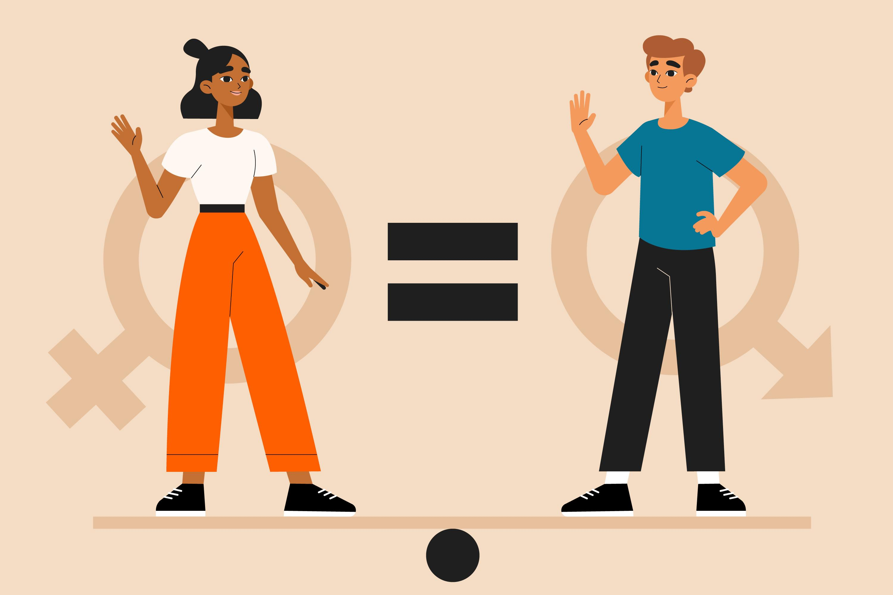
Any Questions ?
THANK YOU

