Slide 1
BLOOD COUNT
Submitted by:
Kannaboina Vinod Yadav
Gojur Ravi Kanth
Tokala Rajesh
Supervisor:
Mr. Kiran Kumar Kaki
Assistant Professor

Slide 2
INTRODUCTION
In the present situation searching for blood donors is done through blood bank centres or through toll free numbers.
Lots of time is wasted for going to blood bank if the particular type of blood is not available in case of urgency or emergency it leads to a bad situation.
We have created Blood Count app(React-Native based) which will provide you near by blood banks and availability of particular type of blood in the blood bank
We allow the user to donate, request of blood and we provide e-certificate after donation.

Slide 3
Reason for choosing react native
Cross-Platform Support
Reuse of code
Runs like a native app
Less Complexity
Simple to learn

Slide 4
Objectives
To allow probable recipients to make search by current location and get nearby blood banks.
To provide synchronized and centralized donor and blood stock database.
To provide immediate storage and retrieval of data and information.
The use of e-certificate for future use.
To help the people regarding blood during urgency and emergency situations.

Slide 5
Scope
The main purpose of this project is to interconnect all the blood banks, donors on to a single network.
This application provides the required information in less time and also helps out in quicker decision making.
Blood Banks, Request Blood, Donate Blood, E-Certificate are the important modules.

Slide 6
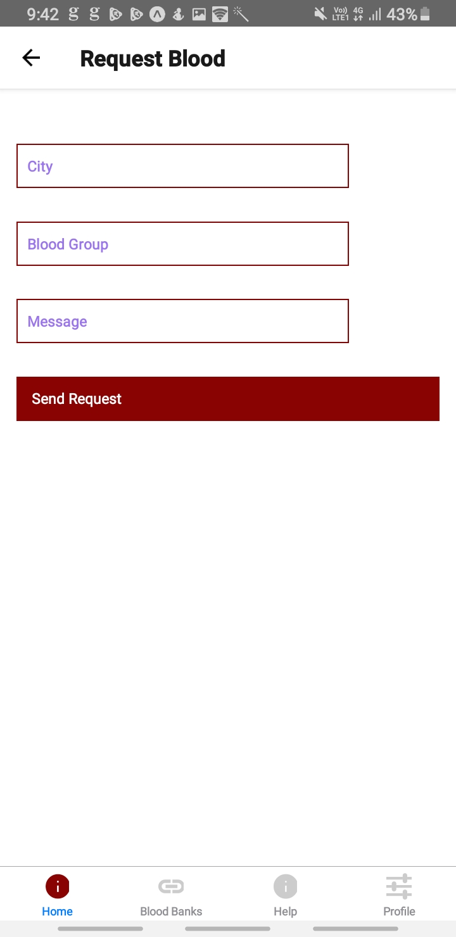
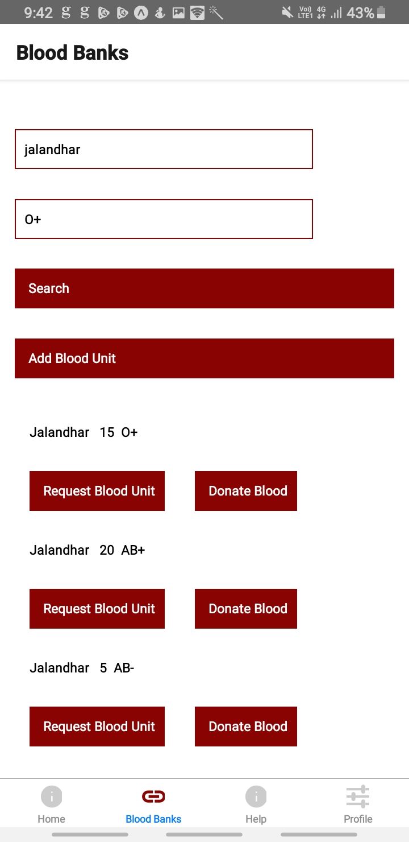
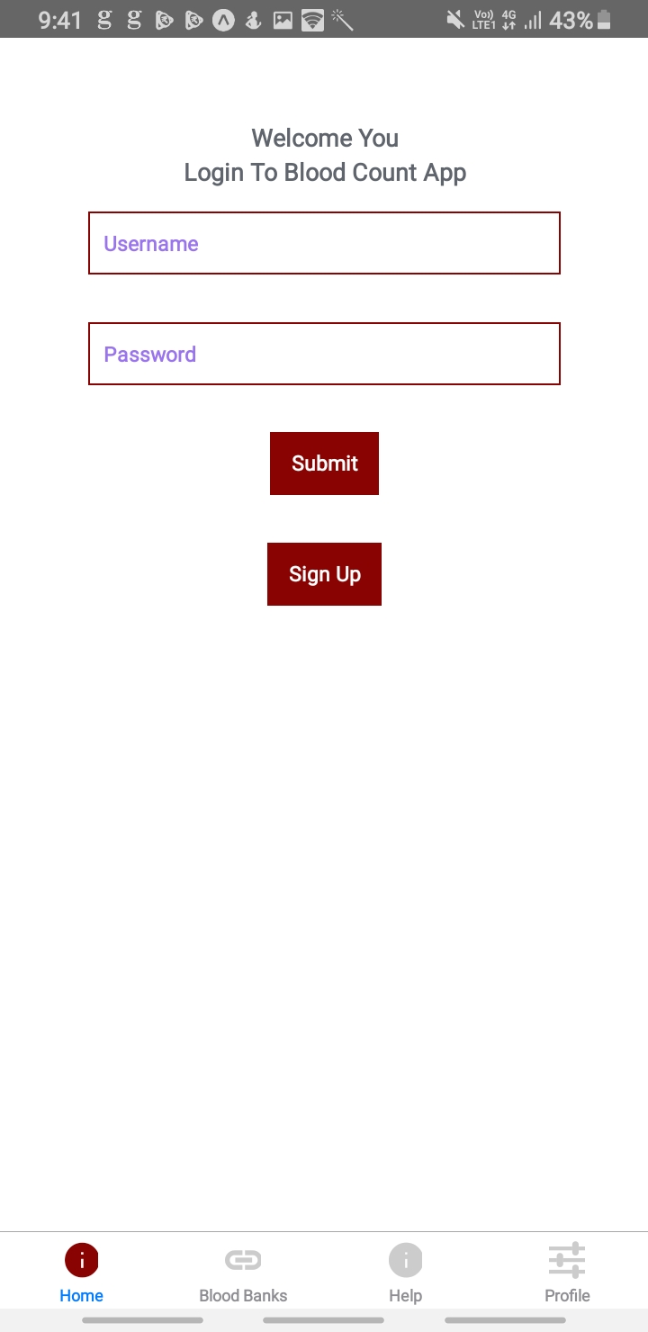
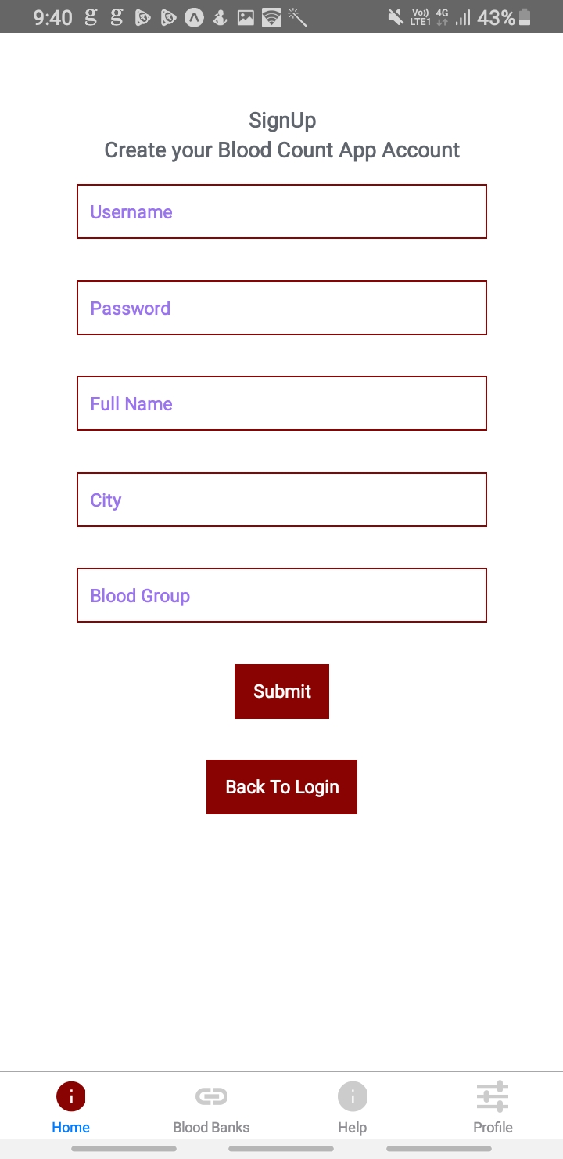
BLOOD COUNT
Shares blood

Slide 7
What is Blood Count?
Blood count is an application which provides online services , establishes connection between blood banks and people.
users donate and request blood.

Slide 8

Registration Module
Username
Password
Full name
City
Blood group

Slide 9
Login Module
Username
Password
Login button
Signup button

Slide 10
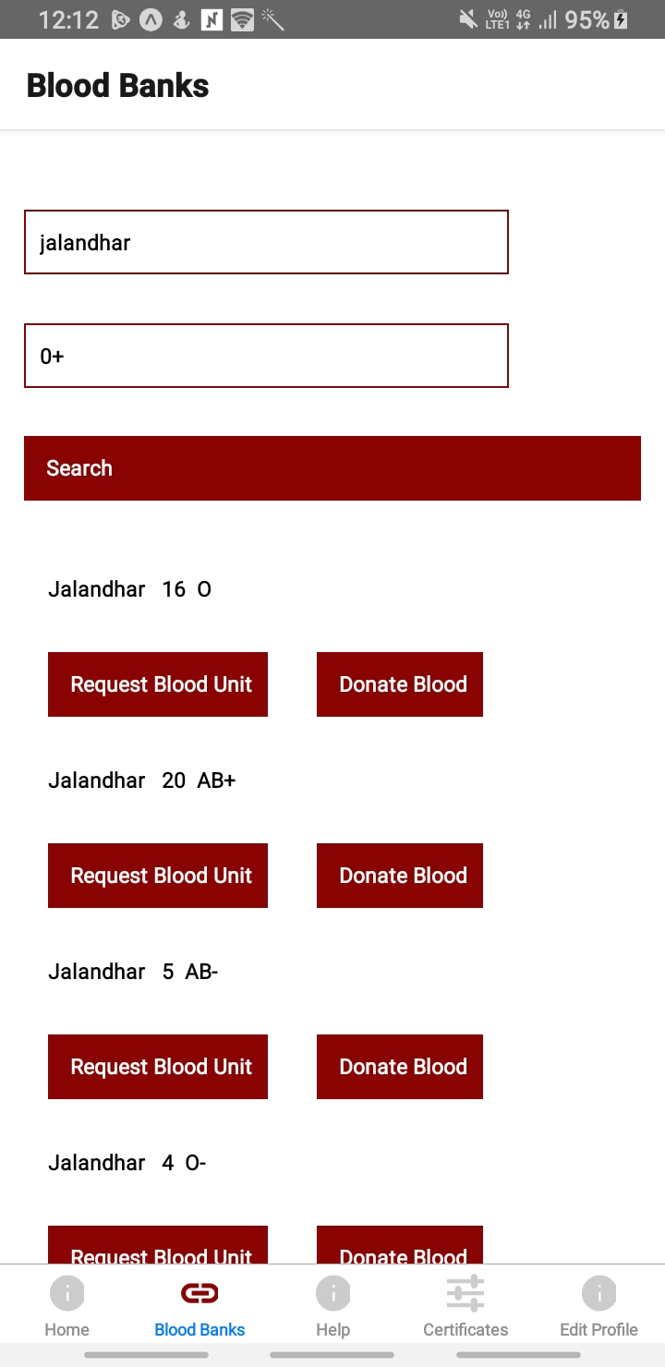
Blood bank search module
City
Blood group

Slide 11
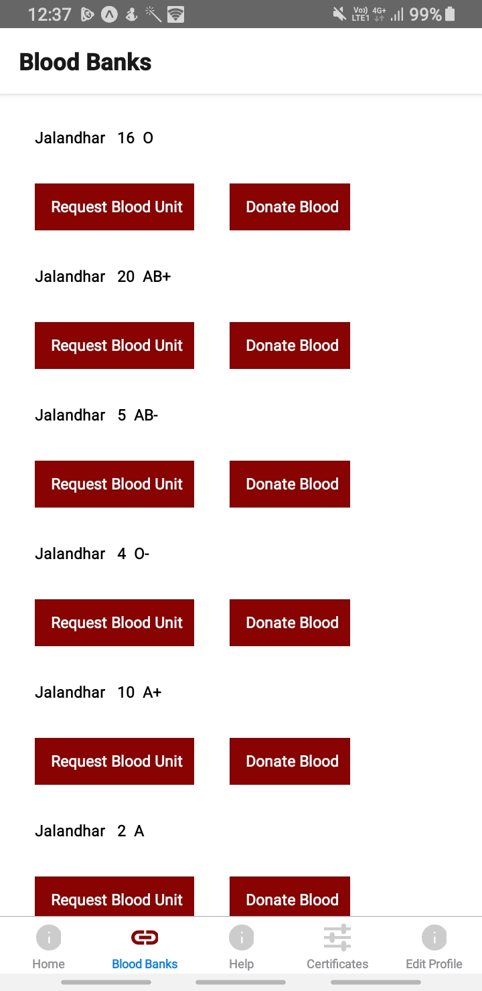
Blood bank details
Availability of blood
Request blood unit
Donate blood unit

Slide 12
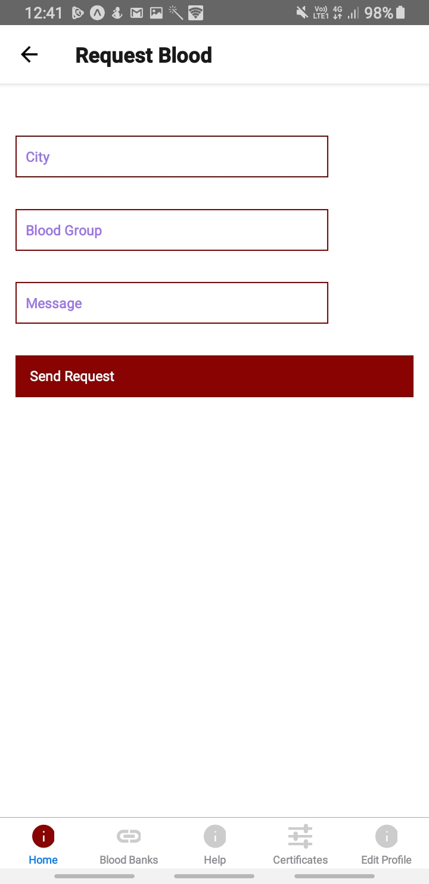
Request blood unit
City
Blood group
Message

Slide 13
When you click on send request it sends a message to the administrator requesting for a particular blood type in particular location.

Slide 14
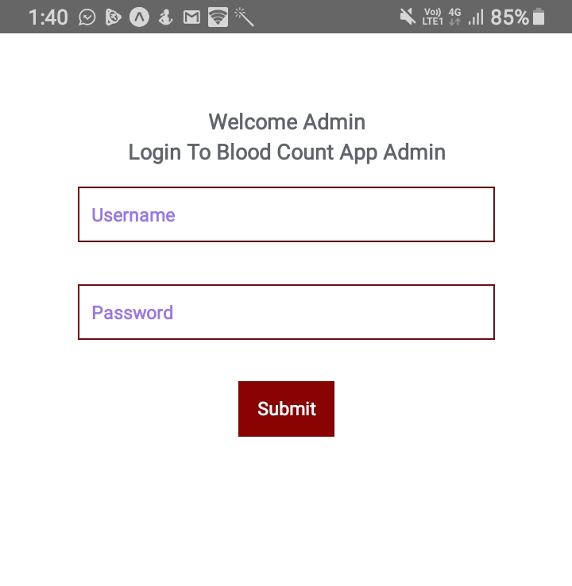
Admin login
Username
Password
Login button

Slide 15
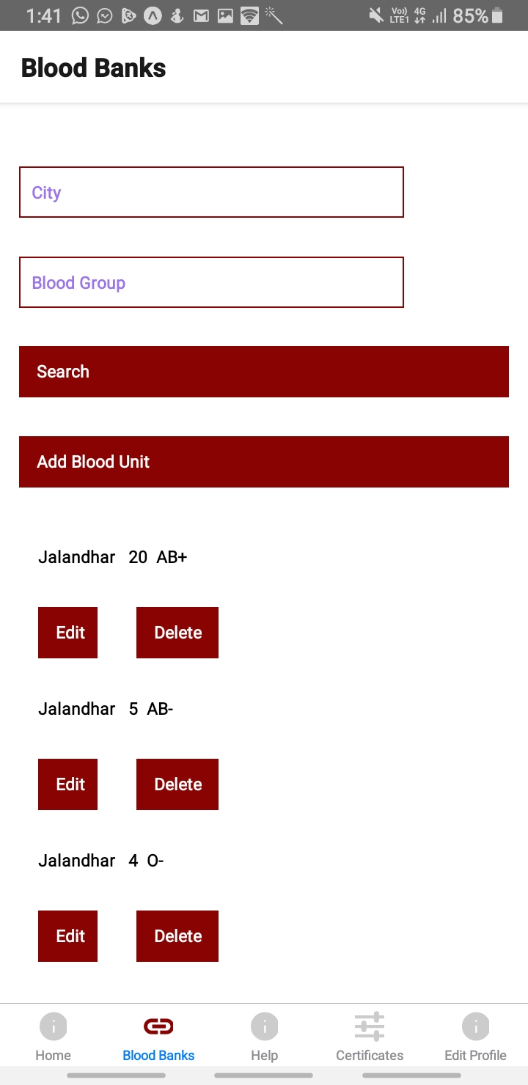
Blood bank search
City
Blood group
Add blood unit
Availability of blood
Edit and delete for Updation of blood availability

Slide 16
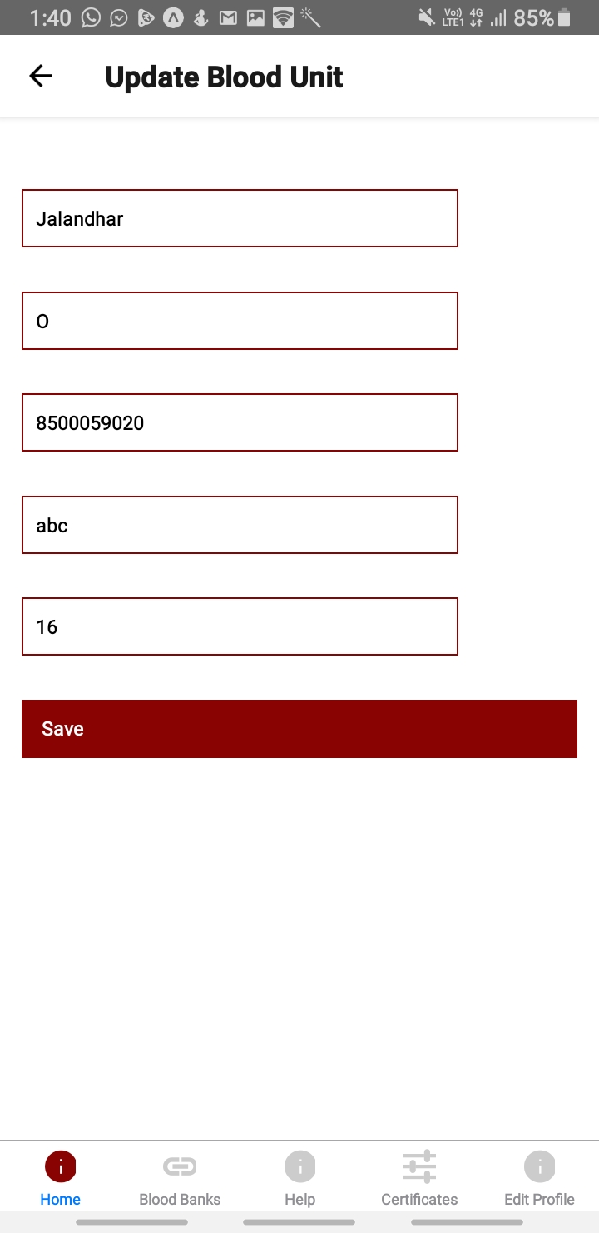
Updation of blood availability
City
Blood group
Mobile number
Blood bank name
Number of units

Slide 17
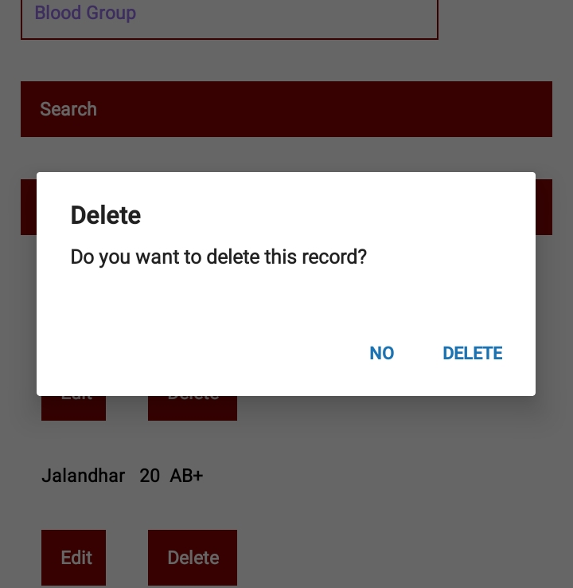
Update : Delete
On clicking deleting button it updates the availability

Slide 18
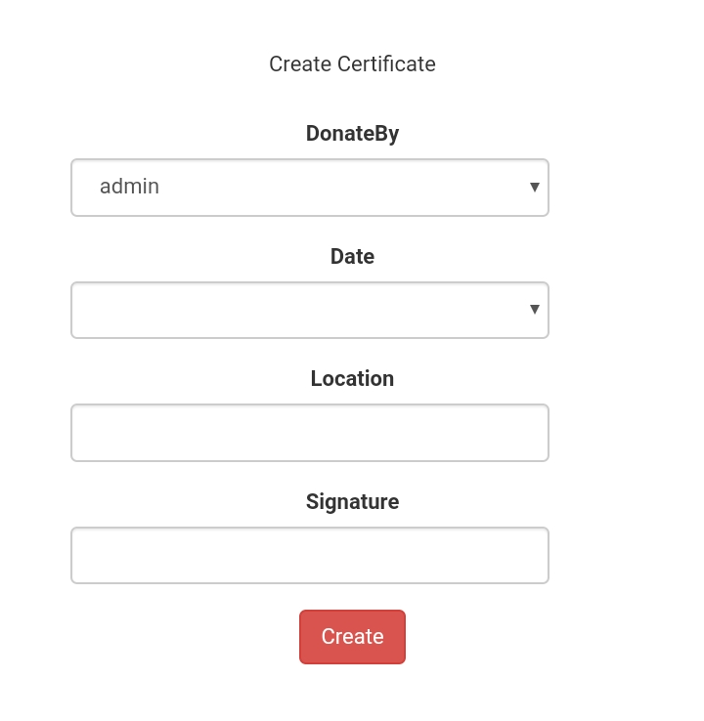
Generating certificate
Name of the Admin
Date
Location
signature

Slide 19
Conclusion and future scope
React Native is the future of mobile apps, which has cross-platform compatibility. The Blood Count app which we developed is useful to the society in emergency and it is available for both android and iOS users.
In the future we can make an IOT refrigerator to store the blood and to update the blood availability automatically.

