Slide 1


Airbnb Data Analysis

Slide 2
Introduction
Objective:
The Airbnb Data Analysis Project aims to explore and analyze a dataset from Airbnb, a popular online marketplace for short-term rentals. The project focuses on gaining insights and understanding various aspects of the Airbnb ecosystem, such as pricing trends, property types, geographic patterns, and other property related characteristics.
Benefits:
Market Insights
Pricing Optimization.
Business Strategy Development.
Data-Driven Decision Making
Competitive Advantage
Dataset:
The dataset was taken from: https://drive.google.com/drive/folders/1ANkgtAT0Pdp2r86IxFKv9vKYmnsYjJDO?usp=sharing and the name of the file is airbnb prices.csv

Slide 3
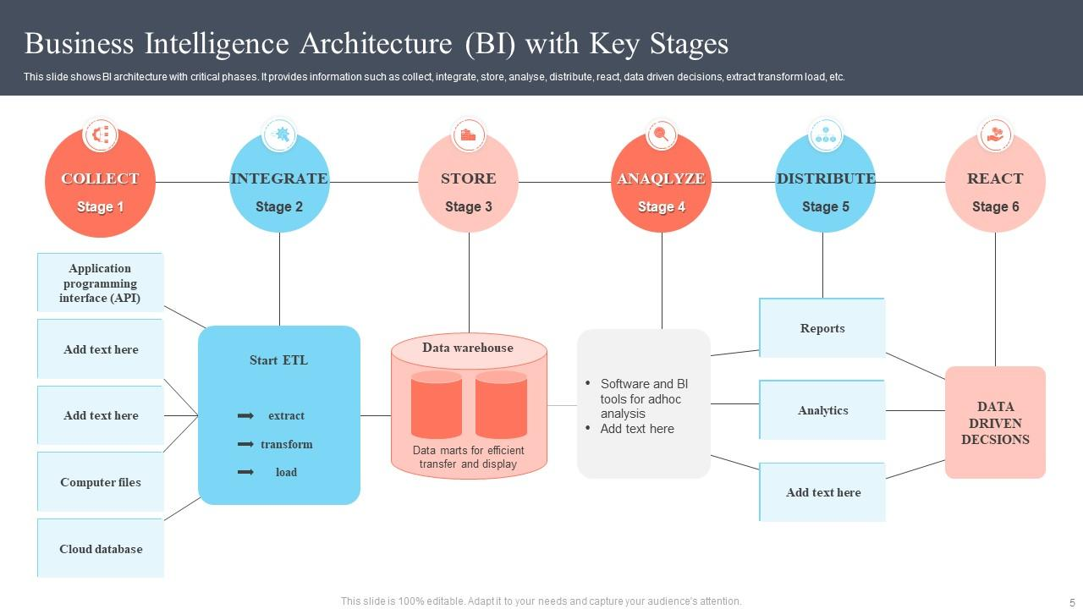
Architecture

Slide 4
Data Collection
The data was collected from airbnb prices.csv file into a pandas data frame using jupyter notebook interface. The data consists of:
Number of rows:18723
Number of Columns: 20
Column names: 'room_id', 'survey_id', 'host_id', 'room_type', 'country', 'city’, 'borough', 'neighborhood', 'reviews', 'overall_satisfaction', 'accommodates', 'bedrooms', 'bathrooms', 'price', 'minstay', 'name’, 'last_modified', 'latitude', 'longitude', 'location’.
Column data type: float64(9), int64(5), object(6)

Slide 5
Data cleaning
The airbnb prices.csv dataset consists of missing values in the columns country, borough, bathrooms, minstays and name.
We have filled the null values with appropriate values which helps us to carry on further analysis without dropping any of the feature of the dataset and without affecting other features.
To do this fillna() method of pandas was used to fill in appropriate values wherever necessary.
Due to this data cleaning process we have now obtained a clean dataset which can be further used to perform EDA.

Slide 6
We have performed Exploratory Data Analysis (EDA) on the clean dataset.
In this we have taken steps to find out answers to the questions given in the problem statement which are as follows:
Regarding the Host
Who are top earners
Is there any relationship between monthly earning and prices
Regarding the Neighborhood
Any particular location getting maximum number of bookings
Price relation with respect to location
Regarding the reviews
Relationship between Quality and Price
Regarding Price
Price vs amenities
Price vs location
Exploratory Data Analysis (EDA)

Slide 7
Insights and Findings
The top 5 earners are:-
1. Zonnige woonboot,centraal en rustig
2. One public bedroom
3. AmsterdamBase
4. Welkom in noordzijde
5. Ultra luxe dreamboat
the bottom 5 earners are:-
1. Kattenoppas gezocht
2. Relax 9 hours!
3. Nice room in de Pijp
4. Cozy Studio
5. Minimalist White Room
top 5 locations with highest number of bookings are:-
1. 0101000020E6100000DAFE9595268513402C82FFAD642F4A40 532 The Backroom - Central private appt
2. 0101000020E6100000AA46AF06286D134077BB5E9A222E4A40 465 Cozy Studio 1 - Perfect for Couple!
3. 0101000020E6100000AE11C138B8941340AEB8382A372F4A40 463 Rebel (Private Room)
4. 0101000020E61000009D9FE238F06A1340478D093197304A40 452 Independant studio with balcony and WiFi
5. 0101000020E6100000965E9B8D959813405DA96741282F4A40 447 Amsterdam Houseboat 'Centre’

Slide 8
Insights and Findings
Any Airbnb property having price above € 2000 are having Overall satisfaction or Quality as 0 i.e. they are not offering the quality of services according to their high price. On the other hand majority of properties under € 2000 are having Overall satisfaction or Quality either 3 or above or 0 i.e. customers may get good Quality service which is in accordance with the price and there is a probability of getting very low quality also.
Most of the properties are distributed within the price range of € 0 to € 1000 irrespective of the people they accommodate and the rest in the range of € 1000 to € 2000 irrespective of the people they accommodate. Only 2 properties in Amsterdam are significant outliers in which one accommodates 2 people and it's price is € 6000 and the other accommodates 16 people and it's price is € 3770
De Baarsjes / Oud West and Centrum West generate the most revenue and Westpoort generates the least revenue
Out of all the properties, 80% of the room types are Entire home/apt, 19.7% are Private room and 0.336% are shared room
From the above graph we can compare prices across each of the room types among various neighborhoods and select the lowest price in the neighborhood which is closest to the place of visit.
From the above graph we can see that De Baarsjes / Oud West neighborhood gets the max no. of bookings i.e. 3289 bookings

Slide 9
Data Visualization
We have used charts, graphs, maps, and other visual elements to represent and convey the insights gathered from the data, visually.
We have used bar charts, pie charts, scatter plots, folium maps etc. wherever appropriate to convey the information effectively.

Slide 10
Conclusions
We have successfully completed the data analysis of the Airbnb dataset.
In this project we started with importing various libraries required for data analysis, visualisation and for plotting the map using the latitude and longitude .We then read the data set from the csv file into pandas data frame.
We then carried out the initial investigation of the data set followed by automated exploratory data analysis using pandas profiling library.
Then we performed data cleaning and preparation of the data set and obtained a clean data set without the missing values and null values.
After this we performed the exploratory data analysis.
In this we identified the Top 10 earners as well as the bottom 10 earners.
We then obtained the top locations with the highest number of bookings.
We then analyzed price with respect to the location and the neighborhood name with respect to the average price.
We then analyzed the relationship between quality and price, price and amenities and price versus location. ### We then found out the number of properties with respect to the room type and the neighborhood price by room type.
We also found the top 5 neighborhoods with maximum booking.
All these findings were also plotted graphically using various charts to properly visualize the data and to draw insights more conveniently.
We then plotted the latitude and the longitude coordinates of all the 18723 Airbnb properties.
At last we obtained a conclusive report using the D Tale library.

