Slide 1
PQC-MAV
A Complete Post-Quantum Cryptographic Tunnel for UAV–GCS Communication
Burak Güneysu
Department of Computer Science • February 2026
72
3
3
19,600
Cipher Suites
KEM Families
Scenarios
Benchmarks

Slide 2
Presentation Outline
1. Motivation & Problem Statement
2. System Architecture – Bump-in-the-Wire Tunnel
3. Post-Quantum Cryptography Primer
4. 72 Cipher Suite Registry – KEMs, SIGs, AEADs
5. PQC Handshake & AEAD Framing Protocol
6. Benchmark Methodology & Hardware Testbed
7. KEM Primitive Performance Analysis
8. Signature & AEAD Benchmark Results
9. End-to-End Handshake Results (All 72 Suites)
10. Pareto-Optimal Suites & Rekey Overhead
11. DDoS Detection Models – XGBoost & TST
12. Three-Scenario Benchmark Comparison
13. DDoS Overhead Analysis & Cross-Run Delta
14. Adaptive Policy & Graceful Degradation
15. Key Findings & Conclusions
1

Slide 3
01
Motivation & Problem Statement
Why post-quantum cryptography for drones?
2

Slide 4
The Quantum Threat to UAV Communications
■ Modern UAVs use MAVLink 2.0 protocol – compact binary telemetry up to 320 Hz
■ Current protection relies on classical crypto: RSA, ECDH, ECDSA
■ NIST warns: quantum computers will break ALL classical key exchange
■ Three critical challenges for drone PQC deployment:
① Extreme performance heterogeneity – KEM keygen spans 4 orders of magnitude
② Resource constraints – RPi 5 at 3.8W power budget, 80°C thermal limit
③ Safety continuity – MAVLink heartbeats must arrive within 5 seconds
■ No prior work implements a complete PQC tunnel for real MAVLink traffic
■ PQC-MAV is the first bump-in-the-wire PQC tunnel for UAV–GCS links
3

Slide 5
02
System Architecture
PQC-MAV: A transparent bump-in-the-wire tunnel
4

Slide 6
Tunnel Architecture Overview
■ Bump-in-the-wire proxy: zero changes to MAVProxy / QGroundControl
■ Data Path (bidirectional):
Pixhawk FC → MAVProxy (serial) → PQC Proxy → [ENCRYPTED] → PQC Proxy → MAVProxy → QGC
■ Controller–Follower model:
• Drone (RPi 5) = Controller – initiates suite changes, manages rekey
• GCS (Windows 11) = Follower – executes commands via JSON-RPC (TCP:48080)
■ Two-phase rekey: Prepare → Commit → Abort/Rollback
• Blackout = T_startup (~3s) + T_handshake
• Failed suites are blacklisted (TTL: 30 min)
■ Clock synchronisation via Operation Chronos (NTP-lite, 3-message)
5

Slide 7
Hardware Testbed
■ Drone (uavpi):
• Raspberry Pi 5 – ARM Cortex-A76 (4 cores)
• 3,796 MB RAM, Linux 6.12.47+rpt
• Python 3.11.2, liboqs 0.12.0
• Power: INA219 sensor at 1,100 Hz / RPi5 hwmon
■ GCS (lappy):
• Windows 11 x86-64
• Python 3.11.13, liboqs 0.12.0
■ Network: Ethernet LAN (sub-ms RTT)
■ MAVLink: Pixhawk SITL at 320 Hz telemetry rate
6

Slide 8
03
Post-Quantum Cryptography Primer
NIST standards & mathematical assumptions
7

Slide 9
PQC Algorithm Families
■ KEM (Key Encapsulation Mechanism) – replace Diffie-Hellman:
• ML-KEM (FIPS 203) – Module Learning-with-Errors (lattice)
• HQC – Hamming Quasi-Cyclic codes
• Classic McEliece – Binary Goppa codes (Niederreiter)
■ Digital Signatures – replace RSA/ECDSA:
• ML-DSA (FIPS 204) – Module-LWE lattice signatures
• Falcon – NTRU lattice + fast Fourier sampling
• SPHINCS+ (FIPS 205) – Stateless hash-based signatures
■ AEAD (Authenticated Encryption with Associated Data):
• AES-256-GCM – NIST standard, HW-accelerated on x86
• ChaCha20-Poly1305 – Software-friendly (Bernstein)
• Ascon-128a – Lightweight, NIST LWC winner
■ NIST Security Levels: L1 (AES-128), L3 (AES-192), L5 (AES-256 equivalent)
8

Slide 10
04
72 Cipher Suite Registry
9 KEMs × 8 SIGs × 3 AEADs = 72 NIST-level-matched suites
9

Slide 11
Suite Construction Formula
■ Suite Registry S = { (KEM_i, SIG_j, AEAD_k) | Level(KEM_i) = Level(SIG_j) }
■ 9 KEMs: ML-KEM-{512,768,1024}, HQC-{128,192,256}, McEliece-{348864,460896,8192128}
■ 8 SIGs: ML-DSA-{44,65,87}, Falcon-{512,1024}, SPHINCS+-{128s,192s,256s}
■ 3 AEADs: AES-256-GCM, ChaCha20-Poly1305, Ascon-128a
■ Level distribution:
• L1 = 3 KEMs × 3 SIGs × 3 AEADs = 27 suites
• L3 = 3 KEMs × 2 SIGs × 3 AEADs = 18 suites (no Falcon at L3)
• L5 = 3 KEMs × 3 SIGs × 3 AEADs = 27 suites
─────────────────────────────────────────────
Total: 72 cipher suites
■ Algorithm diversity: 3 distinct mathematical assumptions (lattice, quasi-cyclic code, Goppa code)
■ Suite ID format: cs-{kem}-{aead}-{sig} e.g., cs-mlkem768-aesgcm-mldsa65
10

Slide 12
05
PQC Handshake & AEAD Framing
KEM + SIG + HKDF handshake with deterministic nonces
11

Slide 13
PQC Handshake Protocol (3 Messages)
■ Message 1 – ServerHello (GCS → Drone):
• GCS generates ephemeral KEM keypair: (pk, sk) ← KEM.Keygen()
• Signs transcript: σ ← SIG.Sign(sk_GCS, ver ‖ kem_name ‖ sig_name ‖ sid ‖ pk)
• Sends: ver ‖ pk ‖ σ ‖ sid ‖ challenge
■ Message 2 – ClientFinish (Drone → GCS):
• Verifies signature (anti-downgrade)
• KEM encapsulation: (ct, ss) ← KEM.Encaps(pk)
• Sends: ct ‖ HMAC-SHA256(PSK, ct ‖ challenge)
■ Message 3 – Key Derivation (both sides):
• GCS verifies HMAC, decapsulates: ss ← KEM.Decaps(sk, ct)
• k_d→g ‖ k_g→d = HKDF-SHA256(ss, salt, ver ‖ sid ‖ kem ‖ sig)
• Directional keys prevent reflection attacks
■ AEAD Wire Format: 22-byte header (AAD) + encrypted payload + 16-byte tag
• Nonce = epoch(4B) ‖ seq(8B) — never transmitted, reconstructed
• Anti-replay: sliding-window bitmap (64+ packets)
12

Slide 14
06
Benchmark Methodology
19,600 timed operations + 72 end-to-end tunnel runs
13

Slide 15
Benchmarking Approach
■ Three-tier benchmarking:
Tier 1: Primitive-level (KEM/SIG/AEAD operations, n=200 each)
Tier 2: DDoS overhead measurement (per-handshake with detector active)
Tier 3: End-to-end tunnel – full 110s MAVLink session per suite
■ Three scenarios (each runs all 72 suites):
• Baseline (No DDoS) – run 20260211_141627 – pure tunnel performance
• + XGBoost Detector – run 20260211_150013 – fast ML detection overhead
• + TST Detector – run 20260211_171406 – heavy DL detection overhead
■ Per-suite data pipeline:
Drone scheduler → start_proxy RPC → handshake → 110s traffic → stop → merge metrics → JSON
■ 18 metric categories (A–R): crypto_identity, handshake, crypto_primitives,
data_plane, latency, MAVProxy, fc_telemetry, system, power/energy, validation
■ 432 total JSON files (72 suites × 2 endpoints × 3 scenarios)
14

Slide 16
07
KEM Primitive Performance
Four orders of magnitude – from 0.08 ms to 8,835 ms
15

Slide 17
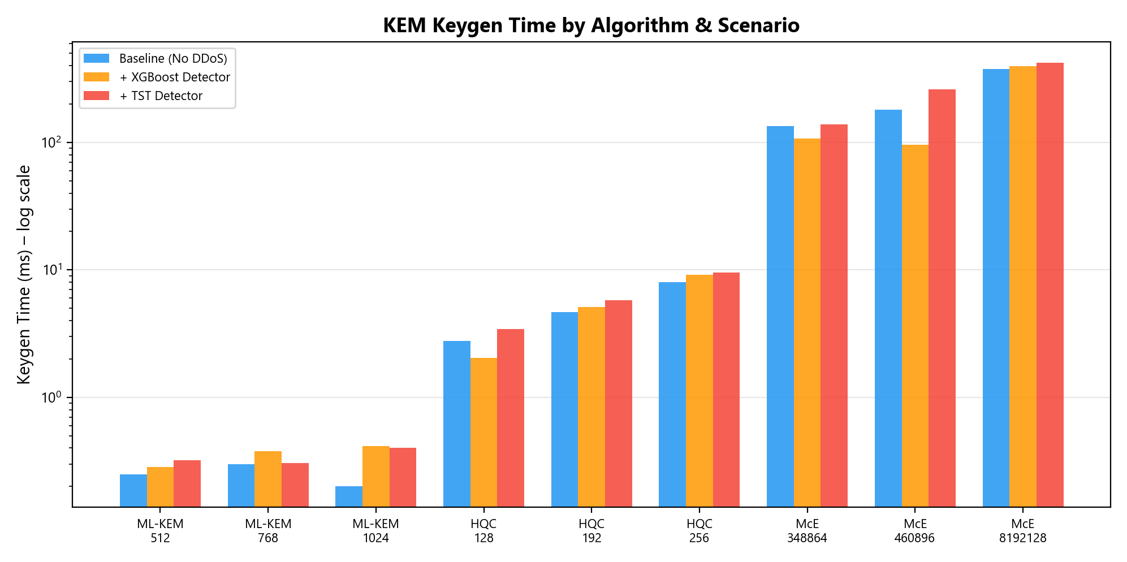
KEM Keygen Time Across Algorithms & Scenarios
Median keygen times (log scale) – ML-KEM is sub-millisecond, McEliece is seconds
16

Slide 18
KEM Performance – Key Findings
■ Key Finding 1: ML-KEM dominates in speed
• ML-KEM-512: 0.08 ms keygen | ML-KEM-1024: 0.14 ms keygen
• 3 orders of magnitude faster than HQC (22–392 ms)
• 5 orders faster than McEliece keygen (333–8,835 ms)
■ Key Finding 2: McEliece has extreme variance
• McEliece-8192128: σ = 857 ms (probabilistic key generation)
• Worst case keygen: up to 36.6 seconds!
• Unsuitable for time-bounded rekey operations
■ Key Finding: Public key sizes vary enormously
• ML-KEM-512: 800 bytes vs. McEliece-8192128: 1,357,824 bytes (1.36 MB)
• 867× size difference → bandwidth and memory implications
■ Across all 3 scenarios, KEM primitive times are consistent
→ DDoS detection does NOT affect the crypto layer
17

Slide 19
08
Signature & AEAD Benchmarks
SPHINCS+ signing > 1 second • AEAD is a non-factor
18

Slide 20
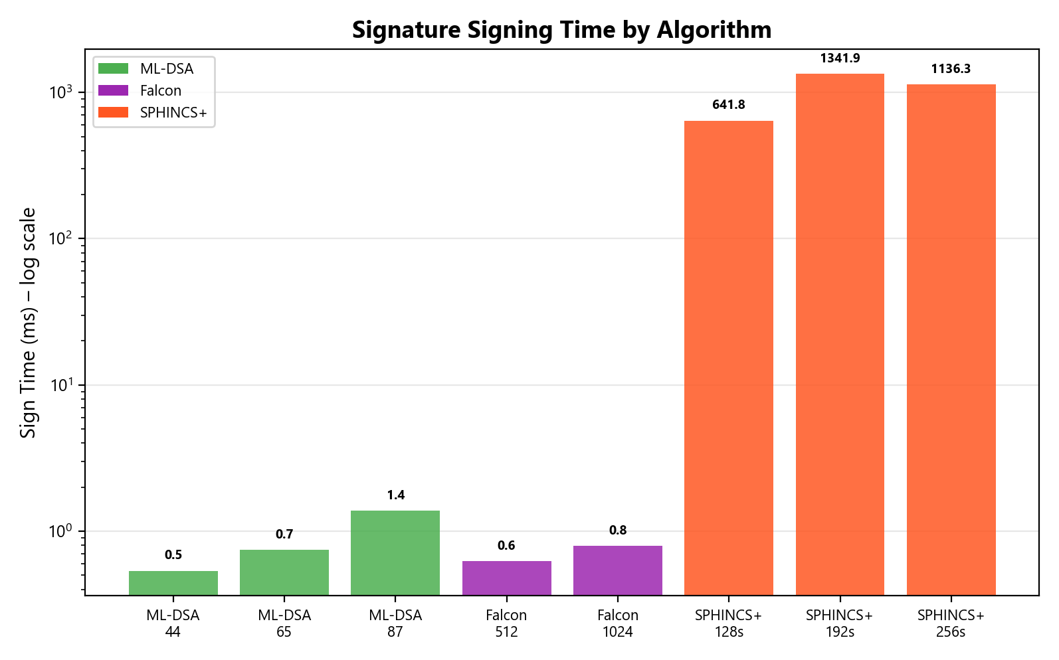
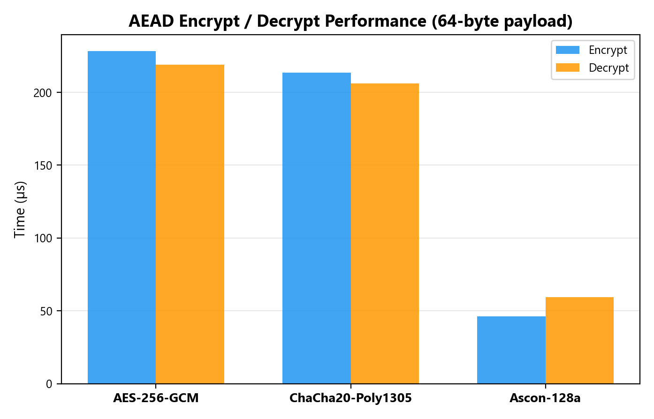
Signature & AEAD Performance
SIG sign times by algorithm (log scale)
AEAD encrypt/decrypt (µs)
19

Slide 21
SIG & AEAD – Key Findings
■ Signature Performance:
• Falcon-512: sign 0.65 ms, verify 0.11 ms – fastest combo
• ML-DSA-65: sign 1.59 ms, verify 0.38 ms – good all-rounder
• SPHINCS+-128s: sign 1,461 ms – >1000× slower than Falcon!
• SPHINCS+ is the dominant bottleneck in any suite that includes it
■ Key Finding 3: AEAD algorithm choice is a non-factor
• AES-256-GCM: 7.3 µs | ChaCha20: 6.7 µs | Ascon-128a: 4.1 µs
• Max difference: 3.5 µs/packet → 1.12 ms/sec at 320 Hz = 0.11%
• Ascon is 44% faster (no AES-NI on ARM Cortex-A76)
• AEAD selection should be driven by side-channel resistance, not performance
■ Conclusion: Rekey decisions should focus on KEM + SIG, not AEAD
20

Slide 22
09
End-to-End Handshake Results
71/72 suites succeeded • Complete tunnel validation
21

Slide 23
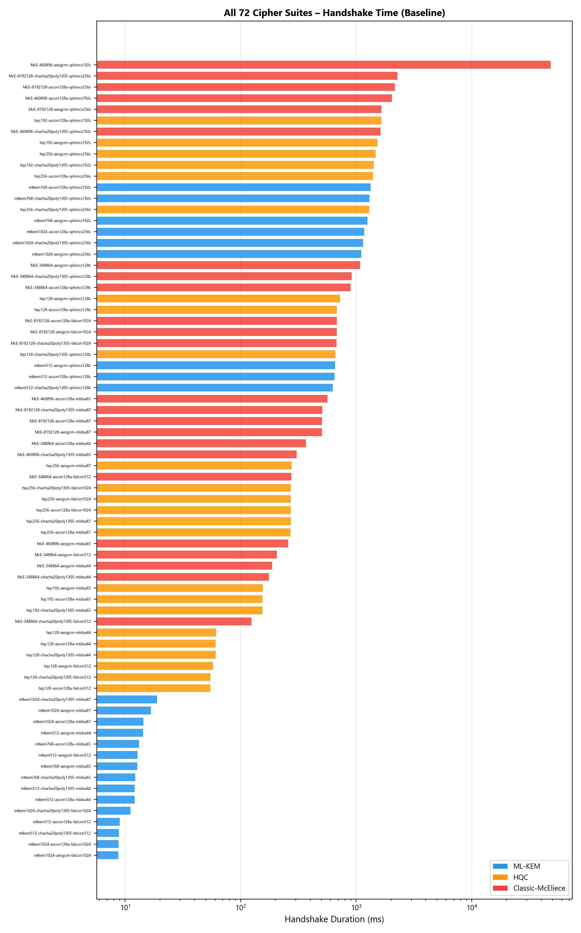
All 72 Cipher Suites – Baseline Handshake Time
Horizontal bars: sorted by handshake duration (log scale)
22

Slide 24
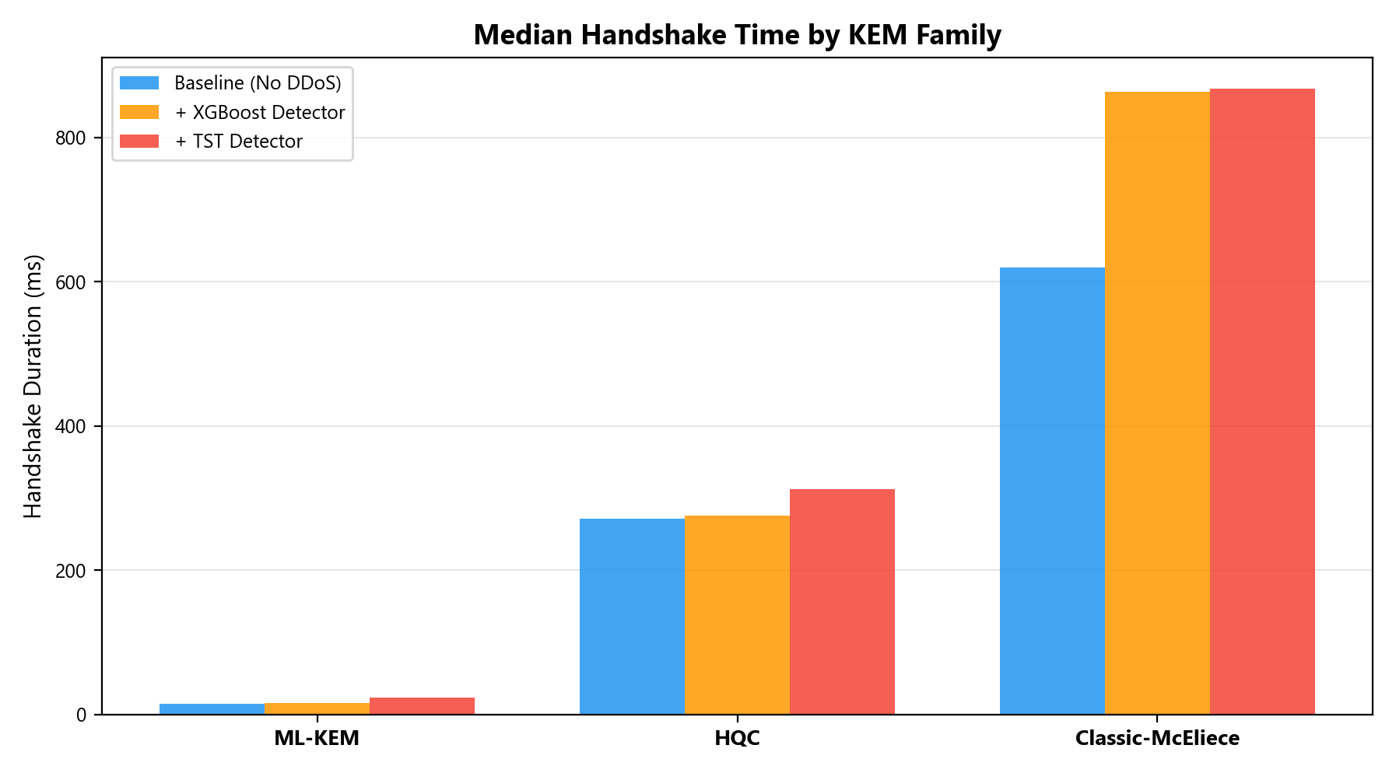
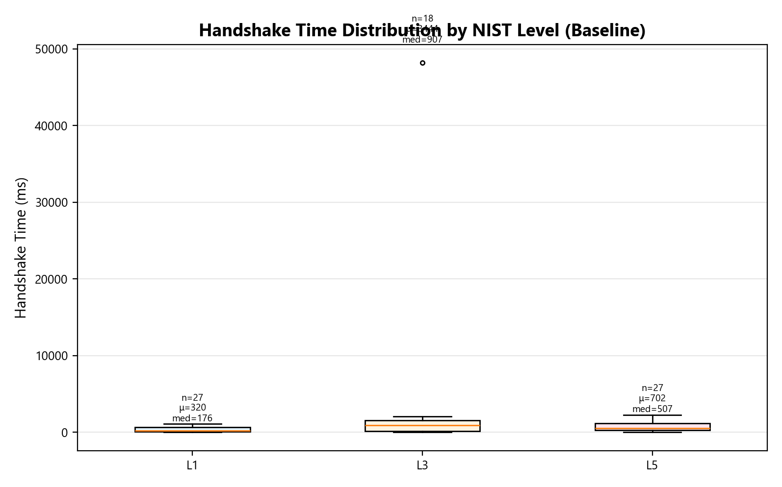
Handshake Analysis: By KEM Family & NIST Level
Median handshake time by KEM family across scenarios
Handshake distribution by NIST level (baseline)
23

Slide 25
End-to-End Handshake – Key Statistics
■ 71/72 suites completed successfully
• 1 timeout: McEliece-460896 + SPHINCS+-192s (combined weight)
■ By NIST Level (baseline):
• L1: n=27, mean=290 ms, median=123 ms, P95=835 ms
• L3: n=17, mean=749 ms, median=416 ms, P95=1,583 ms
• L5: n=27, mean=855 ms, median=870 ms, max=3,273 ms
■ By KEM Family (baseline median):
• ML-KEM suites: ~10–22 ms (without SPHINCS+)
• HQC suites: ~100–400 ms
• McEliece suites: ~400–3,000+ ms
■ Regression: log₁₀(T_hs) = −2.39 + 0.30·log₁₀(pk_size) + 0.97·log₁₀(sig_size)
R² = 0.67 – Signature size is the dominant predictor (β = 0.97)
24

Slide 26
10
Pareto-Optimal Suites & Rekey Overhead
Identifying the best security-performance trade-offs
25

Slide 27
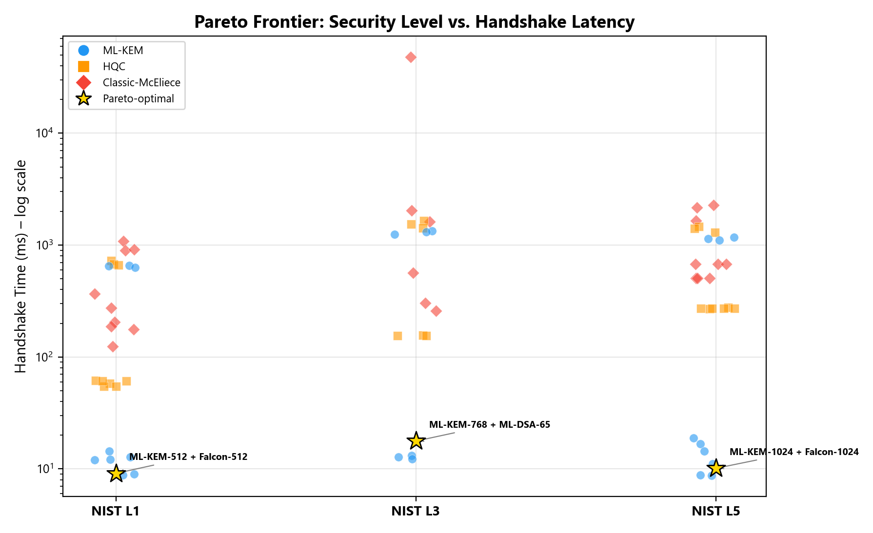
Pareto Frontier: Security Level vs. Handshake Latency
All suites plotted; gold stars = Pareto-optimal (ML-KEM + Falcon/ML-DSA)
26

Slide 28
Pareto-Optimal Suites & Rekey Overhead
■ Three Pareto-Optimal Suites (all use ML-KEM):
★ L1: ML-KEM-512 + Falcon-512 → 9.1 ms handshake
★ L3: ML-KEM-768 + ML-DSA-65 → 17.7 ms handshake
★ L5: ML-KEM-1024 + Falcon-1024 → 10.1 ms handshake
■ Rekey Overhead Fraction: Φ(R) = T_hs / (R + T_hs)
At R = 60s rekey interval:
• ML-KEM-768: Φ = 0.029% ✓ negligible
• HQC-256: Φ = 0.45% ⚠ acceptable
• McE-8192128: Φ = 0.85% ✗ high overhead
■ 29× difference between ML-KEM and McEliece overhead!
■ Key Finding 5: Runtime cipher-suite management is NOT optional –
operating heavy suites with aggressive rekey intervals degrades MAVLink availability
27

Slide 29
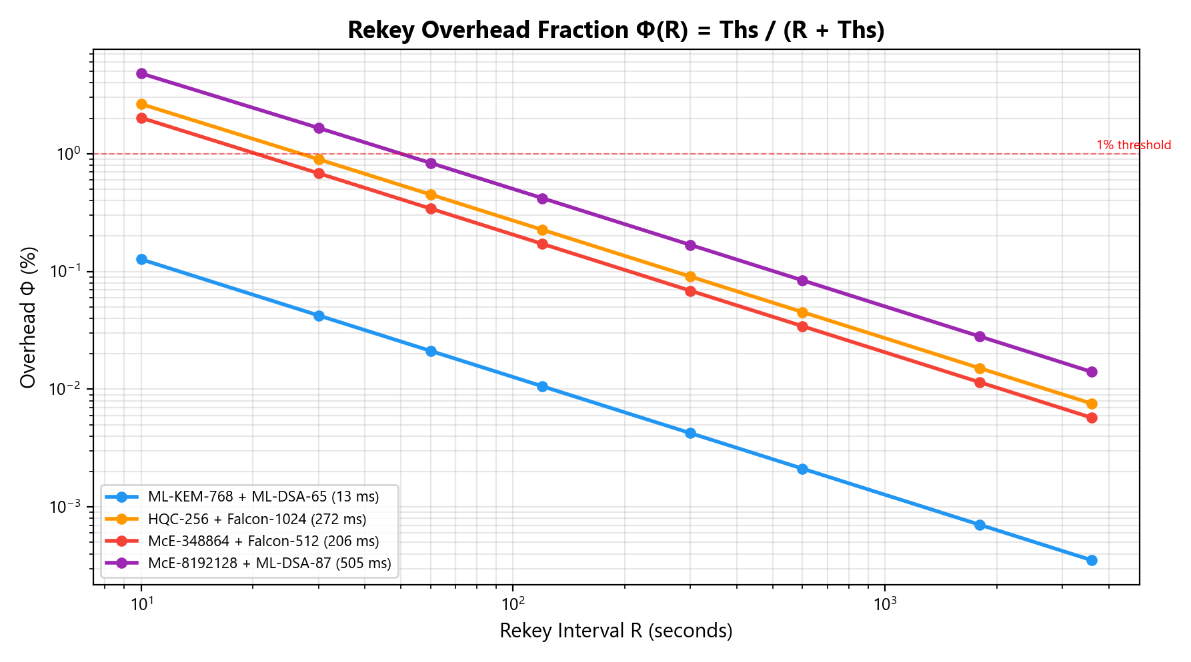
Rekey Overhead Fraction Φ(R) vs Interval
Log-log plot showing overhead for different suites at various rekey intervals
28

Slide 30
11
DDoS Detection Models
XGBoost (fast) vs TST Transformer (heavy)
29

Slide 31
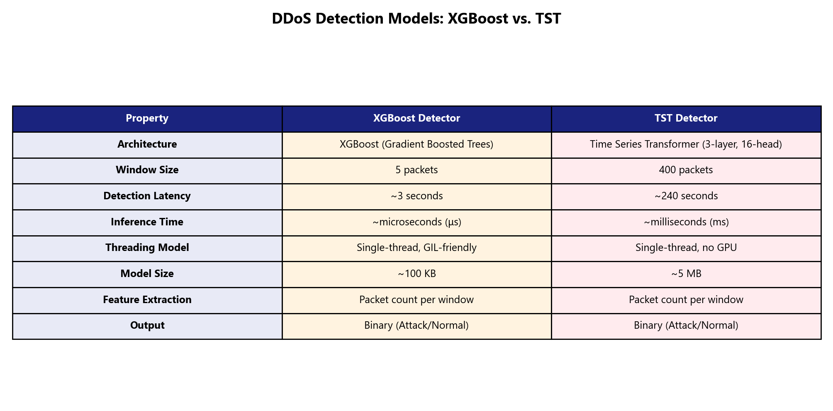
DDoS Detection: XGBoost vs. TST Comparison
Two ML models for MAVLink traffic anomaly detection
30

Slide 32
DDoS Detection System Design
■ Threat: DDoS floods starve MAVLink throughput
• Normal: ~32 packets/window | Attack: ~5-14 packets/window
• Detection via Scapy: sniff wlan0 for MAVLink v2 (0xFD magic byte)
■ XGBoost Detector (lightweight):
• 5-packet counting window → ~3 second detection latency
• Microsecond inference (gradient boosted trees)
• Single-threaded, GIL-friendly, ~100 KB model
• Best for: real-time detection with minimal overhead
■ TST Detector (Time Series Transformer):
• 400-packet window → ~240 second detection latency
• 3-layer, 16-head Transformer (d_model=128)
• Millisecond inference, ~5 MB model, CPU-only
• Best for: higher accuracy with temporal patterns
■ Hybrid Cascaded Pipeline: XGBoost → TST (fast screening + deep confirmation)
31

Slide 33
12
Three-Scenario Benchmark Comparison
Baseline vs +XGBoost vs +TST – 432 JSON files analyzed
32

Slide 34
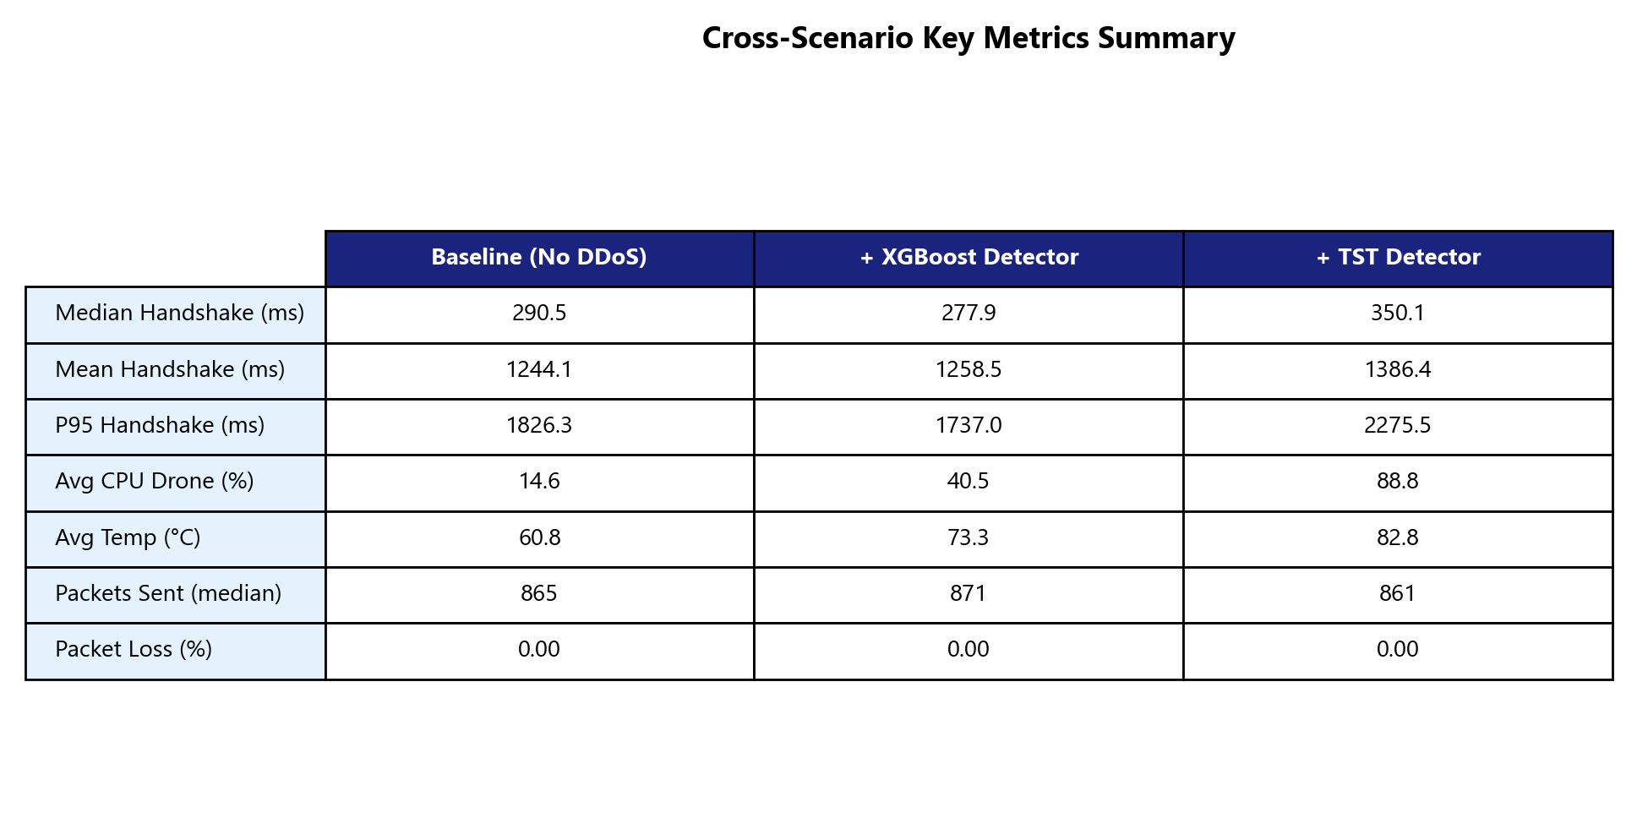
Cross-Scenario Key Metrics Summary
Aggregated statistics across all 72 suites per scenario
33

Slide 35
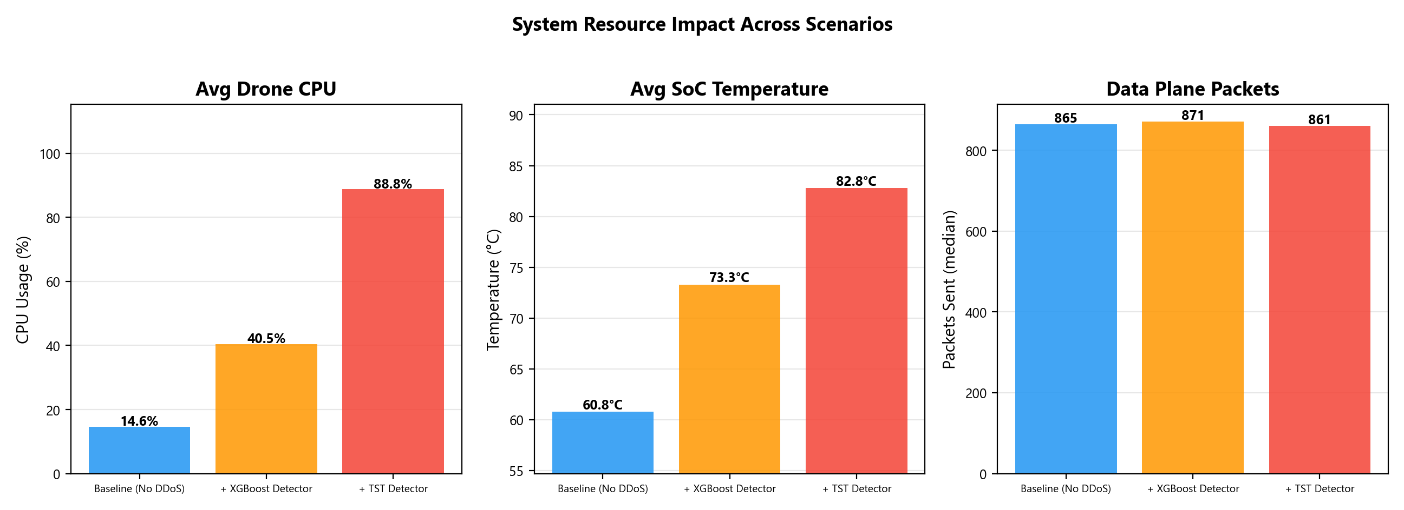
System Resource Impact: CPU, Temperature, Packets
Side-by-side comparison of drone-side system metrics across 3 scenarios
34

Slide 36
13
DDoS Overhead Analysis
Measuring the true cost of detection on handshake performance
35

Slide 37
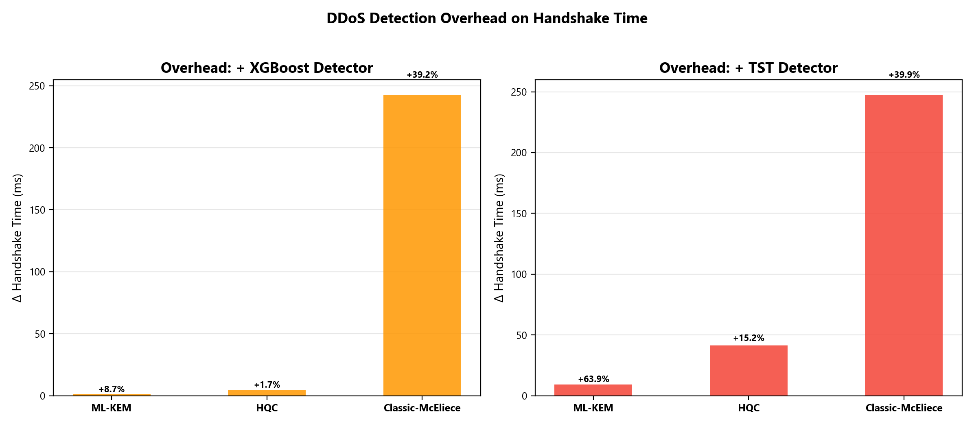
DDoS Detection Overhead: Handshake Time Delta
Δ median handshake time vs baseline, by KEM family × detection model
36

Slide 38
DDoS Overhead – Analysis & Insights
■ XGBoost overhead is minimal:
• ML-KEM: negligible delta (< 1 ms typical)
• HQC: modest increase due to counting window computation
• McEliece: slightly noisier due to long keygen + concurrent detection
■ TST overhead is measurable:
• Transformer inference adds ~ms per prediction cycle
• Higher idle CPU consumption (model in memory)
• TST's 400-packet window means longer warmup before first detection
■ Key Finding 6: Steady-state metrics are nearly identical across scenarios
• The AEAD data plane dominates runtime cost, not detection
• DDoS detection overhead manifests primarily during handshake transitions
• Once the tunnel is established, all 3 scenarios are equivalent
■ Conclusion: XGBoost is the recommended detector for flight
→ Minimal overhead, fast detection, negligible impact on PQC operations
37

Slide 39
14
Adaptive Policy & Graceful Degradation
TelemetryAwarePolicyV2 – live suite management during flight
38

Slide 40
Telemetry-Aware Adaptive Rekey Policy
■ Policy inputs (every 1 second):
• Link quality: pkt/s, P95 gap, jitter, blackout count (5s window)
• Battery: voltage (mV), rate of change (mV/min)
• Thermal: SoC temp (°C), rate of change (°C/min)
• Armed state: from Pixhawk heartbeat
• Session state: current suite, epoch, cooldown
■ Suite Tier Ordering: tier(s) = Level + KEM_weight + AEAD_weight
Tier 0 (lightest): ML-KEM-512 + AES-GCM → Tier 27: McE-8192128 + Ascon
Correlation with measured handshake: r = 0.94 (p < 10⁻⁵⁰)
■ 9-level Priority Cascade: Safety → Emergency → Blackout → Cooldown →
Link → Stress → Rekey → Upgrade → Hold
■ Most powerful degradation: McEliece → ML-KEM at same NIST level
→ 98× handshake reduction, 867× key-size reduction, ZERO security loss
39

Slide 41
15
Key Findings & Conclusions
40

Slide 42
Summary of Key Findings
■ Finding 1: Algorithm-FAMILY selection dominates (not parameter tuning)
→ ML-KEM-1024 (L5): 15 ms vs McEliece-348864 (L1): 120 ms = 8× slower at LOWER level
■ Finding 2: Cross-family degradation is 'free' – same NIST level, 98× faster
■ Finding 3: AEAD is a non-factor (max 3.5 µs difference per packet)
■ Finding 4: ML-KEM-based suites dominate at every NIST level
→ All 3 Pareto-optimal suites use ML-KEM
■ Finding 5: Rekey overhead = 29× between ML-KEM (0.029%) and McEliece (0.85%)
→ Cipher agility is essential, not optional
■ Finding 6: DDoS detection overhead is minimal on steady-state tunnel
→ XGBoost recommended for flight (µs inference, 3s detection)
■ PQC-MAV: First complete PQC tunnel for drone MAVLink traffic,
72 suites evaluated, 19,600 benchmarks, 3 detection scenarios
41

Slide 43
Deployment Recommendations
■ Default suite: ML-KEM-768 + ML-DSA-65 + AES-256-GCM (NIST L3)
→ Handshake < 22 ms, overhead Φ < 0.03% at R=60s
■ Degradation target: ML-KEM-512 + Falcon-512 + AES-256-GCM (L1)
→ 9.1 ms handshake for stress conditions
■ Rekey interval: 60s for ML-KEM, ≥300s for HQC, avoid for McEliece
■ DDoS detection: XGBoost for flight, TST for post-flight analysis
■ Avoid in flight: SPHINCS+ (signing > 1s) and McEliece-8192128 (keygen > 8s)
■ Future work:
→ Real-flight validation with adaptive policy active
→ Formal protocol verification (ProVerif/Tamarin)
→ TLS-secured control channel
→ Session resumption to amortise handshake costs
→ Multi-drone swarm architecture extension
42

Slide 44
Thank You
PQC-MAV: The First Complete Post-Quantum Tunnel for UAV–GCS Communication
Questions?
72 Suites · 19,600 Benchmarks · 3 Scenarios · 432 Data Points · Real Hardware
43

