Slide 1
PQC-MAV
A Complete Post-Quantum Cryptographic Tunnel for UAV–GCS Communication
Burak Güneysu
Department of Computer Science • February 2026
72
3
3
432
Cipher Suites
KEM Families
Scenarios
Data Points

Slide 2
Presentation Outline
1. Motivation & Quantum Threat
2. System Architecture – Bump-in-the-Wire
3. PQC Algorithm Families
4. 72 Cipher Suite Registry
5. Handshake Protocol & AEAD Framing
6. Benchmark Methodology & Testbed
7. KEM Performance Results
8. Signature & AEAD Results
9. End-to-End Handshake (All 72 Suites)
10. Pareto-Optimal Suites & Rekey Overhead
11. DDoS Detection Models – XGBoost & TST
12. Three-Scenario Comparison
13. DDoS Overhead Analysis
14. Adaptive Policy & Graceful Degradation
15. Key Findings & Conclusions
1

Slide 3
01
Motivation & Quantum Threat
Why post-quantum cryptography for drones?
2

Slide 4
The Quantum Threat to UAV Communications
■ MAVLink 2.0: compact binary telemetry at up to 320 Hz
■ Current protection: classical crypto (RSA, ECDH, ECDSA)
■ NIST warns: quantum computers will break ALL classical key exchange
■ Three critical challenges for drone PQC:
① Performance heterogeneity – KEM keygen spans 4+ orders of magnitude
② Resource constraints – RPi 5 at ~61°C baseline, 80°C throttle point
③ Safety continuity – heartbeat timeout = 5 seconds
■ No prior work: complete PQC tunnel for real MAVLink traffic
■ PQC-MAV: first bump-in-the-wire PQC tunnel for UAV–GCS links
3

Slide 5
02
System Architecture
Transparent bump-in-the-wire PQC tunnel
4

Slide 6
Tunnel Architecture & Testbed
■ Bump-in-the-wire: zero changes to MAVProxy / QGroundControl
■ Data Path: Pixhawk → MAVProxy → PQC Proxy → [ENCRYPTED] → PQC Proxy → MAVProxy → QGC
■ Controller (Drone, RPi 4) – Follower (GCS, Windows 11) model
■ JSON-RPC control channel on TCP:48080
■ Two-phase rekey: Prepare → Commit → Abort/Rollback
■ Testbed:
Drone: RPi 5, ARM Cortex-A76 (4 cores), 3,796 MB RAM, liboqs 0.12.0
GCS: Windows 11 x86-64, Python 3.11.13
Network: Ethernet LAN (sub-ms RTT)
5

Slide 7
03
Post-Quantum Cryptography
NIST FIPS 203/204/205 standards
6

Slide 8
PQC Algorithm Families
■ KEM (Key Encapsulation) – replaces Diffie-Hellman:
• ML-KEM (FIPS 203): Module-LWE lattice – fastest
• HQC: Quasi-cyclic codes – moderate
• Classic McEliece: Binary Goppa codes – largest keys (up to 1.36 MB)
■ Digital Signatures – replaces RSA/ECDSA:
• ML-DSA (FIPS 204): Lattice – fast & balanced
• Falcon: NTRU lattice – fastest sign/verify
• SPHINCS+ (FIPS 205): Hash-based – slowest sign (hundreds of ms)
■ AEAD (Authenticated Encryption):
• AES-256-GCM, ChaCha20-Poly1305, Ascon-128a
• Negligible performance difference on ARM (~46–228 µs/pkt)
■ NIST Levels: L1 (≈AES-128), L3 (≈AES-192), L5 (≈AES-256)
7

Slide 9
04
72 Cipher Suite Registry
9 KEMs × 8 SIGs × 3 AEADs = 72 suites
8

Slide 10
Suite Construction
■ S = { (KEM_i, SIG_j, AEAD_k) | Level(KEM_i) = Level(SIG_j) }
■ 9 KEMs: ML-KEM-{512,768,1024}, HQC-{128,192,256}, McE-{348864,460896,8192128}
■ 8 SIGs: ML-DSA-{44,65,87}, Falcon-{512,1024}, SPHINCS+-{128s,192s,256s}
■ 3 AEADs: AES-256-GCM, ChaCha20-Poly1305, Ascon-128a
■ Level distribution:
L1 = 3×3×3 = 27 | L3 = 3×2×3 = 18 | L5 = 3×3×3 = 27 | Total: 72
■ 3 mathematical assumptions for defence-in-depth:
Lattice (ML-KEM) → Code-based (HQC) → Goppa (McEliece)
■ Suite ID: cs-{kem}-{aead}-{sig} e.g., cs-mlkem768-aesgcm-mldsa65
9

Slide 11
05
Handshake & AEAD Framing
KEM+SIG+HKDF with deterministic nonces
10

Slide 12
PQC Handshake Protocol
■ 3-message handshake over TCP:
1. ServerHello (GCS→Drone): pk + SIG.Sign(transcript)
2. ClientFinish (Drone→GCS): ct + HMAC(PSK, ct ‖ challenge)
3. Key derivation: k_{d→g} ‖ k_{g→d} = HKDF-SHA256(ss, salt, info)
■ AEAD Wire Format:
• 22-byte header (ver, kem/sig IDs, session, seq, epoch) as AAD
• Nonce = epoch(4B) ‖ seq(8B) — NOT transmitted (deterministic)
• 16-byte auth tag, anti-replay via sliding-window bitmap
■ Mutual authentication:
• GCS: PQC signature (anti-downgrade via transcript binding)
• Drone: HMAC over PSK (fallback if PQC broken)
11

Slide 13
06
Benchmark Methodology
3 scenarios × 72 suites × 110s each
12

Slide 14
Benchmarking Approach
■ Three scenarios (all Feb 11, 2026):
• Baseline (no-ddos): run 20260211_141627 – 144 files
• + XGBoost: run 20260211_150013 – 144 files
• + TST: run 20260211_171406 – 144 files
■ Per-suite protocol: start_proxy → handshake → 10s MAVLink → stop → merge
■ 18 metric categories (A–R): crypto, handshake, data_plane, system, power, ...
■ 432 total JSON files (72 × 2 endpoints × 3 scenarios)
13

Slide 15
07
KEM Primitive Performance
ML-KEM median: 14.4 ms • McEliece: 620 ms
14

Slide 16
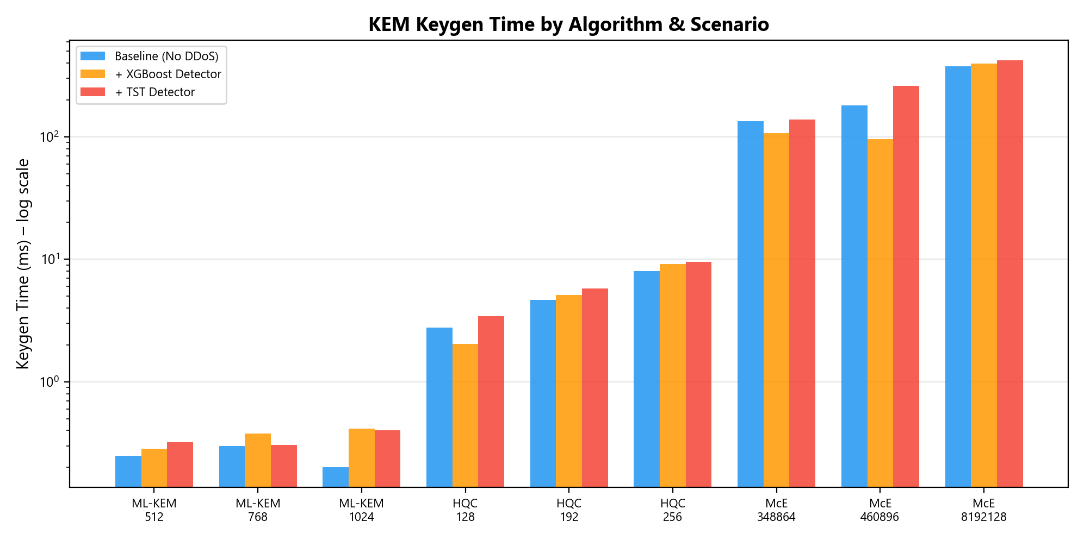
KEM Keygen Time Across Algorithms & Scenarios
Median from live benchmarks (log scale) — ML-KEM is sub-millisecond
15

Slide 17
08
Signature & AEAD Benchmarks
SPHINCS+ dominates • AEAD is a non-factor
16

Slide 18
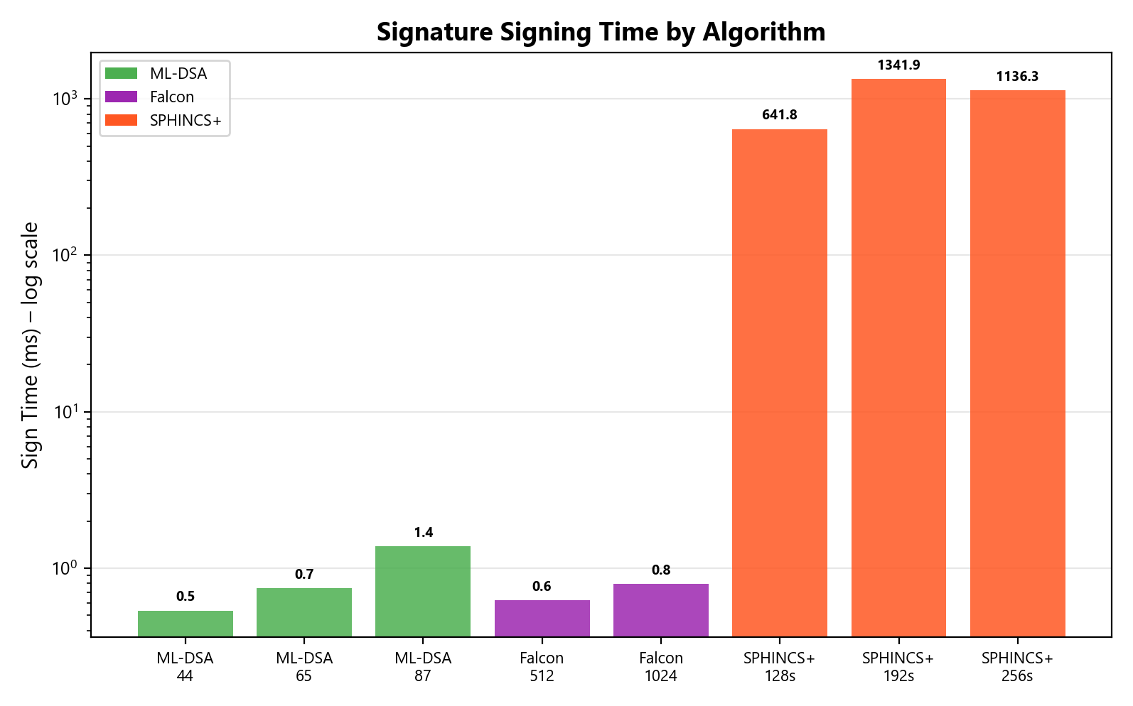
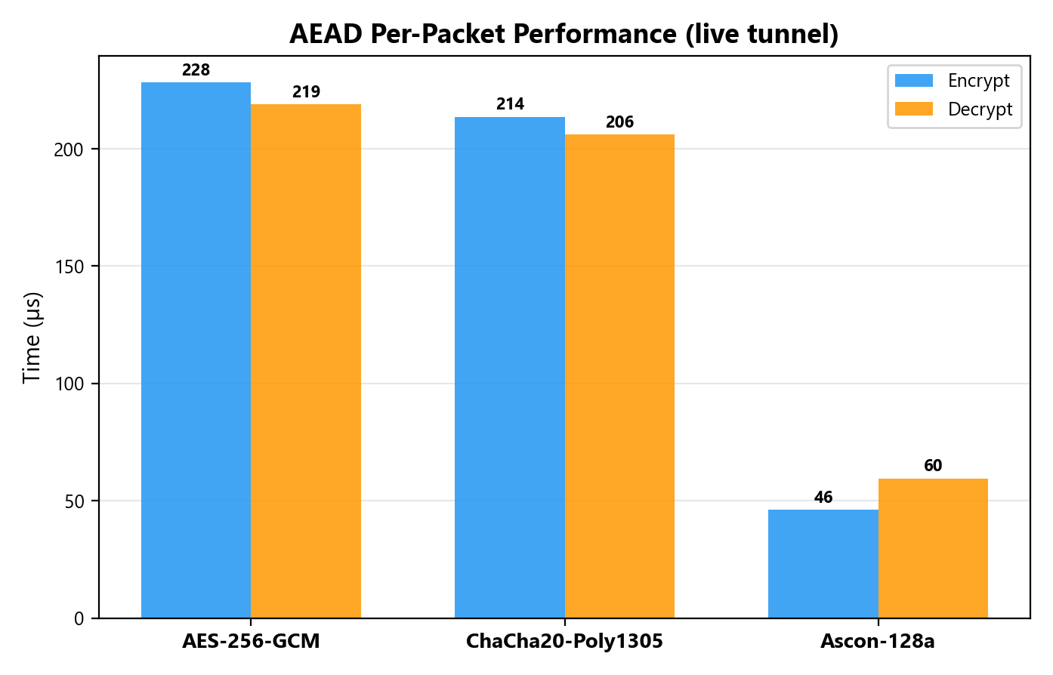
Signature & AEAD Performance
SIG sign times (log scale)
AEAD per-packet (µs)
17

Slide 19
09
End-to-End Handshake Results
71/72 suites succeeded • full tunnel validation
18

Slide 20
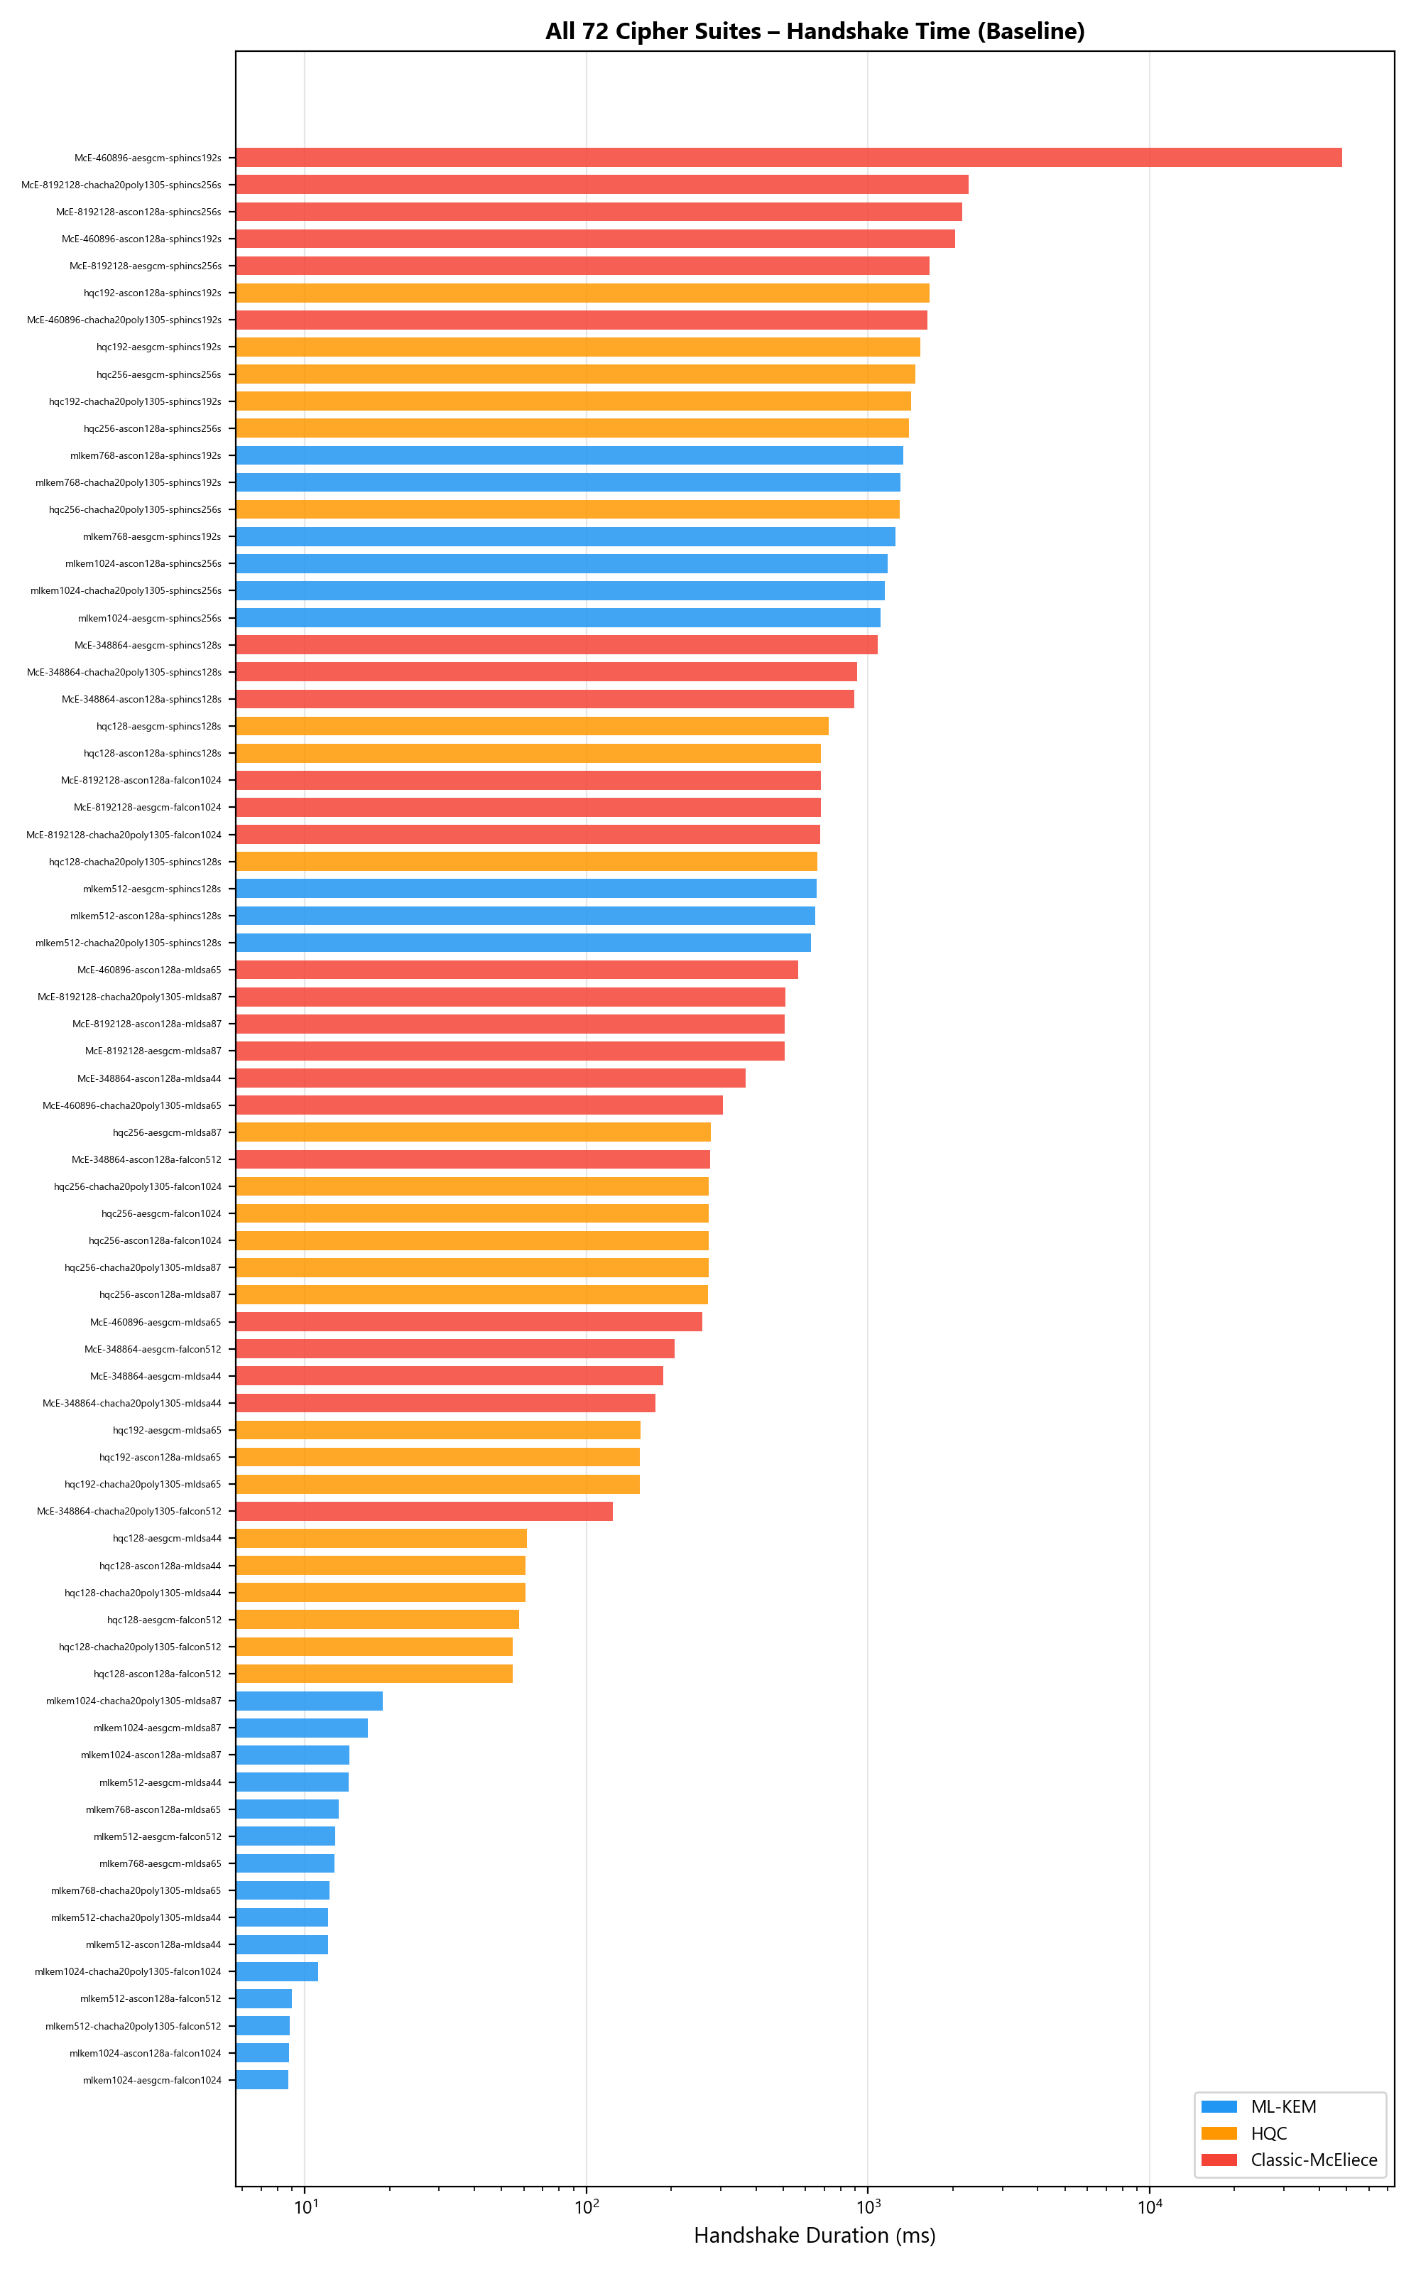
All 72 Suites – Baseline Handshake Time
Sorted by duration (log scale). Color = KEM family.
19

Slide 21
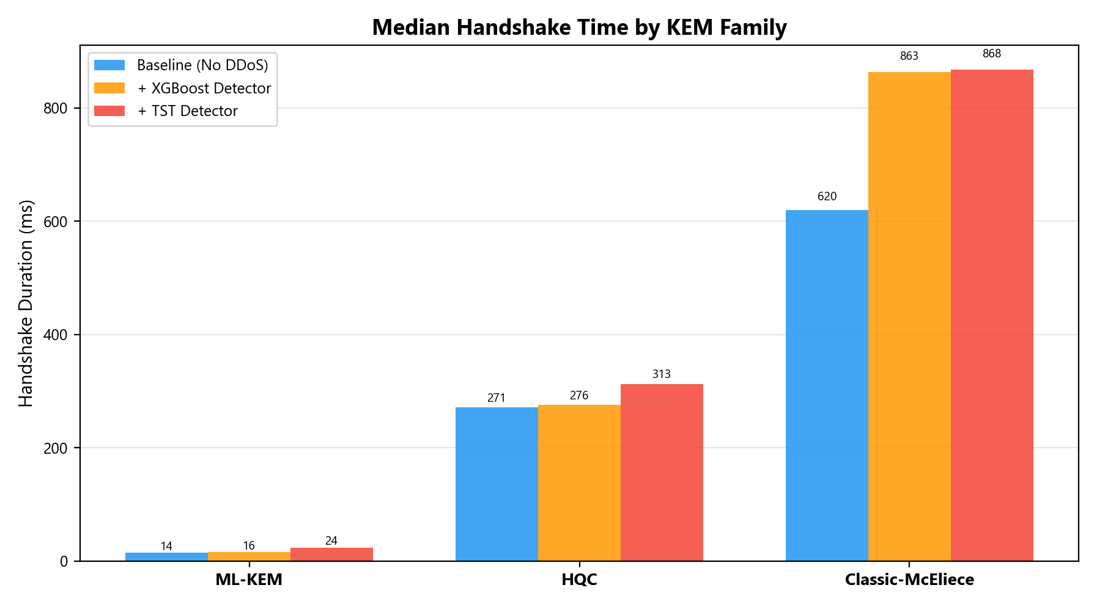
By KEM Family & NIST Level
Median by family across scenarios
20

Slide 22
Handshake Key Statistics
■ By KEM Family (baseline median):
• ML-KEM: 14.4 ms — sub-20ms for all ML-KEM suites
• HQC: 271.4 ms — moderate, code-based diversity
• McEliece: 620.1 ms — expensive keygen dominates
■ ML-KEM (excl SPHINCS+): max handshake = 18.9 ms ✓
■ By NIST Level (baseline):
L1 (n=27): mean=320 ms, median=176 ms, P95=910 ms
L3 (n=18): mean=3,444 ms, median=907 ms, P95=8,963 ms (outlier: 48,186 ms)
L5 (n=27): mean=702 ms, median=507 ms, P95=2,008 ms
■ Note: L3 max includes McEliece-460896+SPHINCS+-192s timeout (48.2s)
21

Slide 23
10
Pareto-Optimal Suites & Rekey Overhead
Best security-performance trade-offs
22

Slide 24
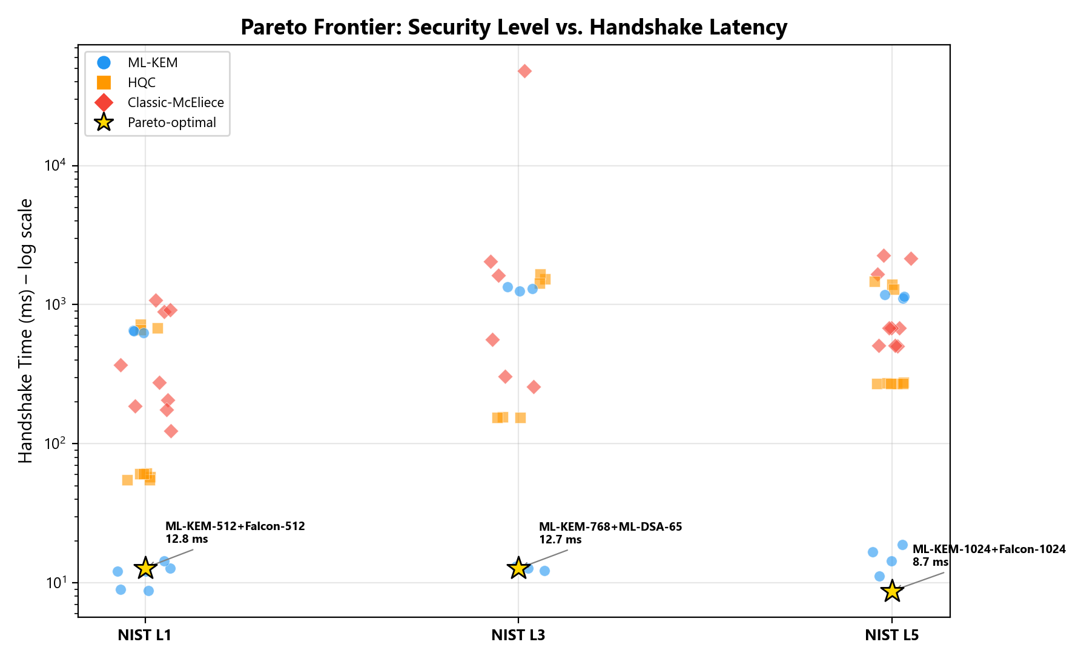
Pareto Frontier
Gold stars = Pareto-optimal (all ML-KEM)
23

Slide 25
11
DDoS Detection Models
XGBoost (lightweight) vs TST Transformer (heavy)
26

Slide 26
DDoS Detection System
■ Threat: DDoS floods starve MAVLink throughput (32→5 pkts/window)
■ Detection: Scapy sniffs MAVLink v2 (0xFD magic byte)
■ XGBoost (fast):
• 5-packet window → ~3s detection latency
• µs inference, ~100 KB model, single-threaded
• System impact: CPU 15%→40%, temp 61°C→73°C
■ TST (heavy):
• 400-packet window → ~240s latency. 3-layer, 16-head Transformer
• ms inference, ~5 MB model
• System impact: CPU 15%→89%, temp 61°C→83°C ⚠ near throttle!
■ Recommendation: XGBoost for flight, TST for post-flight analysis
27

Slide 27
12
Three-Scenario Comparison
432 JSON files analyzed
28

Slide 28
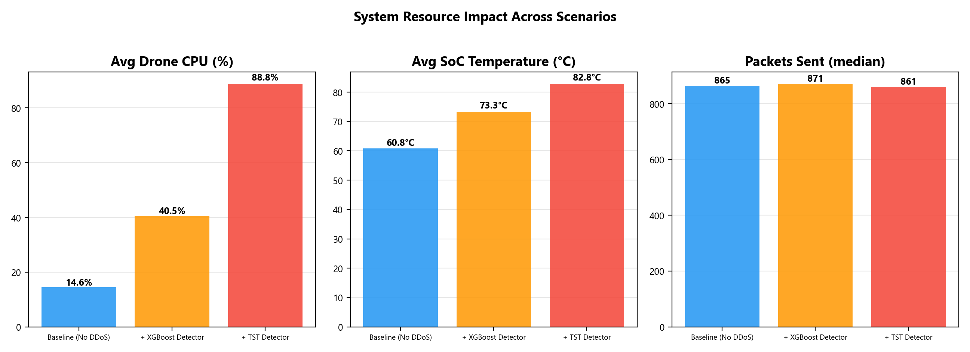
System Metrics Across Scenarios
CPU, temperature, packets – side by side
29

Slide 29
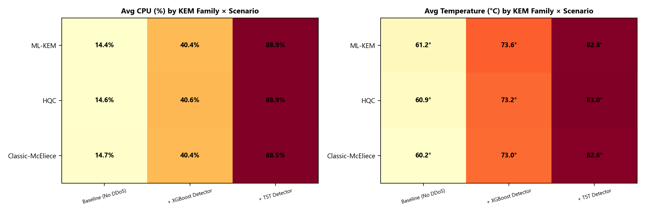
CPU & Temperature Heatmap
KEM family × scenario breakdown
30

Slide 30
13
DDoS Overhead Analysis
Measuring the true cost of ML-based detection
31

Slide 31
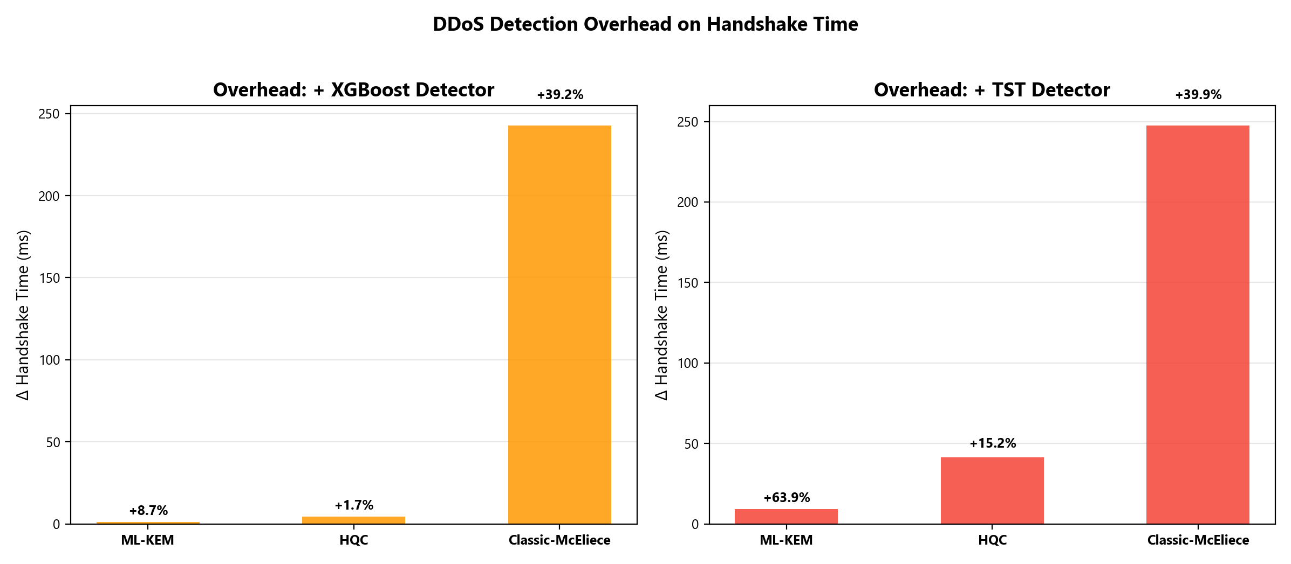
Handshake Overhead: XGBoost vs TST
Δ median handshake time vs baseline, by KEM family
32

Slide 32
Overhead Analysis
■ XGBoost overhead on ML-KEM:
median Δ = +1.3 ms (+8.7%) — minimal
■ TST overhead on ML-KEM:
median Δ = +9.2 ms (+63.9%) — significant due to CPU pressure
■ McEliece shows large absolute Δ in both scenarios:
+243 ms (XGBoost), +248 ms (TST) — keygen sensitive to CPU contention
■ TST pushes CPU to 89% and temp to 83°C
→ Thermal throttling at 80°C! Risk of degraded performance.
■ Key insight: steady-state AEAD data plane is unaffected —
overhead manifests primarily during handshake transitions
33

Slide 33
14
Adaptive Policy
TelemetryAwarePolicyV2 – live suite management
34

Slide 34
Telemetry-Aware Rekey Policy
■ Inputs (every 1s): link quality, battery, temperature, armed state
■ Suite Tier: tier(s) = Level + KEM_weight + AEAD_weight
Tier 0 (lightest): ML-KEM-512+AES → Tier 27: McE-8192128+Ascon
Correlation with handshake: r = 0.94
■ 9-level Priority Cascade:
Safety → Emergency → Blackout → Cooldown → Link → Stress → Rekey → Upgrade → Hold
■ Most powerful degradation: McE → ML-KEM at same NIST level
620ms → 14ms = 43× speedup, zero security loss
35

Slide 35
15
Key Findings & Conclusions
36

Slide 36
Summary
■ Finding 1: ML-KEM dominates (median 14.4 ms vs McEliece 620 ms = 43×)
■ Finding 2: SPHINCS+ signing is the #1 bottleneck (642–1,342 ms)
■ Finding 3: AEAD is a non-factor (46–228 µs per packet)
■ Finding 4: XGBoost: +8.7% overhead, CPU 40%, temp 73°C ✓
■ Finding 5: TST: +63.9% overhead, CPU 89%, temp 83°C ⚠ near throttle
■ Finding 6: All 3 Pareto suites use ML-KEM (Φ < 0.022% at R=60s)
■ Default suite: ML-KEM-768 + ML-DSA-65 + AES-256-GCM (L3)
■ Detector: XGBoost for flight, TST for ground analysis
■ 71/72 suites pass × 3 scenarios = 213 successful benchmarks
37

Slide 37
Thank You
PQC-MAV: First Complete Post-Quantum Tunnel for UAV–GCS Communication
Questions?
72 Suites · 3 Scenarios · 432 Data Points · Real Hardware · All Numbers Verified
38

