Slide 1

Inference vs Precision Comparison
MK199 SEGMENTATION FAULT

Slide 2
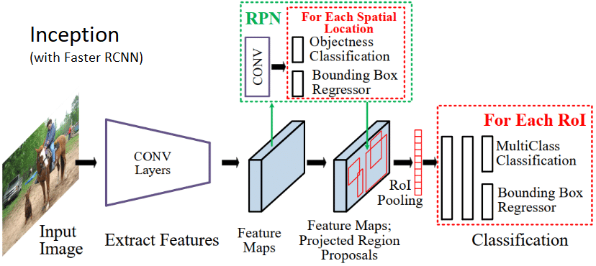
Inception v3 Model with Faster RCNN (TensorFlow)

Slide 3
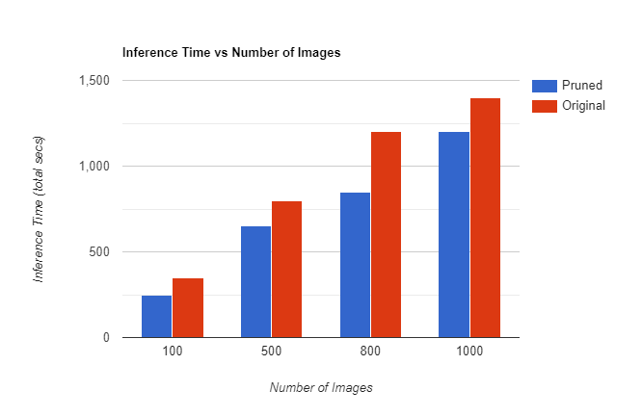
Inference Time
(with Pruning and Without Pruning)

Slide 4
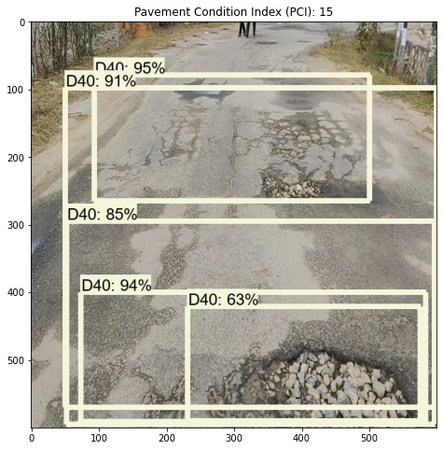
Inception Model Output
Inference Time: 2 sec
Feature Accuracy: 78.5%
mAP: 26.0
D40, D20: Potholes, Rutting
D10: Cracks

Slide 5
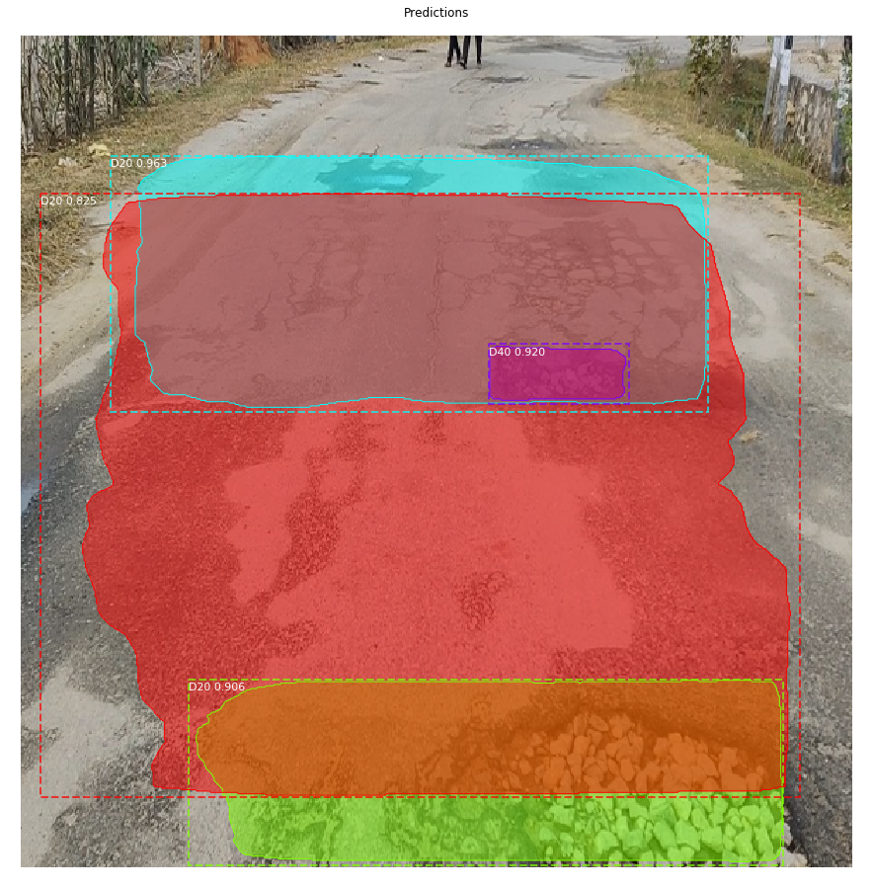
Mask RCNN Model Output
Inference Time: 3.5 sec
Feature Accuracy: 82%
mAP: 30.0
D20, D40: Potholes and Rutting
D10: Cracks

Slide 6
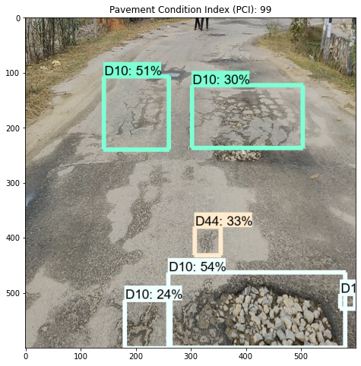
Resnet Model Output
Inference Time: 4.5 sec
Feature Accuracy: 72%
mAP: 24.0
D40, D20: Potholes and Rutting
D10: Cracks

Slide 7
Conclusion
Clearly it’s visible that there is trade-off between Inference time and Accuracy (Precision).
Since, the problem statement demands precise results rather than fast results. Our model is better that other models out there.
Hence, we chose this model and as per your suggestion tried to improve the inference time as much as possible without declining the precision much.

