Slide 1

Project Title: Seasonal Agriculture Performance Analysis
Student Name: Vemu Lakshmi Anuhya
College Name: Krishna University College of Engineering and Technology
AICTE STU ID: STU668937e35f11c1720268771

Slide 2

PROBLEM STATEMENT
Agricultural activities are influenced by seasonal variations in environmental conditions, farming practices, resource availability and market conditions. As a result, agricultural performance may differ from one season to another. However, raw agricultural data does not clearly explain how agricultural performance changes across seasons or what patterns can be observed in different seasonal conditions. The problem is to analyze the given agricultural dataset and investigate seasonal differences in agricultural performance by identifying meaningful patterns, trends, relationships and variations within the available data.

Slide 3
Project Description
The project analyzes agricultural performance across Kharif, Rabi and Zaid seasons using a dataset containing 4000 records and 28 variables.
The analysis covers:
Yield and production performance
Revenue, cost and profitability
Water usage and water efficiency
Rainfall, temperature and soil moisture
Irrigation methods
Crop-season performance
State-season profitability
Disease and pest risk
Relationships between agricultural variables

Slide 4
Project Description
Data cleaning was performed by handling missing values using season-wise median imputation and checking for duplicate records. Exploratory analysis was then performed using statistical summaries, visualizations, correlation analysis and group-based comparisons.
The project aims to identify seasonal patterns and provide data-driven recommendations for agricultural planning.

Slide 5

WHO ARE THE END USERS?
Farmers – to understand seasonal crop and irrigation performance.
Agricultural Planners – to support seasonal crop and resource planning.
Agricultural Officers – to understand regional and seasonal agricultural patterns.
Agricultural Analysts/Researchers – to analyze yield, profitability, resource usage and environmental relationships.
Agribusiness Decision-Makers – to evaluate crop-season and irrigation performance.

Slide 6

Technology Used
Programming Language
Python
Data Analysis
Pandas
NumPy
Data Visualization
Matplotlib
Seaborn
Environment
Google Colab

Slide 7
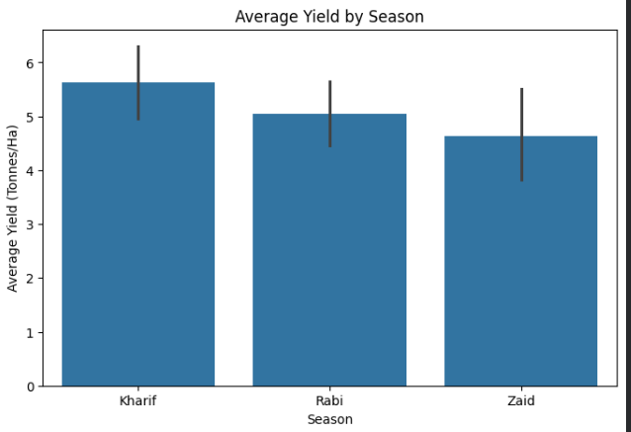
RESULTS
Kharif recorded the highest average yield (5.63 tonnes/ha), while Zaid recorded the lowest (4.64 tonnes/ha).

Slide 8
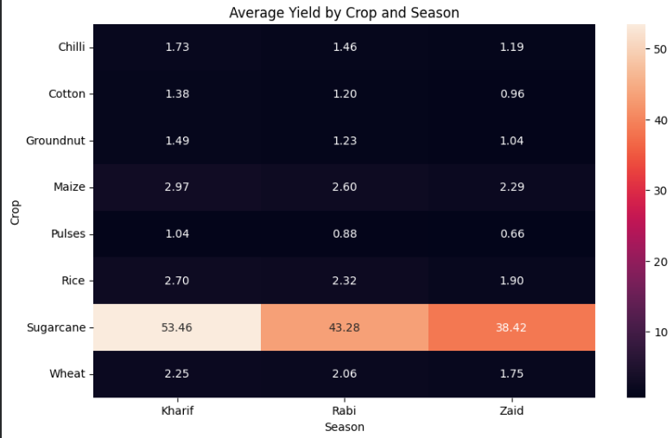
RESULTS
Sugarcane in Kharif was the strongest crop-season combination, with an average yield of 53.46 tonnes/ha and profit of about ₹10.01 lakh.

Slide 9
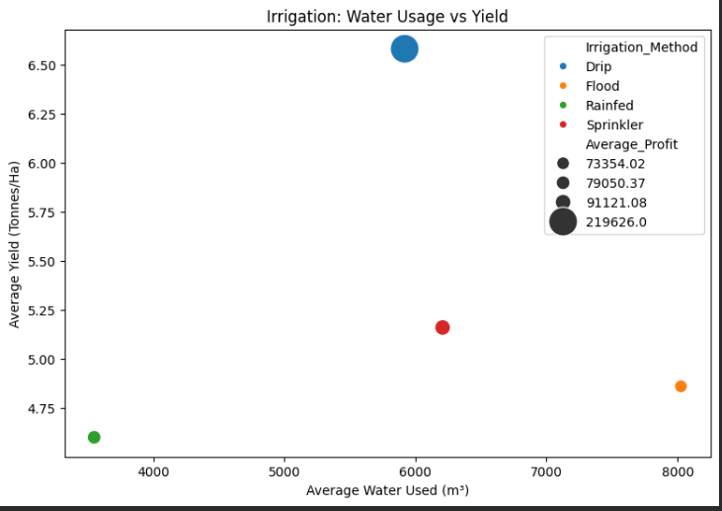
RESULTS
Drip irrigation recorded the highest average yield (6.58 tonnes/ha) and profit (₹2.20 lakh), while Rainfed agriculture achieved the highest water efficiency.

Slide 10
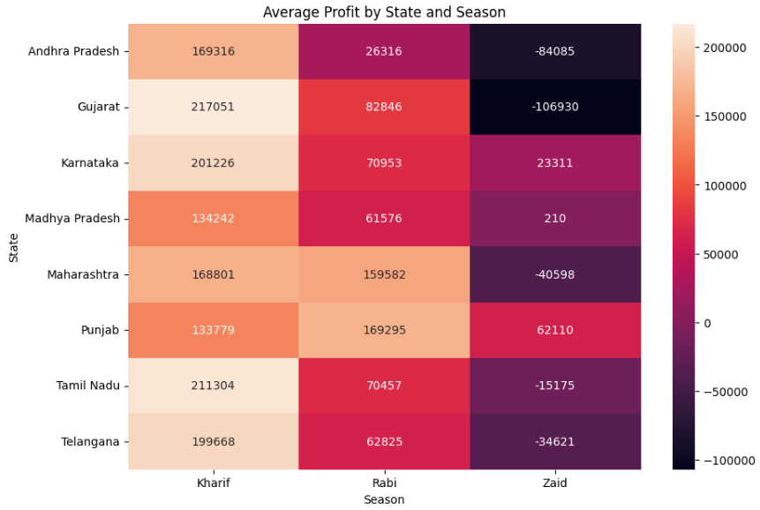
RESULTS
Seasonal performance varies by state: Gujarat performs best in Kharif, whereas Punjab records higher average profit in Rabi.

Slide 11
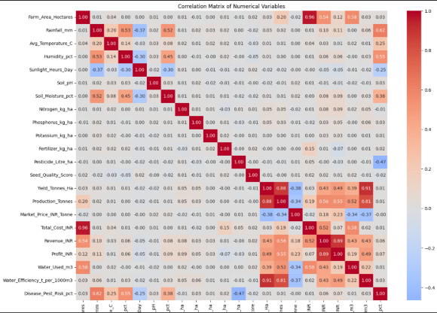
RESULTS
Rainfall (0.03), temperature (0.01) and soil moisture (0.01) show very weak linear relationships with yield in the dataset.

Slide 12
Future Scope
Incorporate historical weather data to study seasonal and yearly trends.
Include market price fluctuations to better understand changes in profitability.
Add detailed farm-management practices for deeper analysis.
Perform crop-specific and region-specific analysis to reduce the effect of crop composition.
Develop predictive models to forecast yield and profitability for future seasons.
Build an interactive dashboard for easier exploration of seasonal agricultural performance.
Analyze irrigation and resource usage further to support water-efficient agricultural planning.

Slide 13
GitHub Link
https://github.com/Anuhya903/Seasonal-Agriculture-Performance-Analysis

Slide 14
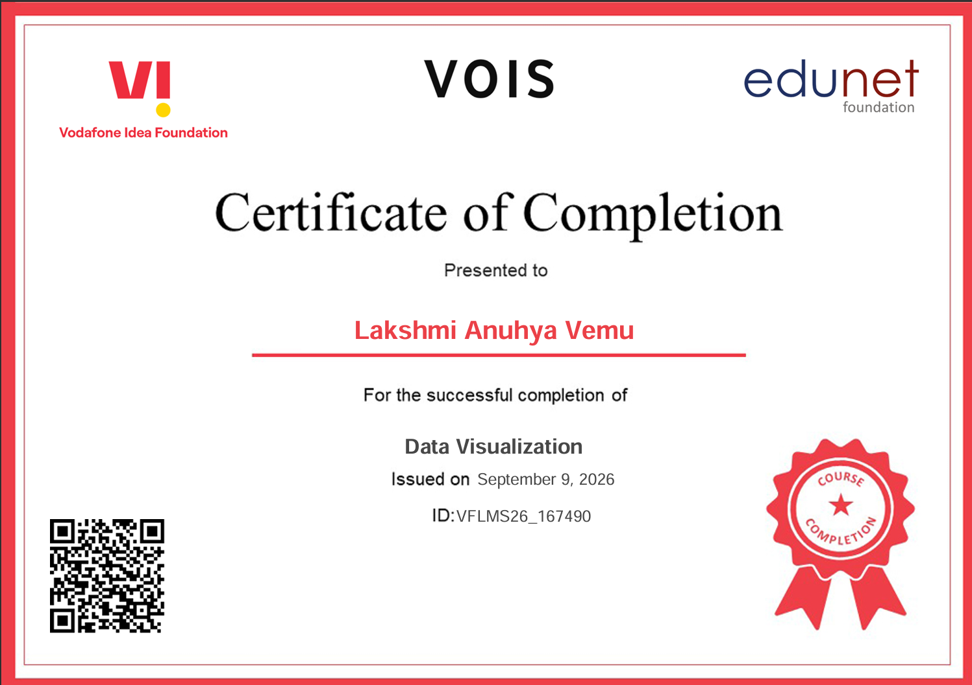
VOIS Course completion certificate - Course name- Data Visualization

Slide 15
Thank you
.
.

