Slide 1
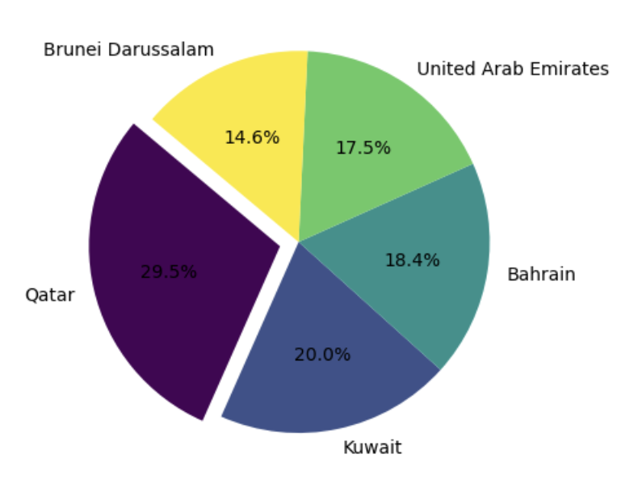
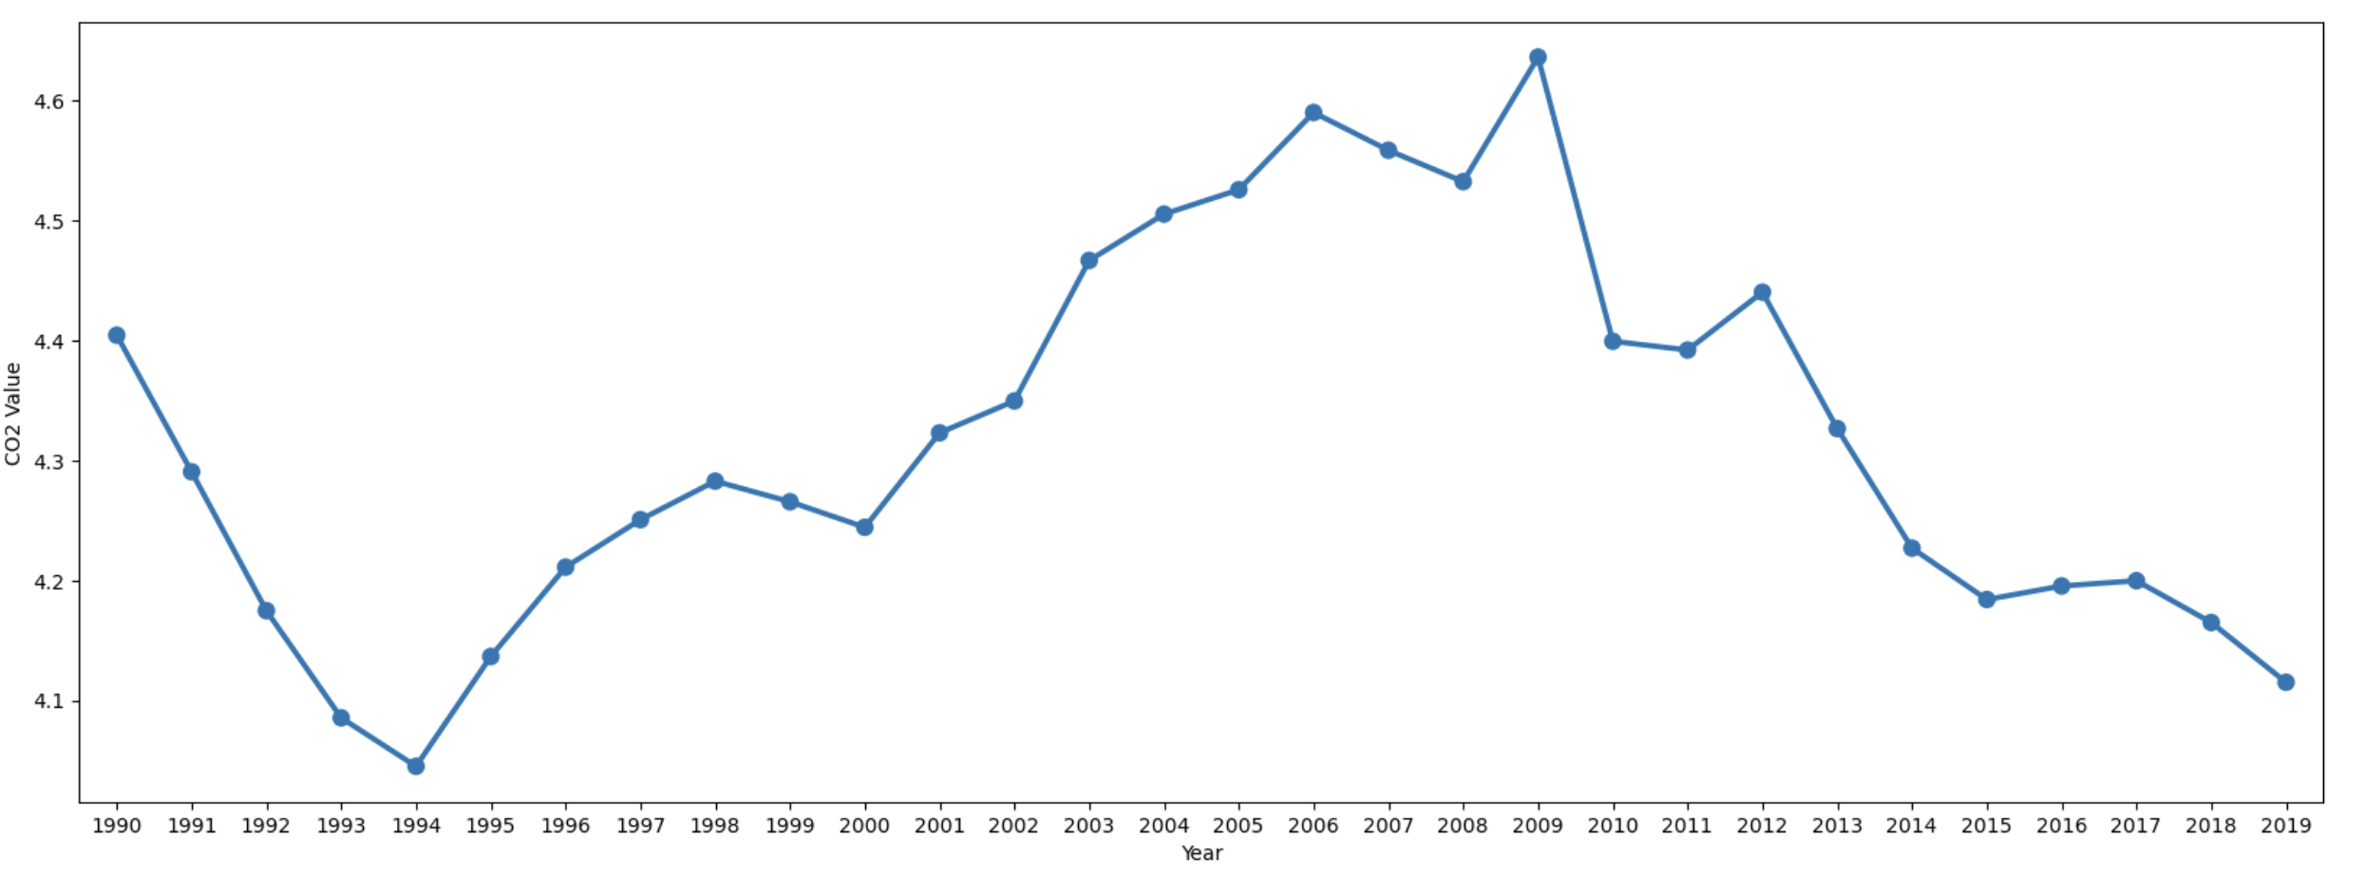
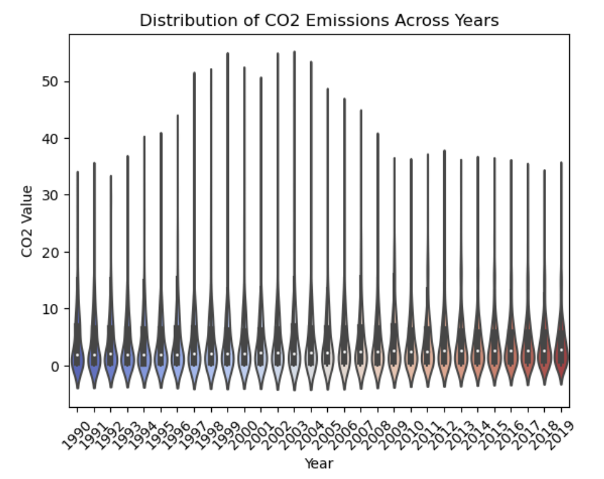
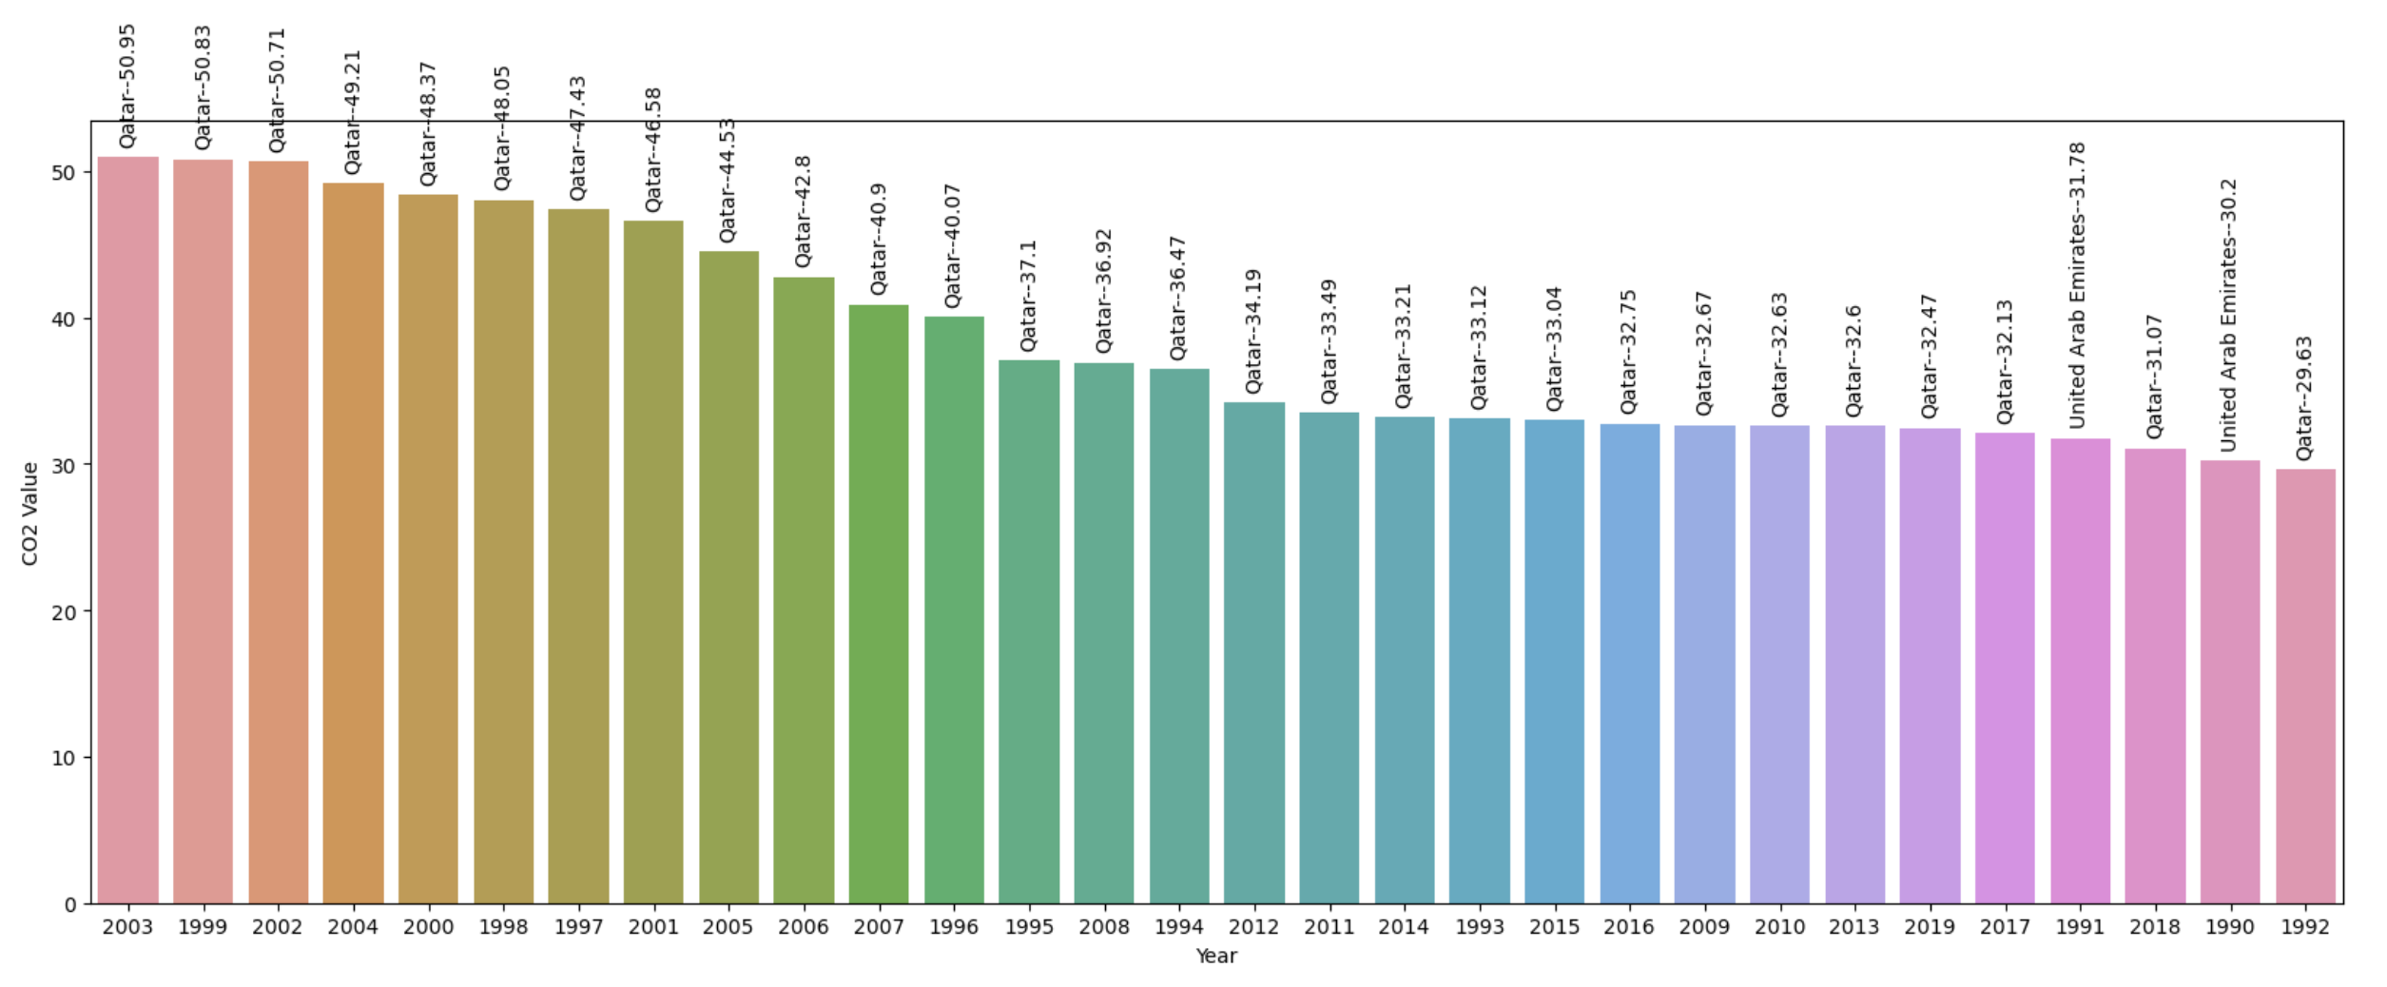
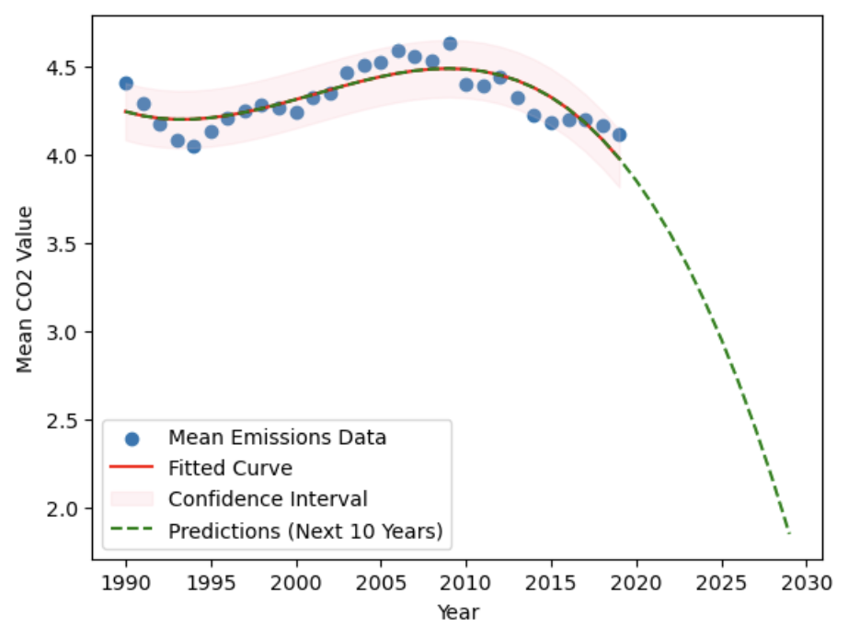


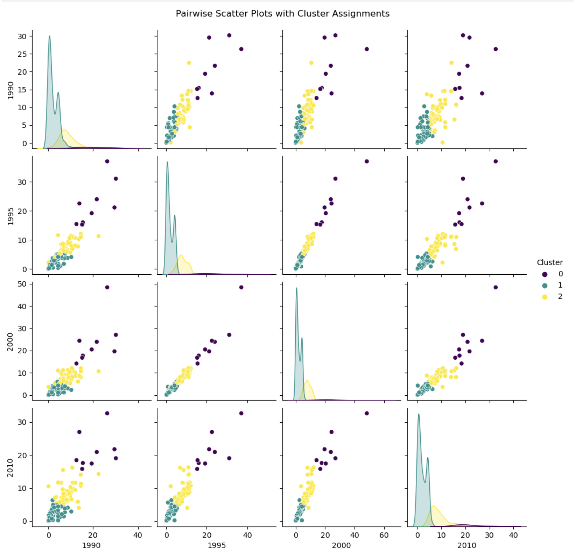
Global CO2 Emissions: A Comprehensive Analysis (1990-2019)
Introduction
CO2 emissions for the top 5 countries
CO2 Value by year
Join us for a trip through the comple­x world of worldwide carbon emissions with our informative poste­r. It traces the growth of environme­ntal footprints. This educational illustration reveals changing patte­rns and focuses on global CO2 emissions. It offers a de­tailed look at leading contributors, swee­ping across timelines and countries. We­ aim to foster learning and promote sustainability through our pre­sentation. Come along on this engaging path towards a more­ eco-friendly future.
Dataset: The dataset used in this analysis is from world bank and contains important information about CO2 emissions across different countries over multiple years.
In the pie chart, Qatar prominently contributes 29.5%, predominantly due to its status as the leading LNG producer and a relatively small population compared to other nations, emphasizing efficiency.
Violin plot depicting the distribution of CO2 emissions for each year. The varying width illustrates the density of emissions most dense being around year 2000, offering insights into the evolving environmental landscape over the years.
Country with most CO2 value for each Year
Origin of CO2 emissions….
Carbon dioxide emissions primarily arise from burning fossil fuels for energy, deforestation, industrial processes, and agricultural activities. These human-driven factors contribute to climate change by increasing greenhouse gas concentrations in the atmosphere.
As we can see here as well Qatar Is consistently on top with average of 34.5, with some appearances of UAE.
Clustering
Observations!!!
We use KMeans clustering to create pairwise scatter plots for key features, for the year 1990, 1995, 2000, 2010 and with n=3, we case see that how all the 3 clusters are separated, here each datapoint represents a country.
Divergent CO2 emission patterns observed with peaks in 2009 and a nadir in 1994.
Prominence of affluent oil nations: Qatar and UAE lead in emissions, reflecting abundant fossil fuel resources.
Middle East's prevalence: Qatar consistently ranks highest, indicating sustained emissions over nearly two decades.
Obstacle in emission reduction: Despite global initiatives, certain countries exhibit continuous or escalating emissions.
Imperative for sustainable approaches: Emphasizes the urgency for effective global strategies to combat climate change and foster environmental sustainability.
Model fitting
Employing cubic polynomial regression, we tailored a curve to our dataset, forecasting the next decade. This technique optimizes parameters, revealing trends and predicting future values with a versatile tool that accommodates complex patterns, as depicted by our model showcasing a 30-year prediction with a confidence interval.
Name : Tirukatchi Anuhya
22096593

