Slide 1
EqRAG: Augmented LLM for Precise, High-Alpha Recommendation
Aditya Motwani, Anuj Gupta

Slide 2
Problem Statement
Current trading systems add recent market events to company financials, limiting accurate capture of recent events.
Notes:
0.5 min

Slide 3


Problem Statement
Current trading systems add recent market events to company financials, limiting accurate capture of recent events.
Proposed Solution
Combining News and Financial Metrics to generate investment recommendations from a single reasoning LLM.
+
Notes:
0.5 min

Slide 4

Evaluation Metrics
Buy
Sell
Hold
Notes:
0.5 min

Slide 5


Evaluation Metrics
Buy
Sell
Perplexity For model generalization across financial texts
Accuracy
On model recommendations
Hold
Precision
Recall
F1 Score
Notes:
0.5 min

Slide 6
Dataset
For the purpose of running the experiments, we make use of fingpt-forecaster-dow30
[INST]<<SYS>>
You are a seasoned stock market analyst. Your task is to list the positive developments and potential concerns for companies based on relevant news and basic financials from the past weeks, then provide an ...
<</SYS>>
[Company Introduction]:
American Express Co is a ...
From 2023-05-07 to 2023-05-14, AXP's stock price decreased from 150.55 to 145.90. News during this period are listed below:
[Headline]: Credit cards: issuers could use their own flexible friends
[Summary]: Concerns ...
Some recent basic financials of AXP, reported at 2023-03-31, are presented below:
[Basic Financials]:
assetTurnoverTTM: 0.2614
...
[/INST]
Notes:
0.5 min

Slide 7


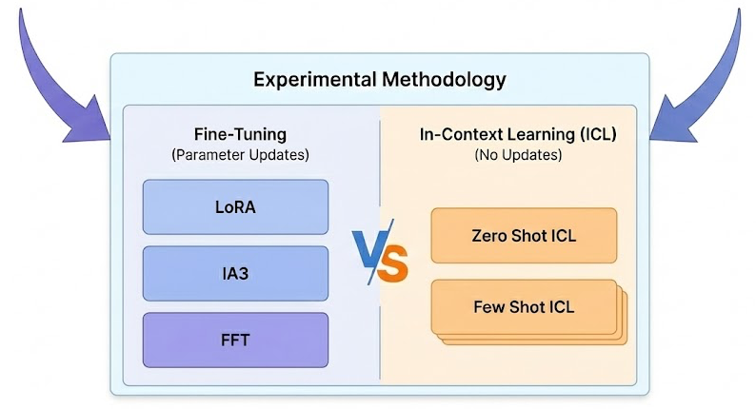
Experiments
Math 7B
Math 7B Instruct
Notes:
0.5 min

Slide 8
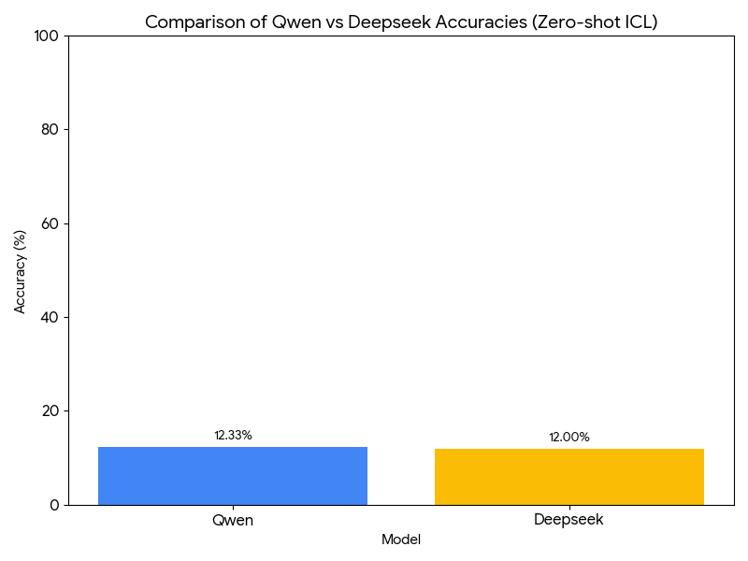
Results
In Context Learning
Notes:
0.5 min

Slide 9
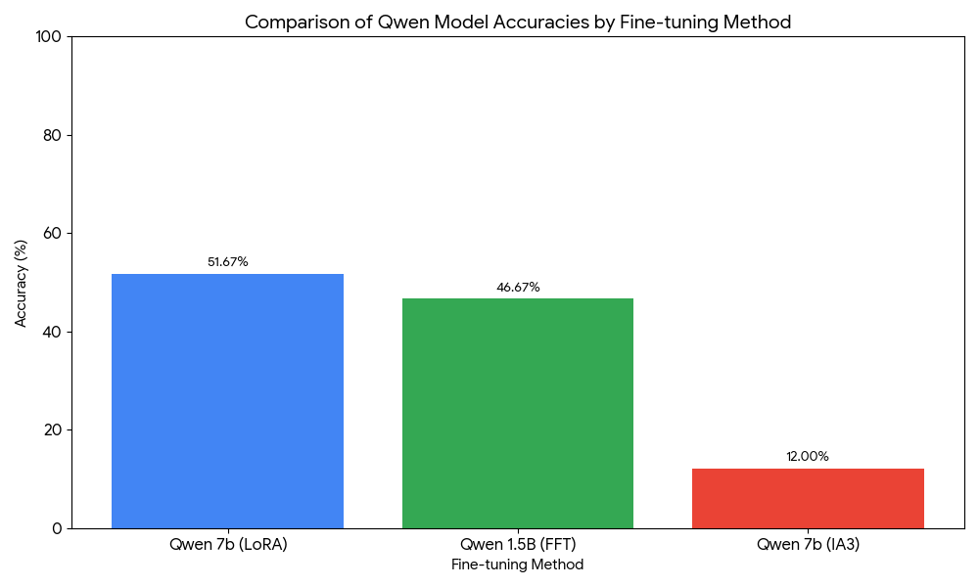
Results
In Context Learning
Fine Tuning (FT)
Notes:
0.5 min

Slide 10
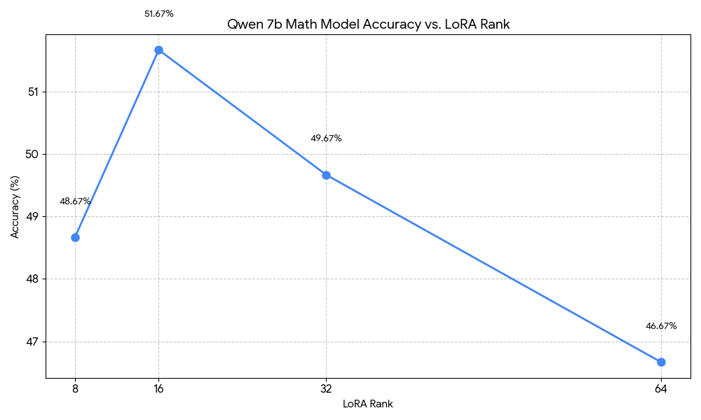
Results
LoRA Rank
Notes:
0.5 min

Slide 11
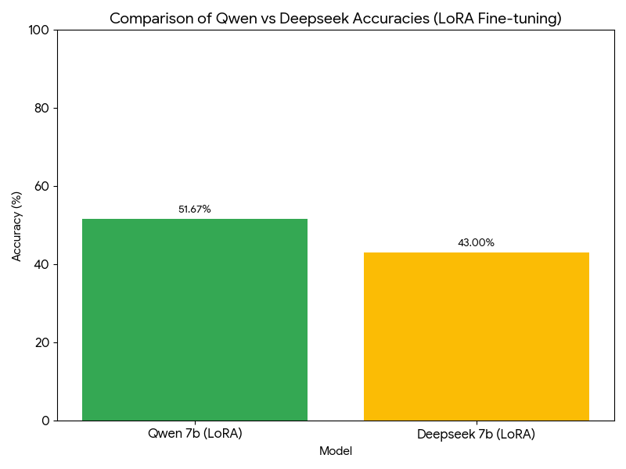
Results
LoRA Rank
Qwen V/s DeepSeek in FT
Notes:
0.5 min

Slide 12
Thank You
For your Attention

