Slide 1
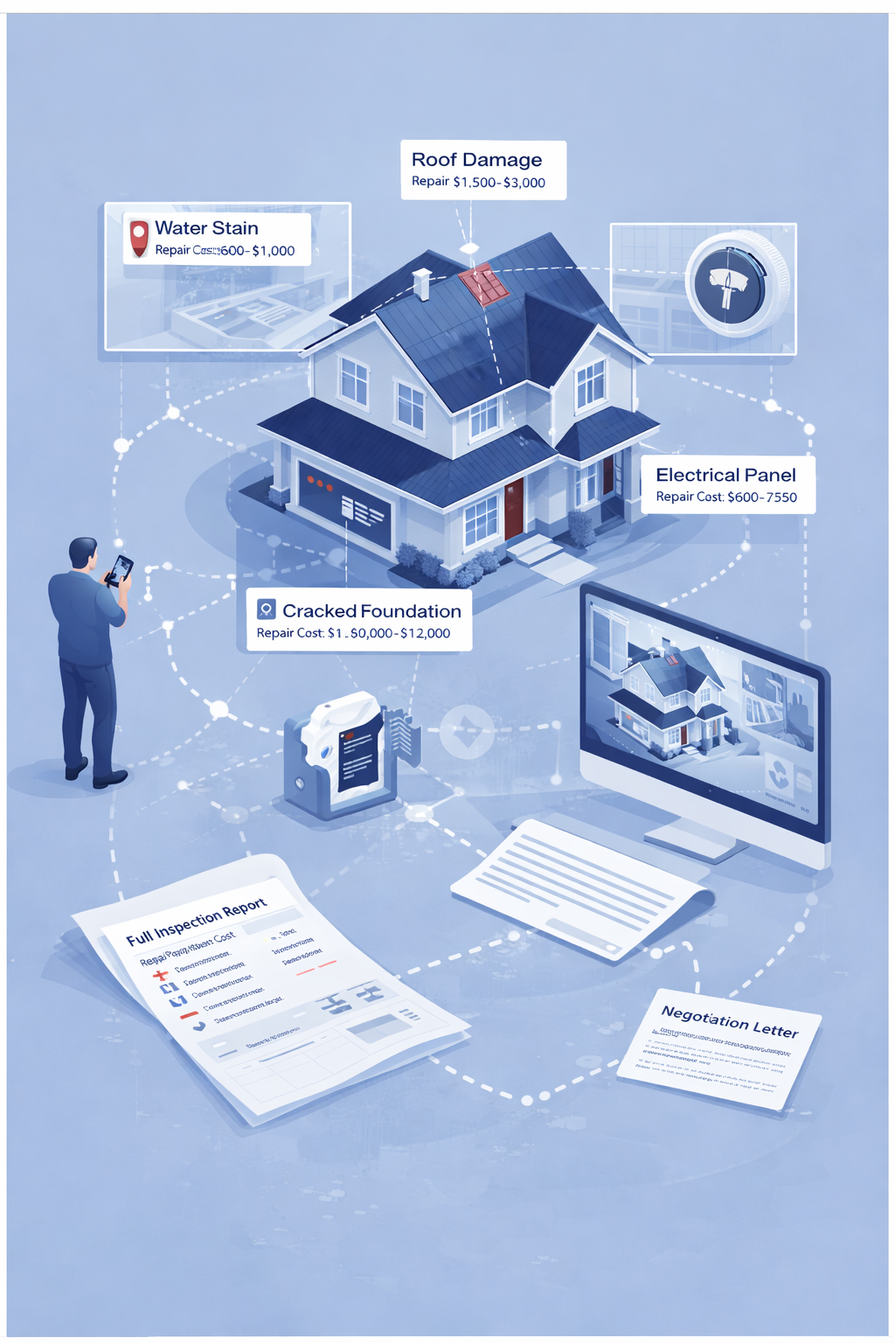
HomeScope
A Smart Inspection Tool
Anuj Gupta & Rohit Kottomtharayil

Slide 2
The Problem
Market Forces Their Hand
In competitive bidding, inspection contingencies can kill the deal
25%
Homebuyers
Made an offer last year with zero inspection
Inspections Come Too Late
Professional inspections happens after an offer is accepted
The Cost of Not Knowing
Buyers who waived an inspection and discovered issues later faced an average cost of $14,000

Slide 3
The Solution
HomeScope
Upload your walkthrough video. Get back an annotated version with every defect mapped, costed and ready to negotiate.
Record 60-second walkthrough on your phone. Any camera app. No special equipment.
Upload Drop the video into HomeScope. Gemini AI analyzes every frame in under 45 seconds.
Get Your Report Annotated video with defects highlighted. Repair costs. Negotiation letter ready.
1
2

