Slide 1
SafePaws
“Where compassion meets action—empowering you to save lives, one paw at a time”
BY:
Anuj Sijapati Saait Pradhan

Slide 2
Introduction to SafePaws Empowering Animal Welfare Through Innovation and Collaboration
1
Connecting Shelters and Resources
Streamlining Adoption Processes
Access to Expert Care
Educational Resources for Pet Owners
Fostering Community Involvement

Slide 3
Proposed System Addressing Gaps in Animal Welfare Coordination
2
Centralized Platform: Connects pet owners, shelters, and veterinarians for seamless interaction..
Key Features: Pet adoption, reporting lost/found pets, and access to pet care services (training, grooming, vet).
This Photo by Unknown Author is licensed under CC BY-NC

Slide 4
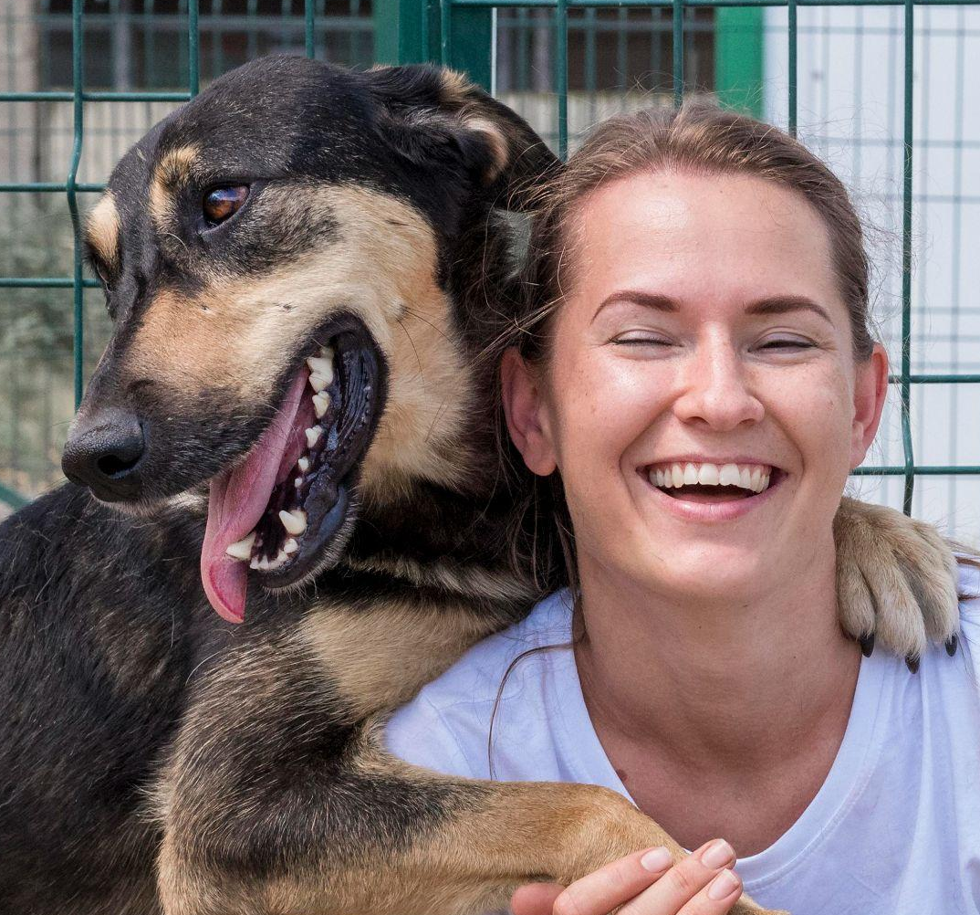
Currently Working On Connecting People and Resources to Improve Animal Lives
3
Making a Unapproved button
Fixing the footer part
Fixing Small bugs

Slide 5
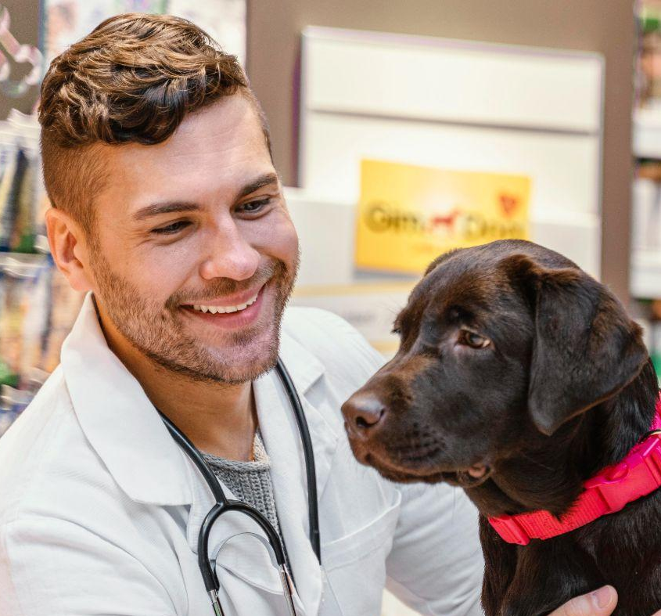
Tools and Technology Used Transforming Animal Welfare Through Holistic Approaches and Strategic Partnerships
4
Frontend:
HTML, CSS, JavaScript
Backend:
XAMPP, PHP, MySQL
Other Tools:
Photoshop for design
VS code for coding and debugging
Git for version control & tracking changes
GitHub for collaboration

Slide 6
Project Management/Tracking Acknowledging Boundaries While Focusing on Core Impact Areas
5
Project Management: Used Git and GitHub to organize and manage project tasks and features.
Version Control: Leveraged Git for tracking code changes and maintaining different project versions.
Collaboration: Utilized GitHub for seamless collaboration, code sharing, and team communication.

Slide 7
Process Flow Advancing Animal Welfare Through Cutting-Edge Solutions and Collective Efforts
6
Visual Representation: A process flow is a diagram that shows the sequence of steps or activities in a process.
Decision Points: It includes decision points where the process branches based on conditions or outcomes.
Start and End: The flow begins with a start point and ends when the process or task is completed.

Slide 8
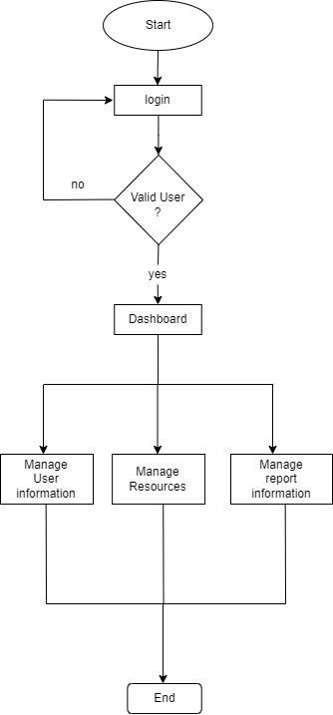
Admin Flow

Slide 9
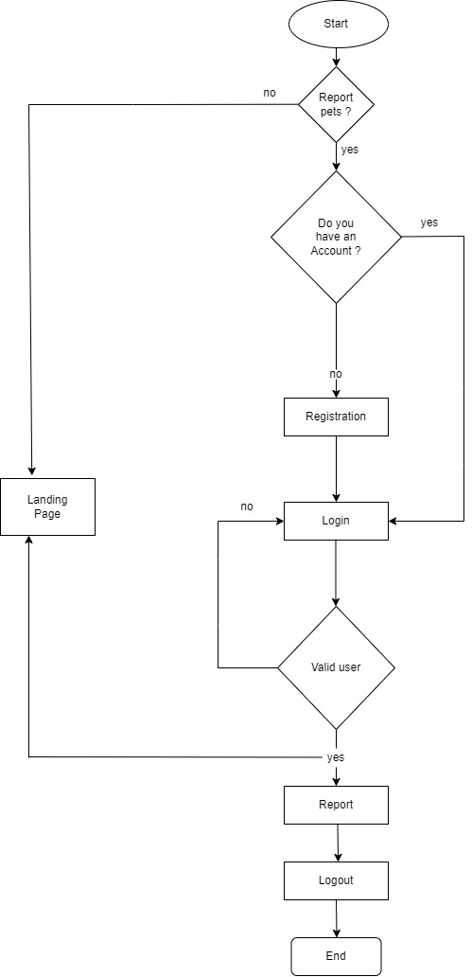
User Flow

Slide 10
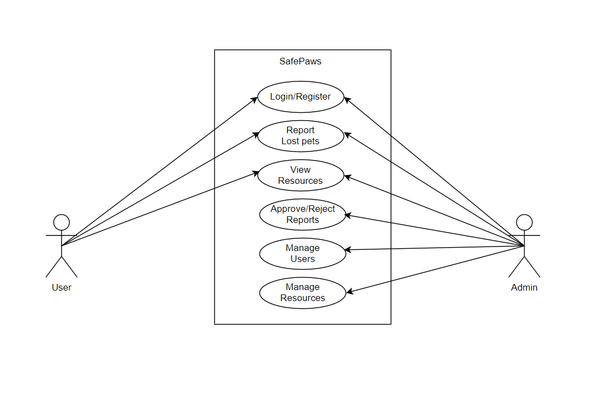
Use case Diagram

Slide 11
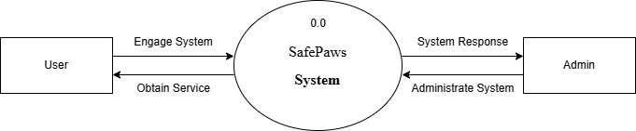
Level 0 DFD of SafePaws

Slide 12
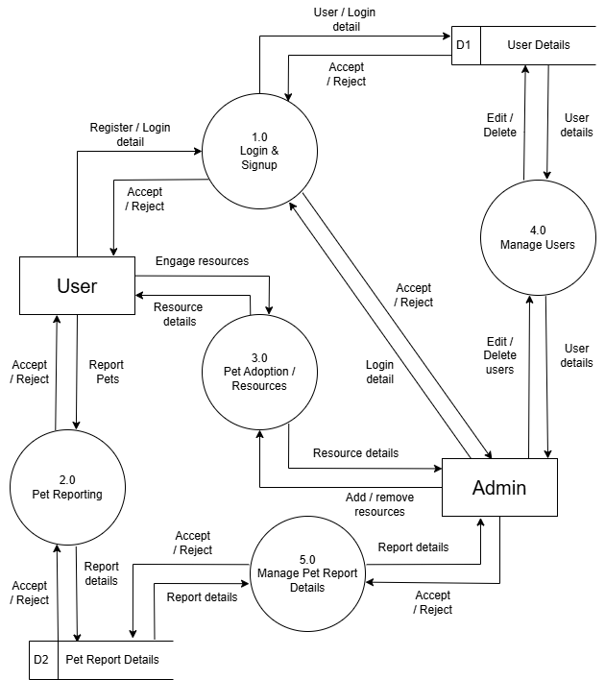
Level 1 DFD of SafePaws

Slide 13
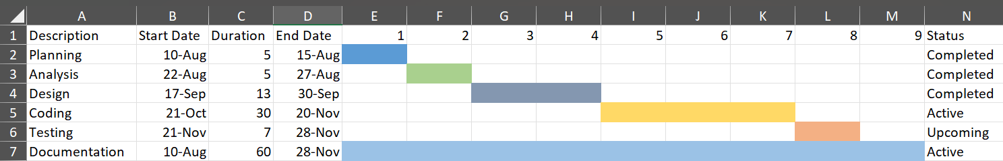
Gantt Chart of SafePaws

Slide 14
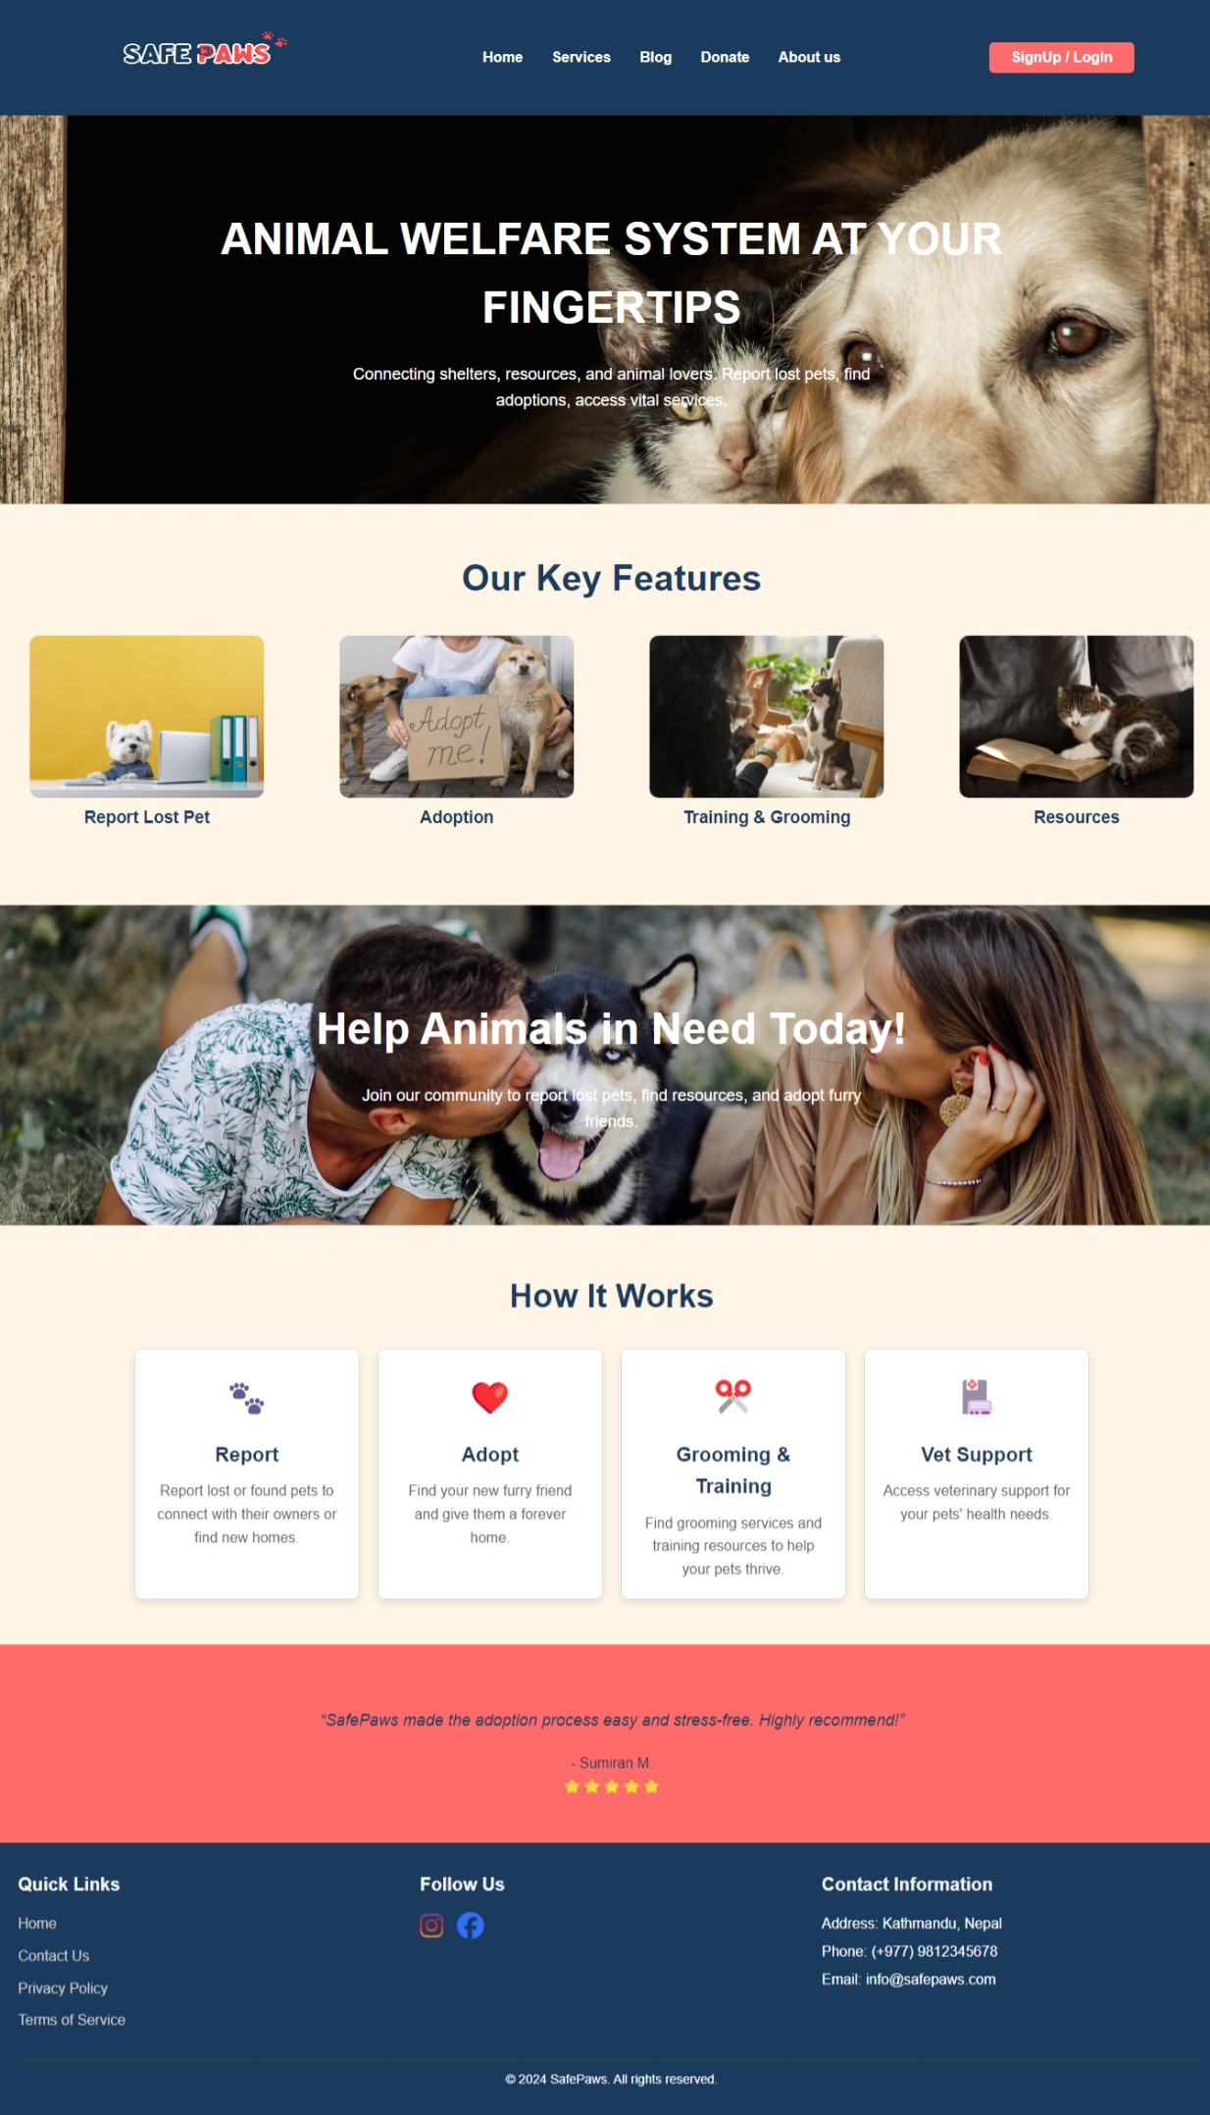
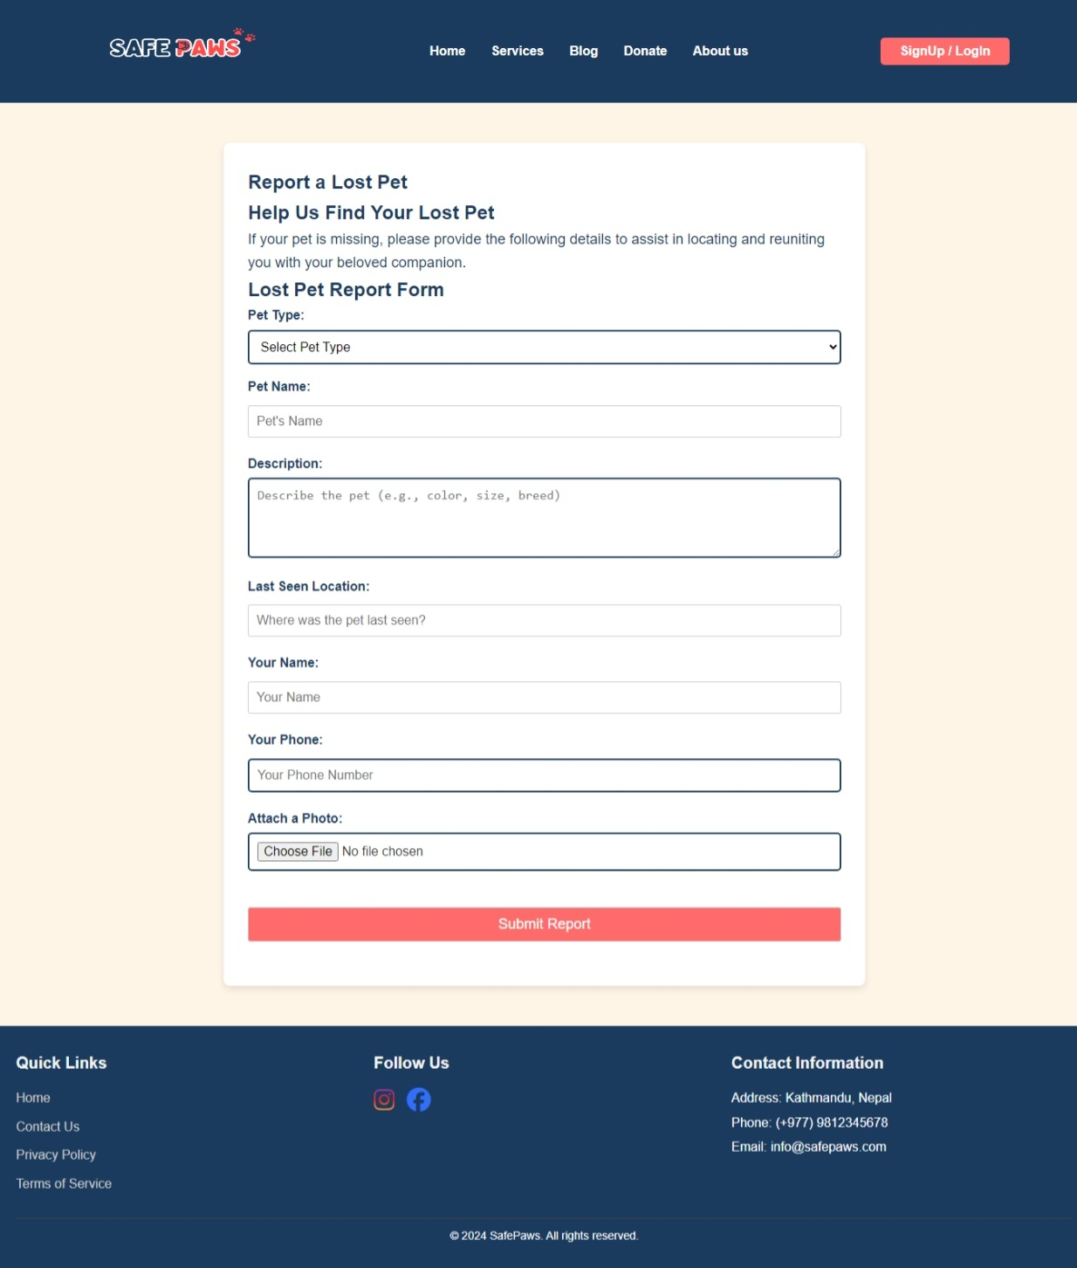
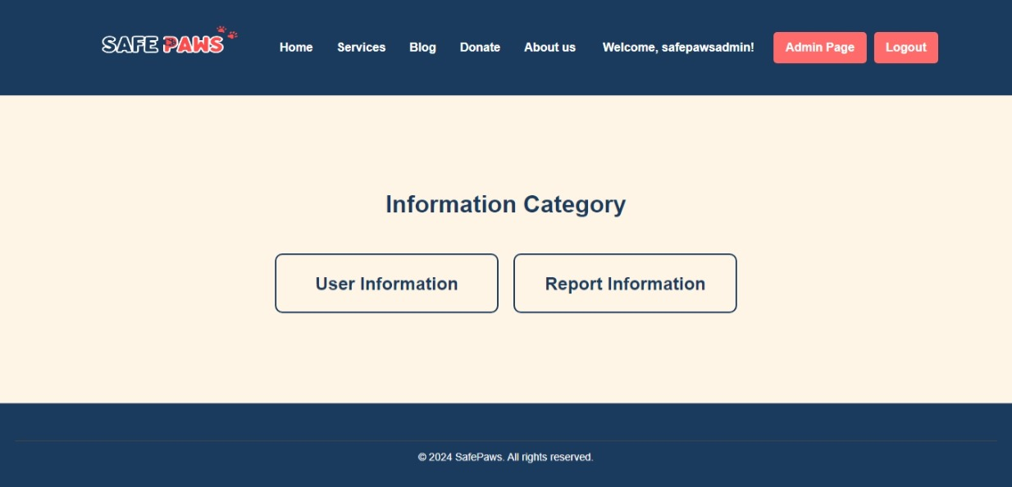
Design Sample
7

Slide 15
LIVE DEMO

