Slide 1
SafePaws
“Where compassion meets action—empowering you to save lives, one paw at a time”
BY:
Anuj Sijapati Saait Pradhan

Slide 2
Introduction to SafePaws Empowering Animal Welfare Through Innovation and Collaboration
1
Connecting Shelters and Resources
Streamlining Adoption Processes
Access to Expert Care
Educational Resources for Pet Owners

Slide 3
Proposed System Addressing Gaps in Animal Welfare Coordination
2
Centralized Platform: Connects pet owners, shelters, and veterinarians for seamless interaction..
Key Features: Reporting lost pets, Pet adoption, and access to pet care services (training, grooming, vet).
This Photo by Unknown Author is licensed under CC BY-NC

Slide 4
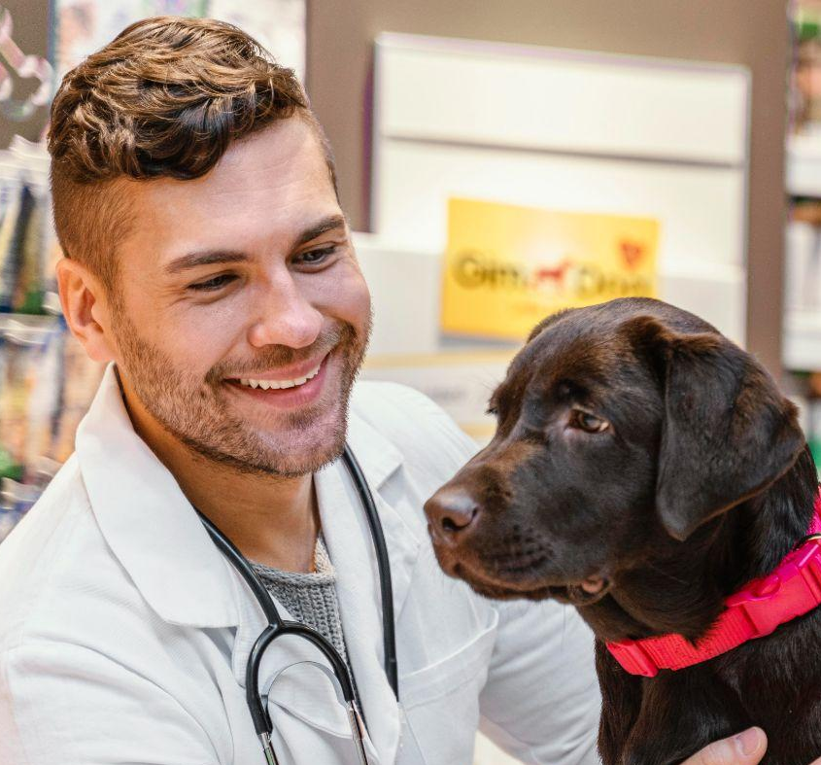
Tools and Technology Used Transforming Animal Welfare Through Holistic Approaches and Strategic Partnerships
4
Frontend:
HTML, CSS, JavaScript
Backend:
XAMPP, PHP, MySQL
Other Tools:
Photoshop for design
VS code for coding and debugging
Git for version control & tracking changes
GitHub for collaboration

Slide 5
Process Flow Advancing Animal Welfare Through Cutting-Edge Solutions and Collective Efforts
6

Slide 6
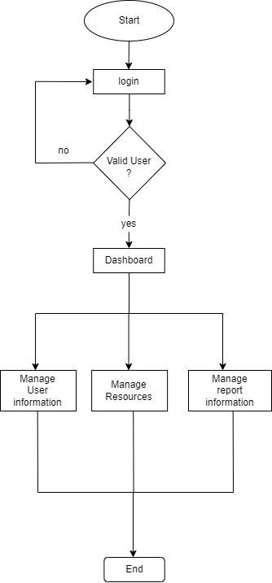
Admin Flow

Slide 7
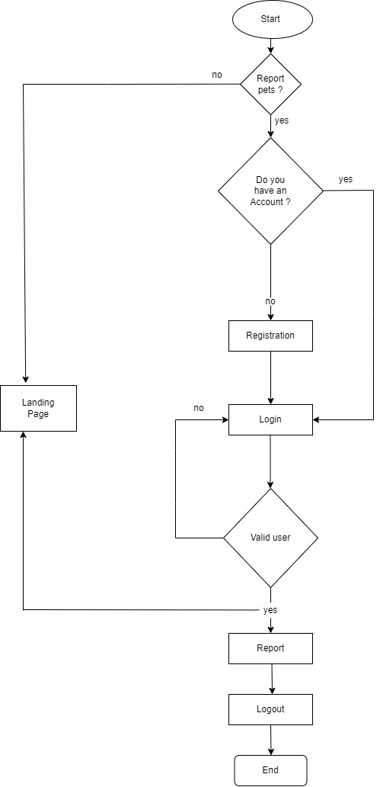
User Flow

Slide 8
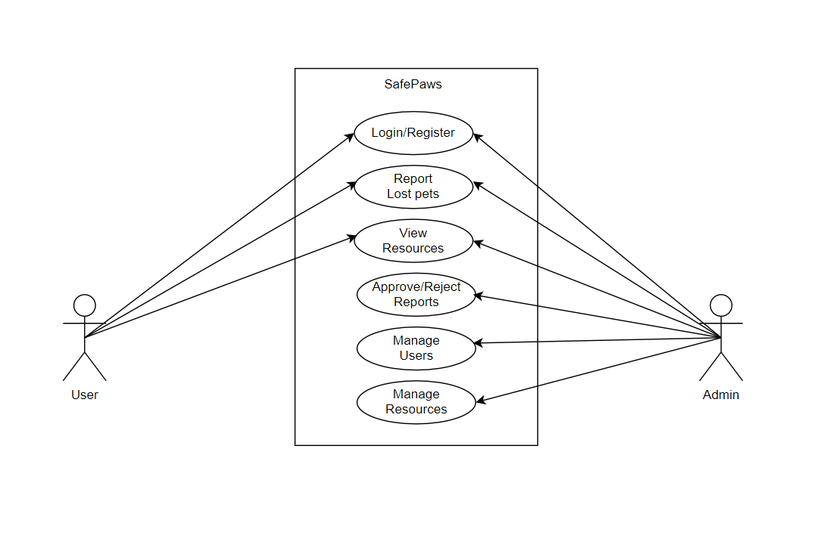
Use case Diagram

Slide 9
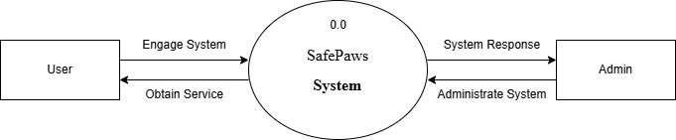
Level 0 DFD of SafePaws

Slide 10
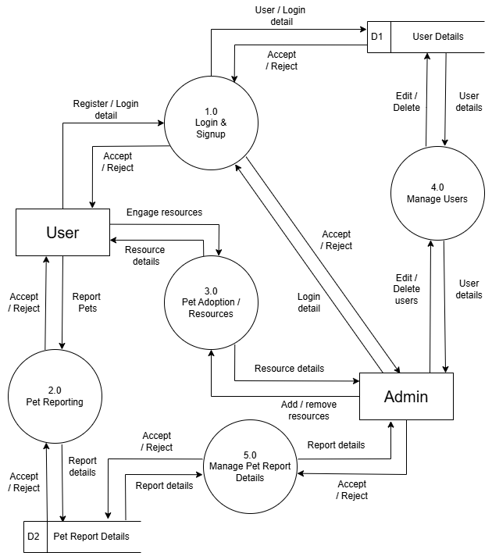
Level 1 DFD of SafePaws

Slide 11
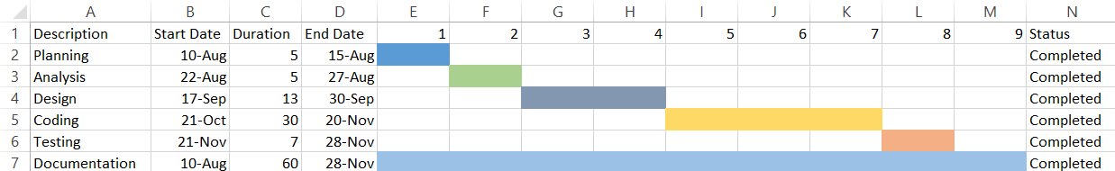
Gantt Chart of SafePaws

Slide 12
Future Recommendations
Though the development of SafePaws has been successful, there are areas for improvement and opportunities for further enhancement. Some of the future recommendations include
Implement password recovery features.
Add search feature.
Add more filter option.
Include more animal welfare services.

Slide 13
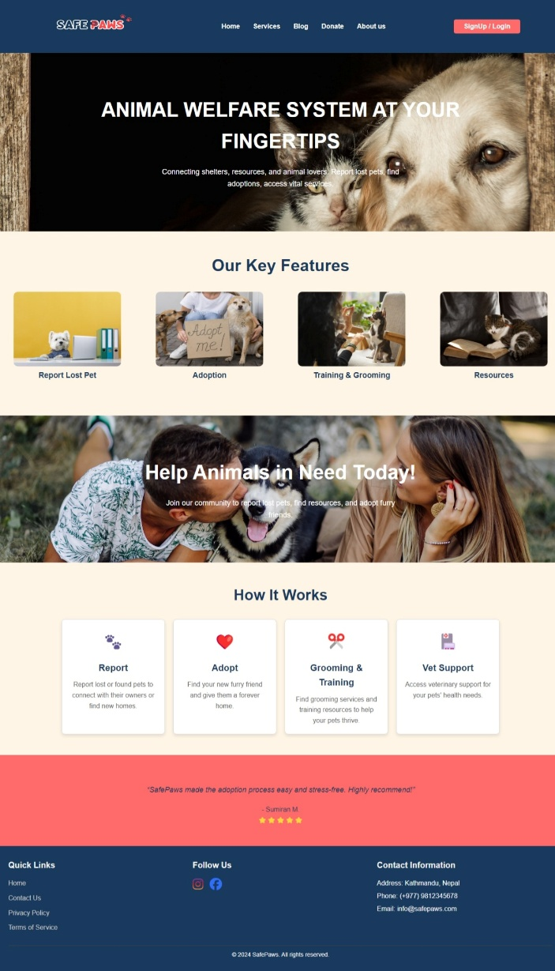
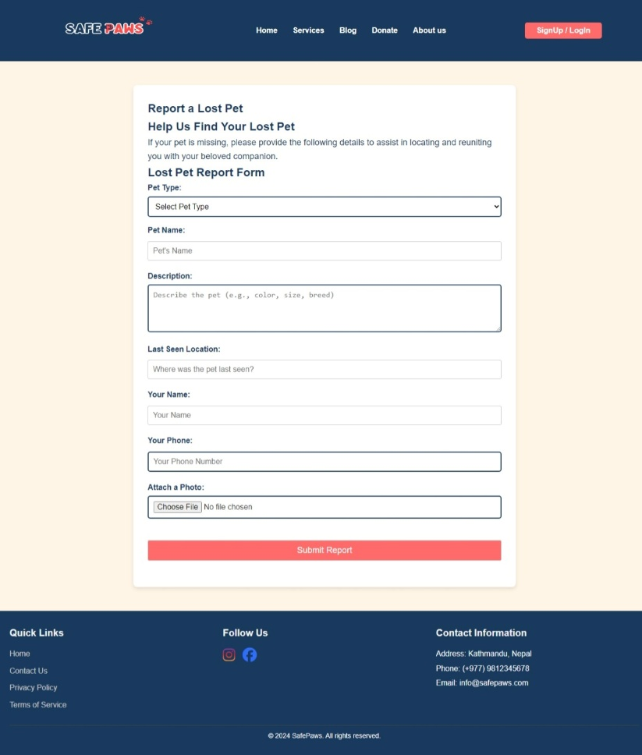
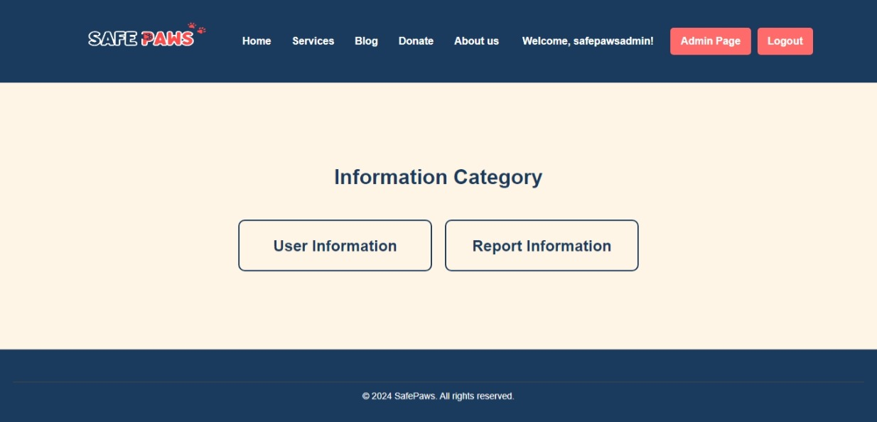
Design Sample
7

Slide 14
LIVE DEMO

