Slide 1
SafePaws
“Where compassion meets action—empowering you to save lives, one paw at a time”
BY:
Anuj Sijapati Saait Pradhan

Slide 2
Introduction to SafePaws Empowering Animal Welfare Through Innovation and Collaboration
1
Connecting Shelters and Resources
Streamlining Adoption Processes
Access to Expert Care
Educational Resources for Pet Owners
Fostering Community Involvement

Slide 3
Problem Statement Addressing Gaps in Animal Welfare Coordination
2
Coordination Challenges
Resource Fragmentation
Information Accessibility
This Photo by Unknown Author is licensed under CC BY-NC

Slide 4
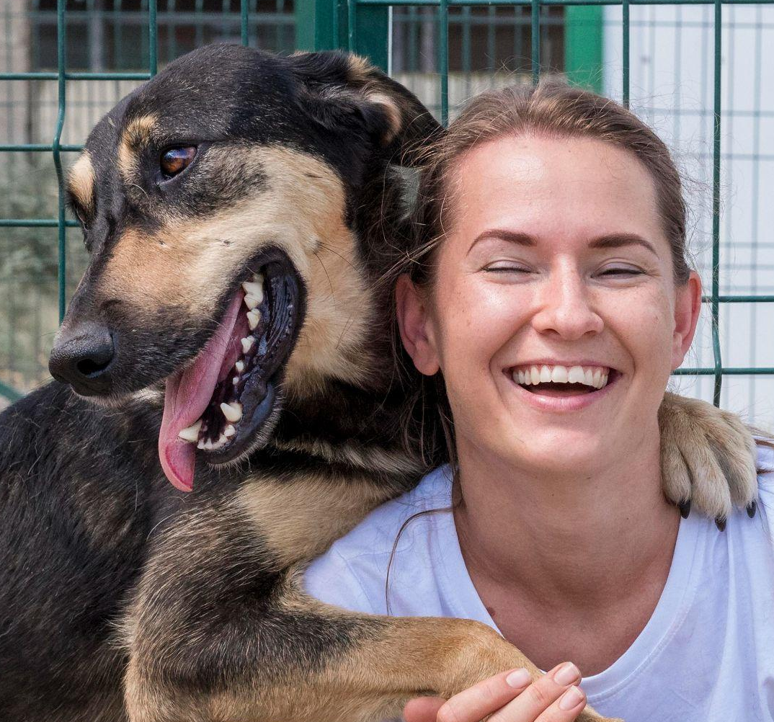
Objective of SafePaws Connecting People and Resources to Improve Animal Lives
3
Educational Resources
Pet Reporting and Adoption
Shelter Resource Connection

Slide 5
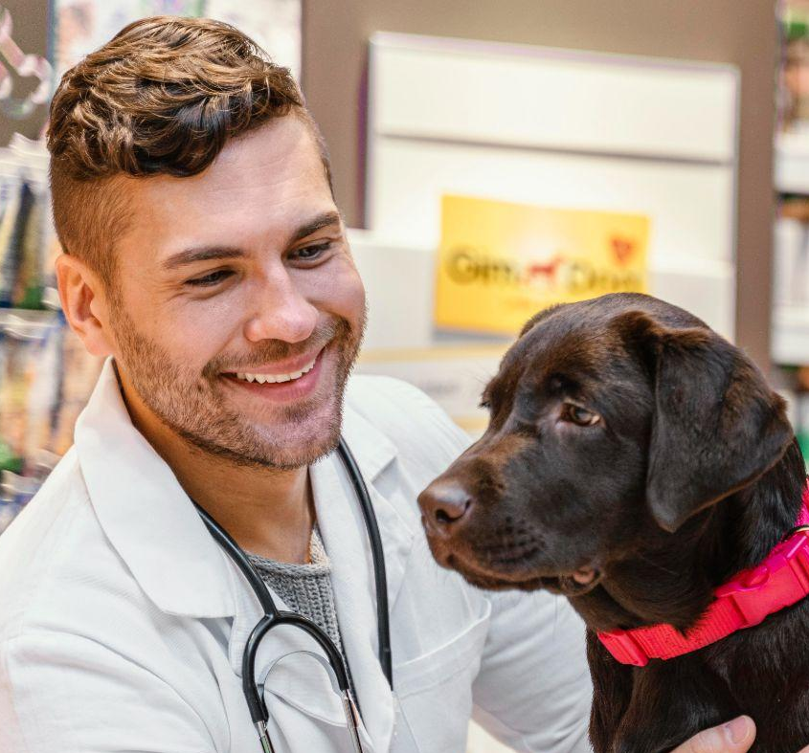
Scope of SafePaws Transforming Animal Welfare Through Holistic Approaches and Strategic Partnerships
4
Shelter and Rescue Connections
Educational Hub for Pet Care
Access to Pet Services

Slide 6
Limitation of SafePaws Acknowledging Boundaries While Focusing on Core Impact Areas
5
Legal Processes of Adoption
Donations and Payments

Slide 7
Literature Review Advancing Animal Welfare Through Cutting-Edge Solutions and Collective Efforts
6
Existing Platforms and Their Limitations
The Growing Pet Ownership Trend
Demand for Grooming Services
Safe Paws' Solution

Slide 8
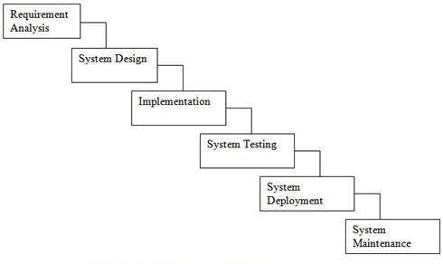
Methodology
7

Slide 9
Core Services of SafePaws Enhancing Animal Rescue Efforts through Vital Services
8
Reporting Lost or Found Pets
Facilitating Fostering and Adoption
Providing Access to Animal Care Resources

Slide 10
Specialized Features Enhancing pet care with tailored services
9
Pet Training
Veterinary Support
Grooming Services

Slide 11
Educational Materials Empowering Pet Owners with Essential Knowledge
10
Nutrition Guidelines
Behavior Management Tips
Health Information

Slide 12
Expected Outcome Empowering Animal Welfare through SafePaws Initiative
11
Enhance Animal Rescue Efficiency
Improve Adoption Rates
Foster Culture of Compassion
Centralize Resources for Pet Care

