Slide 1
BEE – PROJECT EVALAUTION II
Team Members :
Abhinav Rathee (2310991675)
Akanksha Mishra (2310991681)
Anuj Kumar (2310991699) Anushi (2310991700)

Slide 2
Introduction
Express.js is a fast, unopinionated web framework for Node.js.
Helps in handling routes, middleware, and HTTP requests efficiently.
Used for building APIs and web applications.

Slide 3
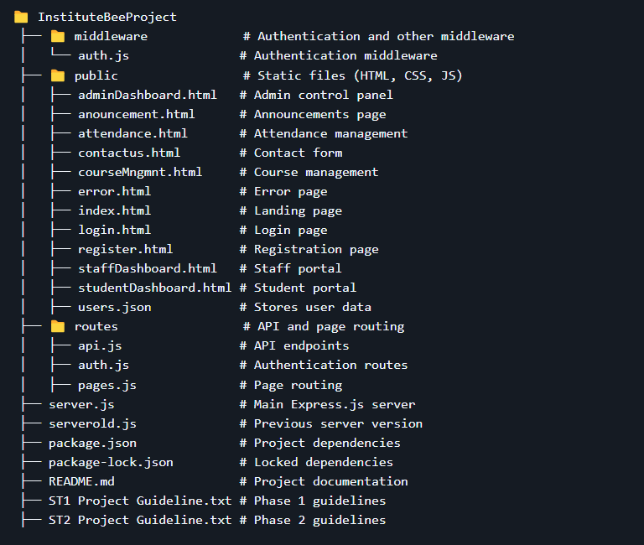
Project Overview
Institute Management System
Directory Structure:
Technologies: Node.js, Express.js

Slide 4
Express.js Middleware
Middleware: Functions executed during request-response lifecycle.
Types:
Built-in (e.g., express.json())
Application-Level (Custom middlewares)
Router-Level (Applied to specific routes)
Third-Party (morgan, cors, helmet)
Error-Handling (next(err))

Slide 5
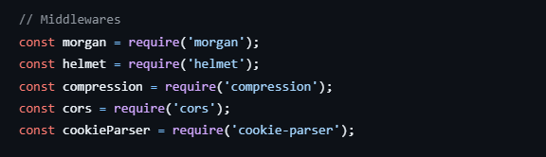
Third-Party Middlewares
Morgan → Logs HTTP requests
Cors → Enables cross-origin requests
Helmet → Enhances security
Body-Parser → Parses request body
Express-Rate-Limit → Rate-limiting middleware

Slide 6

Serving Static Files
Static files (HTML, CSS, JS, images) stored in public folder.
Use express.static() to serve them.

Slide 7
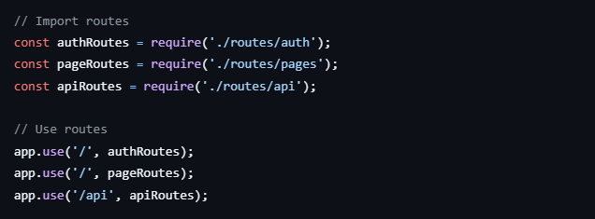
Routing in Express.js
Route Methods: GET, POST, PUT, DELETE
Route Paths: Define URL structure
Route Parameters: Capture dynamic values in URLs

Slide 8
Express Router for Modular Routing
express.Router() helps separate route logic.
Keeps code clean and maintainable.

Slide 9
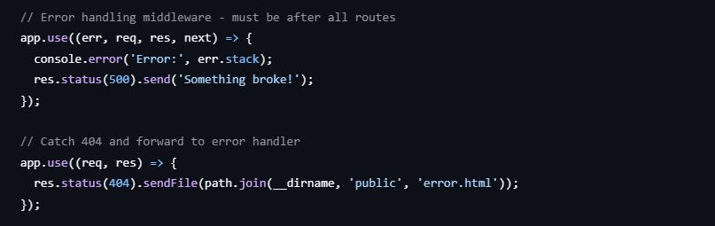
Exception Handling in Express.js
Handle errors globally using error-handling middleware.
Use next(err) to forward errors.

Slide 10
References
Express.js & Middleware
https://expressjs.com/en/guide/using-middleware.html
https://expressjs.com/en/guide/routing.html
Handling Static Files & Routing
https://expressjs.com/en/starter/static-files.html
Error Handling & Status Codes
https://developer.mozilla.org/en-US/docs/We/Statusb/HTTP
Third-Party Middleware
https://www.npmjs.com/package/morgan
https://www.npmjs.com/package/helmet
https://www.npmjs.com/package/cors
https://www.npmjs.com/package/express-rate-limit

Slide 11
The End

