Slide 1
DOCONNECT
Ask your question and get your answer!

Slide 2
Mentor:
Group Members:
1. Valeti Brama Naidu
2. Anuj Kumar Singh
3.Talagana Srikanya

Slide 3
PROBLEM STATEMENT
• DoConnect is a popular Q and A form in which technique questions was asked and answered.
•To do the above application there are two types of users.
1. User
2. Admin

Slide 4
INTRODUCTION
• It is a Q&A stage that enables individuals to share and develop the world's information
• In this task we made a site to offer every one of the types of assistance to the clients through on the web
• There are two users in this application
1.User
2.Application

Slide 5
OBJECTIVES
The principal Objective of the undertaking DoConnect is to make a straightforward Online stage where clients can track down responds to for their inquiries with the specialists endorsement

Slide 6
ADMIN REGUIREMENTS
• As an Admin we should be able to login, Logout and Register into the application.
• As an Admin we should be able to get mail as soon as any new Question is asked or any Answers given.
• As an Admin we should be able to approve the question and Answer. Any Question or Answer will be visible on the platform only if it is approved.
• As an Admin we should be able to delete inappropriate Questions or Answer

Slide 7
USER REQUIREMENTS
• As a user we should be able to login, Logout and Register into the application.
• As a user we should be able to ask any question under any topic
• As a user we should be able to search the question on any string written in search box
• As a user we should be able to Answer any question asked
• As a user we should be able to answer more than one question and more than one time
• As a user we should be able to chat with other users.
• As a user we should be able to upload images to refer

Slide 8
SOFTWARE REQUIREMENTS
Technologies IDE
1.Angular 1.Visual Studio Code
2.Spring Boot 2.Spring Tool Suite and Eclipse 3. MySql Workbench
Languages
1.TypeScript
2.Html
3.Java
4.SQL

Slide 9
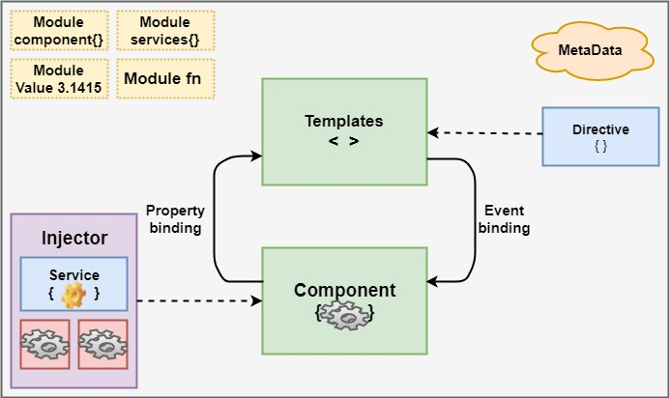
Angular
Architecture

Slide 10
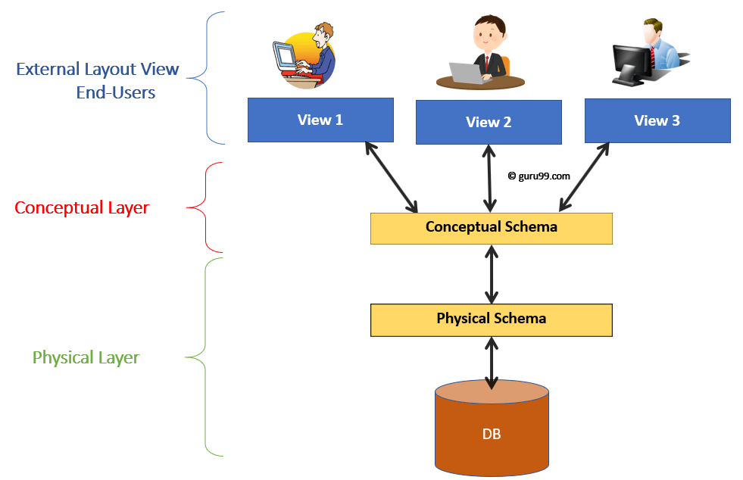
Data Base
Architecture

Slide 11
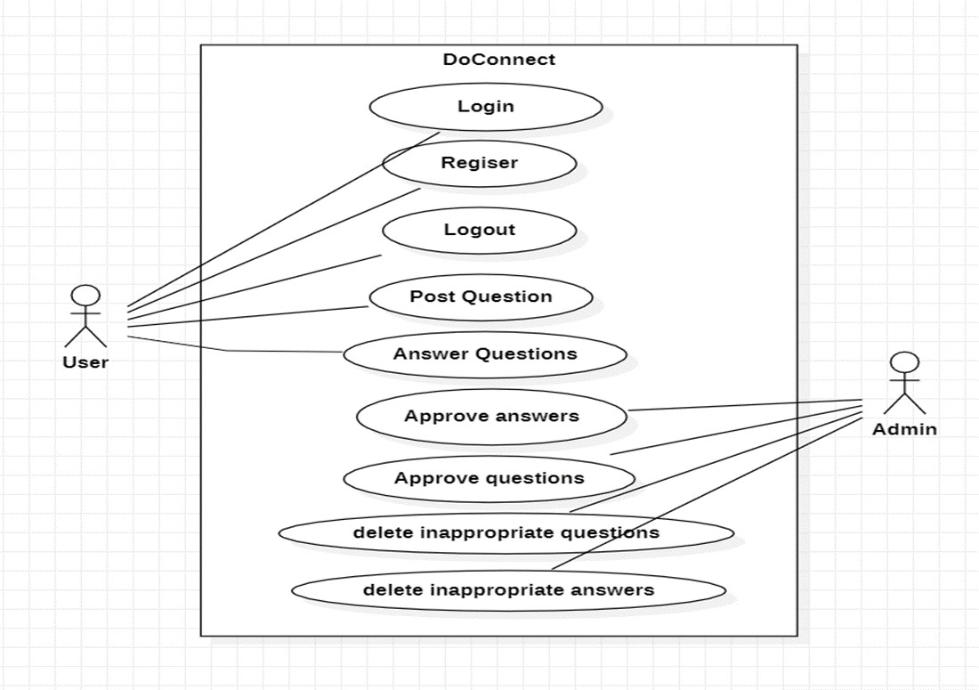
Use Case
Diagram

Slide 12
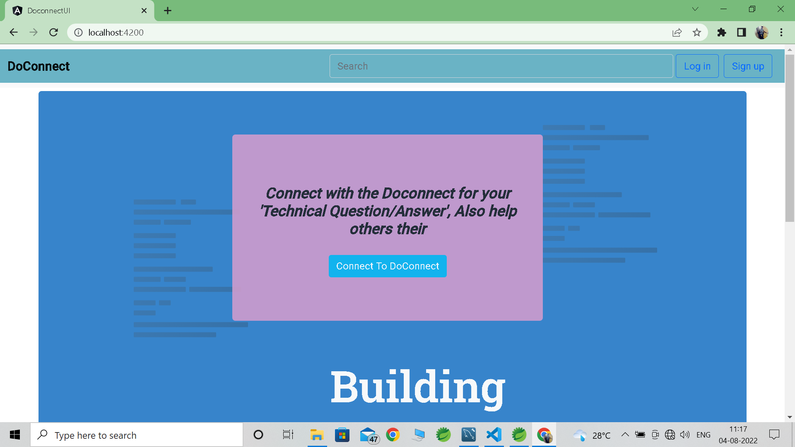
Home Page
The page normally experienced first on a site that generally contains connections to different pages of the site

Slide 13
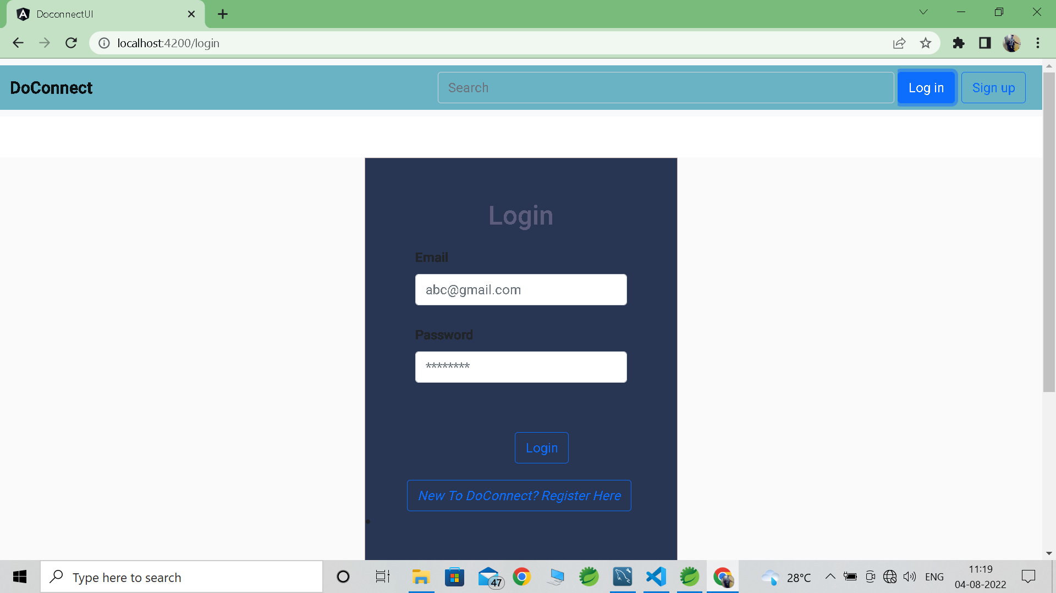
Login Page
Login page allows a user to gain access to an application by entering their user name and password

Slide 14
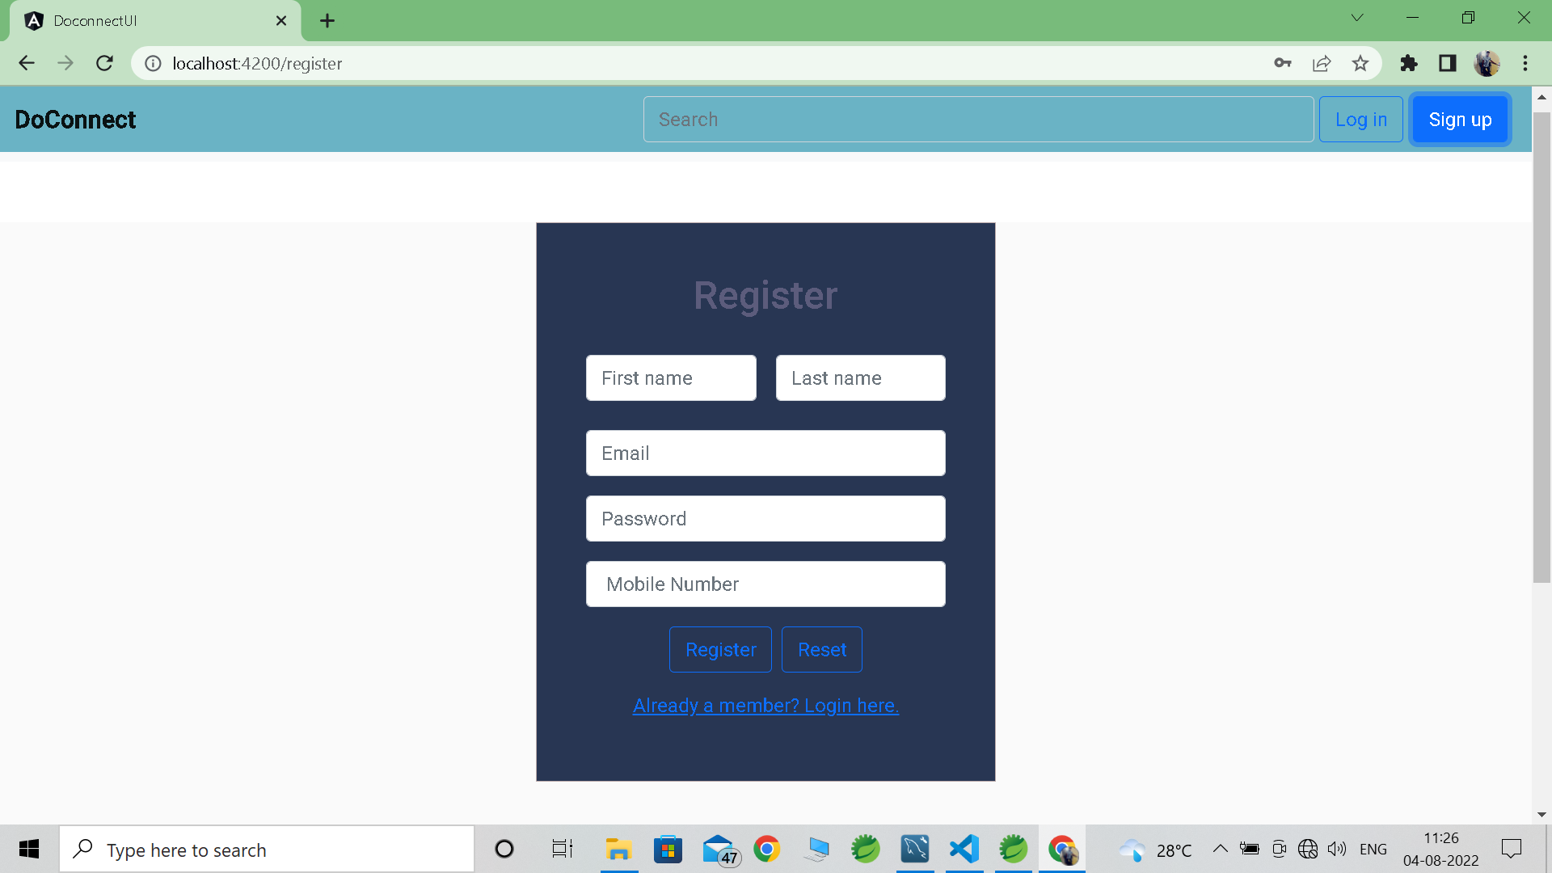
Register Page
In Register Page the new user can register to our Doconnect

Slide 15
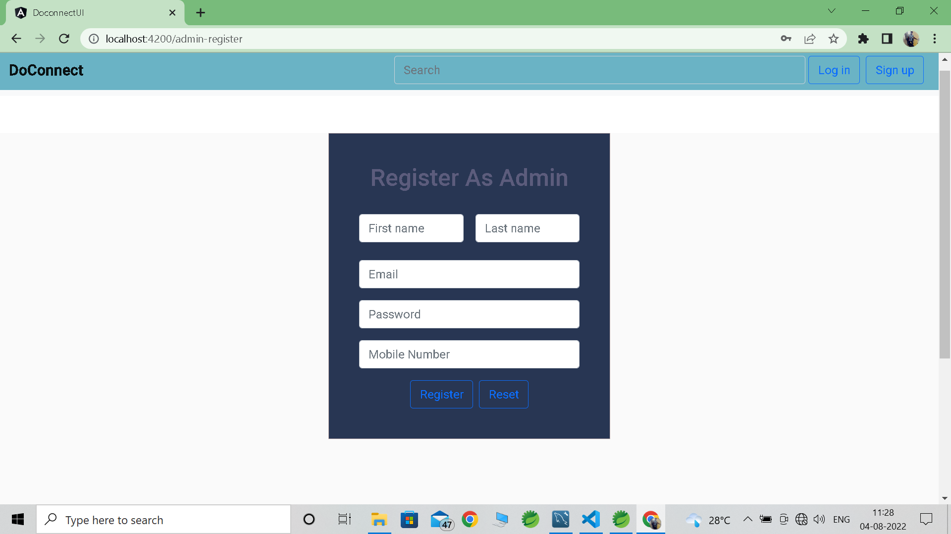
Admin Signup

Slide 16
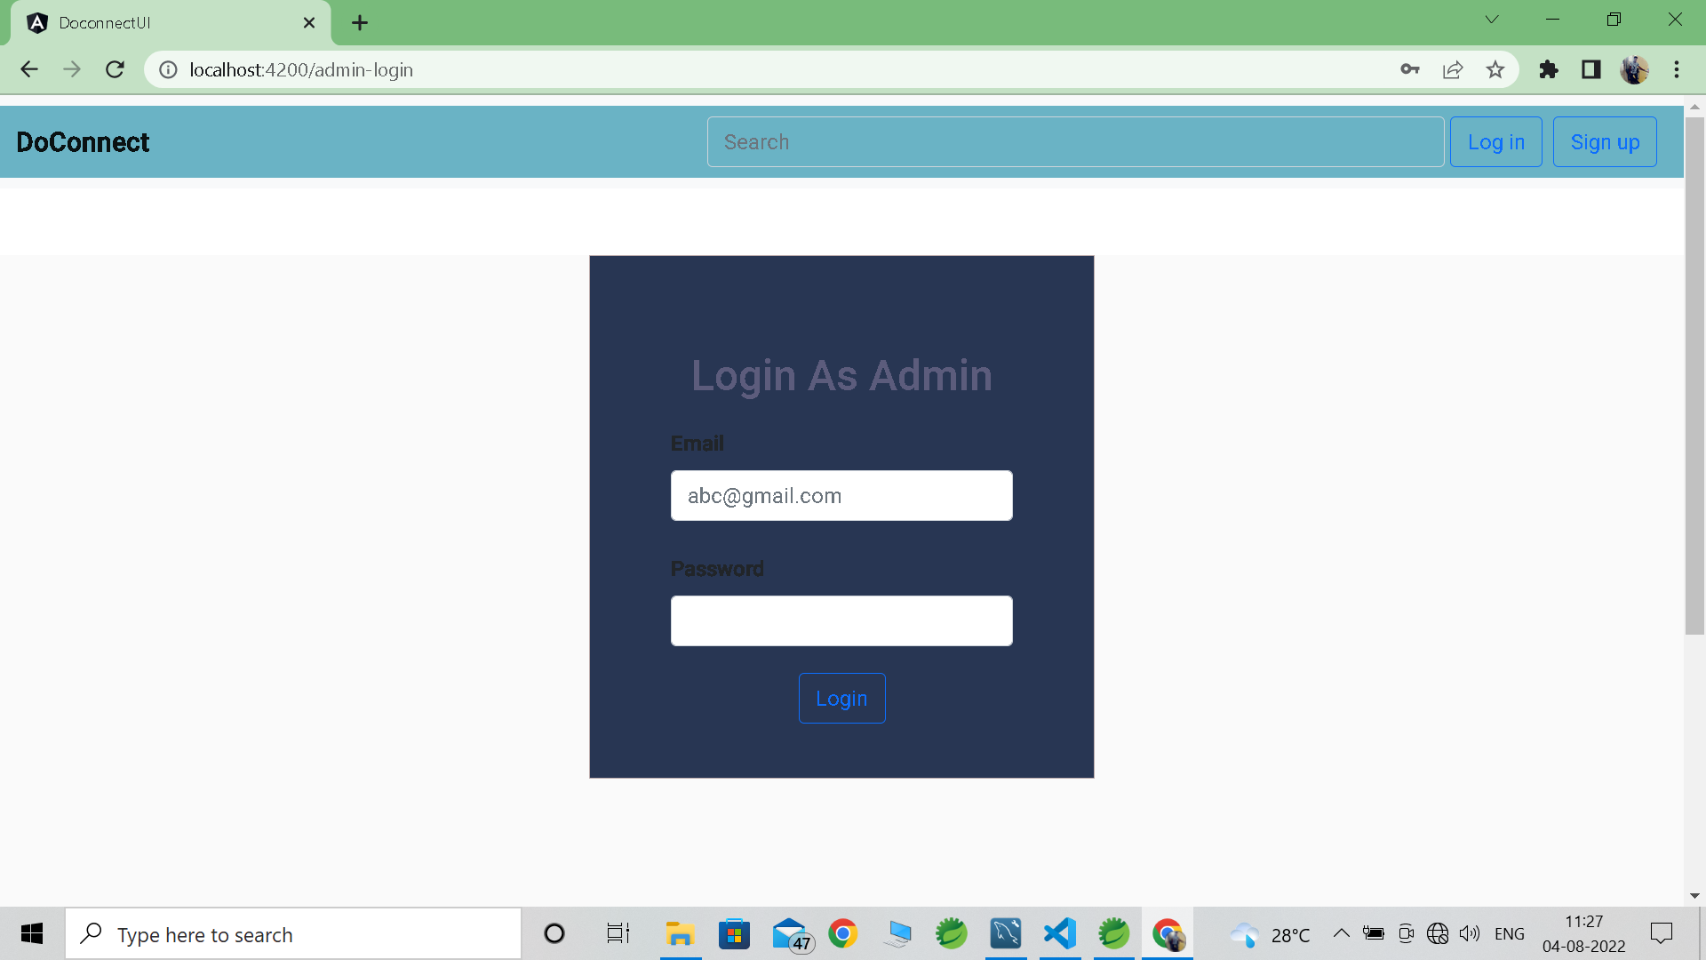
Admin Login Page

Slide 17
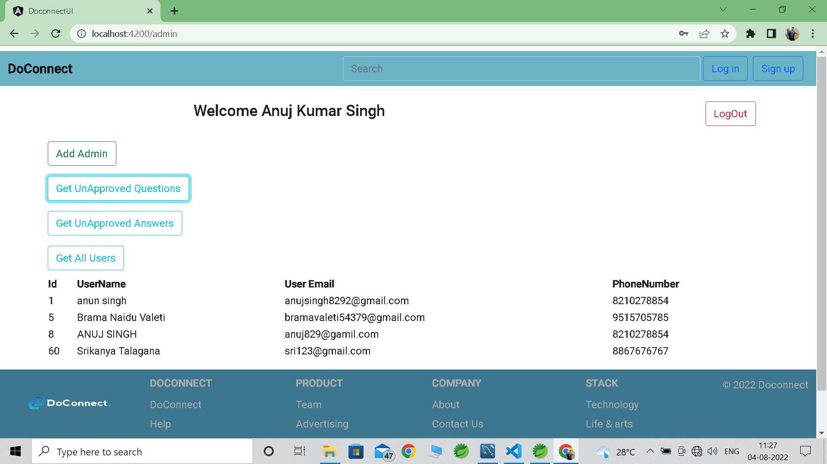
Admin Page

Slide 18
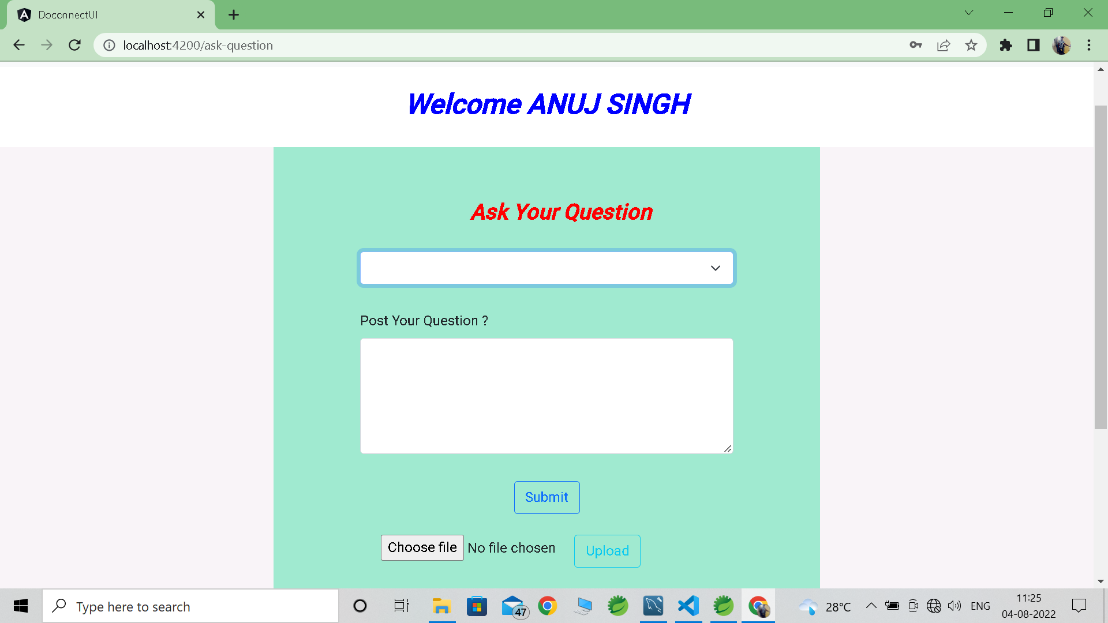
Ask Question Page

Slide 19
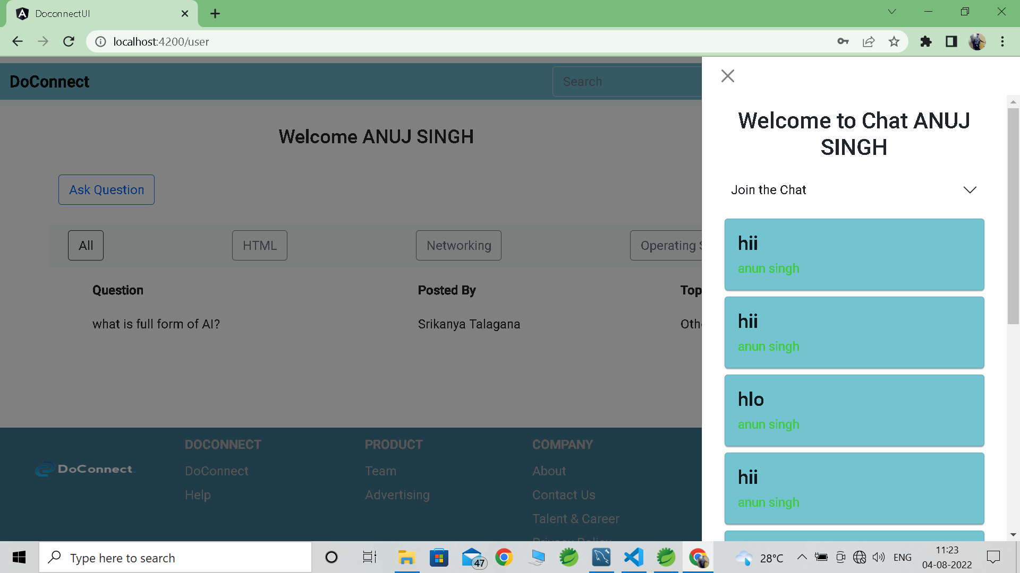
Chat Box

Slide 20
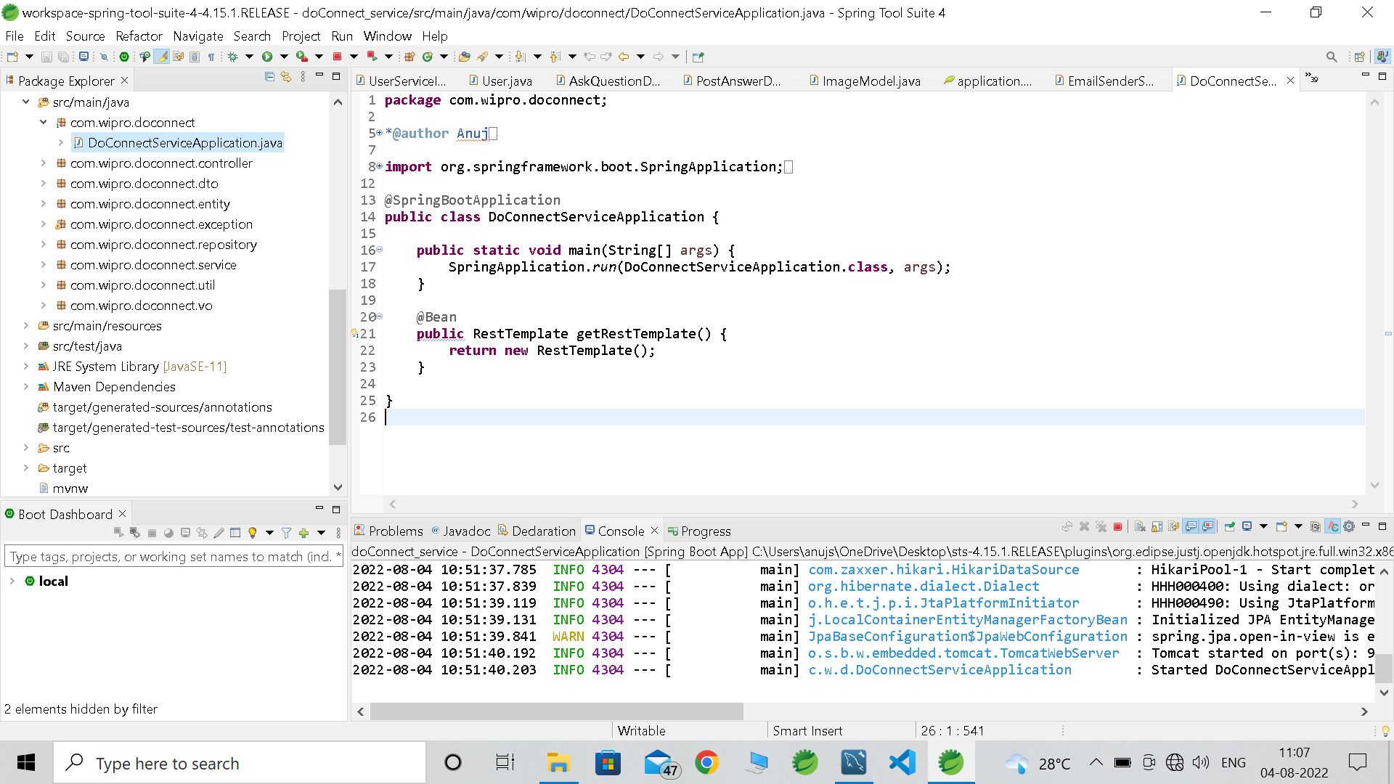
Structure Of Spring

Slide 21
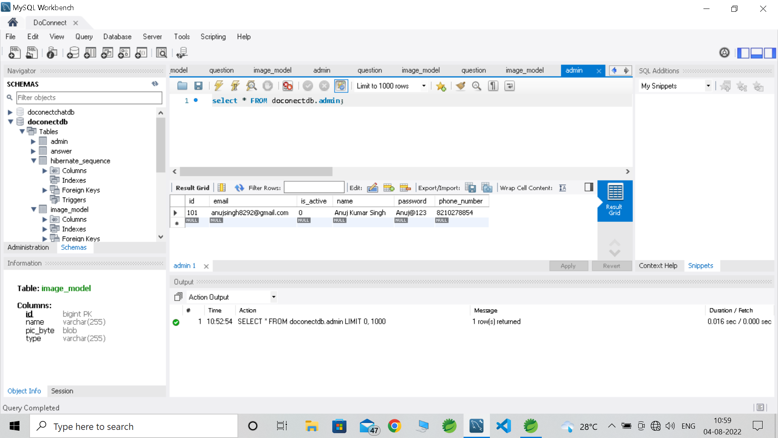
Structure Of Database

Slide 22
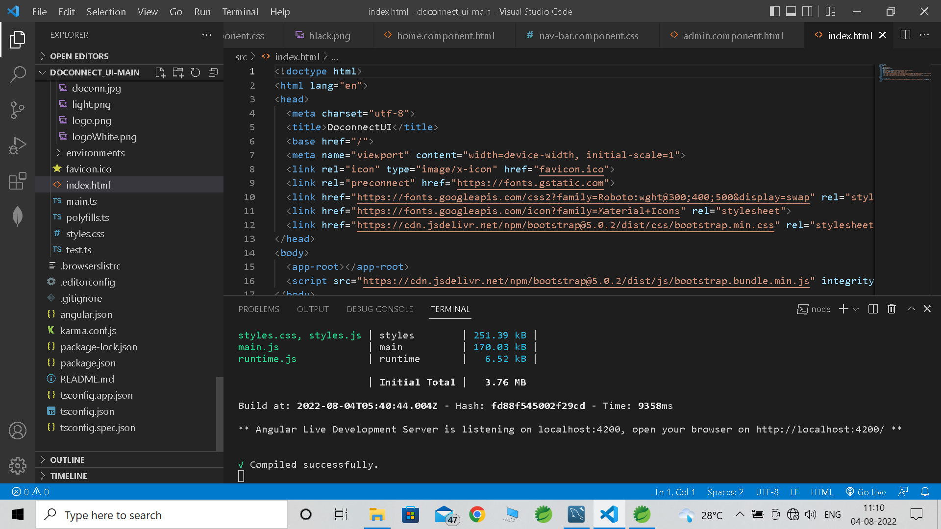
Structure Of Visual Studio

Slide 23
Thank You

