Slide 1
RAI TECHNOLOGY UNIVERSITY
Title : Personal Expense Tracker💵💰
Subject :- Machine Learning
Presented by :- W. Anuj
regis no:- RTU24101CS038
Subject code :- 0CS330T
1
Presented to:- Satyam Sir

Slide 2
INTRODUCTION
  Managing daily expenses manually can be time-consuming
  This project helps users record, categorize, and visualize expenses easily
  Built using Python and Streamlit.
  Future update will include user login and SQLite3 database.
Tools and Technologies
  Frontend / Framework: Streamlit
  Language: Python
  Libraries: Pandas, Matplotlib / Plotly, Streamlit
2

Slide 3
Project Folder Structure
personal_expenses_tracker/
│
├── app.py # Main Streamlit app file
│
├── data/
│ ├── expenses.csv # Stores user expense data .csv file
│ ├── budget.txt # Stores user budget
│
├── requirements.txt # Python libraries
└── README.md # Project documentation
3

Slide 4
Features
  Add, view, and delete expenses
  Categorize transactions (Food, Travel, Bills, etc.)
  Display total and category-wise spending
  Generate charts and summaries
Future Enhancements
  Future Enhancements
  Store data in SQLite3 database for each user
  Add monthly and yearly budget analytics
  Enable export/import of expense data
4

Slide 5
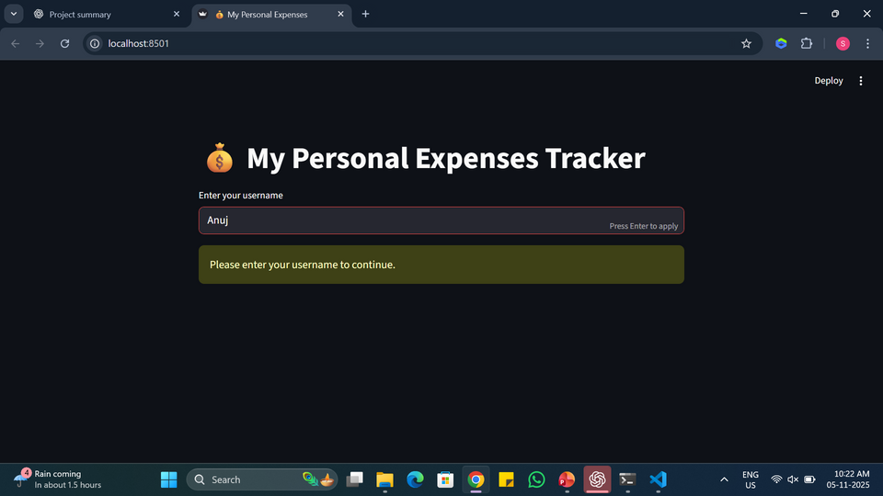
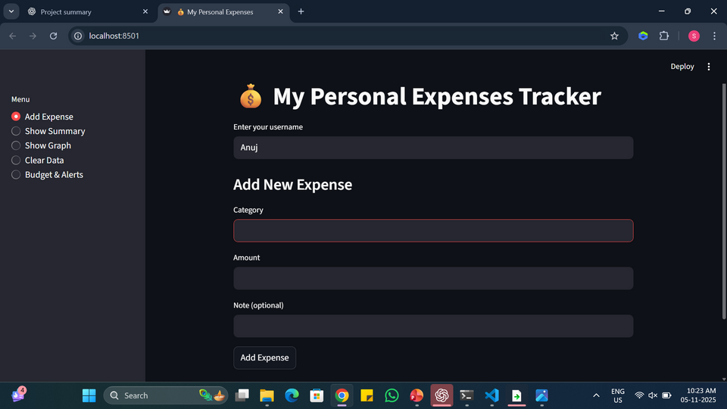
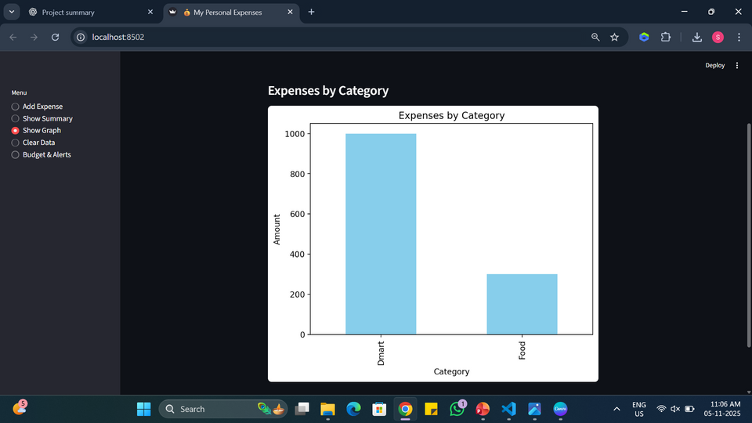
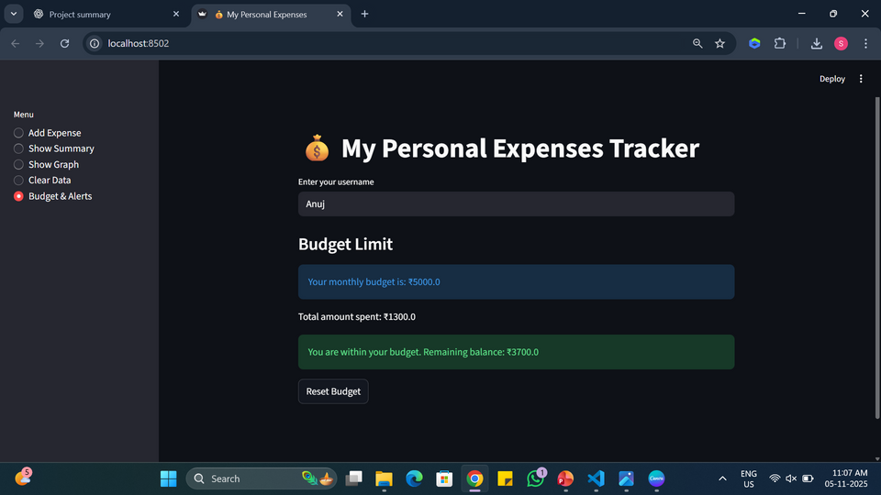
App Interface
5

Slide 6
Methodology
  Requirement Analysis : Identify the need for expense tracking.
  Design Phase : Plan app layout and user interface.
  Development : Build app.py and core features.
  Testing : Verify correctness of expense calculations.
  Deployment : Host on Streamlit Cloud via GitHub.
  Future Enhancement : Add SQLite3 user login and data storage.
8

Slide 7
Conclusion
  The app simplifies financial tracking using Python and Streamlit.
  Future versions will include login and personalized storage.
  Demonstrates practical use of Python, Streamlit, and data visualization
  Uploaded app on streamlit cloud link : https://personal-expense-tracker-02.streamlit.app/
6

Slide 8
THANK YOU!!!
Contact
  Github :- https://github.com/Anuj04432
  linkdin :- https://in.linkedin.com/in/anuj-wagmore-275518358
  gmail :- anujwagmore835@gmail.com
7

