Slide 1
Superstore Sales Dashboard
Interactive Sales & Profit Analysis for Business Stakeholders
Date: 10 August 2025
Anuj Kumar Kushwaha

Slide 2
Objective
Design an interactive Power BI dashboard that helps business stakeholders monitor sales, profit, and growth trends.
Enable analysis across time, product categories, and regions to support data-driven decision-making.

Slide 3
Dataset Information
Dataset: Superstore Dataset – Kaggle (https://www.kaggle.com/datasets/vivek468/superstore-dataset-final)
Rows: ~9,994
Columns: 21 (Order Date, Ship Date, Customer Name, Segment, Country, City, State, Region, Product Category, Sales, Quantity, Discount, Profit, etc.)
Time Period: 2011 – 2014
Coverage: Global sales transactions

Slide 4
Tools & Techniques Used
Tools:
- Power BI Desktop – Dashboard creation & data visualization
- Excel – Data inspection & minor cleaning
- Kaggle – Dataset source
Techniques:
- Data cleaning (removed null/duplicate records)
- Created custom date table using DAX (ADDCOLUMNS, CALENDAR)
- Calculated KPIs for Sales, Profit, and Quantity
- Built visuals: Line Charts, Bar/Column Charts, Donut Charts, Tree Map, Map Visualizations, Scatter Plot
- Added slicers for Year, Month, Category, Region, Segment

Slide 5
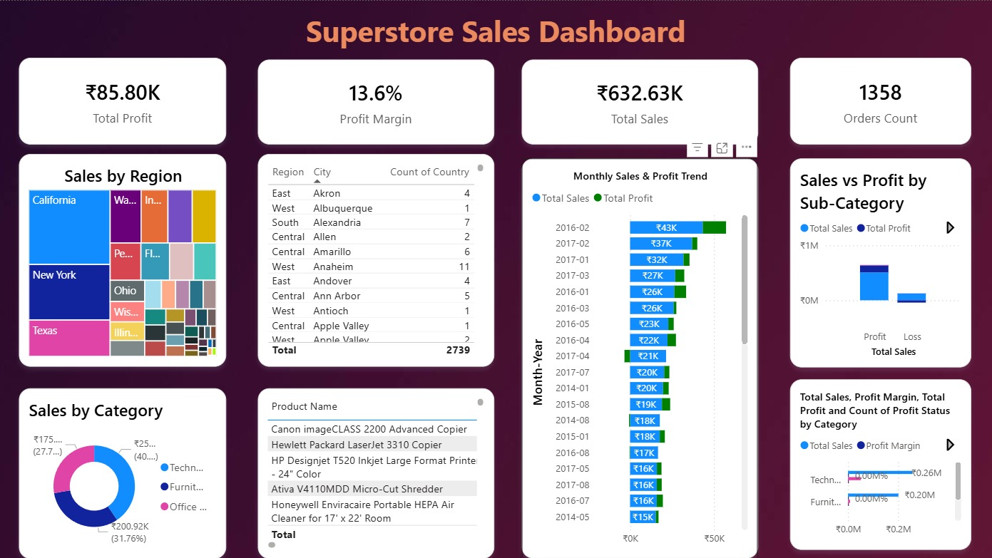

Slide 6
Dashboard Overview
Interactive slicers for multi-dimensional filtering
Summary cards for quick KPI view
Time-series trends for sales and profit
Category and sub-category performance breakdown
Geographical sales & profit mapping
Discount vs. Profit correlation analysis

Slide 7

Key Insights
Sales peaked in 2013 with steady YoY growth.
Phones and Chairs are top-selling sub-categories.
Technology category delivers the highest profit margins.
Some countries (e.g., United States, Turkey) dominate sales, but certain regions show negative profit.
High discounts often correlate with reduced profit.
Consumer segment accounts for the largest sales volume.

Slide 8

Conclusion
The dashboard allows stakeholders to track performance across time, geography, and product categories.
Identifies high-performing areas and low-profit zones for strategic improvement.
Can be updated dynamically as new sales data is added.

