Slide 1

Exploring Airbnb Data of major US cities
Anuj Chanchlani – (674153696)
Pratik Talreja – (657488876)
Rashi Desai – (663553314)

Slide 2
Problem Statement
Create a model that identifies Airbnb listings with similar amenities based on preferences entered by a user.
Purpose: To help users find listings that offer similar amenities and services in a particular neighborhood
Notes:
The model also includes descriptive attributes (amenities, property type, room type, user verification)

Slide 3
About the Data
Dataset: Airbnb Data (New York City, Chicago, Boston, Denver)
Type: Public
Data source: Inside Airbnb (http://insideairbnb.com/get-the-data.html)
Description about data:
106 attributes with 68,271 unique listings
A mix of categorical, object and numerical data variables
The data has listings from four cities as of August 2019
Listing types: apartment, house, town house, condominium
Important descriptive attributes: Amenities (WiFi, stove, hot water, bed linens), room type (private, shared), host verification (email, phone, reviews, offline government ID), description of the listings among others

Slide 4






Body of Work
Data Procurement
Data Cleaning
Data Exploration
Feature Selection
Feature Engineering
Cluster Analysis
Notes:
Procurement: Data collected for NYC, Chicago, Boston and Denver, later concatenated to form a comprehensive dataset.
Cleaning: remove punctuations ($, comma, dots), data type conversion (string to float), removed attributes with null values >20%
Exploration: first-hand analysis, descriptive statistics (barplots - visualizations)
Feature selection: removed unimportant variables by observation (listing_URL, scrape_ID, country code, first & last reviews)
Feature engineering: One-hot encoding of categorical variables, standardizing numerical variables, PCA for dimensionality reduction
Cluster analysis: Clusters based on price - low, medium, high
By choosing another member of the same cluster closer to the penn station, you can trust that there is some similarity between these two locations. You can then, narrow down your search and find what you are looking for.

Slide 5
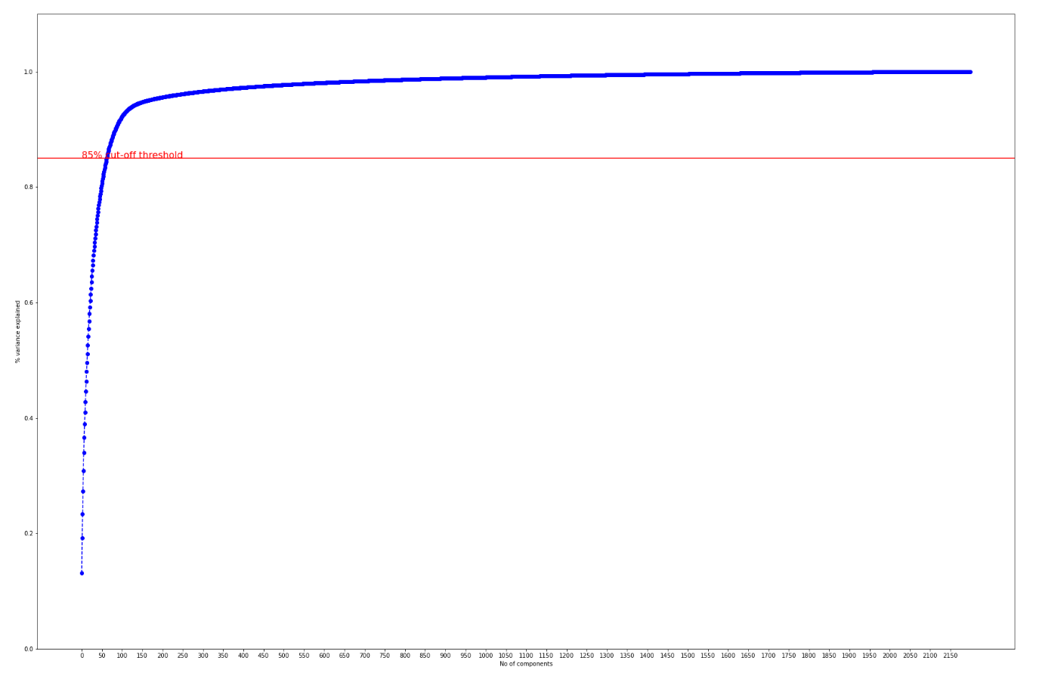
Results (Selecting number of principal components)

Slide 6
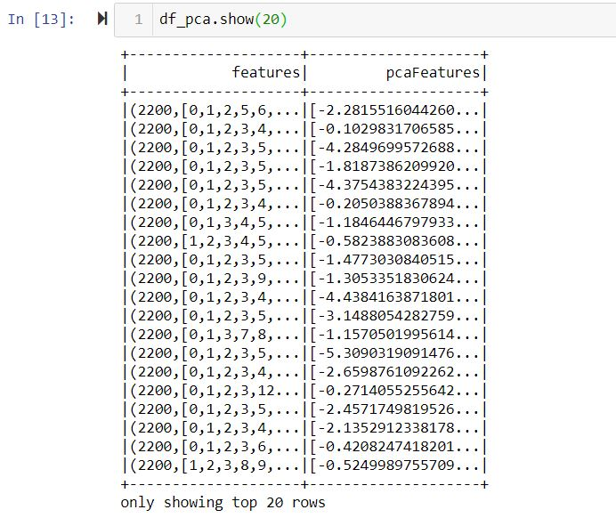
Results (Principal Component Analysis)

Slide 7
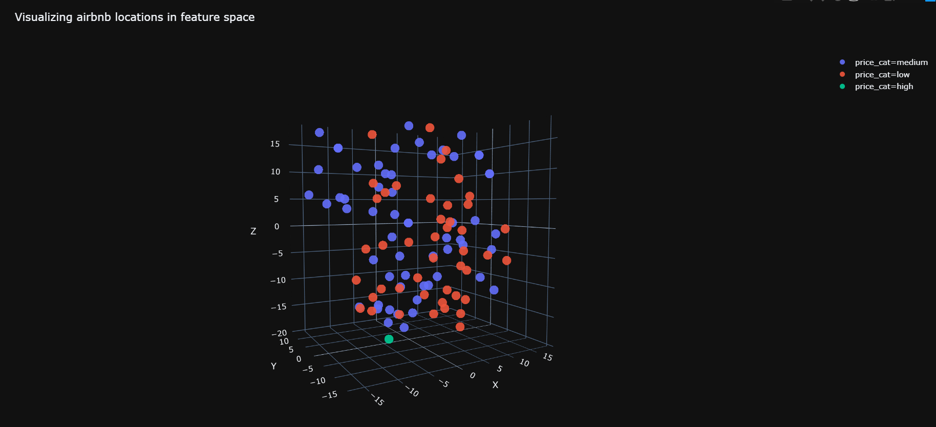
Results (Visualizing listings in 3D space)
Note: The .html file of the above visualization is uploaded along with the code.

Slide 8
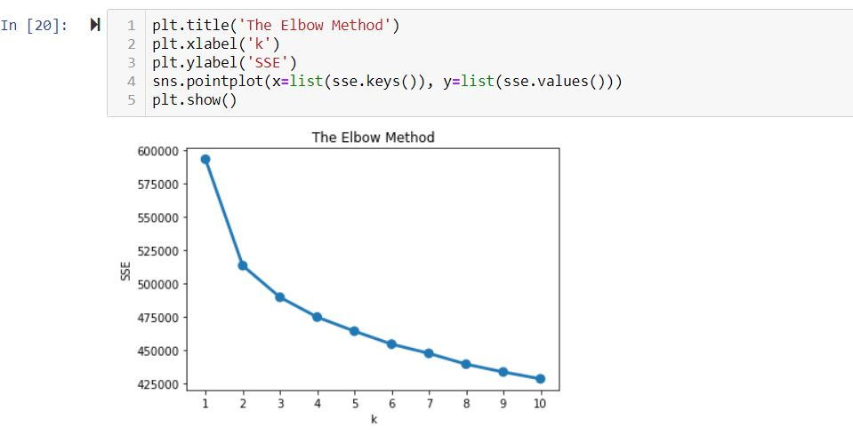
Results (Elbow Plot : K-means)

Slide 9
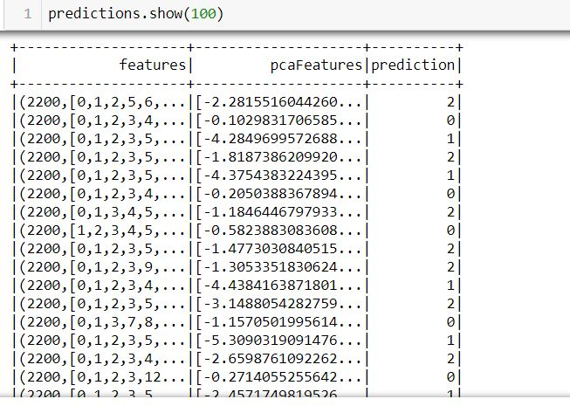
Results (Clustering)

