Slide 1
Data Normalization

Slide 2
Normalization
Database normalization is a technique for designing relational database tables to minimize duplication of information and to safeguard the database against certain types of logical or structural problems, namely data anomalies
Objectives
Data normalization aims to derive at records which avoid 
  Repetition of Data
  Update anomalies
  Insert Anomalies
  Delete Anomalies

Slide 3
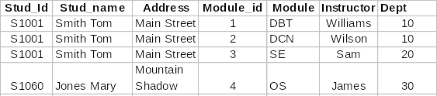
Student

Slide 4
The Process of Normalization
Usually three steps (in industry) giving rise to
  First Normal Form (1NF)
  Second Normal Form (2NF)
  Third Normal Form (3NF)
In academia
  Boyce -Codd Normal Form (BCNF)
  Fourth Normal Form (4NF)

Slide 5
Steps in Data Normalization
UNORMALISED ENTITY
step1 ...
Eliminate repeating groups
1st NORMAL FORM
step2 ...
Eliminate partial dependencies
2nd NORMAL FORM
step3 ...
Eliminate Transitive dependencies
3rd NORMAL FORM
step4 ...
remove multi-dependencies
step4 ..every determinate a key
4th NORMAL FORM
BOYCE-CODD NORMAL FORM

Slide 6
Attributes - Repeating Groups
When a group of attributes has multiple values then we say there is a repeating group of attributes in the entity
BRANCH
BRANCH
COMPANY No
NAME
ADDRESS
NAME
ADDRESS
A123
ABC Ltd
100 High St
ABC1
Manchester
ABC2
London
ABC3
Glasgow
 (BRANCH_NAME, BRANCH_ADDRESS) is a repeating group

Slide 7
Functional Dependency
Consider a relation R that has two attributes A and B. The attribute B of the relation is functionally dependent on the attribute A if and only if for each value of A no more than one value of B is associated.
In other words, the value of attribute A uniquely determines the value of B
  Stud_id -> stud_name
  Stud_id -> Date of Birth
  Module_id -> Module name
  Marks -> grade

Slide 8
Full Functional Dependency
Let A and B be distinct collections of attributes from a relation R B is then fully functionally dependent on A if B is not functionally dependent on any subset of A.
(Stud_id, Module_id) -> marks

Slide 9
First Normal Form
A relation is in 1NF if and only if every attribute is single valued for
each tuple or row.
A relation is in 1NF if and only if there are no repeating groups of
Attribute values.

Slide 10

Example of First Normal Form
UN-NORMALISED ENTITY TYPE
PURCHASE-ORDER (ORDER NO, SUPPLIER NO, ORDER DATE
DELIVERY DATE, PART NO, PART DESCRIPTION,
QUANTITY ORDERED, PRICE)

Slide 11
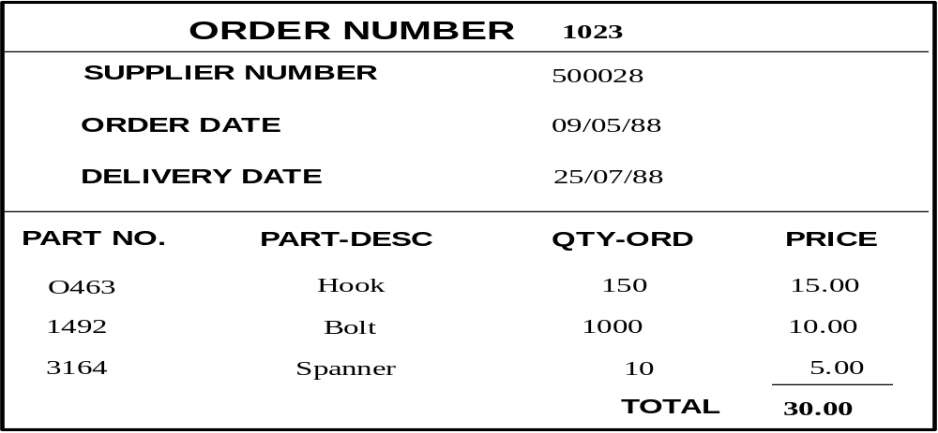
Example in 1NF
ENTITY TYPES IN 1NF
PURCHASE-ORDER (ORDER NO, SUPPLIER NO, ORDER DATE
DELIVERY DATE)
PURCHASE-ITEM-1 ( ORDER NO, PART NO, PART DESCRIPTION,
QUANTITY ORDERED, PRICE)

Slide 12
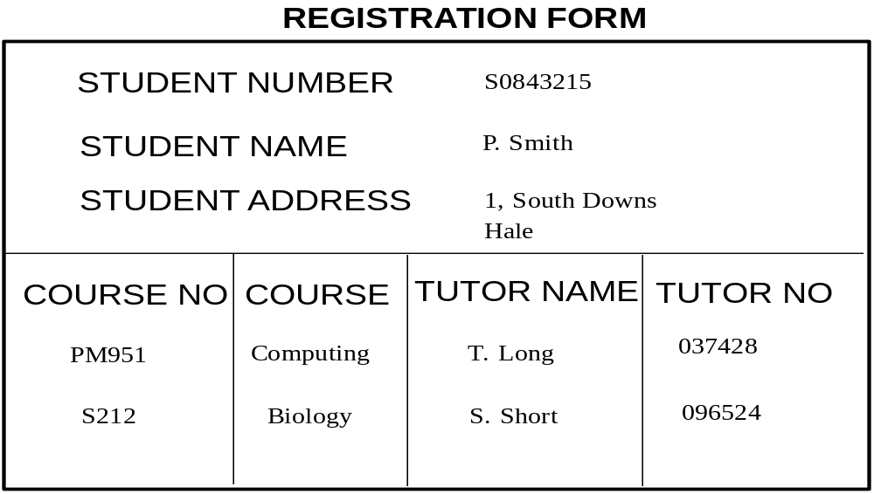
Example
STUDENT (Student No, student-name, student-address)
ENROLMENT (Student No, Course No, course-title,
tutor-name,tutor-staff No

Slide 13
1st Normal Form
Process results in separation of different objects
BUT anomalies may still exist
PURCHASE-ITEM-1( ORDER#, PART#, PART-DESCRIPTION,QUANTITY-ORDERED, PRICE)
  PART-DESCRIPTION appears on every PURCHASE-ITEM occurrence.
  This may result in anomalies when updating or deleting records
  The problem in the example is that PART-DESCRIPTION is functionally dependent only on PART# (part of the identifier)

Slide 14
Second Normal Form
A relation is in 2NF if and only if it is in 1NF and all the
non-key attributes are fully functionally dependent on the
key.
Any entity type in 1NF is transformed to 2NF
  Identify functional dependencies
  Re-write entity types so that each non-identifying attribute is functionally dependent on the whole of the identifier

Slide 15

Example
ENTITY TYPES IN 1NF
PURCHASE-ORDER (ORDER NO, SUPPLIER NO, ORDER DATE
DELIVERY DATE)
PURCHASE-ITEM-1 ( ORDER NO, PART NO, PART DESCRIPTION,
QUANTITY ORDERED, PRICE)

Slide 16
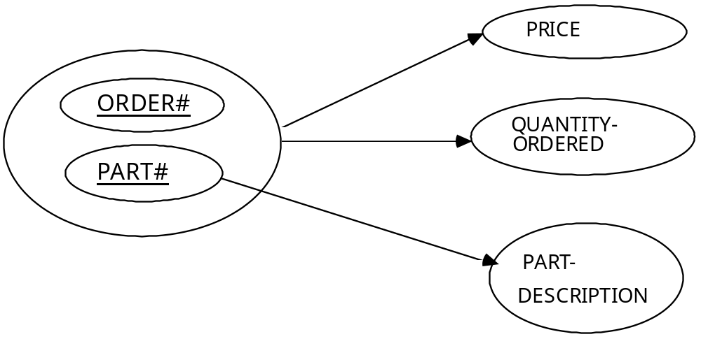
Functional Dependencies
PURCHASE-ORDER (ORDER NO, SUPPLIER No, ORDER-DATE
DELIVERY-DATE, TOTAL-PRICE)
PURCHASE-ITEM-1 ( ORDER NO, PART NO, PART-DESCRIPTION,
QUANTITY-ORDERED, PRICE)

Slide 17
In 2nd Normal Form
Decompose PURCHASE-ITEM into two entity types
PURCHASE-ITEM (OrderNo, PartNo, Quantity-Ordered, Price)
PART (PartNo, Part-Description)
Original entity types are decomposed into three entity types in 2nd normal form
PURCHASE-ORDER (OrderNo,SupplierNo, Order-Date, Delivery-Date, Total-Price)
PURCHASE-ITEM (OrderNo, PartNo,Quantity-Ordered, Price)
PART (PartNo, Part-Description)

Slide 18

Example in 2NF
ENTITY TYPES IN 2NF
STUDENT (Student No,Student-Name, Student-Address)
ENROLMENT ( Student No, Course No)
COURSE (Course No, Course-Title, Tutor-Name, Tutor-Staff No)

Slide 19
Third normal Form
A relation is in 3NF if and only if it is in 2NF and no
non-key attribute is transitively dependent on the key.
Any entity type in 2NF is transformed in 3NF
  Determine functional dependencies between non identifying attributes
  Decompose entity into new entities

Slide 20

Example
ENTITY TYPES IN 2NF
STUDENT (Student No,Student-Name, Student-Address)
ENROLMENT ( Student No, Course No)
COURSE (Course No, Course-Title, Tutor-Name, Tutor-Staff No)

Slide 21

Example in 3NF
ENTITY TYPES IN 3NF
STUDENT (Student No,Student-Name, Student-Adderss)
ENROLMENT ( Student No, Course No)
COURSE (Course No,, Course-Title, Tutor-Staff No)
TUTOR (Tutor-Staff No, Tutor-Name)

Slide 22
Codd’s Rules

Slide 23
Codd’s Twelve Rules
In 1985, Edgar Frank Codd designed rules that a database management system must use to be considered fully relational.
Rule ZERO: A relational database management system must manage its stored data using only its relational capabilities.
Rule 1: Information Representation: All information must be represented, at the logical level, only as values in tables.
Rule 2: Guaranteed Access: It must be possible to access any data item in the database by giving its table name, column name, and primary key value.
Rule 3: Systematic Treatment of null values: The system must be able to represent null values in a systematic way, regardless of the data type of the item. Null values must be distinct from zero or any other number, and from empty strings.

Slide 24
Codd’s Rules - contd.,
Rule 4: Relational catalog: The system catalog that contains the
logical description of the database must be represented in the
same way as ordinary data.
Rule 5: Comprehensive Data Sub-language: The database must
include one language that allows statements expressed as
character strings to support data definition, definition of views,
data manipulation, integrity rules, user authentication, and a
method of identifying units for recovery.
Rule 6: Updating Views: Any view that is theoretically
updateable can actually be updated by the system.
Rule 7: Insert, Delete, and Update Operations: Capability of handling a base table or a view as a single operand applies not only to data retrieval but also to insert update & delete operations

Slide 25
Codd’s Rules - contd.,
Rule 8: Physical data Independence: The application programs are
immune to changes made to storage representations or access
methods.
Rule 9: Logical Data Independence: Changes made to the logical
level that do not affect the information content at the logical level
do not require modification of applications.
Rule 10: Integrity Rules: Integrity constraints such as entity integrity
and referential integrity must be specifiable in the data sub-language
and stored in the catalog. Application program statements should not
be used to express these constraints.

Slide 26
Codd’s Rules - contd.,
Rule 11: Distribution Independence: The data sub-language should be
such that if the database is distributed, the applications programs and
user’s commands need not be changed.
Rule 12: Non-subversion: If the system allows a language that
supports record at a time access, any program using this type of access
can not bypass the integrity constraints.

