Slide 1

Pizza Sales Data Analytics using zure
Anuj Jhunjhunwala (348612)

Slide 2
WHY ?

Slide 3
WHAT ?

Slide 4
Basic Idea of the Project
The source of my data for Pizza Sales would be the popular repository called Kaggle. (Link: https://www.kaggle.com/datasets/ulrikthygepedersen/pizza-place-sales)
The project involves extracting the data from SQLServer to Azure Data Factory and create a data pipeline to store it in Azure Blob Storage.
Then I used some transformation techniques on the data using Azure Databricks to format the data into a form suitable for my purpose of analyzing.
Next, I imported this transformed dataset to PowerBI, where I created a sample dashboard which could be fruitful to the clients.

Slide 5


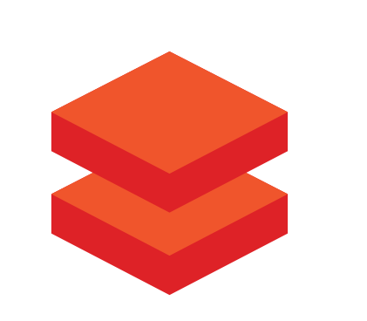

Tools and Services
Data Factory - Azure's cloud ETL service for scale-out serverless data integration and data transformation. It offers a code-free UI for intuitive authoring and single-pane-of-glass monitoring and management.
Azure Blob Storage - Capable of storing large quantities of structured, semi-structured, and unstructured data in their original file formats. Afterwards, it is convenient to use any tools like Databricks to process and analyze the data as per our business needs.
Databricks - Azure Databricks provides tools that help to connect the sources of data to one platform to process, store, share, analyze, model, and monetize datasets with solutions from BI to generative AI
PowerBI - Power BI provides cloud-based BI services which contains data warehouse capabilities including data preparation, data mining, and interactive dashboards. In March 2016, Microsoft released an additional service called Power BI Embedded on its Azure cloud platform. So, this can be easily connected with Azure.

Slide 6

Flow of the Project
Data Source
Azure Data Factory
Azure Blob Storage
PowerBI
Azure
Databricks

Slide 7
Thank you!

