Slide 1
Automated Image Captioning using Neural Networks
Anuj Jhunjhunwala
17BCE2149
Guide – Prof. Delhi Babu R.

Slide 2
Problem Statement
A blind person obviously cannot know what is exactly going on in his surroundings. He either has to use a stick to feel objects in front of him or be dependent on another person to move around with him for guidance. This problem will be solved using this project. A camera (such as GoPro) can be installed as a headgear for the blind person. This will capture the image which will be the input for the model. Now, the model will generate a suitable caption for the image which best describes the image. Further, this will be converted into speech so that the blind can receive an audio output for the generated caption.

Slide 3
Objectives
A solution requires both that the content of the image be understood and translated to meaning in the terms of words, and that the words must string together to be comprehensible. It combines both computer vision using deep learning and natural language processing and marks a true challenging problem in broader artificial intelligence. Further, the generated text will be converted to speech so that the blind can hear the description of what is there in his surroundings. So, the main objectives to achieve the goal are:
Extract features from the captured image.
Generate a caption for the extracted features
Convert the caption (text) to speech so that the user can hear

Slide 4
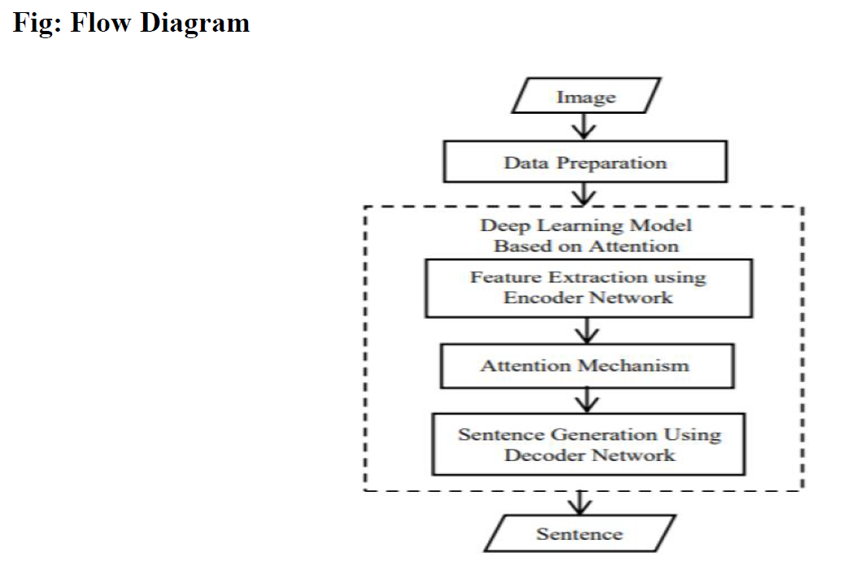
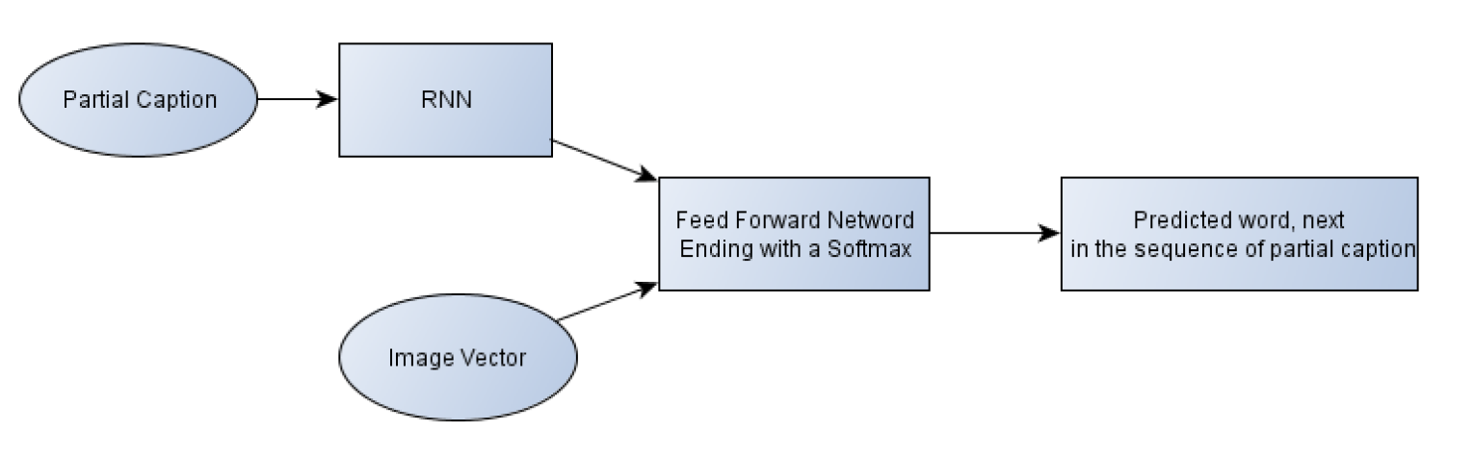
Flow Diagram

Slide 5
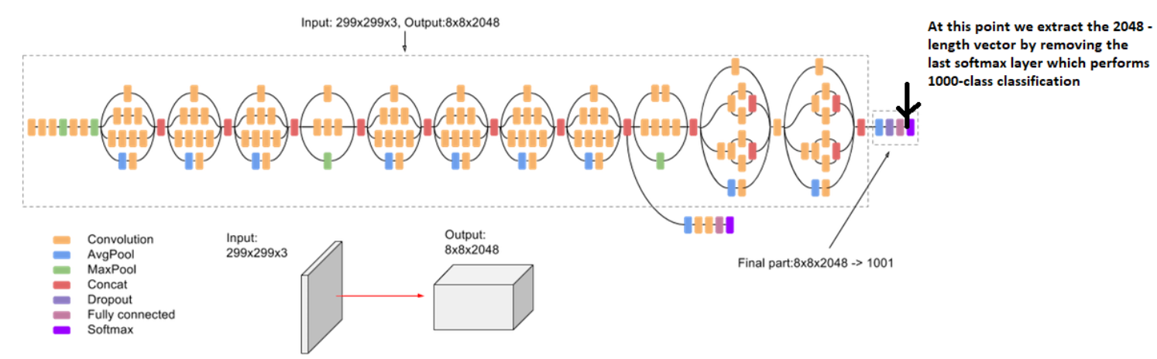
Architecture Diagram

Slide 6
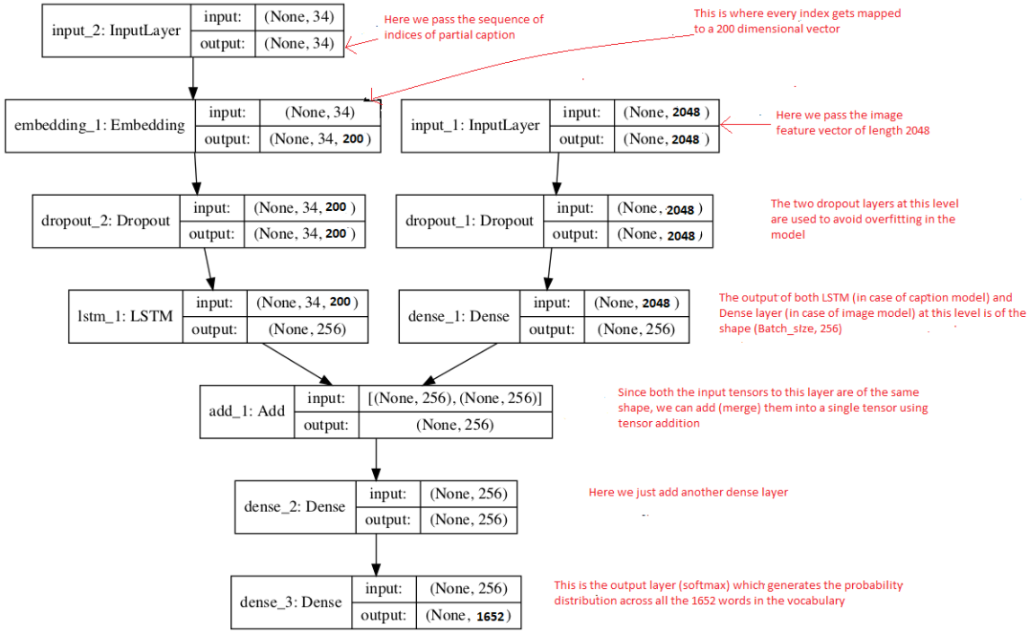

Slide 7
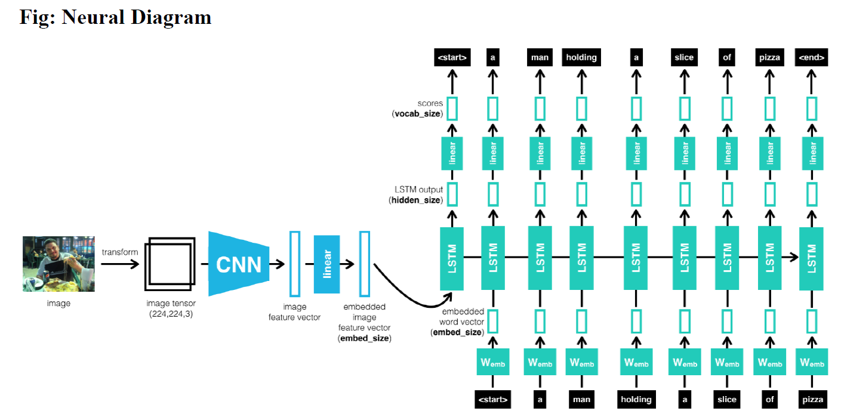

Slide 8
Architecture Explanation
1. Data Cleaning
When I deal with text, I generally perform some basic cleaning like lower-casing all the words (otherwise “hello” and “Hello” will be regarded as two separate words), removing special tokens (like ‘%’, ‘$’, ‘#’, etc.) and eliminating words which contain numbers (like ‘hey199’, etc.). After generating the tokens, I observe that many of these words will occur very few times, say 1, 2 or 3 times. Since I am creating a predictive model, I would not like to have all the words present in our vocabulary but the words which are more likely to occur or which are common. This helps the model become more robust to outliers and make less mistakes.
2. Loading the training set
I have separated the 6000 training images in the list named “train”. When I load the descriptions for the images in the training set, I add two tokens in every caption as follows:
‘startseq’ -> This is a start sequence token which will be added at the start of every caption.
‘endseq’ -> This is an end sequence token which will be added at the end of every caption.

Slide 9
3. Data Preprocessing on Images
Images are nothing but input (X) to our model. As any other model, this input is given in the form of a vector. Each image is converted into a fixed sized vector which can then be fed as input to the neural network. For this purpose, I opt for transfer learning by using the InceptionV3 model (Convolutional Neural Network) created by Google Research. Hence, I just remove the last softmax layer from the model and extract a 2048 length vector (bottleneck features) for every image. I then save all the bottleneck train features in a Python dictionary and save it on the disk using Pickle file.
4. Data Preprocessing on Captions
I must note that captions are something that I want to predict. So, during the training period, captions are the target variables (Y) that the model is learning to predict. The prediction of caption is done word by word. Thus, I need to encode each word into a fixed sized vector. I have created two Python Dictionaries namely “wordtoix” (word to index) and “ixtoword” (index to word).
5. Data Preparation using Generator Function
Consider I have 3 images and their 3 corresponding captions as follows:

Slide 10
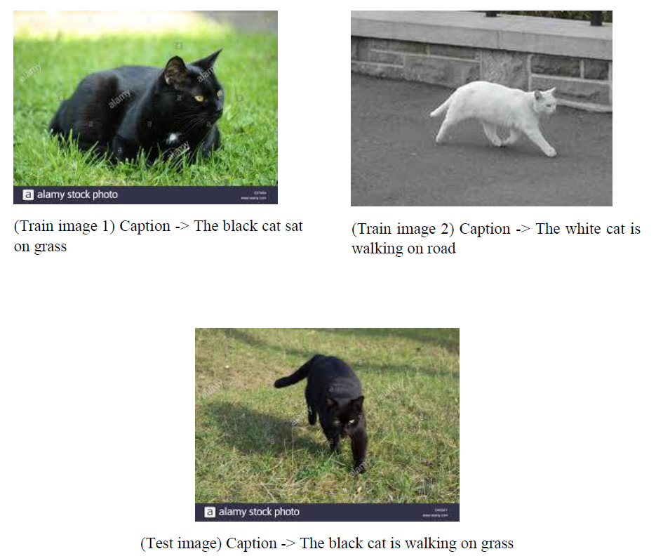

Slide 11
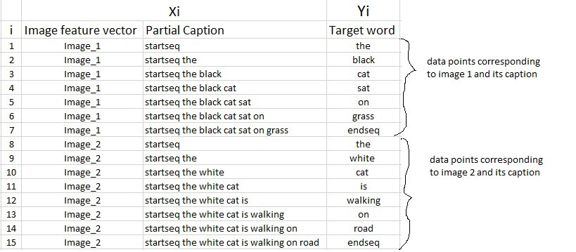

Slide 12
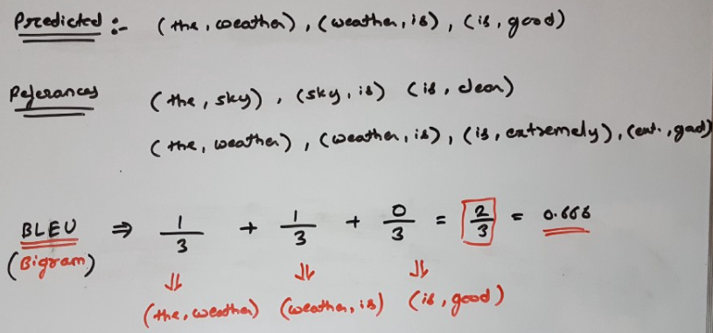
Results
BLEU (Bilingual Evaluation Understudy) Score – This is an algorithm used to evaluate the quality of machine translated text. This is used because it is language independent, easy to compute and understand and it lies between 0 and 1. It is directly proportional.
How is it calculated?
predicted caption= “the weather is good”
references:
the sky is clear
the weather is extremely good

Slide 13
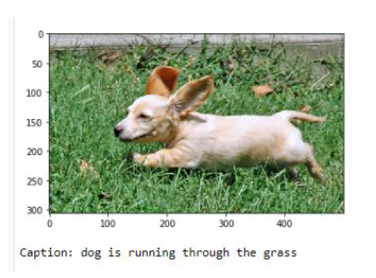
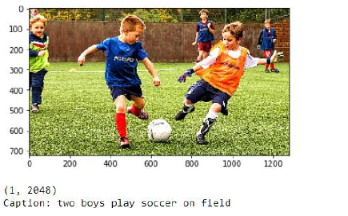
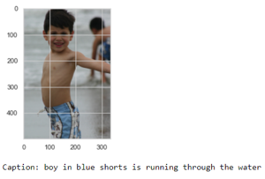
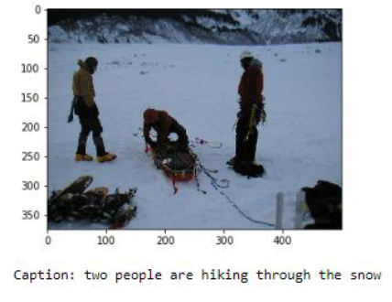
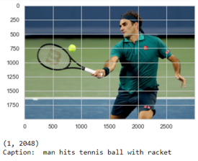

Slide 14
Conclusion and Future Developments
The neural network system is capable of viewing an image and generating a reasonable representation in English depending on the words in its dictionary generated on the basis of tokens in the captions of train images. The purpose of the model is to maximize the likelihood of the sentence given the image. Experimenting the model with Flickr8K dataset shows decent results. I have assumed accuracy of the model to be about 75-80% according to the results. The accuracy can be increased if the same model is worked upon a bigger dataset such Flickr30k and MS COCO dataset .
Some improvements that can be made in future would be:
Using a larger dataset.
Changing the model architecture, e.g. include an attention module.
Doing more hyper parameter tuning

Slide 15
References
• Wang, E. K., Zhang, X., Wang, F., Wu, T. Y., & Chen, C. M. (2019). Multilayer dense attention model for image caption. IEEE Access, 7, 66358-66368.
• Gupta, N., & Jalal, A. S. (2019). Integration of textual cues for fine-grained image captioning using deep CNN and LSTM. Neural Computing and Applications, 1-10.
• Ghosh, A., Dutta, D., & Moitra, T. (2020). A Neural Network Framework to Generate Caption from Images. In Emerging Technology in Modelling and Graphics (pp. 171-180). Springer, Singapore.
• Bhatia, Y., Bajpayee, A., Raghuvanshi, D., & Mittal, H. (2019, August). Image Captioning using Google's Inception-resnet-v2 and Recurrent Neural Network. In 2019 Twelfth International Conference on Contemporary Computing (IC3) (pp. 1-6). IEEE.
• Yang, J., Sun, Y., Liang, J., Ren, B., & Lai, S. H. (2019). Image captioning by incorporating affective concepts learned from both visual and textual components. Neurocomputing, 328, 56-68.
• Su, J., Tang, J., Lu, Z., Han, X., & Zhang, H. (2019). A neural image captioning model with caption-to-images semantic constructor. Neurocomputing, 367, 144-151.
• Zhang, X., He, S., Song, X., Lau, R. W., Jiao, J., & Ye, Q. (2019). Image captioning via semantic element embedding. Neurocomputing.
• Xu, N., Liu, A. A., Liu, J., Nie, W., & Su, Y. (2019). Scene graph captioner: Image captioning based on structural visual representation. Journal of Visual Communication and Image Representation, 58, 477-485.

Slide 16
Thank You!

