Slide 1
ACM x Aurora Day-2 Theory about Neural Network and Introduction to CNN
By- Anuj Kamath

Slide 2
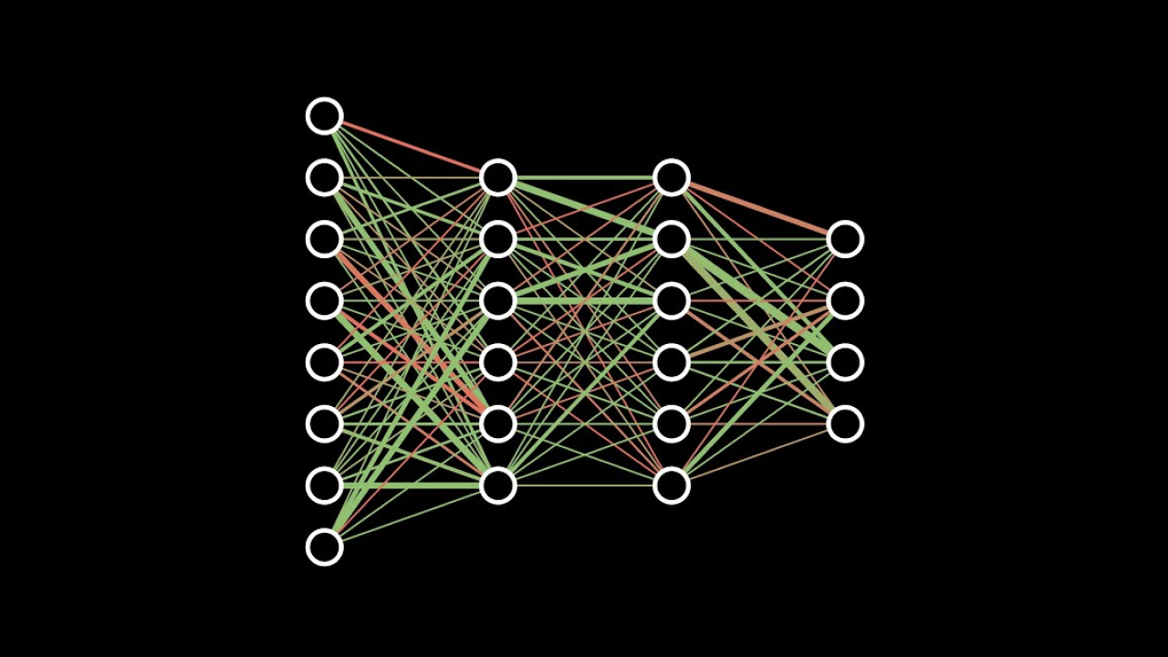
Neural Network

Slide 3
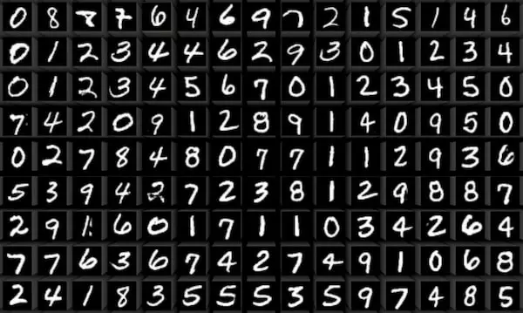
MNIST Dataset for Number detection

Slide 4
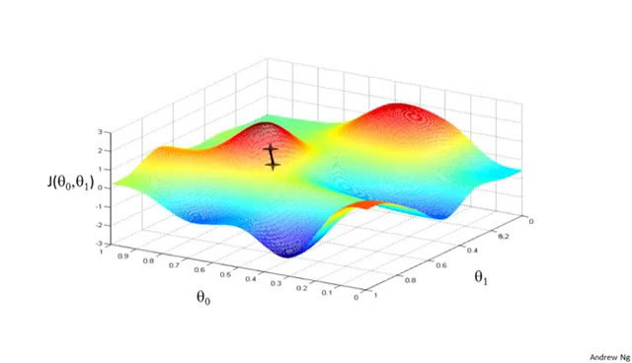
Gradient Descent

Slide 5
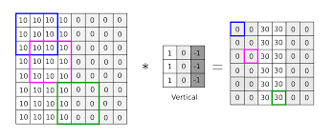
.

Slide 6
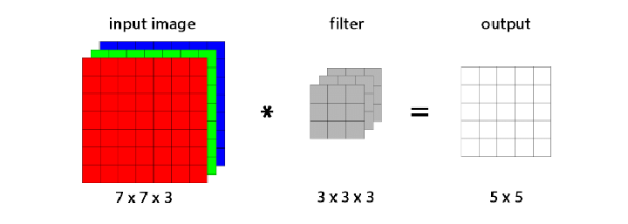
Convolution

Slide 7
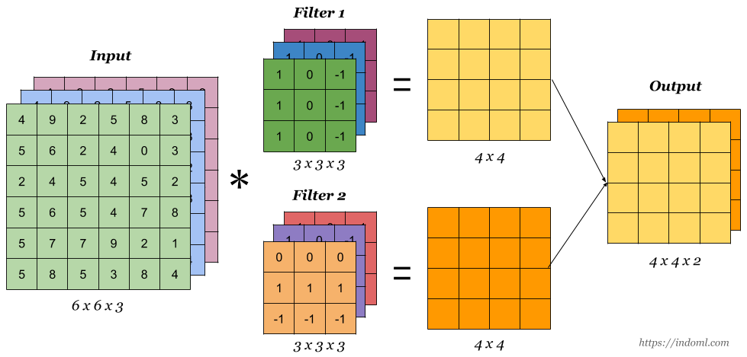

Slide 8
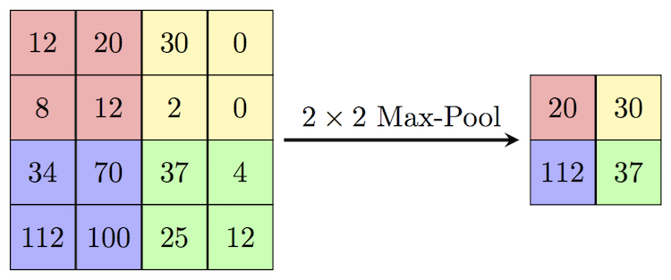
Max Pooling

Slide 9
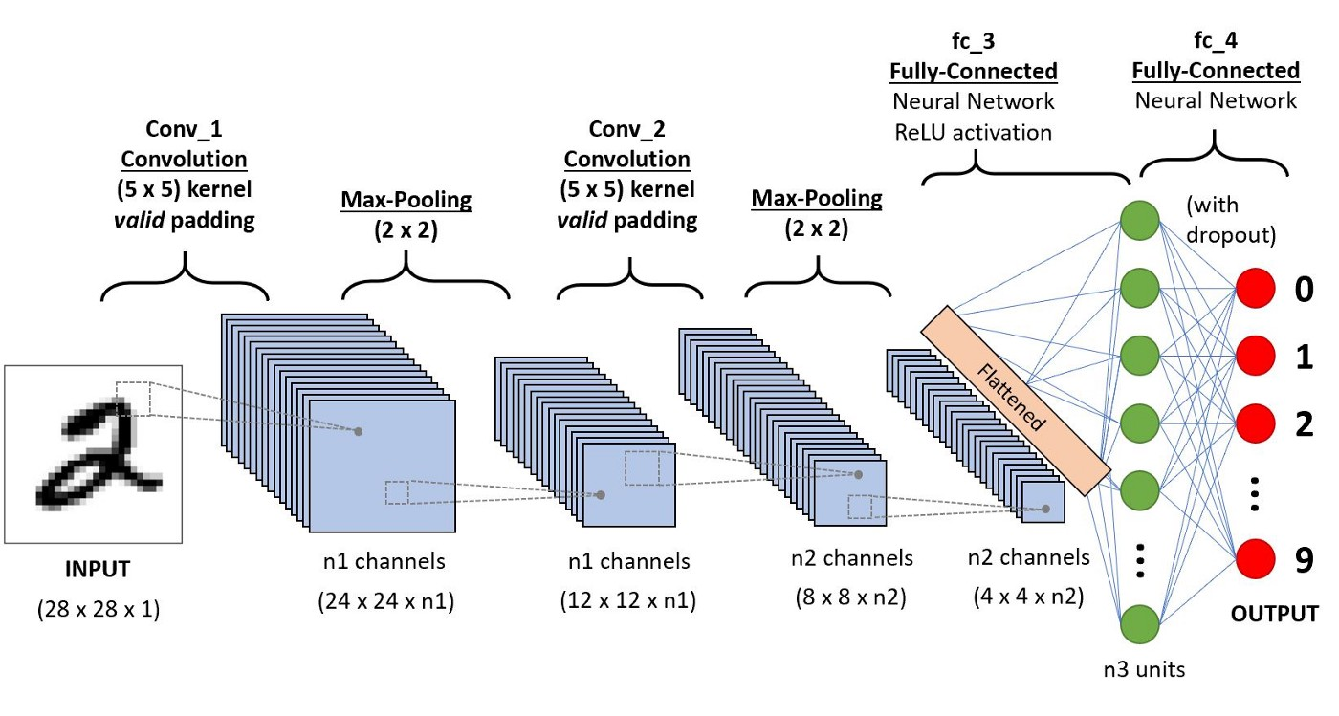
Convolution Layers

