Slide 1


OpenCV Workshop : Python Basics

Slide 2

AGENDA :
Introduction & Overview
Python Indentations & Print Statements
User Inputs
Control Flow: If/Else and Loops
Defining and Using Functions
Data Structures: Lists, Tuples, Dictionaries
Indexing, Looping & Operations on Collections
String Operations: Formatting, Upper & Lower
Introduction to NumPy Arrays and Basic Operations
Interactive Exercises & Q/A

Slide 3

What is Python?
Python is a genus of constricting snakes in the Pythonidae family native to the tropics and subtropics of the Eastern Hemisphere.

Slide 4
Wrong Slide 💀

Slide 5

What is Python?
What?
Python is a high-level, interpreted programming language known for its simplicity and readability. It's widely used by beginners and professionals alike for a variety of tasks.
Why Python?
Beginner-Friendly
Versatile & Powerful
Huge Community & Library Support
Cross-Platform

Slide 6
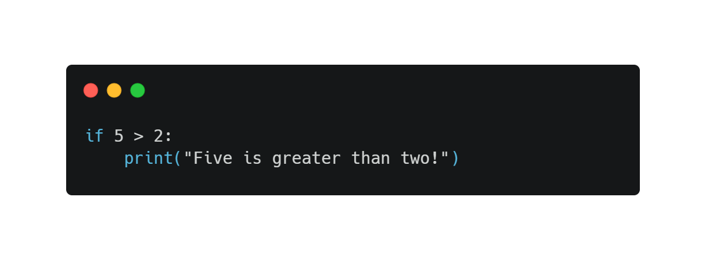
Python Syntax – The Basics
1. Indentation Matters
Python uses indentation to define code blocks.
Consistent indentation is crucial; typically, 4 spaces are used.
(Incorrect indentation will lead to errors.)

Slide 7
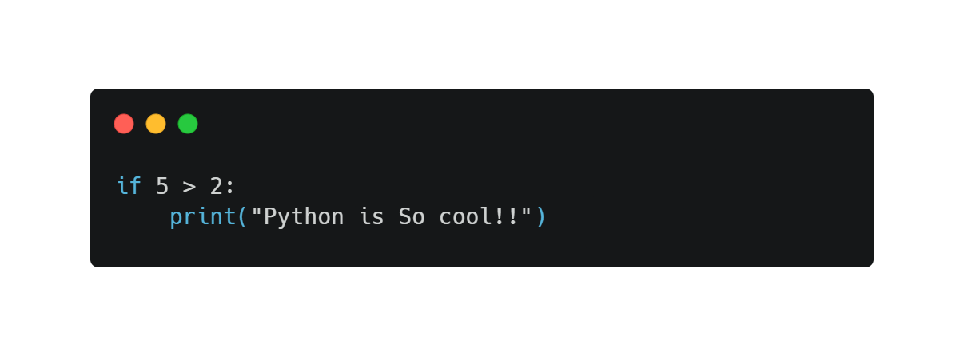
Python Syntax – The Basics
1. Indentation MATTERS!
Python uses indentation to define code blocks.
No { } needed like in C++/Java/JavaScript.
Consistent indentation is crucial; typically, 4 spaces are used.
(Incorrect indentation will lead to errors.)

Slide 8
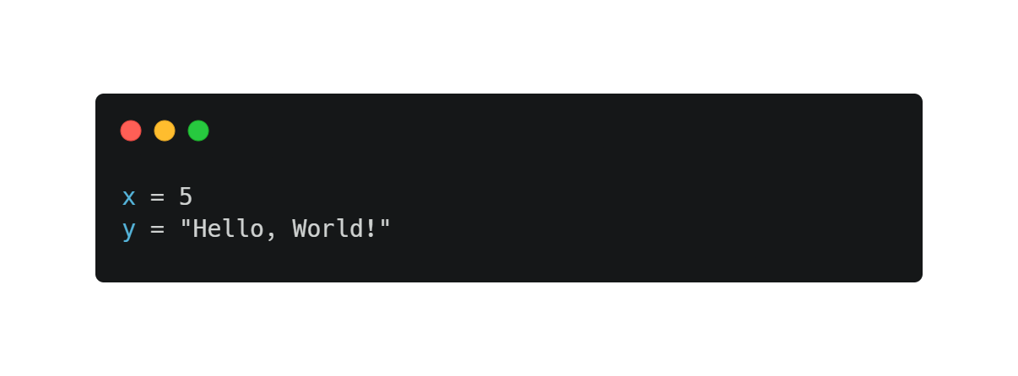
Variables and Assignment
Variables are created by assigning values using the ‘=‘ operator.
No need to declare variable types explicitly.

Slide 9
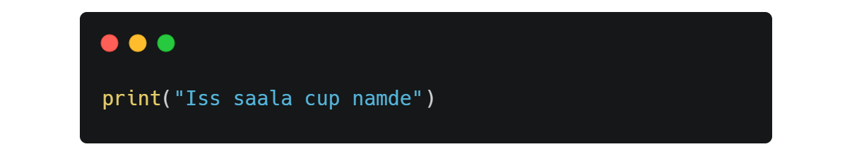

Seeing Output: Print()
Your way to display information, variables, results.

Slide 10
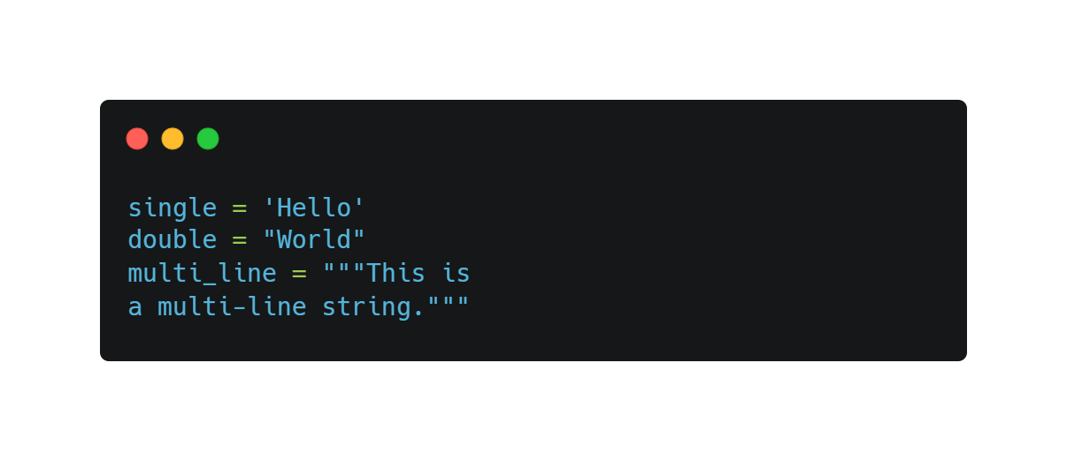
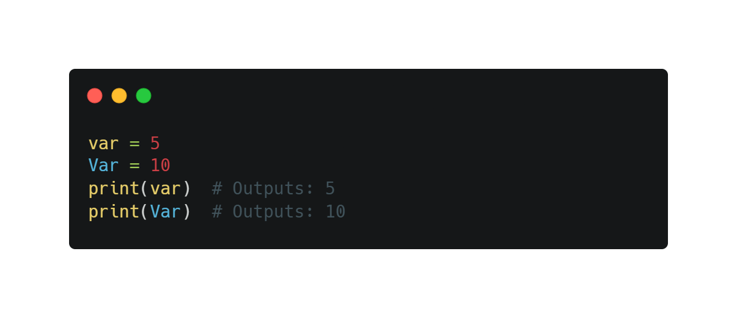
Python Syntax – Continued
5. String Syntax
6. Case Sensitivity Python is case-sensitive.

Slide 11
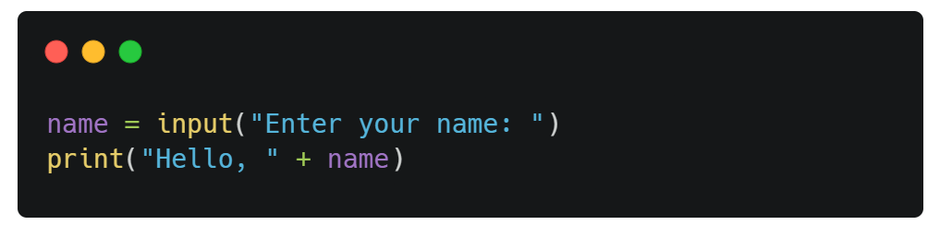
Getting User Input: input()
It is that simple !!

Slide 12
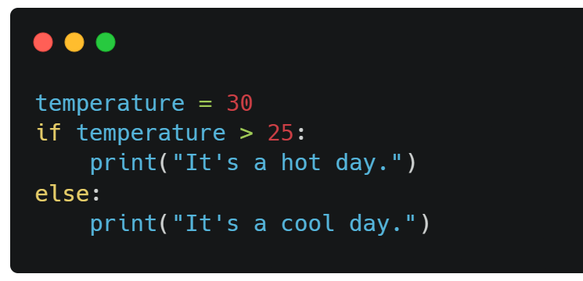
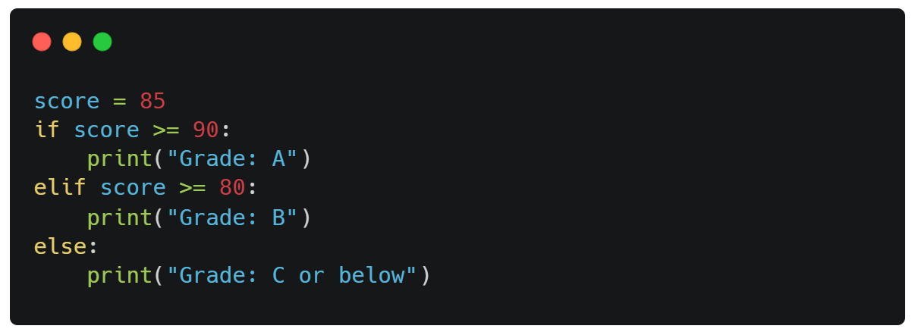
Conditional Statements if / elif /else
Control the flow based on conditions.

Slide 13
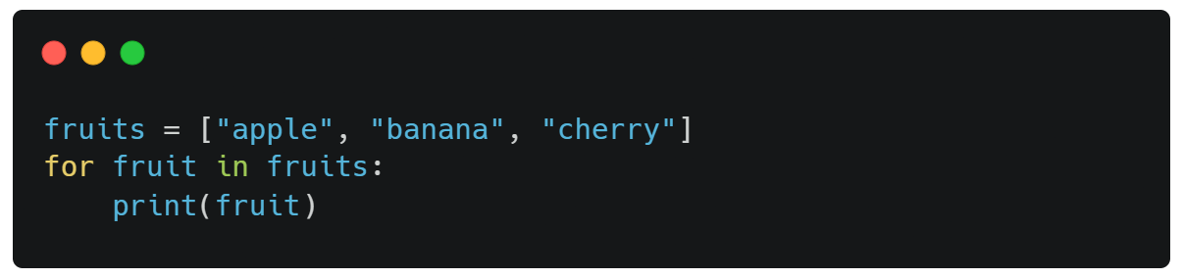
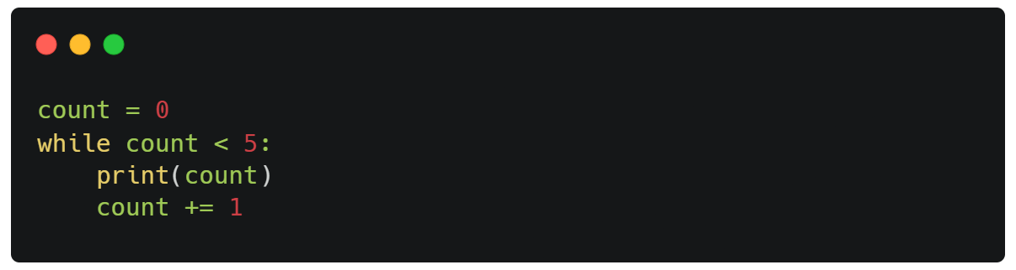
Looping Conditions (For Loop)
For Loop : Iterates over a sequence (like a list, tuple, or string).

Slide 14
Looping Conditions (While Loop)
While Loop : Continues to execute as long as the condition is true.

Slide 15
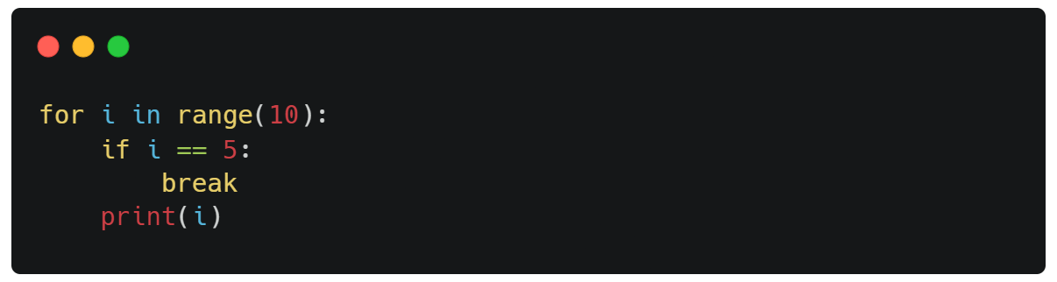
Loop Control Statements : break
Break : Exits the loop prematurely.

Slide 16
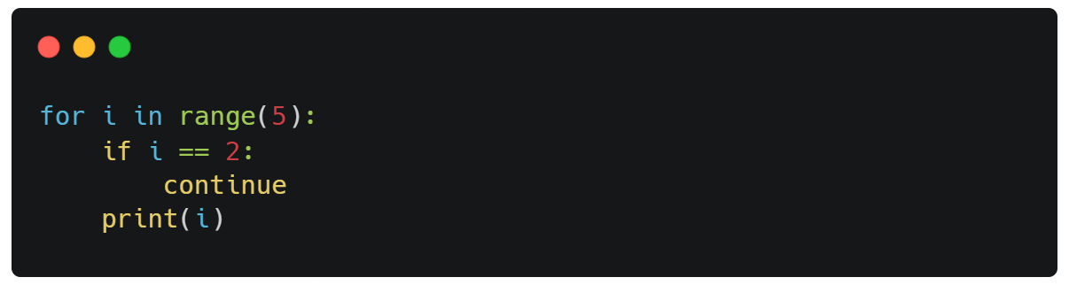
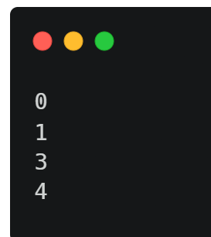
Loop Control Statements : Continue
Continue : Skips the current iteration and continues with the next.
//output :

Slide 17
Note: Proper indentation is crucial in Python to define the scope of loops and conditionals.

Slide 18
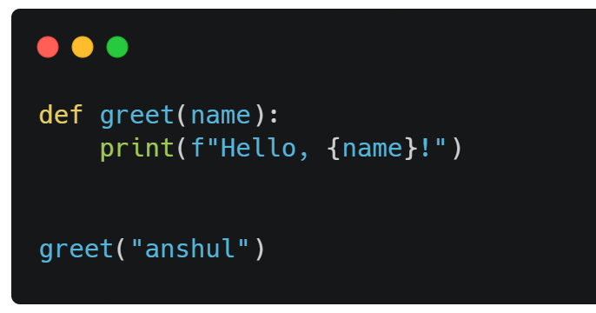
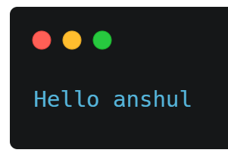
Functions
1. What is a Function?
A function is a reusable block of code that performs a specific task.​
Functions help in organizing code, making it more readable and maintainable.
2. Defining a Function : (def)
//Output :

Slide 19
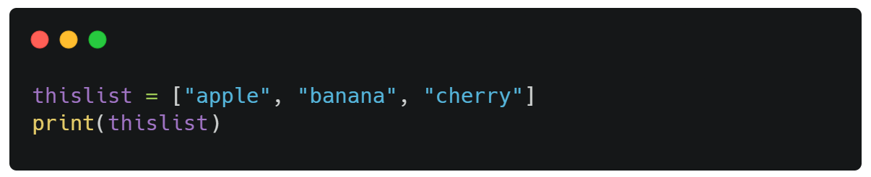
Lists
Lists are used to store multiple items in a single variable.
Lists are one of 4 built-in data types in Python used to store collections of data, the other 3 are Tuple, Set, and Dictionary, all with different qualities and usage.
List items are ordered, changeable, and allow duplicate values.

Slide 20

Tuples
Tuple items are ordered, unchangeable, and allow duplicate values..
.

Slide 21
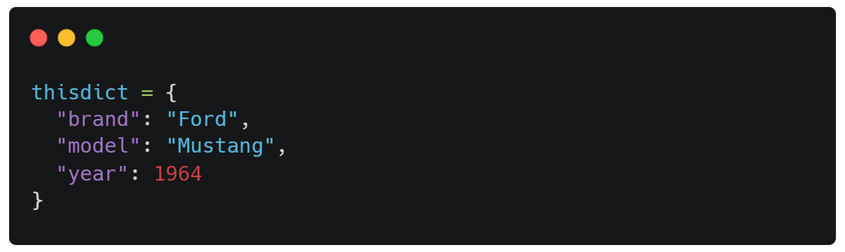
Dictionaries
Dictionaries are used to store data values in key:value pairs.
.

Slide 22
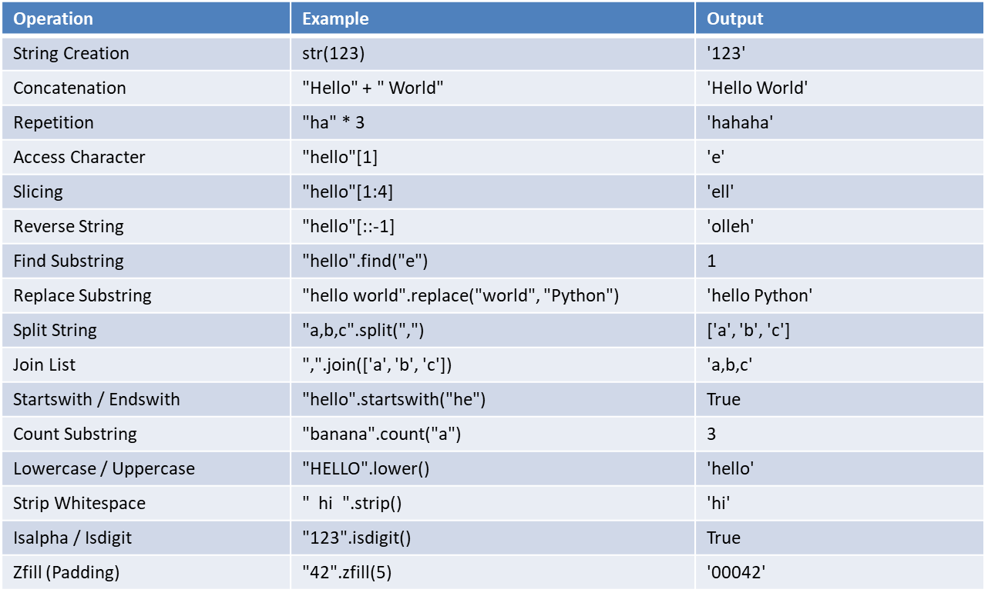
String Operations

Slide 23
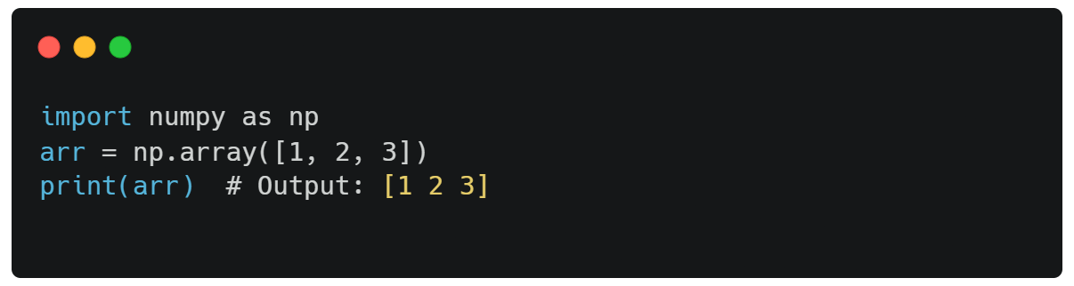
NumPy Arrays & Basic Operations
What is NumPy?
NumPy (Numerical Python) is a powerful library for numerical computations.
It provides support for large, multi-dimensional arrays and matrices.
Offers a collection of mathematical functions to operate on these arrays efficiently.
Creating Arrays

Slide 24
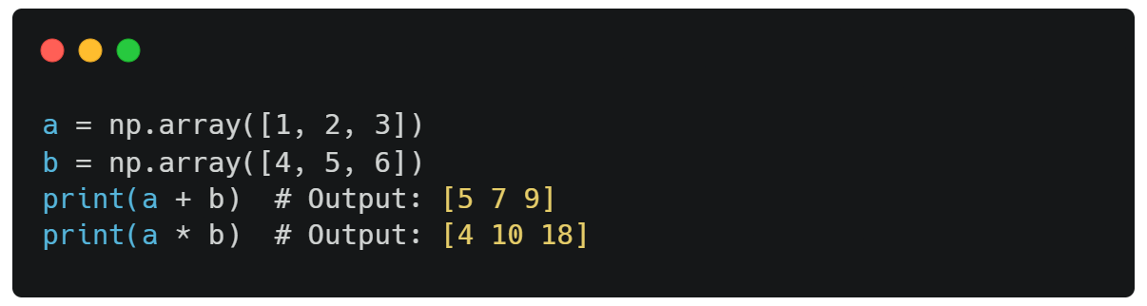
Basic Array Operations
Element-wise Operations:
Perform arithmetic operations directly on arrays.

Slide 25
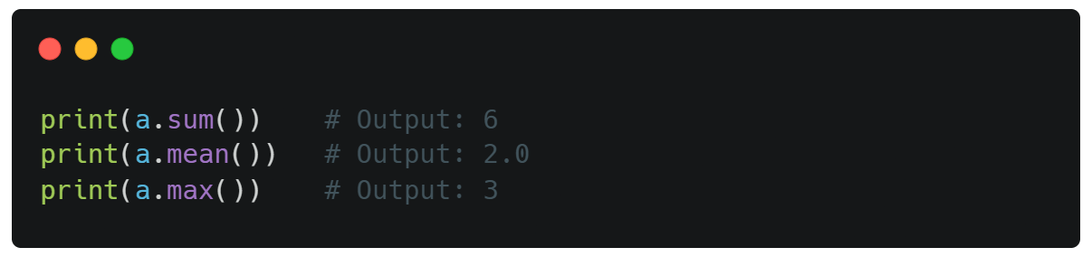
Aggregate Functions:

Slide 26
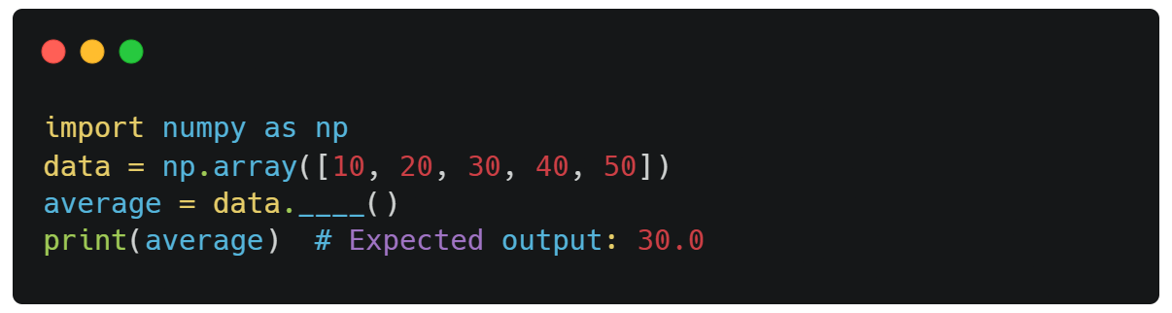
Interactive Exercise: Given the array below, compute the average value:

Slide 27
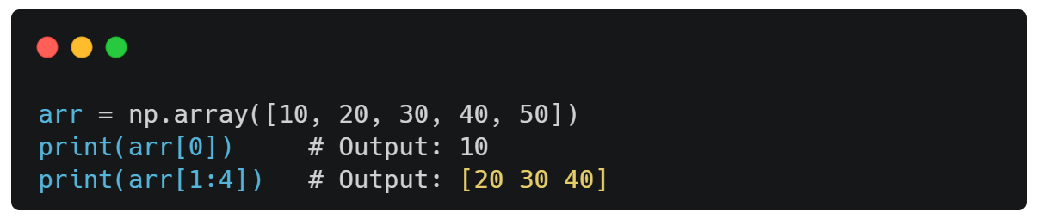
Indexing, Slicing, and Reshaping
Indexing and Slicing:
Access specific elements or subsets of an array

Slide 28
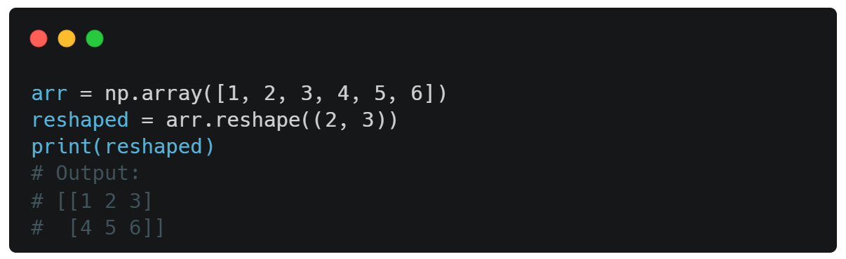
Indexing, Slicing, and Reshaping
Reshaping Arrays:
Change the shape of an array without changing its data.

Slide 29
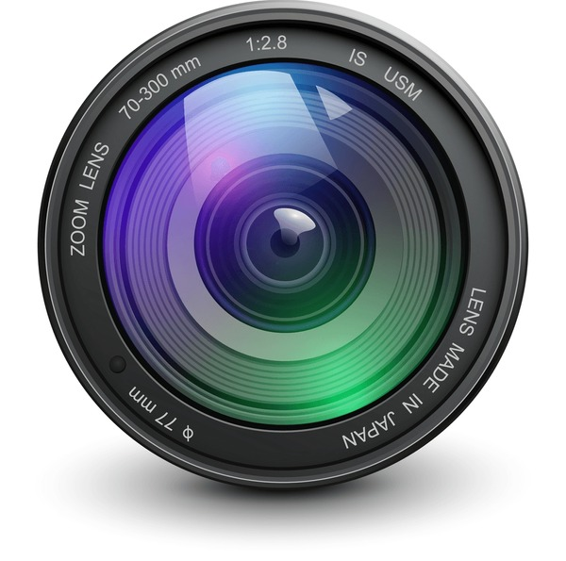
Good Luck for Phase 2! 🚀
Congratulations on Completing Phase 1!
Your dedication and enthusiasm have been truly commendable.​
As you embark on Phase 2, delving into the exciting world of OpenCV, remember:

