Slide 1

IEMCT & IECSE presents
OPENCV WORKSHOP
An introduction to Computer Vision

Slide 2
Agenda
What is OpenCV
Webcam Access
Colour Channels
Image Processing Fundamentals
Understanding the HSV Color Space
Colour Masking
Drawing on Images
Kernels
Gaussian Blurring
Haar Cascades

Slide 3

What is OpenCV
OpenCV (Open Source Computer Vision Library) is an open-source library of programming functions mainly aimed at real-time computer vision.
Cross-platform: Works on Windows, Linux, macOS, Android, and iOS
Interfaces: C++, Python, Java and MATLAB interfaces
GPU Acceleration: Support for CUDA and OpenCL for hardware acceleration
Comprehensive: Covers classical and state-of-the-art computer vision algorithms
Active Community: Regular updates and extensive documentation

Slide 4
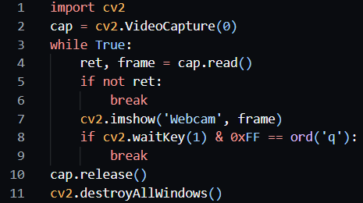
Webcam Access
Implement the code below to display a webcam feed

Slide 5
Colour Channels
In OpenCV, images are typically processed in the BGR color space, which splits an image into three channels: Blue, Green, and Red. Each channel is an 8-bit grayscale image with values ranging from 0 to 255, capturing the strength of that color.
This image can be converted to different formats like RGB, HSV, GRAYSCALE and so on.

Slide 6
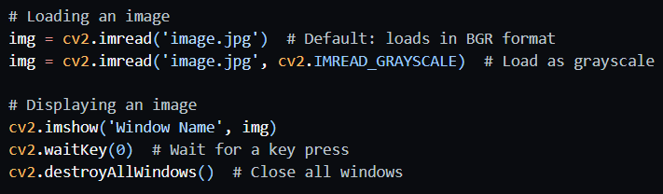
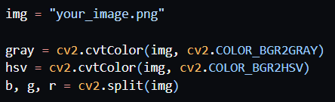
Image Processing Fundamentals
Image Loading, Display, and Saving
Colour conversions

Slide 7
Understanding the HSV Color Space
Unlike BGR, which defines colors by combining red, green, and blue intensities, HSV aligns more closely with how humans perceive colors.
Hue determines the color type, like red or blue, represented as an angle (0–180 in OpenCV’s 8-bit scale). Saturation measures the color’s intensity or purity, from gray (0) to vivid (255). Value indicates brightness, ranging from black (0) to fully bright (255).
This separation makes HSV ideal for tasks where color needs to be isolated from lighting conditions.

Slide 8
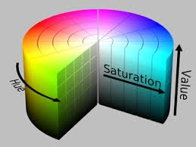

Slide 9

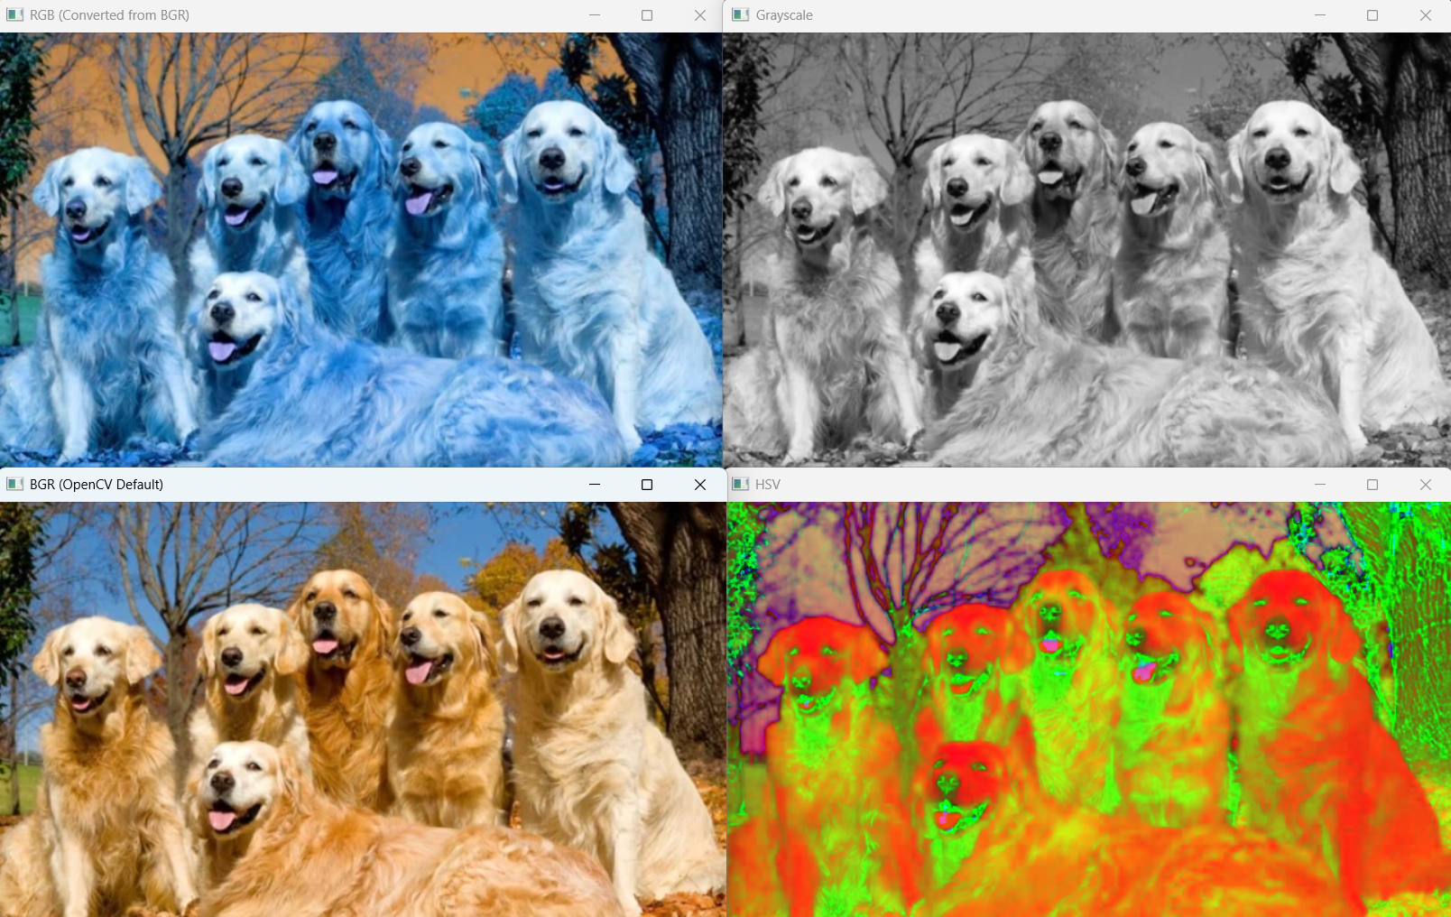
RGB
GRAYSCALE
BGR
HSV

Slide 10
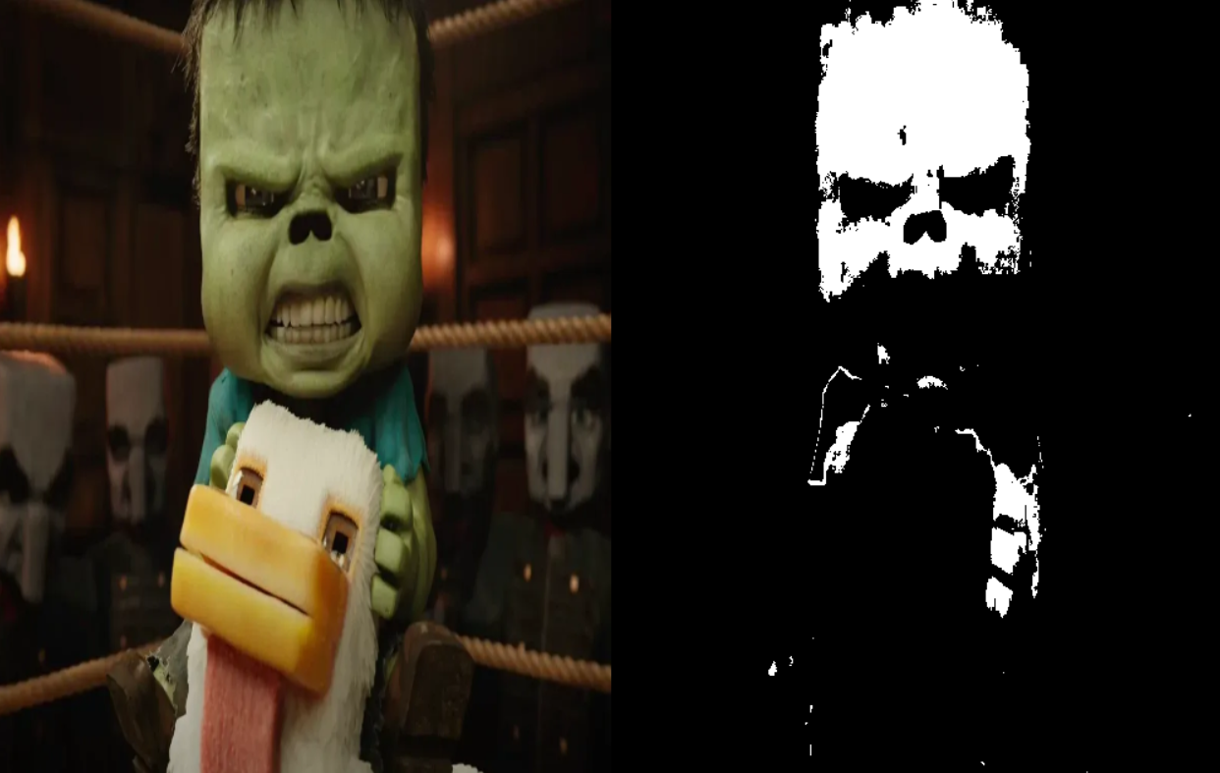
Colour Masking
Color masking in OpenCV involves isolating specific color ranges within an image. This technique is useful for object detection, image segmentation, and selective image manipulation. It relies on defining upper and lower color boundaries, typically in the HSV color space, and creating a binary mask where pixels within the defined range are white and others are black.

Slide 11
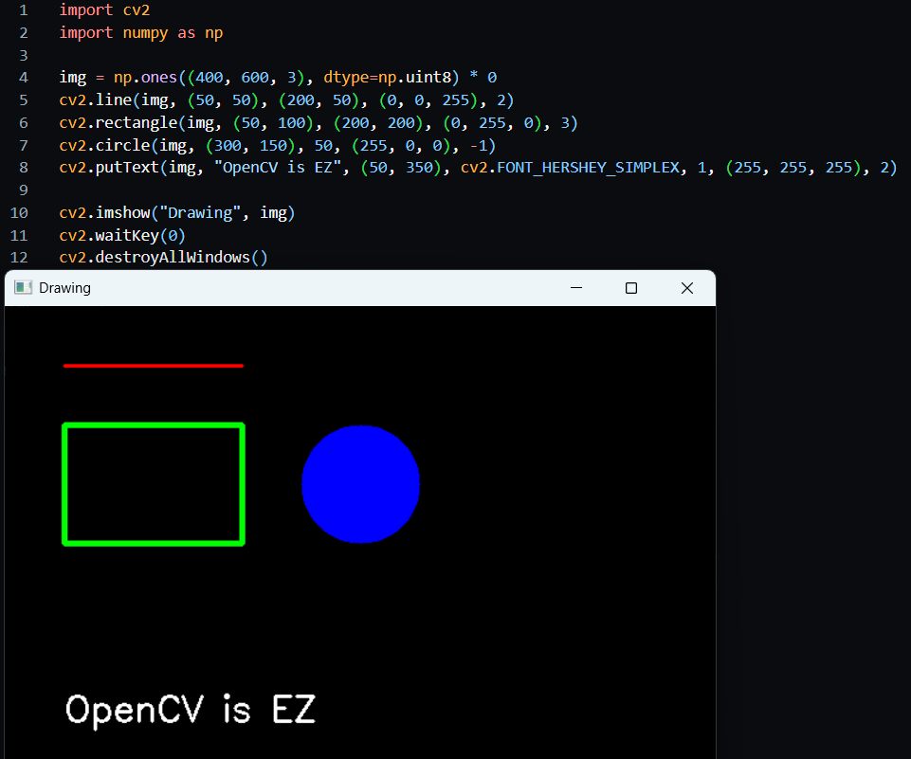
Drawing on Images

Slide 12
Kernels
Small matrix (e.g., 3x3, 5x5) for transformations like blur, sharpening, edge detection.
Slides over image, computes weighted sum for each pixel via convolution.
Kernels can be used for performing blurring techniques. Below given are some popular blurring techniques used in OpenCV
Gaussian Blur
Average Blur
Bilateral
Median

Slide 13
Gaussian Blurring
- Uses a Gaussian kernel to smooth the image
- The (a,a) parameter defines the kernel size
- Sigma=0 lets OpenCV calculate the standard deviation
- Effective for reducing Gaussian noise
- Blurs more in flat areas, less near edges

Slide 14
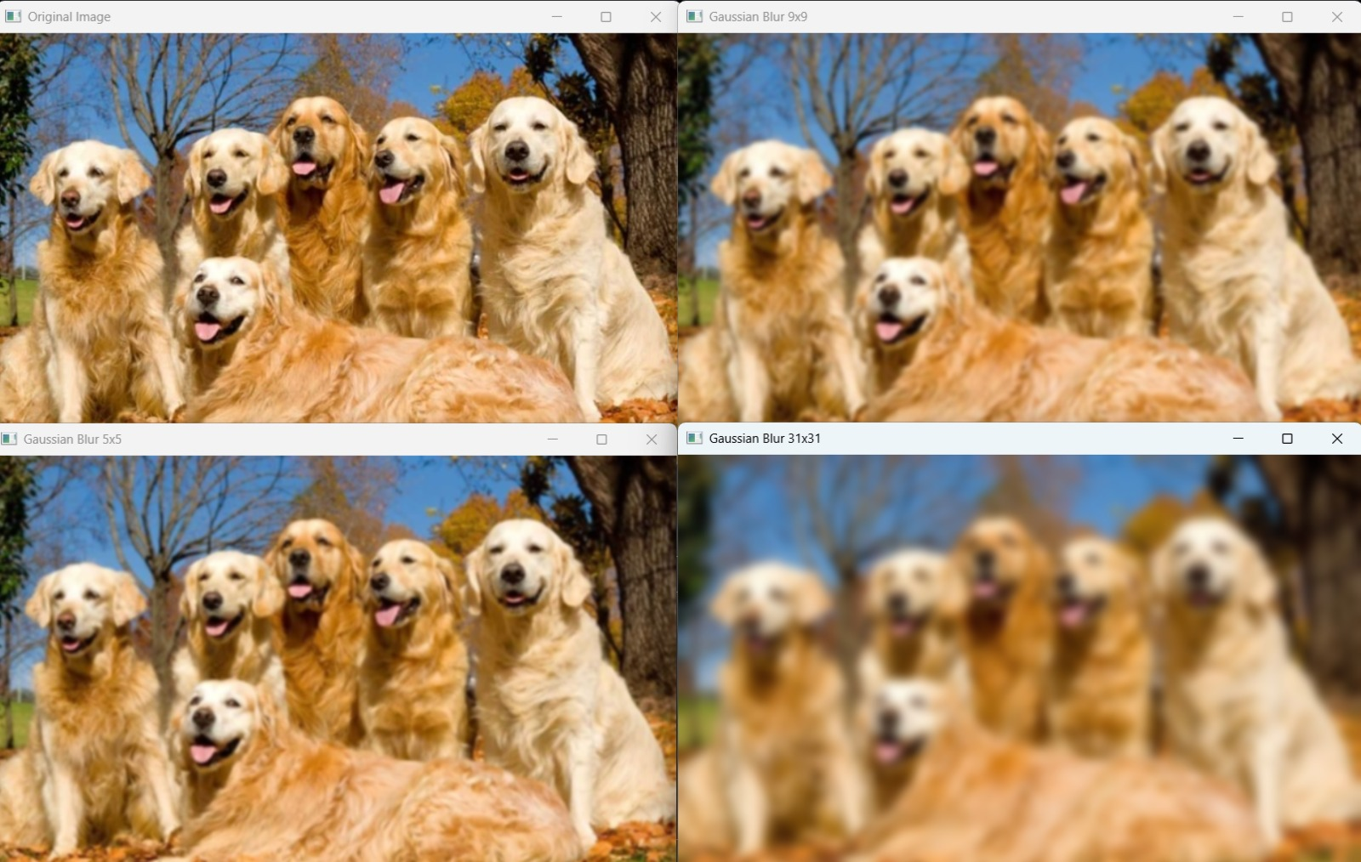
Original
9x9
5x5
31x31

Slide 15
Haar Cascades
Haar Cascades are fast, machine learning-based object detectors used widely for face and body detection in images and video.
Sliding Window: Scans the image at multiple scales.
Haar Features: Simple patterns (e.g., edge/line contrasts) that capture visual structure.
Integral Image: Speeds up feature calculation.
Cascade of Classifiers: A multi-stage filter that quickly rejects non-object areas and focuses computation on likely matches.
Trained Model: AdaBoost is used to select the best features from thousands of training images.

Slide 16
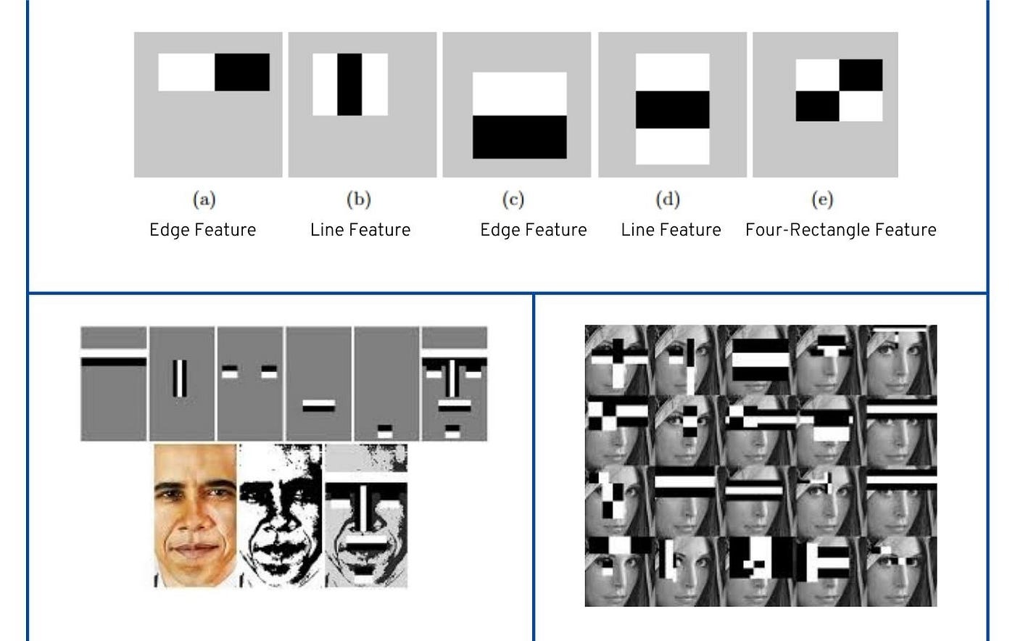

Slide 17
Thank you!

