Slide 1
TE LP1 Assignment 1
Process Synchronization using Semaphores and Mutex

Slide 2
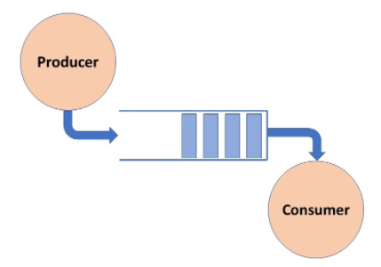
Producer Consumer Problem
Multiple producers and consumers can be present
Producer produces an item
Buffer shared between consumer and producer
Consumer consumes an item

Slide 3
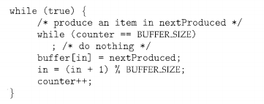
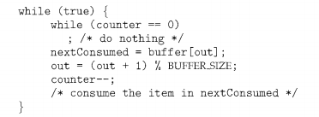
Producer Consumer Problem
Producer
Consumer
Although producer and consumer routines are correct separately they may not function correctly when executed concurrently.

Slide 4


What is the problem?
Consider code at producer side: counter++ and code at consumer side as counter--.
Producer
Consumer
Suppose counter = 5 and producer and consumer execute instruction of updating counter.

Slide 5
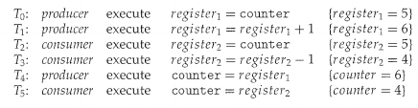
What is the problem?
Suppose lower level statements are interleaved as:
Incorrect state of counter reached as 4.
Situations like this in which several processes access and manipulate same data concurrently and outcome of execution depends on particular order in which access takes place is called race condition.
Thus we need to ensure that only one process is manipulating the variable counter. Hence process synchronization is necessary.

Slide 6
Critical Section Problem.
Consider a system consisting of n processes {Po, P1 , ... , P11 _ I}. Each process has a segment of code, called a critical section in which the process may be changing common variables, updating a table, writing a file, and so on.
When one process is executing in its critical section, no other process is to be allowed to execute in its critical section. That is, no two processes are executing in their critical sections at the same time.
Each process must request permission to enter critical section.

Slide 7
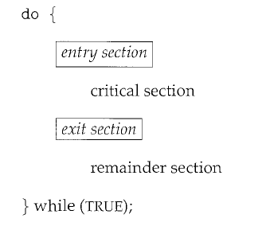
General structure of process pi

Slide 8
Synchronization required in producer-consumer
When a producer is placing an item in the buffer, then at the same time consumer should not consume any item.
Producer should wait if buffer is full.
Consumer should wait if buffer is empty.

Slide 9
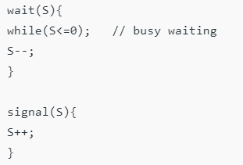


Semaphores
A semaphore S is an integer variable that can be accessed only through two standard operations : wait() and signal().
Semaphores can be used to solve synchronization problem

Slide 10
Types of Semaphores
Binary Semaphore
It can have only two values – 0 and 1. Its value is initialized to 1. It is used to implement the solution of critical section problem with multiple processes. Also called mutex locks.
Counting Semaphore
Its value can range over an unrestricted domain. It is used to control access to a resource that has multiple instances.

Slide 11
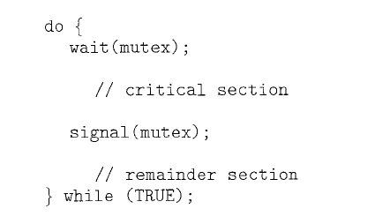
Semaphores for mutual exclusion

Slide 12
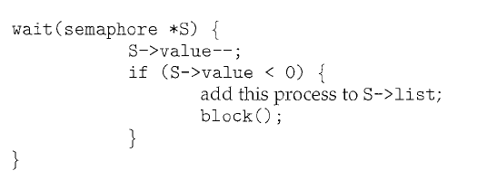
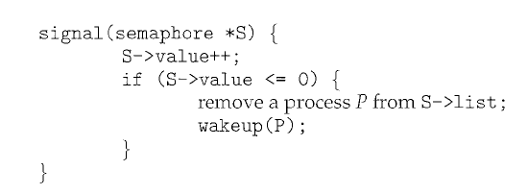
Semaphore implementation

Slide 13
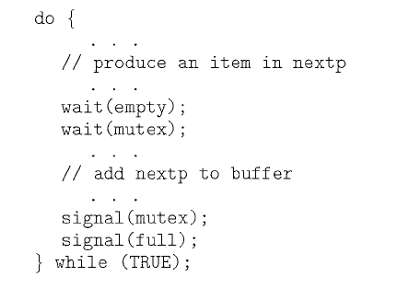
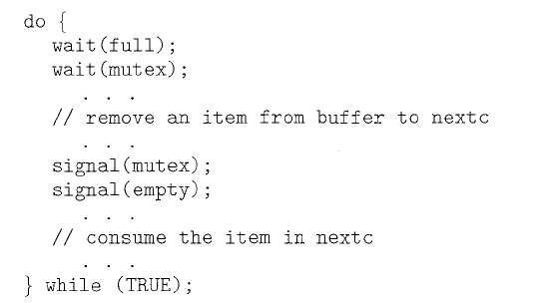
Producer-Consumer Problem
A Consumer must wait for the buffer to be non-empty
A Producer must wait for the buffer to be non-full
Only one process or thread can fiddle with buffer list at a time
3 semaphores, 2 counting and 1 mutex used. empty = n, full = 0
Producer
Consumer

Slide 14
References
Operating System Principles”, Abraham Silberschatz, Peter Baer Galvin, Greg Gagne, 7th edition.

