Slide 1
DriverMate
Anuj Rajthala
University id: 77297965

Slide 2
Table of Contents
Topic one
Topic two
Topic three
Topic four
Topic five

Slide 3
The Communication

Slide 4
Introduction
Aims:
  Revolutionize driver hiring.
  Seamlessly connect passengers with nearby drivers.
Key Features:
  Advanced algorithms for efficient matching.
  Matching based on proximity and preferences.
User Experience:
  Streamlined booking process.
  Transparent pricing.
  Stringent driver verification.

Slide 5
Problem Statement
Current Issues in Transportation:
  Difficulty in finding reliable and available drivers.
  Safety and trust concerns for passengers.
  Inefficient ride matching and long wait times.
  Lack of transparency in pricing and ride tracking.
Impact on Users:
  Inconvenience and frustration for passengers.

Slide 6
Objectives
Efficient & Reliable Transportation:
  Seamlessly connect passengers with nearby drivers.
Ride Request and Matching: Provide an efficient system to match ride requests with available drivers.
Real-Time Tracking: Enable real-time tracking of rides for safety and convenience.
Streamlined Booking Process:
  Intuitive interfaces.
  User-friendly features.
Transparency:
  Transparent pricing mechanisms.
Continuous Innovation:
  Drive positive change in the transportation industry.

Slide 7
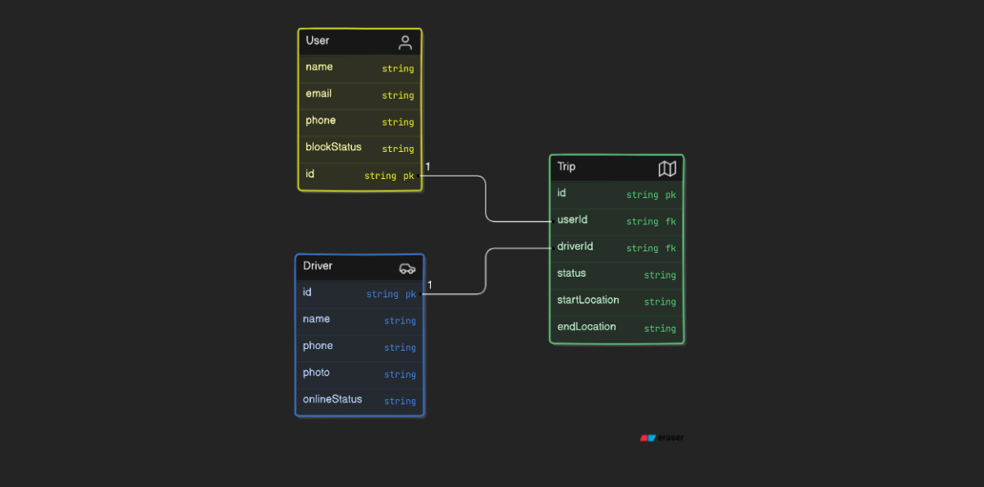
Erd

Slide 8
Use Case Diagram

Slide 9

LoGO

Slide 10
Technologies Used
Flutter
Firebase
Google Maps API

Slide 11
Similar apps
Uber:
  Global reach, real-time tracking, user-friendly interface.
  Strengths: Brand recognition, extensive driver network.
  Weaknesses: Surge pricing, safety concerns.
Lyft:
  Focus on community and driver-passenger relationships.
  Strengths: Strong customer service, clear pricing.
  Weaknesses: Limited international presence.
Ola:
  Popular in India, diverse ride options (autos, bikes, cabs).
  Strengths: Wide range of vehicle choices, localized features.
  Weaknesses: App performance issues, occasional safety reports.

Slide 12
PoTenTial
Market Demand:
  Increasing need for reliable transportation solutions in urban areas.
  Growing preference for on-demand services.
Revenue Opportunities:
  Ride commissions, subscription models, advertising.
User Benefits:
  Convenience, safety, cost-effectiveness.
Driver Benefits:
  Flexible working hours, increased earning potential.

Slide 13
Future Enhancements
Advanced Features:
  AI-based ride matching to reduce wait times.
  Enhanced safety measures (e.g., SOS buttons, driver/passenger verification).
Sustainability Initiatives:
  Integration of electric vehicles and eco-friendly options.
  Incentives for green driving practices.
User Experience Improvements:
  Personalized ride preferences.
  Gamification elements to enhance user engagement.

Slide 14
ConcLusions
Addresses driver reliability issues.
Enhances safety and trust for passengers.
Increases pricing and ride tracking transparency
High demand for reliable transportation solutions.
Opportunity to capture a large share of the transportation market.

Slide 15
THANK YOU
Anuj Rajthala
ranuj21@gmail.com

