Slide 1
Network intrusion detection
CAPSTONE PROJECT
Presented By:
1. Anuj Rawat – Graphic Era Hill University – B.Tech CSE

Slide 2
OUTLINE
Problem Statement (Should not include solution)
Proposed System/Solution
System Development Approach (Technology Used)
Algorithm & Deployment
Result (Output Image)
Conclusion
Future Scope
References

Slide 3
Problem Statement
In today's digital landscape, communication networks are constantly exposed to cyber threats that can compromise data integrity, confidentiality, and availability. Traditional intrusion detection systems, which rely on predefined rules, often fail to detect novel or evolving attacks in real time.
This project aims to design and implement a Machine Learning-based Network Intrusion Detection System (NIDS) that can automatically distinguish between normal and anomalous network traffic. The system will analyze a wide range of network features — such as protocol type, connection duration, and byte transfer statistics — to detect suspicious activity.
The model will be trained using a labeled dataset containing both normal and anomaly traffic patterns. The final system should be capable of accurately flagging potentially harmful activities, providing an early warning mechanism for network administrators. The solution will be developed and deployed using IBM Cloud Lite services to ensure scalability and accessibility.

Slide 4
Proposed Solution
The proposed solution focuses on detecting anomalous network activity using a binary classification model developed in IBM Watsonx.ai Studio. The approach integrates automated pipeline generation, feature engineering, and hyperparameter optimization to deliver a scalable and accurate intrusion detection system. The steps are as follows:
Data Ingestion & Preprocessing :
The dataset was imported and split into training and holdout sets.
Preprocessing steps included encoding categorical variables (protocol_type, service, flag), scaling numerical features, and cleaning the dataset for null or inconsistent values.
Model Selection:
IBM Watsonx.ai AutoAI automatically selected and tested multiple algorithms.
Models used include Snap Decision Tree Classifier and Decision Tree Classifier.
Pipeline Generation:
A total of 8 pipelines were generated through:
Hyperparameter Optimization (HPO)
Feature Engineering
The top-performing pipeline was Pipeline 2, which used a Snap Decision Tree Classifier with HPO and achieved the highest cross-validation accuracy of 99.5%.

Slide 5
Proposed Solution
Deployment Setup:
The final pipeline can be deployed via a REST API or application interface using IBM Cloud Lite, making it suitable for real-time intrusion detection.
Results :
The best-performing model, Pipeline 2, achieved:
Accuracy (CV): 99.5%
Algorithm: Snap Decision Tree Classifier
Enhancements: Hyperparameter Optimization
Multiple pipelines with slightly lower accuracy (99.4%) were also considered for evaluation.

Slide 6
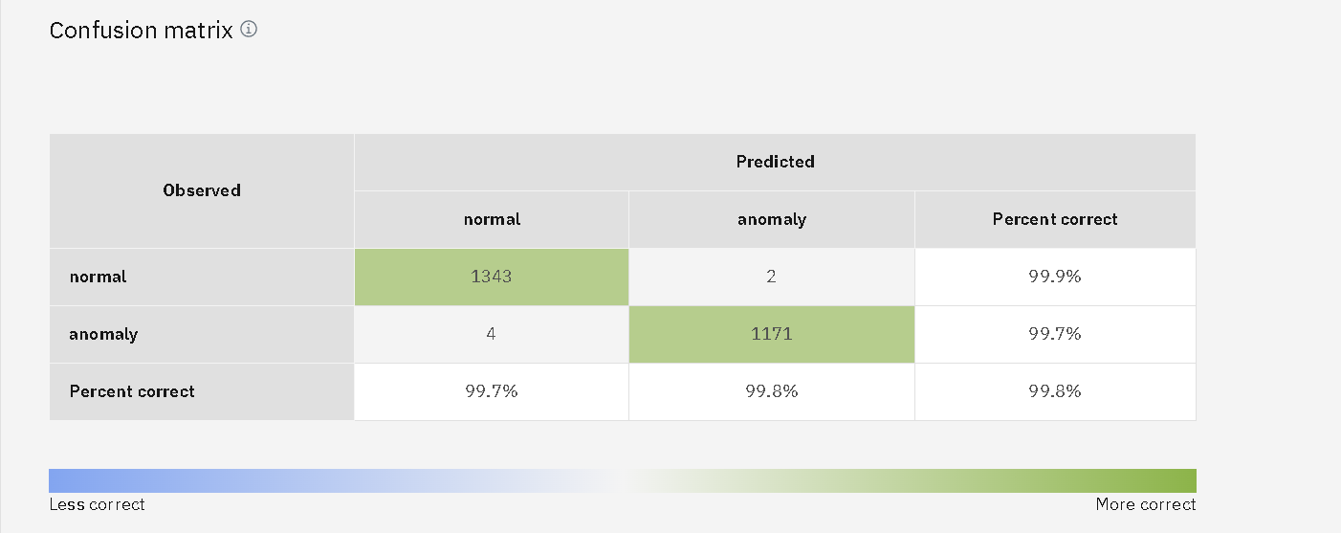
Confusion matrix

Slide 7
System Approach
The System Approach section outlines the complete setup for building and deploying the Machine Learning-based Network Intrusion Detection System (NIDS) using IBM’s cloud ecosystem. This includes data handling, model development, and real-time deployment infrastructure.
System requirements
Platform: IBM Watsonx.ai Studio
Deployment: IBM Cloud Lite
IBM Watsonx Runtime
IBM Watsonx Storage (Bucket)
No local hardware needed (cloud-based)
Library required to build the model
AutoAI (Watsonx)
pandas, numpy – Data handling
scikit-learn – Model training
Watson Machine Learning – Model deployment (optional)

Slide 8
Algorithm & Deployment
The machine learning algorithm selected for this project is the Snap Decision Tree Classifier, a variant of the standard Decision Tree optimized for faster training and better performance in binary classification tasks. This algorithm was selected automatically by IBM Watsonx.ai Studio’s AutoAI, which evaluated multiple models and pipelines.
Algorithm Selection:
Decision Trees are highly interpretable and effective for tabular datasets with both categorical and numerical features—exactly the structure of our network intrusion dataset. Snap Decision Trees extend this by incorporating performance optimizations such as reduced overfitting, efficient feature handling, and faster computation.
Data Input:
The algorithm was trained on a wide range of features extracted from the network traffic dataset. These included:
Categorical features:
protocol_type (e.g., TCP, UDP, ICMP)
service (e.g., HTTP, FTP, Telnet)
flag (status of connection)
Numerical features:
Traffic characteristics like src_bytes, dst_bytes, count, srv_count
Error and rate metrics such as serror_rate, rerror_rate, same_srv_rate, etc.
Label (target variable):
class — indicating whether the traffic record is "normal" or an "anomaly“
These features were selected based on their relevance to identifying patterns of legitimate versus malicious traffic. The combination of both protocol behavior and statistical metrics allows the model to effectively capture suspicious network activity.

Slide 9
Algorithm & Deployment
Training Process:
The Snap Decision Tree Classifier was trained on historical network traffic data using IBM Watsonx.ai Studio. The training included:
Cross-validation to ensure accuracy across different data splits.
Hyperparameter tuning (HPO) to optimize model settings like tree depth and split criteria.
Feature preprocessing like encoding categorical features and scaling numerical values.
The model learned to distinguish between normal and anomalous patterns based on behavioral features in the network data.
Prediction Process:
After training, the model predicts whether incoming traffic is normal or anomalous using the same input features as the training set. Each prediction includes:
A class label (normal or anomaly)
A confidence score
Real-time input support, allowing live or batch predictions
The model is deployable on IBM Cloud Lite, enabling it to be used for real-time intrusion detection in live environments.

Slide 10
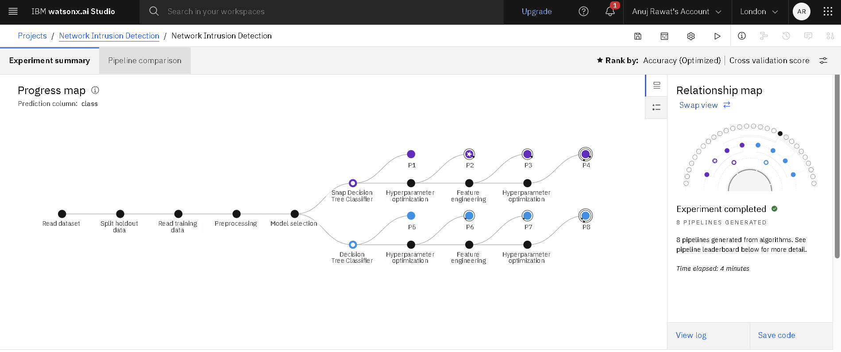
Progress map

Slide 11
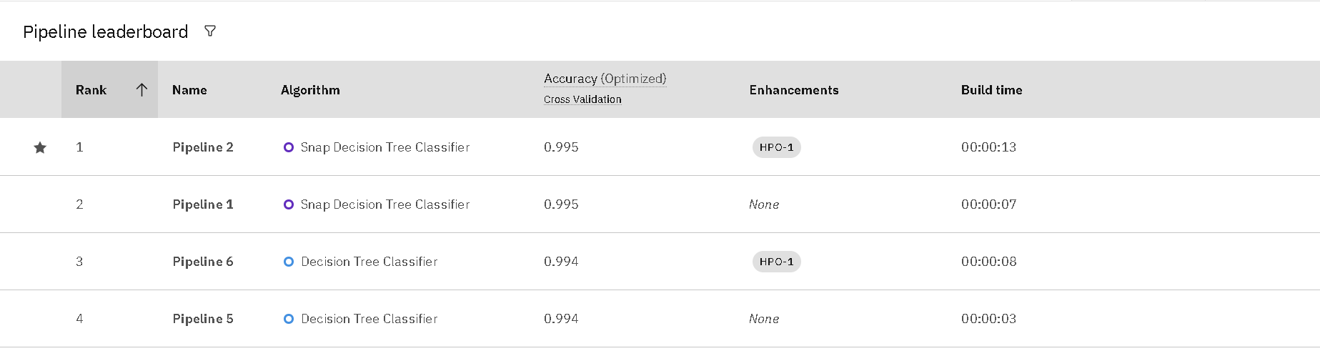
Pipeline leaderboard

Slide 12
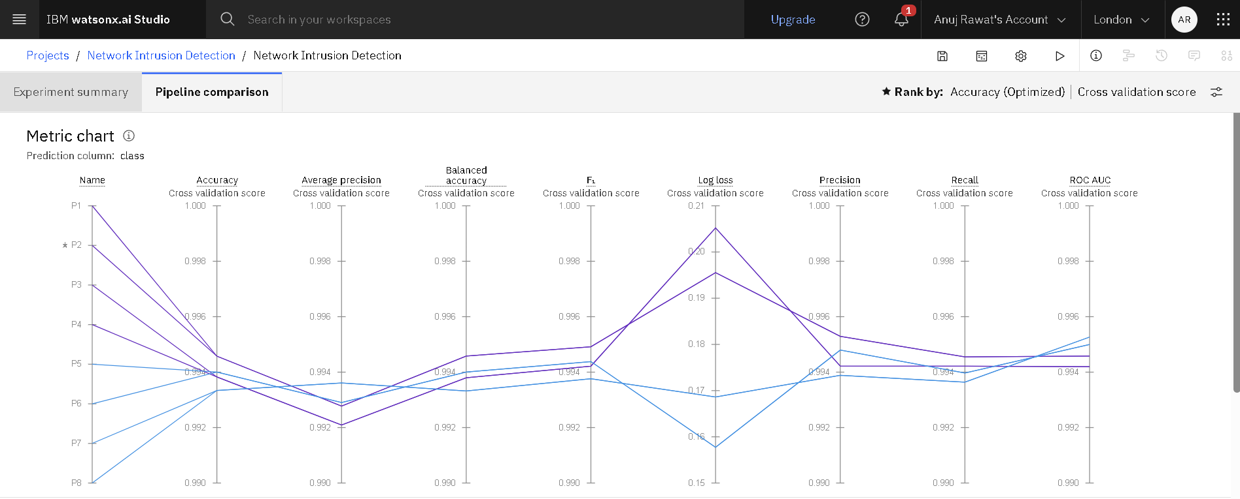
Metric chart

Slide 13
Result
Best Model: Snap Decision Tree Classifier
Training Accuracy: 99.5% (via cross-validation)
Prediction Results:
Correctly classified "normal" and "anomaly" traffic
Confidence scores up to 100% on holdout data
Visualization:
Class distribution pie chart
Leaderboard comparing multiple model pipelines☁️
Deployment-Ready :
Fast and accurate predictions through IBM Cloud Lite

Slide 14
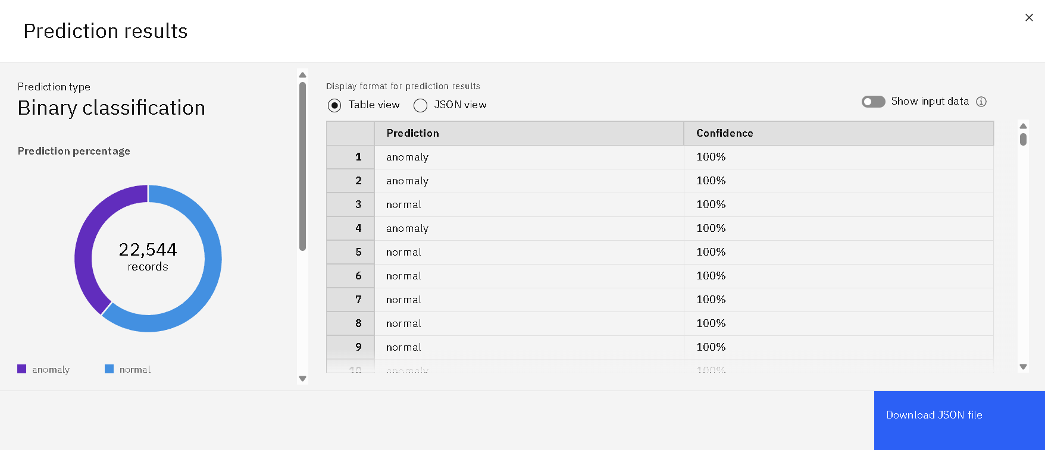
Prediction results

Slide 15
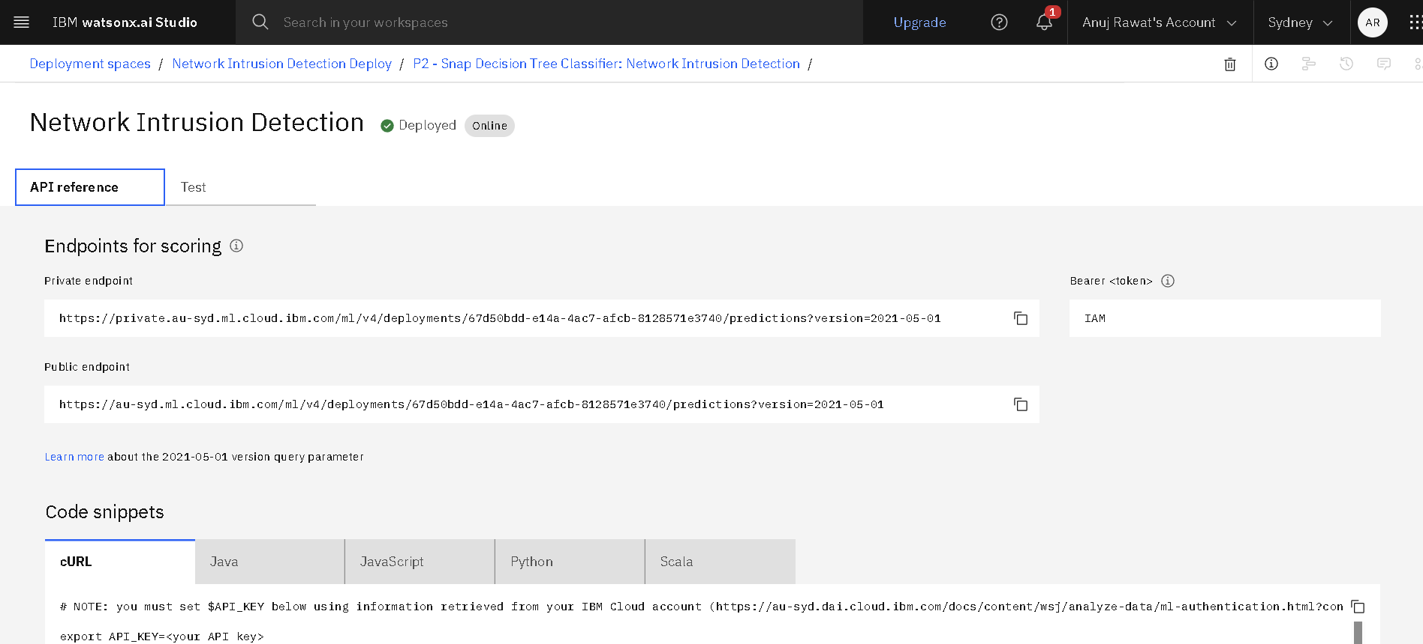
API References

Slide 16
Conclusion
The proposed ML-based system effectively detects anomalous network traffic, achieving 99.5% accuracy using a Snap Decision Tree Classifier.
IBM Watsonx.ai AutoAI simplified model building with automated preprocessing, tuning, and evaluation.
Deployment via IBM Cloud Lite enables real-time intrusion detection in scalable environments.
Challenges:
Handling categorical features and class imbalance during preprocessing.
Ensuring high accuracy without overfitting.
Accurate anomaly detection is critical for maintaining network security and preventing unauthorized access in real-time environments.

Slide 17
Future scope
Incorporate Additional Data Sources
Use real-time traffic logs, threat intelligence feeds, or system-level logs for deeper insights.
Algorithm Optimization
Explore advanced models like XGBoost, LightGBM, or deep learning for improved accuracy and adaptability.
Scalability
Expand deployment across multiple networks or geographic regions, including enterprise-scale systems.
Advanced ML Techniques
Use unsupervised learning (e.g., autoencoders, clustering) for zero-day attack detection.
Edge Computing Integration
Deploy lightweight versions of the model at network edges (routers/switches) for faster, decentralized detection.

Slide 18
References
IBM Watsonx.ai Studio Documentation(AutoAI and Model Deployment on IBM Cloud)
https://dataplatform.cloud.ibm.com
IBM Cloud Lite(Free-tier platform for deploying AI models and services)
https://www.ibm.com/cloud/lite
Network Intrusion Detection Dataset – Kaggle
https://www.kaggle.com/datasets/sampadab17/networkintrusion-detection

Slide 19

IBM Certifications

Slide 20

IBM Certifications

Slide 21

IBM Certifications

Slide 22
THANK YOU

