Slide 1

Customer Retention
E- Commerce

Slide 2

INDEX
Aim
Problem Statement
Data Collection
Data Cleaning
Exploratory Data Analysis
Software Used
Power BI Functionalities
Dashboard
Insights
Recommendations
Future Scope
Conclusion

Slide 3
AIM
To find the Customer Retention Rate in an E-Commerce platform.
To perform EDA on the dataset.
Gathering valuable insights from them.

Slide 4
Problem Statement
KPI's REQUIREMENT
We need to analyze key Indicators for our product sales data to gain insights into business performance.
So we need to calculate the following matrices:
Total Sales : Sum of total original price of products
Total Revenue : Sum of profit prices of all orders

Slide 5
Problem Statement
Total Order value : Count of total orders delivered to customers of all products
Category wise sales : Calculate category wise sales
Charts Requirements :
Churn by city tier:
Create clustered bar chart with X axis and Y axis ,it will help to identify which city tier has less churn rate.

Slide 6
Problem Statement
Satisfaction rate by sales :
Create Tree map that illustrate satisfaction rate according to category with respect to sales.
Complaints by category:
Create Stacked column Chart with help of X axis and Y axis, analyze complaints status of product.
Payment Mode:
Create pie chart that shows us percentage of which mode getting high sales, some payment modes getting cash backs
For example, credit card holders getting high cash back compare to other payment modes.

Slide 7
Data Collection
Download the data set from Kaggle website
E- commerce dataset
Target column : Churn
If Churn = 0 then existing customers retain over a period of time.
If Churn = 1 customers discontinue using a product or service.

Slide 8
Data cleaning
Using Python Jupyter Notebook
Import list of Libraries related to data cleaning
Dropping Duplicates
Finding Nulls and fixing with their Mode
Exploratory Data analysis
Finally save the file with .xlsx extension

Slide 9
Exploratory Data Analysis
Using Pearson Method, we found that the Numerical field which affect the Target variable were:
Number of device Registered
Satisfaction score
Complain
Cashback Amount
Using ANOVA Method, we found that the Categorical field which affect the Target variable were:
Preferred login device
Preferred payment mode
Preferred order category
Marital Status

Slide 10
Software Used
MS - Excel
Jupyter Notebook (Python)
Microsoft Power BI

Slide 11
Power BI Functionalities
Connect power BI to Excel file for importing data
Data cleaning in Power Query Editor
Data Modelling
Different Dax Functions like Sum ,Count, Distinct count
Creating different visualizations like Cards, Tree map, Pie chart, Donut Chart Stacked column chart
Created Dashboard

Slide 12
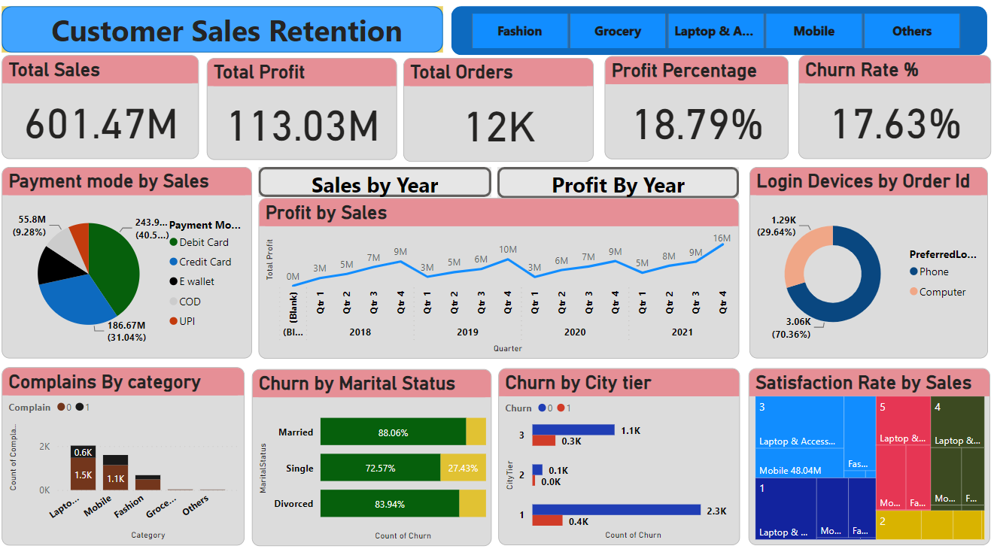
Dashboard

Slide 13
Insights
From the preferred order Category, Laptops & accessories are having Highest sales and Others category having least sales.
Sales and profit increased year over year, except 2020.
Sales by Debit Card payment mode was higher, when compared to other payment mode.

Slide 14
Insights
Churn rate high in city tier 1
Overall Churn rate 17.63%, which leads to 82.73% Retention Rate.
Most of customers giving 3 Star Rating
Total profit percentage is 18.79%

Slide 15
Recommendations
Provide more coupon cards
Giving cashback/discounts to customers
Delivered quality products within delivery time
Take care of complaints

Slide 16
FUTURE SCOPE
Increase Customer Retention percentage and Improve sales, so that business growth will increase.

Slide 17
CONCLUSION
The E-commerce data analysis has provided valuable insights to optimize business operations, Customer Retention.
Leveraging these findings can lead to increased sales, improved customer satisfaction, and a competitive edge in the dynamic e-commerce market.
Continuous monitoring and data-driven decision-making will be essential to sustain and enhance the success of the e-commerce business.

Slide 18

you
Thank

