Slide 1
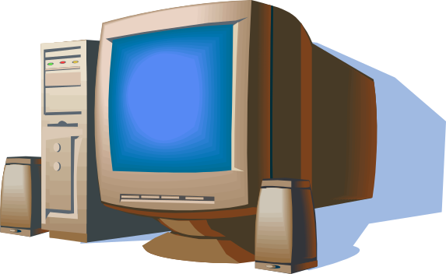
Fundamentals for Better Communication Through Computer
By
P. H. Prajapati
Extension Education Institute
AAU, Anand

Slide 2
What is Computer ?
Computer is an electronic device.
Can store large amounts of data.
Can performing operations on data.
Performing given function on the data & displays the result as output.
Process data whenever needed.
Known from ‘to compute’

Slide 3
What is Process?
Computer works on data as per programme is called process.
Processing means operations like…..
      Calculations,
      Logical decision making,
      Outputting data,
      Communicating with others computer etc.

Slide 4
History of Computers
First(1945-1955): Used vacuum tubes. Were very large. Generated immense heat. Very expensive.
Second(1955-1965): Used transistors. Continued to be large and expensive.
Third(1965-1975): Used integrated circuits. Significant reduction in size and cost
Fourth(1975-1995): Uses Very Large Scale Integration. Desktop computers would not have been possible without VLSI. It used Microprocessor minimizing the size of P.C.
Fifth (in progress): Will provide us with Artificial intelligence. Also called knowledge information processing system

Slide 5
Characteristics of Computer
Speed
Arithmetical and Logical Operations
Accuracy
Reliability
Storage
Retrieving Data and Programme
Automation
Versatility (Flexible)
Consistency
Communications

Slide 6
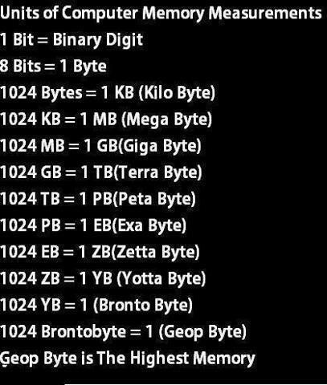

Slide 7
Hardware/Software
Computer Hardware
Parts of computer, which can be touch is called hardware.
(Physical Parts)
      Monitor
      CPU
      Key Board
      Mouse
      Speaker
Computer Software
Parts of computer, which can not be touch is called software.
    Operating System Software : Windows, MAC, Linux
    Application Software : MS Office, Photoshop, Media Player
    Internet Browser Software : Internet Explorer, Google Chrome, Mozilla Firefox, etc.

Slide 8
Classification of Computers
Personal computer :
    A single-user computer
    Can be useful at School, Home, etc.
    Known as Micro Computer
    Laptop, Desktop
Workstation :
    A powerful, single-user computer.
    A workstation is like a personal computer, but it has a more powerful microprocessor
    higher-quality monitor.
    Can be found in companies etc.

Slide 9
Minicomputer
    A multi-user computer
    Capable of supporting from 10 to hundreds of users simultaneously.
    Can be found in banks, government departments etc.
Mainframe
    A powerful multi-user computer
    Capable of supporting hundreds or thousands of users simultaneously.
Supercomputer
    An extremely fast computer
    Can perform hundreds of millions of instructions per second
    Weather, scientific research can be done by these types of computer.

Slide 10
Applications of Computer
Science research
Education
Business applications
Banking
Office Automation
Desktop publishing
Management aids
Engineering designing
Road traffic control
Railway
Medicine
Information services

Slide 11
What is Internet
Inter connection of many computers via network.
Global connected through network (through LAN or WAN)
To provide the various application services i.e. E-Mail, Usenet (News), WWW, Telnet, FTP, etc
At any time millions user connected to the internet from many countries.

Slide 12
Uses of Internet
Searching
E-mail service
Commercial Services
Electronic books & Publication
Video Conferencing
Sharing data and results quickly
Retrieving files & Program of all types
Find information databases and tutorials
News paper columns
Banking
Downloading / Uploading any information
News, sports, stocks, music etc.
Use of internet in various fields like education, Business, governance, etc.
And many more ………………..

Slide 13
Useful Keys Internet
Network: Connecting computers with each other For exchanging information
Client : It is a programme or computer for getting special information from another compute.
Server: It is a programme or computer, which gives information to the client computer.
Protocol: It’s a rules for connecting to the internet. (TCP/IP)
Portal: It is a website. Known as a gateway of internet.
(Search engine)

Slide 14
Router: It is a device, which decides where data will be send (Network point)
www : World Wide Web
Browser: It is a programme which helps us to use internet
Website: Group of different web pages.
URL : Universal Resource Locator

Slide 15
Types of Website (Domain No.)
    .com : Commercial organization
    .net : Large Networks
    .gov : Government organization
    .org : non-profit making organization
    .edu : educational organization
    .mil : military organization
    .in : India
    .au : Australia
    .us : United States
    .uk : United Kingdom

Slide 16

Thank You

