Slide 1

NATIONAL INSTITUTE OF TECHNOLOGY, TIRUCHIRAPPALLI
MOBILE APPLICATION DEVELOPMENT LABORATORY
Placement
Companion
An Android app for organized, personalized placement preparation
Anuj Tanwar
Kratish Mewada
Roll No. 205124017
Roll No. 205124045
PROJECT IMPLEMENTATION • GROUP PRESENTATION • INDIVIDUAL VIVA
Notes:
Presenter: Anuj. Time: 20 seconds.
Introduce both students, roll numbers, institute and laboratory. Describe the application as a placement preparation companion.
Timing: slide discussion totals 7 minutes, followed by a 3-minute live demo. Individual viva is a separate 5-minute component.
Logo: unaltered official NIT Tiruchirappalli emblem downloaded from https://www.nitt.edu/home/about/High-Resolution-Emblem.png; source page https://www.nitt.edu/home/about/. No endorsement is implied.

Slide 2
PROBLEM STATEMENT & OBJECTIVES
From scattered preparation to a daily routine
01 / CONTEXT
02 / GOALS
The student problem
Our objectives
Company information, practice questions and notes are scattered.
Students struggle to prioritize weak topics and maintain a study schedule.
Organize preparation in one Android app.
Track tasks and retain study material locally.
Personalize guidance using AI.
Target users: students preparing for campus placements and interviews
PLACEMENT COMPANION / MOBILE APPLICATION DEVELOPMENT LABORATORY
02 / 12
Notes:
Presenter: Anuj. Time: 35 seconds.
Explain the practical difficulty of switching between schedules, notes and company resources. The project aims to make preparation manageable through a single mobile workflow. Avoid claiming measured academic or placement improvements; no user study has been conducted.
Viva prompt: Why is local persistence useful in a student preparation app?

Slide 3
MARKET DRIVERS & TARGET USERS
Career readiness creates a practical student need
NEED
CONTEXT
PROPOSED CHANNEL
Career readiness
Personal guidance
Campus access
Placement preparation needs technical practice, interview confidence and a consistent routine.
AICTE NEAT supports EdTech that addresses learning gaps and employability skills.
Start with placement-season students; reach them through peer groups and placement cells.
Positioning: a daily preparation companion alongside practice and recruitment platforms.
Context: AICTE NEAT; NIT Trichy Training & Placement. Targeting and positioning are project proposals.
PLACEMENT COMPANION / MOBILE APPLICATION DEVELOPMENT LABORATORY
03 / 12
Notes:
Presenter: Anuj. Time: 30 seconds.
Primary users are students preparing for campus placements; placement cells and training groups are possible distribution partners. The proposal is to organize preparation alongside existing coding-practice and recruitment platforms.
Evidence: AICTE NEAT describes EdTech support for employability skills, capacity building and learning gaps: https://neateoi.aicte-india.org/. NIT Trichy Training and Placement describes placement coordination and individual career-interest counselling: https://www.nitt.edu/home/academics/departments/tp/.
Inference: these activities provide a plausible setting for a preparation companion. They do not demonstrate adoption of this app, willingness to pay, market size or improved placement outcomes. Target users and channels are proposed; no market survey or traction data is available.

Slide 4
BUSINESS DRIVERS & PROPOSED SUSTAINABILITY
Student value must translate into repeat usage
Value & retention
Adoption channels
One place for tasks, notes and AI help.
Saved progress can support a daily routine.
Pilot with student groups and placement cells.
Use feedback to improve the preparation flow.
Possible business model
Costs & success measures
Free core planning; optional paid AI features.
Explore institutional plans after a campus pilot.
AI usage, support and future hosting costs.
Track retention, task completion and cost per user.
Proposed roadmap: pricing, subscriptions, institutional plans and analytics are not implemented.
PLACEMENT COMPANION / MOBILE APPLICATION DEVELOPMENT LABORATORY
04 / 12
Notes:
Presenter: Anuj. Time: 30 seconds.
The business hypothesis connects student value to repeated use: a daily planning routine, retained notes and personalized help. Student groups and placement cells are proposed pilot channels, not existing partnerships.
Potential sustainability options are a free core planner, usage-limited premium AI features, and institutional subscriptions. Billing, subscription limits and institutional dashboards are not in the current app. Pricing and willingness to pay need validation.
Cost drivers would include AI requests, future backend/cloud services, content maintenance and support. Proposed pilot measures: activation after onboarding, weekly retention, completed tasks, feedback quality and API cost per active user. No revenue, adoption, retention or conversion figures have been measured.
Viva prompt: How would you test whether the product is useful before introducing a paid tier?

Slide 5
PROPOSED SOLUTION & MAJOR MODULES
One app, six connected preparation modules
01
02
03
Personalization
Study planning
Company preparation
Target role, subjects and daily study hours.
Tasks, timetable and completion tracking.
Companies, PYQs and interview experiences.
04
05
06
Study material
AI assistance
Daily navigation
Notes, resources, search and bookmarks.
Roadmaps, doubt answers and interview feedback.
Home, calendar and profile access.
PLACEMENT COMPANION / MOBILE APPLICATION DEVELOPMENT LABORATORY
05 / 12
Notes:
Presenter: Anuj. Time: 35 seconds.
Explain how onboarding establishes preferences, the planner supports daily work, company content guides preparation and AI supplies personalized assistance. Notes/resources/bookmarks remain part of the same preparation workflow.
Bottom tabs: Home, Planner, Companies, Resources and Profile. Secondary destinations include AI Planner, Notes, Calendar, PYQs, Experiences, Search, Doubt Assistant and Mock Interview.
Dashboard contains sample recommendation/progress data; do not describe all metrics as dynamically computed. Company/PYQ seed material is demonstration content, not a verified current recruiting dataset.

Slide 6
PROJECT TECH STACK DETAILS
What each technology contributes to the app
LAYER
TECHNOLOGY / TOOL
ROLE IN THIS PROJECT
Language & build
Kotlin · Android Studio · Gradle
Native Android code, builds and APK generation
UI & navigation
Compose · Material 3 · Navigation
Declarative screens, controls and route handling
State & async work
ViewModel · Coroutines · StateFlow
Screen state, background calls and reactive updates
Local persistence
Room / DAO · DataStore
8 structured entities; preferences and onboarding
Networking & AI
Retrofit · OkHttp · Gson · Groq
HTTP requests, JSON parsing and AI responses
Verification
Compose UI tests · AndroidJUnit4
Navigation checks and opt-in live API tests
Android compatibility: min SDK 26 (Android 8.0+) • compile / target SDK 35
PLACEMENT COMPANION / MOBILE APPLICATION DEVELOPMENT LABORATORY
06 / 12
Notes:
Presenter: Kratish. Time: 40 seconds.
Explain the role of each layer rather than only listing library names. Kotlin is the implementation language; Android Studio and Gradle support development and builds. Compose/Material 3 render screens, Navigation manages routes. ViewModels expose StateFlow and use coroutines for database/API work. Room stores structured entities through the DAO, while DataStore stores smaller preference flags. Retrofit defines HTTP calls, OkHttp transports them and Gson converts JSON models; Groq supplies AI replies and plans. Compose UI tests and AndroidJUnit4 are used for instrumentation checks.
Verified against app/build.gradle.kts, gradle/libs.versions.toml and source: Kotlin 2.2.10, Room 2.8.4, min SDK 26, compile/target SDK 35, JVM target 17. Configured Groq model: openai/gpt-oss-120b. WorkManager is a declared dependency with reminder helpers, but end-to-end scheduling has not been verified; do not present full reminders as established functionality.
Viva prompt: Explain the distinction between Room and DataStore, Retrofit and OkHttp, or ViewModel and Repository.

Slide 7
ARCHITECTURE & RESPONSIBILITY BOUNDARIES
UI actions pass through a layered MVVM design
SEPARATION OF CONCERNS
Why MVVM?
Compose UI
ViewModel
Repository
UI renders screen state.
ViewModel owns state and asynchronous work.
Repository coordinates local and remote data.
Room emits saved changes.
Screens + user actions
State + async operations
Data access + API calls
Two data paths
Local: Room database + DataStore preferences
Remote: Retrofit → Groq API → parsed response
PLACEMENT COMPANION / MOBILE APPLICATION DEVELOPMENT LABORATORY
07 / 12
Notes:
Presenter: Kratish. Time: 40 seconds.
MVVM separates Compose screens from state and data operations. ViewModels expose StateFlow, launch coroutines and use repositories; UI observes changes. Room provides local structured data and DataStore stores preferences/onboarding flags. Retrofit/OkHttp/Gson handle remote HTTP and JSON.
Implementation: Kotlin 2.2.10, Room 2.8.4, compile/target SDK 35, min SDK 26; only mention versions if asked.
Viva prompts: What does a ViewModel preserve? Why use a coroutine? How does StateFlow update a Compose screen? Where are navigation routes defined?

Slide 8
API INTEGRATION, WORKFLOW & DATA HANDLING
AI guidance becomes a saved study task
1
2
3
4
Set preferences
Call Groq API
Review output
Save tasks
Company, time budget
and preparation topics
Send a request using
Retrofit / OkHttp
Parse JSON into
weeks and study tasks
Convert the plan;
store tasks in Room
Local storage
Response handling
8 Room entities: user, company, question, task, note, experience, resource and bookmark.
Loading / success / error UI states.
Saved records work offline; AI needs internet.
PLACEMENT COMPANION / MOBILE APPLICATION DEVELOPMENT LABORATORY
08 / 12
Notes:
Presenter: Kratish. Time: 40 seconds.
The Groq OpenAI-compatible endpoint is https://api.groq.com/openai/v1/chat/completions and the configured model is openai/gpt-oss-120b. The repository supports askDoubt, generateStudyPlan and mockInterviewFeedback. Do not display any API credential.
The plan request expects JSON and Gson parses it. convertAiPlanToTasks inserts tasks into Room; DAO Flow then refreshes the planner. The current conversion assigns sequential dates and a fixed time slot; improved mapping of AI day numbers and durations is future work.
Room database: placement_companion_db. DataStore: onboarding completion, target company and theme preference flags.
Viva prompts: What is an entity vs DAO? Where is a task inserted? What happens when the API returns an error?

Slide 9
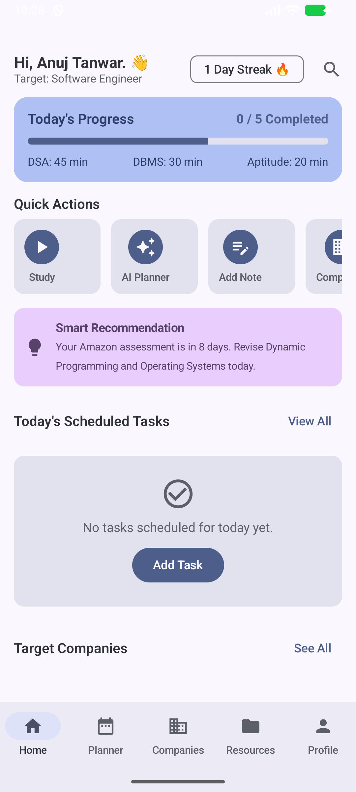
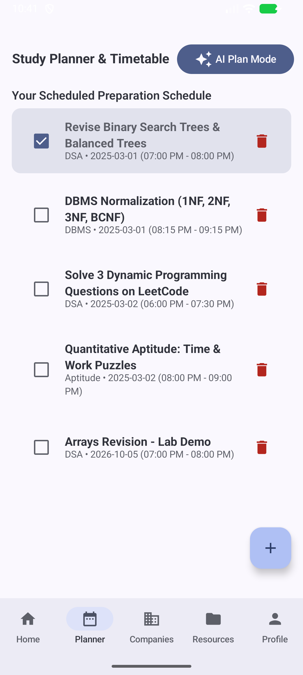
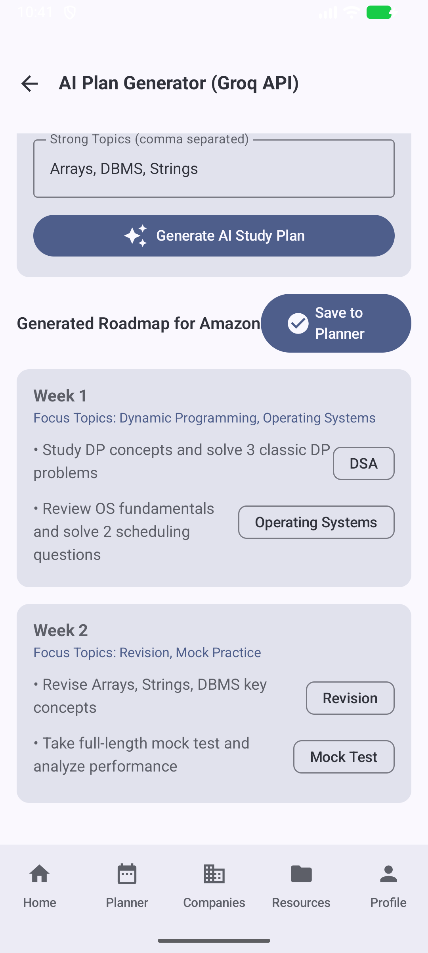
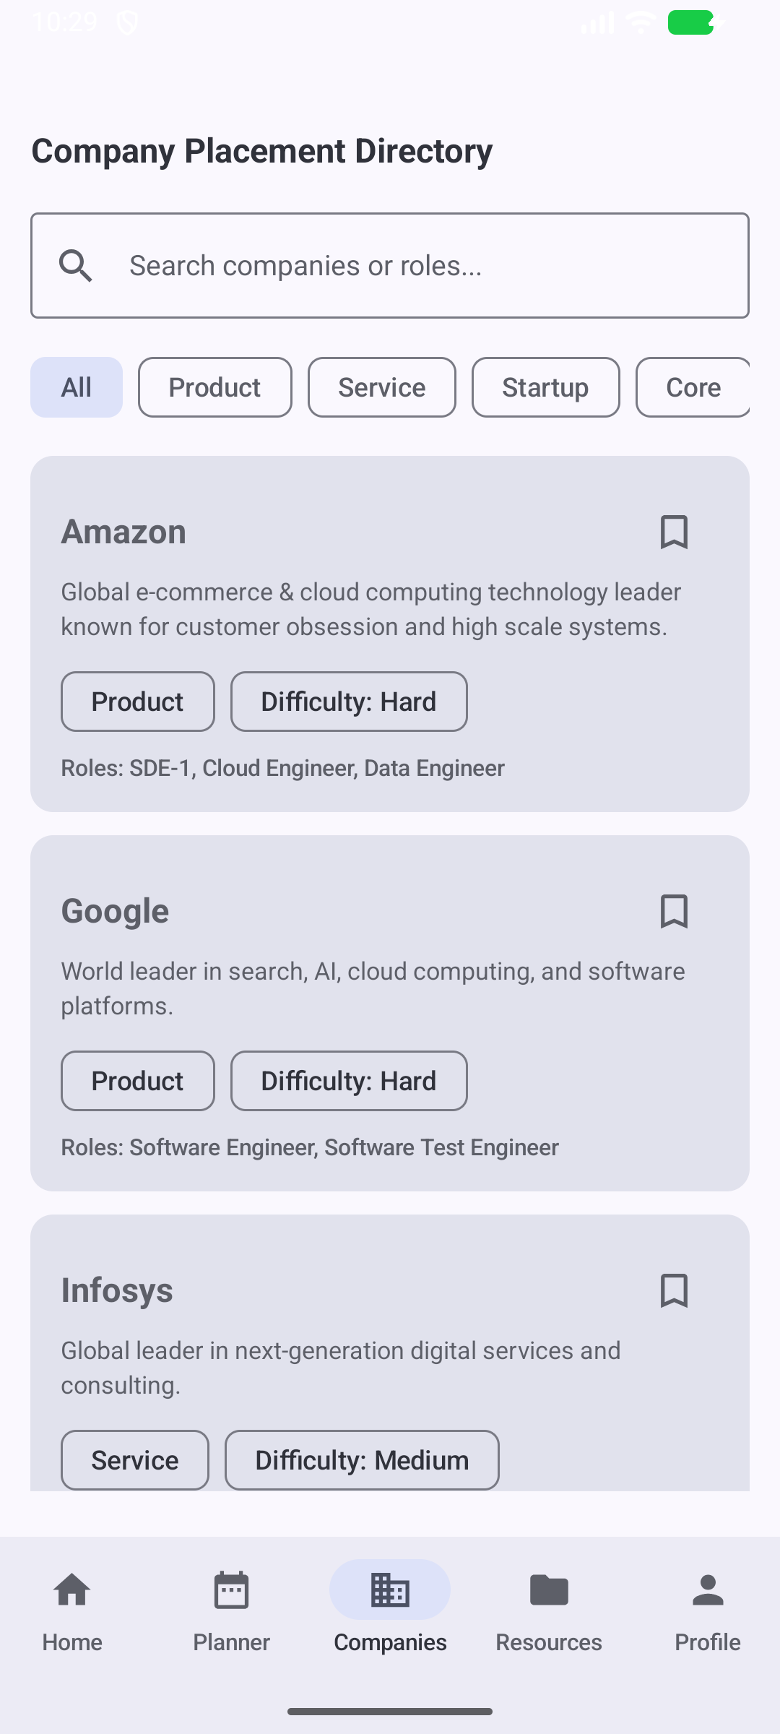
ACTUAL ANDROID EMULATOR CAPTURES
Important screens in the working application
Home
Study planner
AI roadmap
Companies
Quick actions & progress
Fresh task entry
Real API output
Search & company cards
PLACEMENT COMPANION / MOBILE APPLICATION DEVELOPMENT LABORATORY
09 / 12
Notes:
Presenter: Anuj. Time: 30 seconds.
These are real screenshots captured from the project APK on Medium_Phone_API_37.0. Identify the common bottom navigation, dashboard quick actions, planner controls, returned AI roadmap and company search/filter UI. The planner includes a freshly added demo task and seed records; the dashboard recommendation includes sample content.
During the demo, create a fresh task using the actual demonstration date rather than relying on seed dates. The AI result shown is an actual Groq response.

Slide 10
VALIDATION, TESTING, RESULTS & CHALLENGES
Focused checks verify navigation and live API calls
5 + 3
Challenges resolved
Navigation checks + live API checks
Build compatibility
Aligned Kotlin / Room versions and Gradle plugins.
Navigation: Home returns correctly from planner and other tabs.
API: doubt reply, structured study plan and interview feedback received.
Unavailable AI model
Updated the model; verified all three API functions.
Home returning to Planner
Corrected saved navigation-state restoration.
Validation: empty tasks / answers guarded
PLACEMENT COMPANION / MOBILE APPLICATION DEVELOPMENT LABORATORY
10 / 12
Notes:
Presenter: Kratish. Time: 40 seconds.
Eight focused instrumentation checks passed during this development session in separate navigation and live API runs. Five Compose tests cover Study shortcut → Home, AI Planner → Home, Planner tab → Home, switching multiple tabs and preserving Planner state. Three Groq repository tests check an exact assistant reply, valid plan fields/nonempty tasks and nonempty interview feedback. The retained latest XML report has 3 tests, 0 failures, 0 errors, 0 skipped. This is targeted verification, not exhaustive testing of all modules.
Build fixes: add Kotlin Android plugin, align Kotlin 2.2.10 / Room 2.8.4. API fix: replace unavailable model and expose readable HTTP errors. Navigation fix: Home must not restore a saved stack that ends on Planner; preserve other tab state.
Validation: task title must be nonblank; blank AI doubt/interview answers are skipped. Numeric AI fields have fallback defaults, but strict range/date validation still needs improvement.
Viva prompts: Explain the navigation bug. What is restoreState? Why test the repository with a real API?

Slide 11
SUGGESTED CONTRIBUTION SPLIT — CONFIRM ACTUAL OWNERSHIP
Team delivery and individual explanation
Anuj Tanwar | 205124017
Kratish Mewada | 205124045
Suggested scope: Compose UI, onboarding, Home, planner screens and navigation.
Explain the user journey and lead the UI demo.
Suggested scope: Room / DAO, ViewModels, repositories, Groq API and error handling.
Explain data flow and technical verification.
Shared team contribution
Integration, review, testing, demo preparation and overall project understanding.
PLACEMENT COMPANION / MOBILE APPLICATION DEVELOPMENT LABORATORY
11 / 12
Notes:
Presenters: both. Time: 35 seconds.
IMPORTANT: the actual division of work was not provided. The assignments on this slide are suggested, not verified claims of authorship. Replace them with the students’ real work before submission. Both students must understand the entire application and attend individual viva.
Suggested speaking division: Anuj covers slides 1-5 and 9; Kratish covers slides 6-8 and 10; both cover slides 11-12 and the demo. Be ready to identify the exact files each student actually implemented or modified.

Slide 12
FUTURE ENHANCEMENT & CONCLUSION
A practical foundation for placement preparation
Next improvements
Project takeaway
Stronger date, time and numeric validation.
More accurate AI task scheduling and real progress analytics.
Backend-managed AI credentials, authentication and cloud sync.
Improved reminders, accessibility and broader device testing.
Study planning, local storage and AI guidance in one Android app for students.
Thank you • Application demo & individual viva
PLACEMENT COMPANION / MOBILE APPLICATION DEVELOPMENT LABORATORY
12 / 12
Notes:
Presenters: both. Time: 45 seconds.
Summarize the implemented native Android app, local database and live AI integration. Future work addresses strict validation, mapping AI day numbers/durations to a calendar, replacing sample dashboard analytics with actual metrics, secure backend API access, cloud synchronization and stronger reminder integration.
Transition to the 3-minute application demo, then each student attends the individual viva. Do not claim cloud sync, full authentication, exhaustive testing or automatic deadline analytics are already implemented.
Slide timing: 20 + 35 + 30 + 30 + 35 + 40 + 40 + 40 + 30 + 40 + 35 + 45 = 420 seconds (7 minutes). Demo = 180 seconds. Total group presentation/demo = 600 seconds (10 minutes).

