Slide 1



G.H. RAISONI INSTITUTE OF ENGINEERING
& TECHNOLOGY, NAGPUR
Department of Computer Science & Engineering
Introductory Seminar
On
Heart Disease Prediction
Guide: Dr. Sharda A. Chhabria
Name of Projectees
Anuj Wadi (A15)
Aryan Meshram (A20)
Harshal Bodhe (A37)
Ishita Sahare (A42)
Krutika Tathe (A50)

Slide 2
Contents
Introduction
Justifications for Selecting the Title
Problem Statement
Literature Survey
Block Diagram
Expected Result
Work plan
References

Slide 3
Introduction
It is difficult to identify heart disease because of several contributory risk factors such as diabetes, high blood pressure, high cholesterol, abnormal pulse rate and many other factors.
Among various life threatening diseases, heart disease has garnered great deal of attention in medical research.
The diagnosis of heart disease is challenging task, which can offer automated prediction about the heart condition of patient so that further treatment can be made effective.
The diagnosis of heart disease is usually based on signs, symptoms of the patient.
The severity of the disease is classified based on various methods like K-Nearest Neighbor Algorithm(KNN), Decision Trees(DT), Genetic algorithm(GA), and Naive Bayes(NB).
The nature of heart disease is complex and hence, the disease must be handled carefully. Not doing so may affect the heart or cause premature death.

Slide 4
Justification For Selecting The Title
The main objective of this research is to develop heart prediction system, the system can discover and extract hidden knowledge associated with diseases from heart data set.
This system aims to exploit machine learning techniques on medical data set to assist in the prediction of the heart disease.
Reduce the cost of medical tests.
To help avoid human biases.

Slide 5
Problem Statement
Heart disease prediction using machine learning algorithm.

Slide 6
Literature Survey
Sr. No. | Paper Title and its Author | Details of Publication | Findings
1 | Prediction of Heart Disease Using Machine Learning Algorithms Year-2018 By Mr.Santhana Krishnan, Dr.Geetha.S | In this system, heart disease data set is used. The main aim of this system is to predict the possibilities of occurring heart disease of the patients in terms of percentage. This is performed through data mining classification techniques | Decision tree 91% Naive Bayes 87%
2 | Analysis of Heart Disease Prediction using Various Machine Learning Techniques Year-2018 By M. Marimuthu, S.Deivarani, Gayathri.R | To achieve better accuracy and to make the system more efficient so that it can predict the chances of heart attack. | KNN 83.60% NB 80.66% Decision tree 75.58% SVM 65.56%
3 | A Hybrid Machine Learning Approach for Prediction of Heart Diseases Year-2018 By Sanchayita Dhar Pritha Datta, Ankur Biswas, Tanusree Dey, Krishna Roy | In this paper, to develop prediction system that be capable to envisage heart diseases based on measurements, are extracted from The ERIC laboratory consisting of 209 test cases. | Naive Bayes Decision tree Random Forest
4 | Prediction of Heart Disease Using Machine Learning Algorithms Year-2018 By Rajesh N, T Maneesha, Shaik Hafeez, Hari Krishna | In this paper, processing patient's dataset and data of patients to whom we need to predict the chance of occurrence of heart disease. | Naive Bayes Decision tree (ID3 Algorithm)

Slide 7
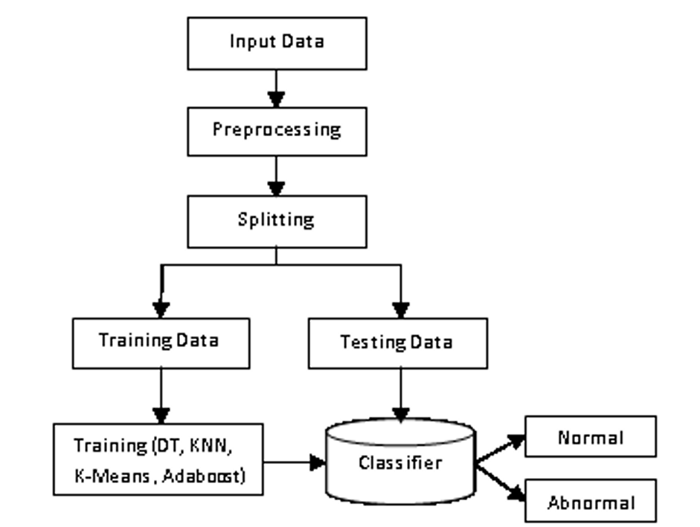
Block Diagram

Slide 8
Expected Result
Heart disease prediction is challenging and very important in medical field. However,the mortality rate can be drastically controlled if the disease is detected at early stage and preventive measures are adopted as soon as possible.
The proposed hybrid HRFLM approach is combined the characteristics of random forest(RF)and linear method(LM).
HRFLM proved to be quite accurate in the prediction of heart disease.

Slide 9
Work – Plan
Months Activities | SEPTEMBER’22 | OCTOBER’22 | NOVEMBER’22
Literature Reviews | √
Component Identification & Selection | √
Designing |  | √
Experimental Analysis |  | √
Fabrication |  | √
Testing and Debugging |  |  | √
Preparation of Project Report |  |  | √

Slide 10
References
Effective heart disease prediction using hybrid machine learning techniques
- Senthil Kumar mohan, chandrasegar thirumalai, and Gautam Srivastava-(19 JUNE 2019).
Prediction of Heart Disease Using Machine Learning
- Aditi Gavhane, Gouthami Kokkula, Isha Pandya,Prof. Kailas Devadkar(PhD)-2018.
Prediction of Heart Disease at early stage using Data Mining and Big Data Analytics
- A Survey Salma Banu N.K, Suma Swamy.-2019.
Prediction of Heart Disease Using Machine Learning Algorithms.
- Mr.Santhana Krishnan.J, Dr.Geetha.S.2019.

Slide 11
Thank you !

