Slide 1
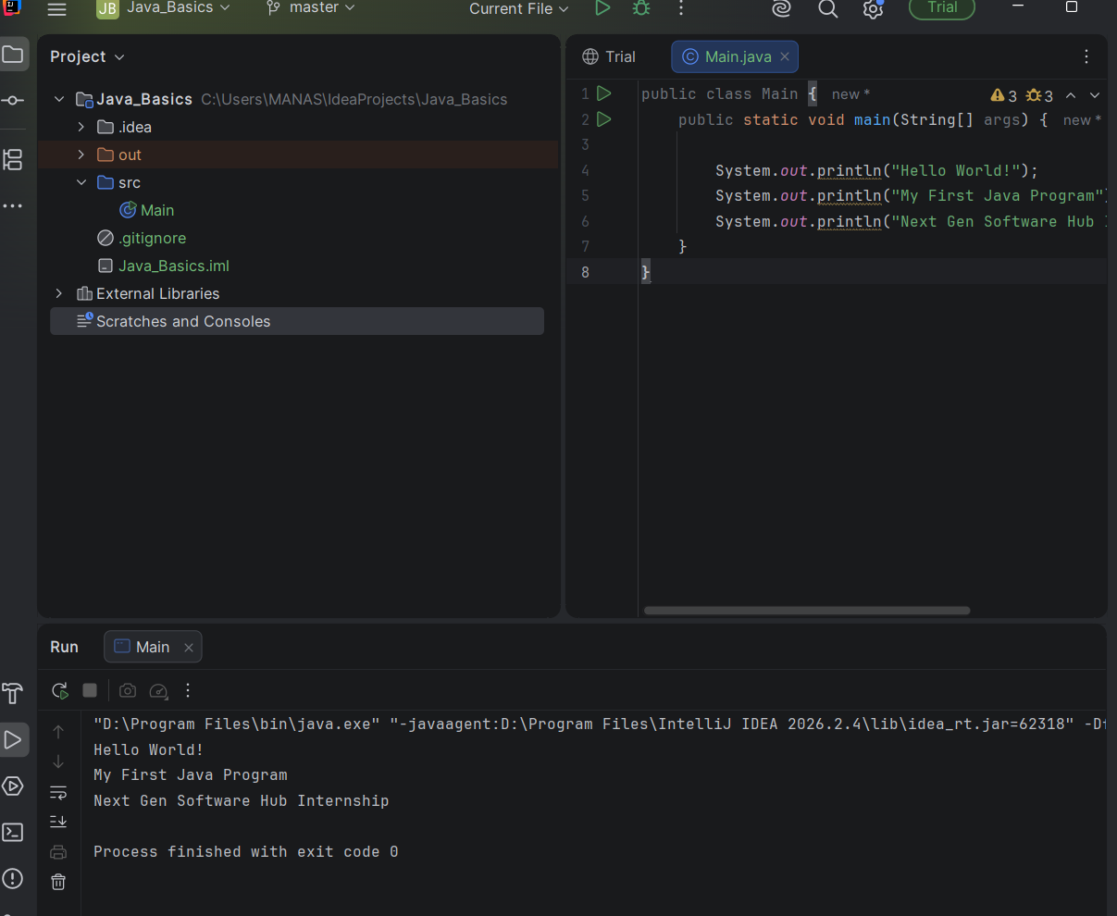
Task 01: Hello World

Slide 2
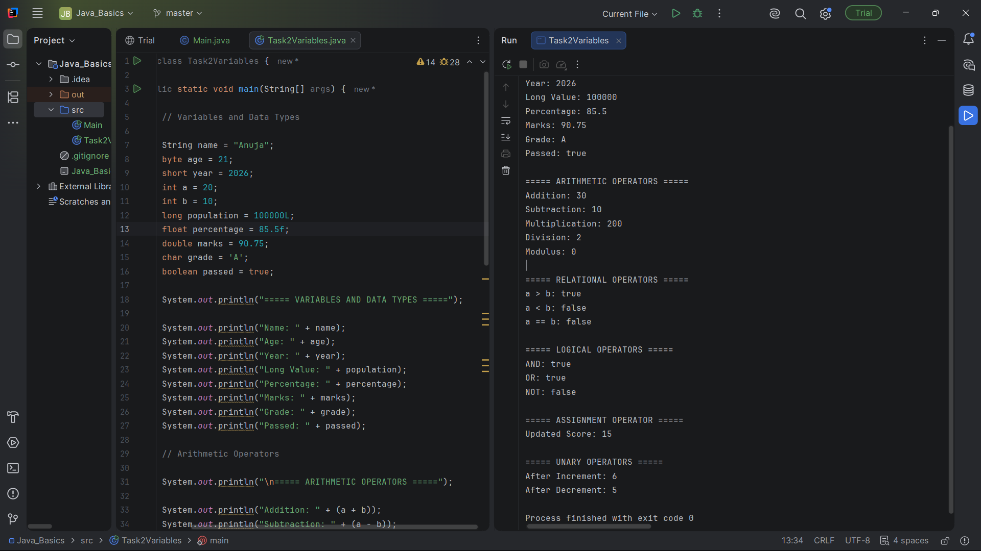
Task 02: Variables and Data Types

Slide 3
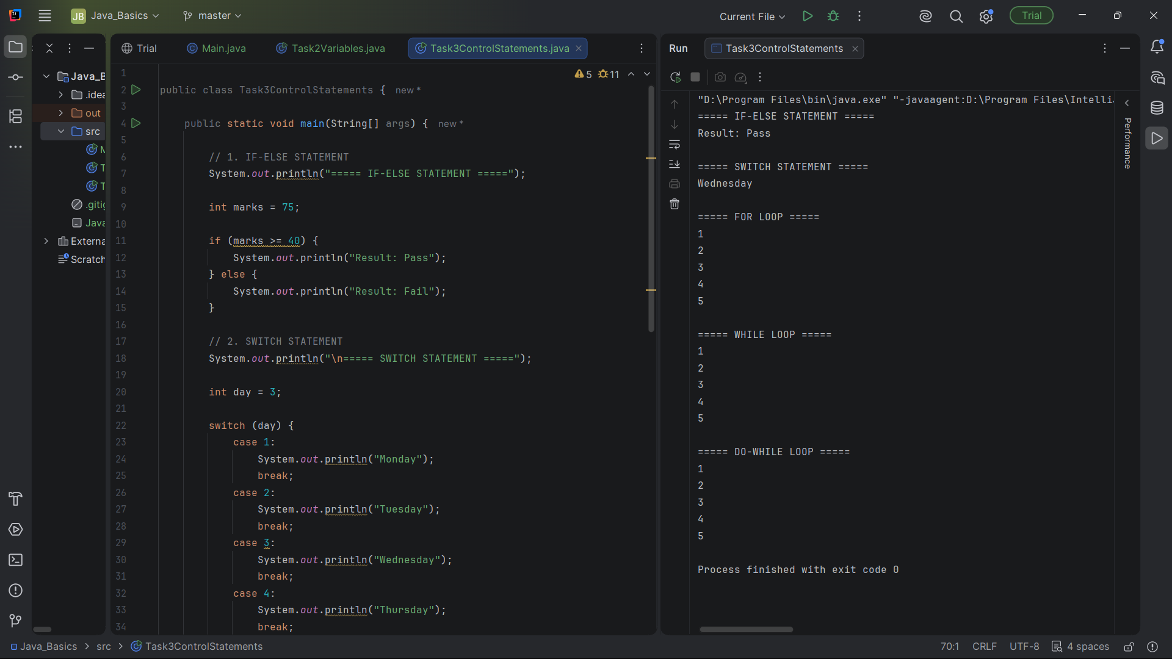
Task 03: Control Statements

Slide 4
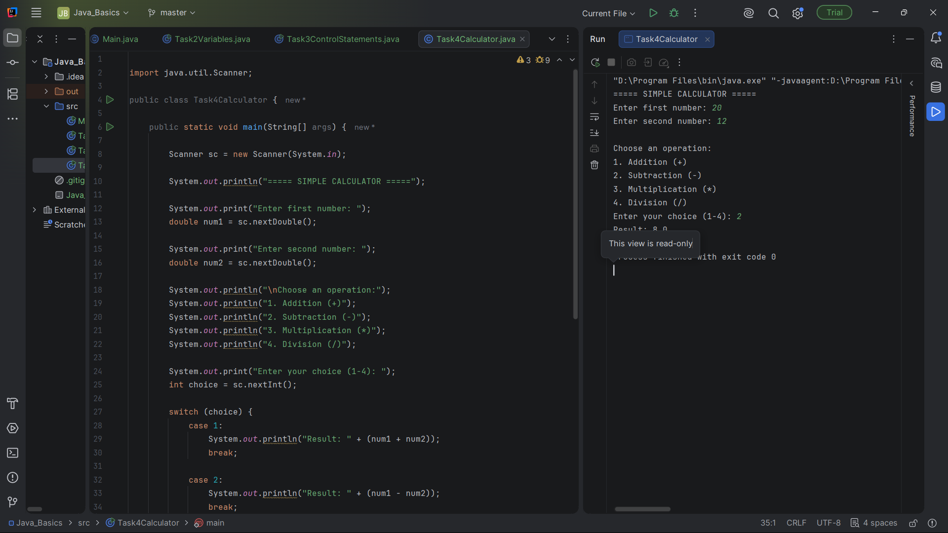
Task 04: Calculator

Slide 5
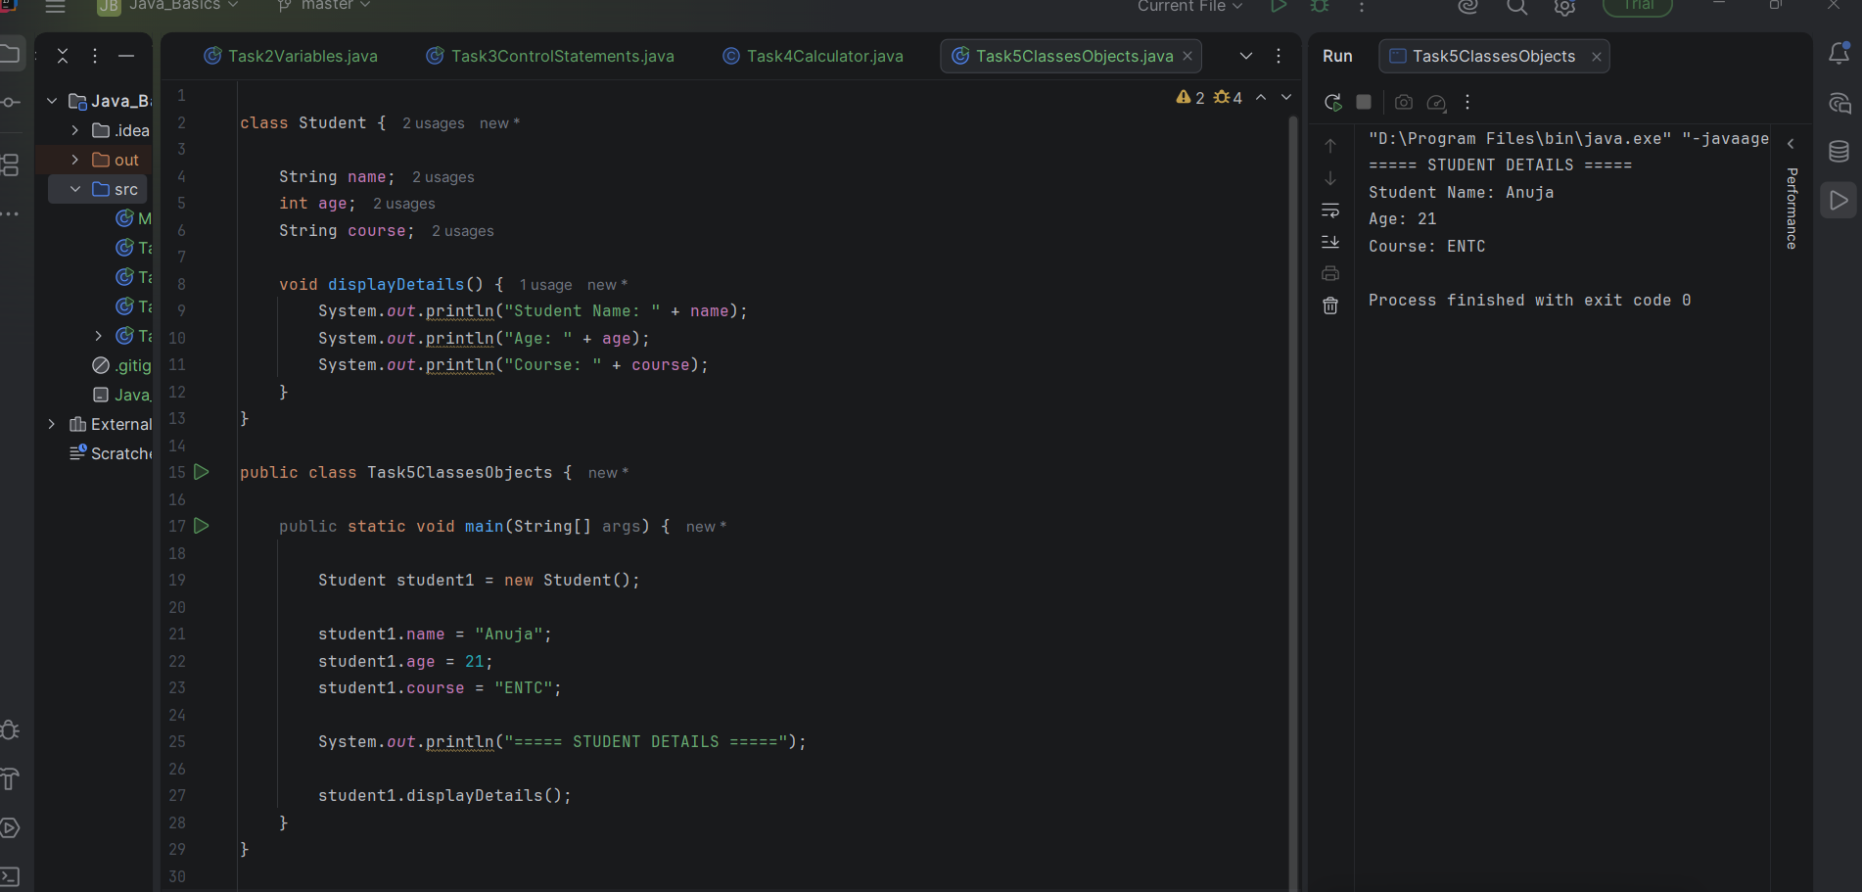
Task 05: Classes and Object

Slide 6
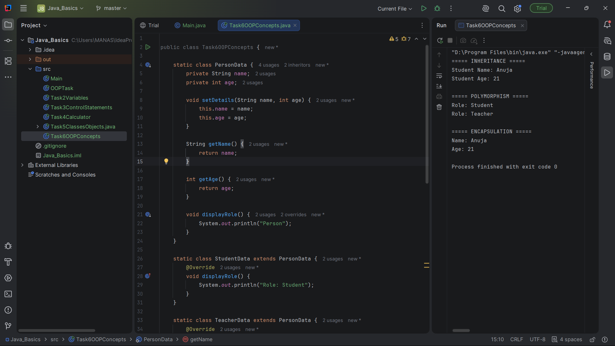
Task 06: OOP Concepts

Slide 7
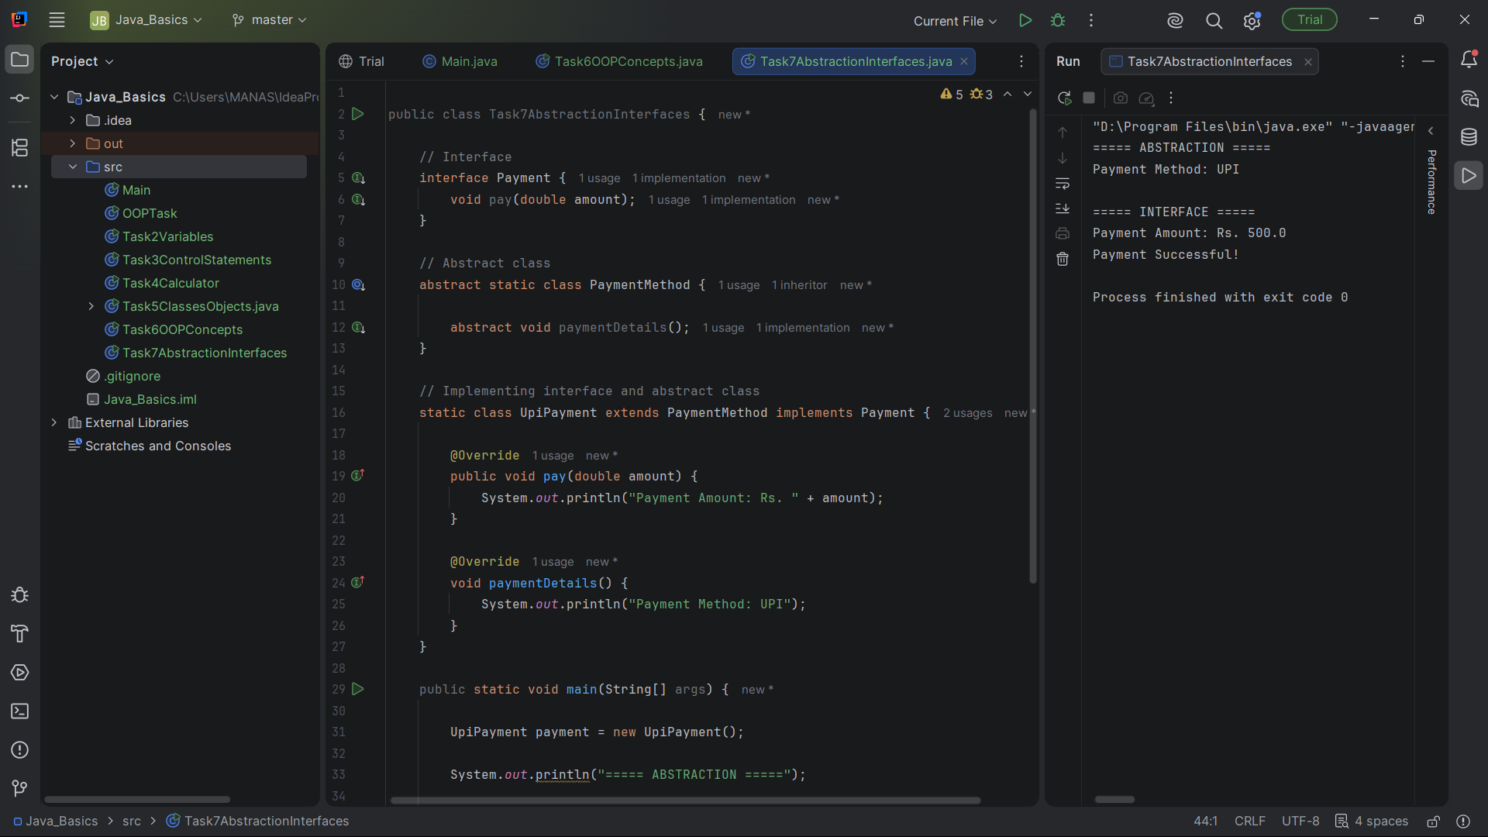
Task 07: Abstraction and InterfacesTask 07: Abstraction and Interfaces

Slide 8
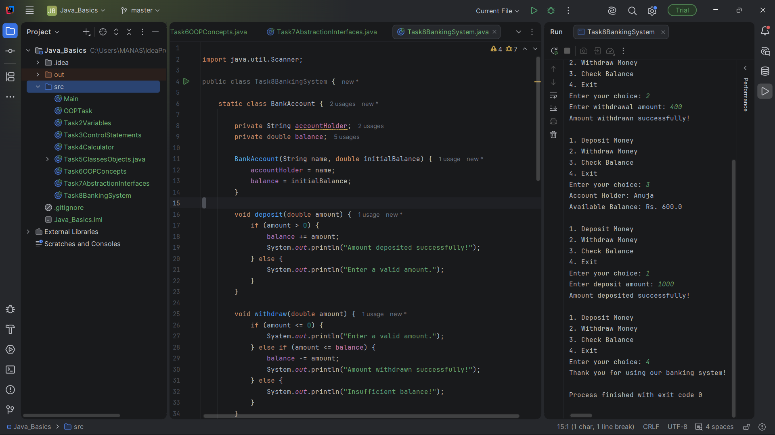
Task 08: Banking System

Slide 9
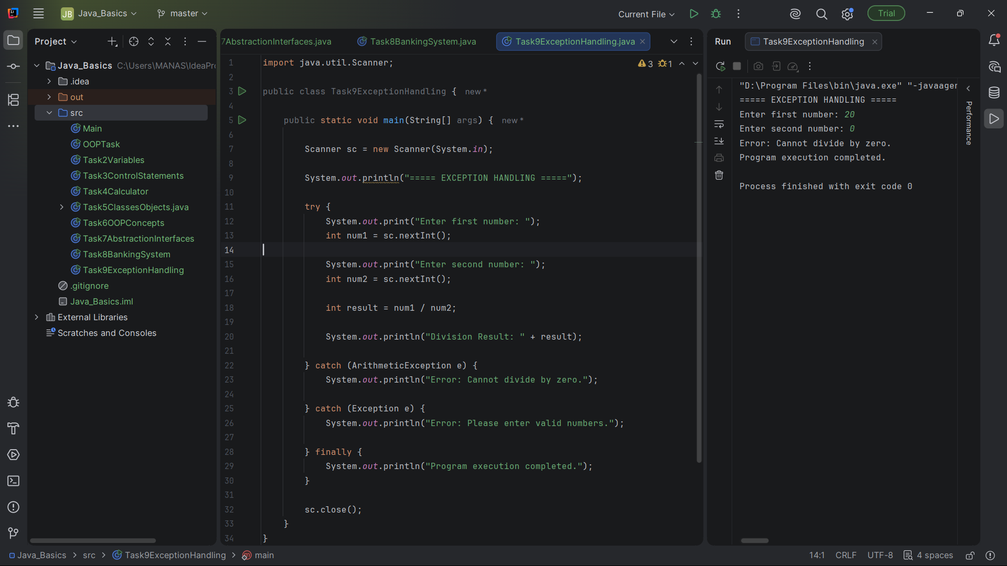
Task 09: Exception Handling

Slide 10
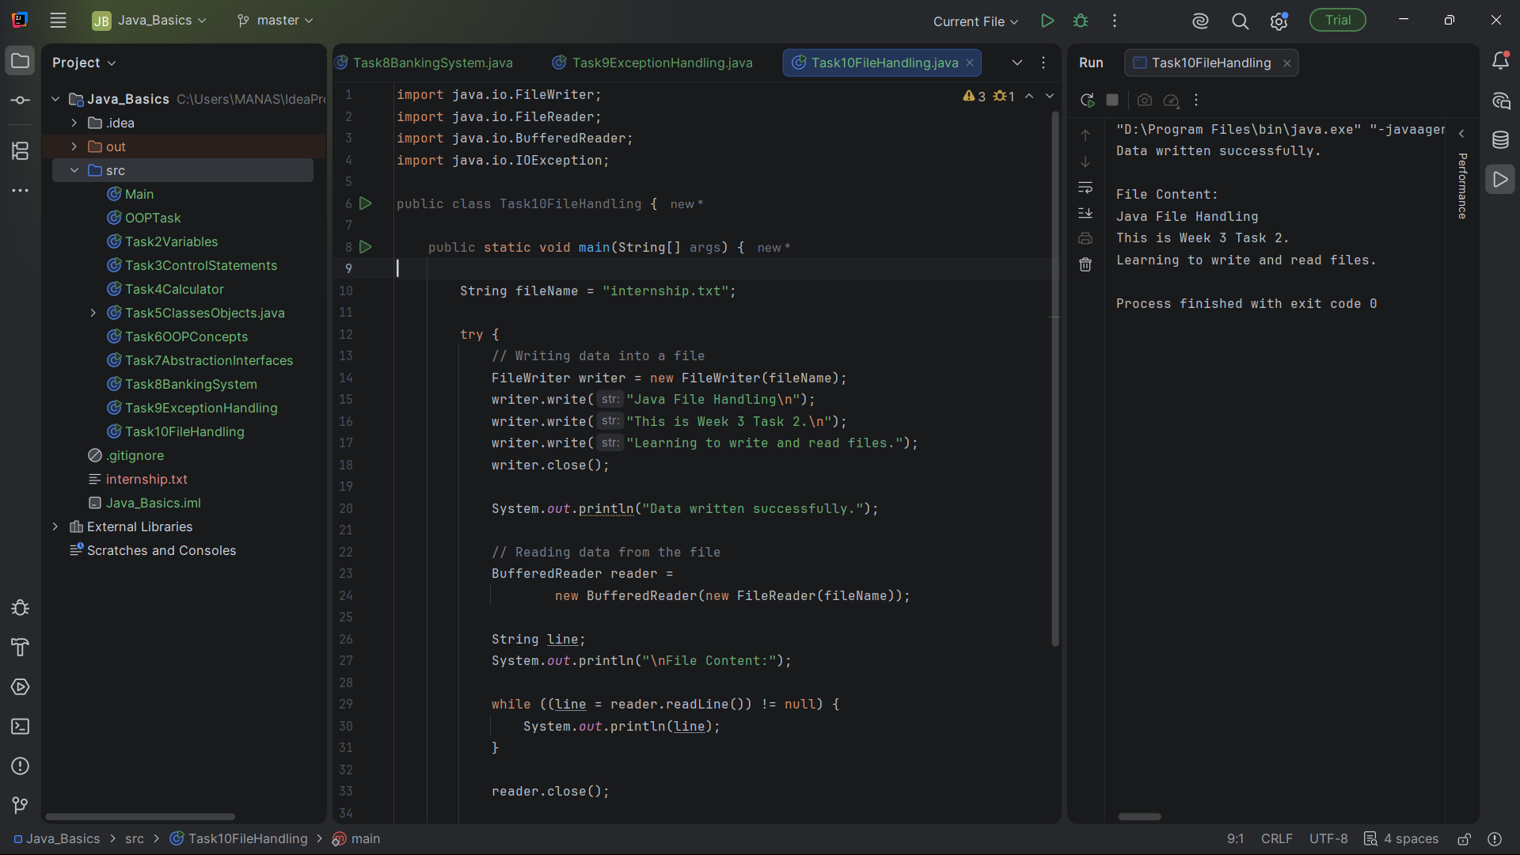
Task 10: File Handling

Slide 11
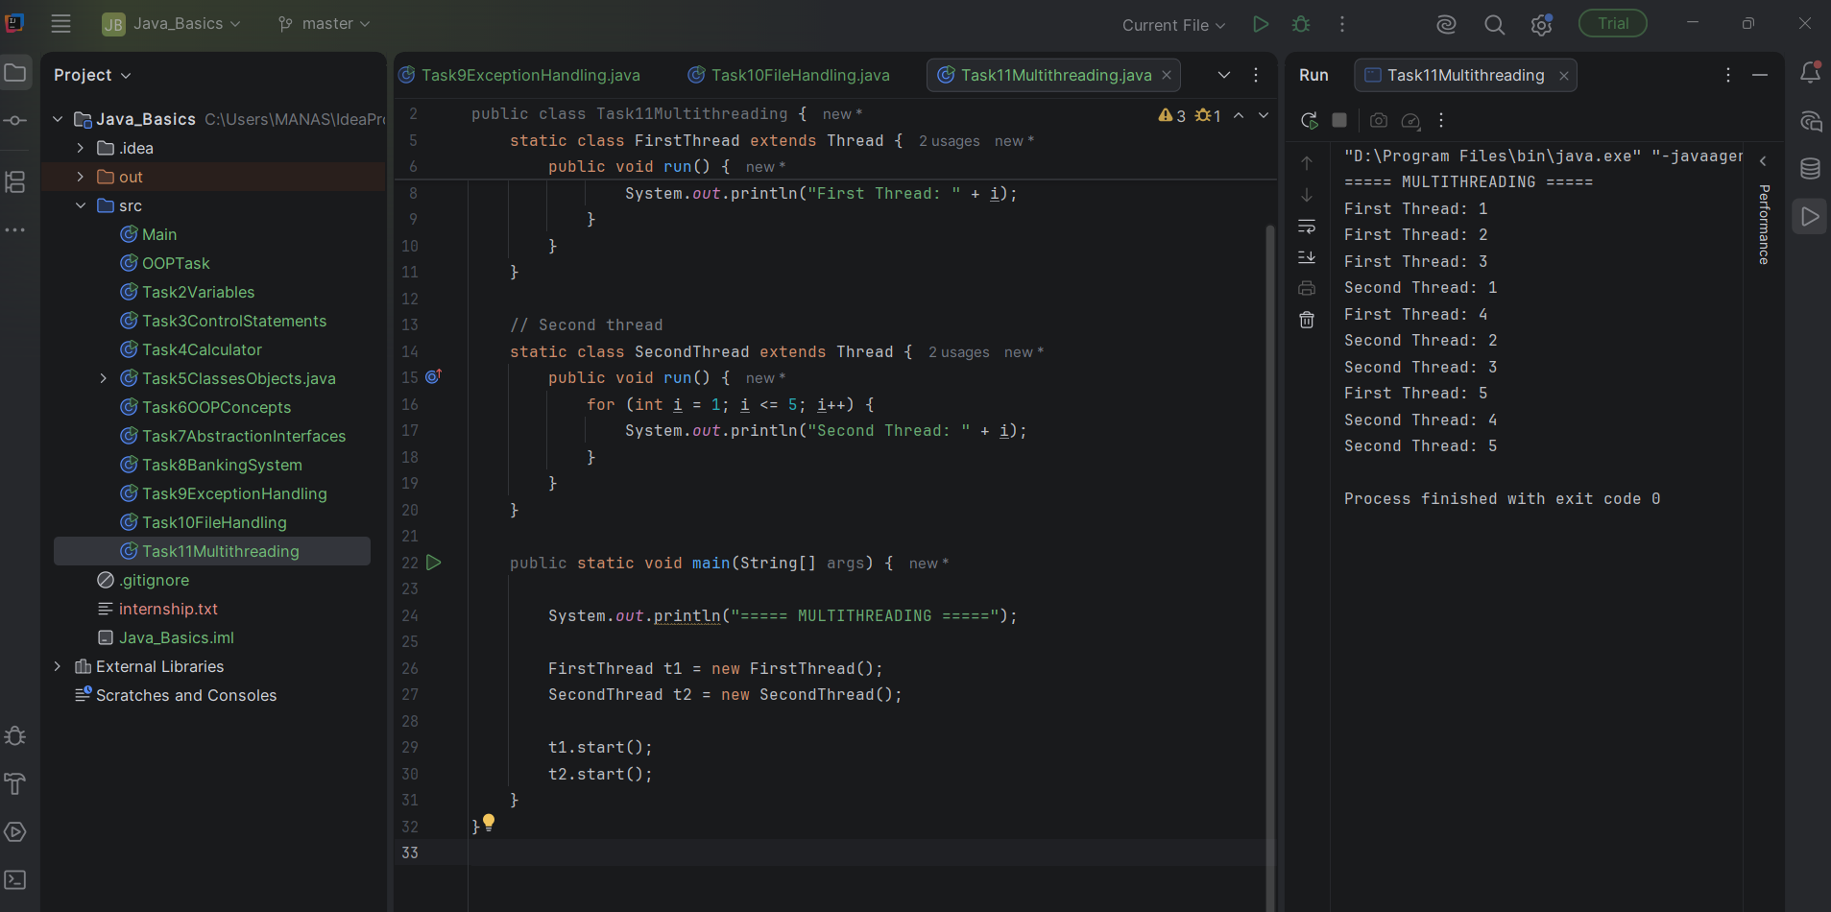
Task 11: Multithreading

Slide 12
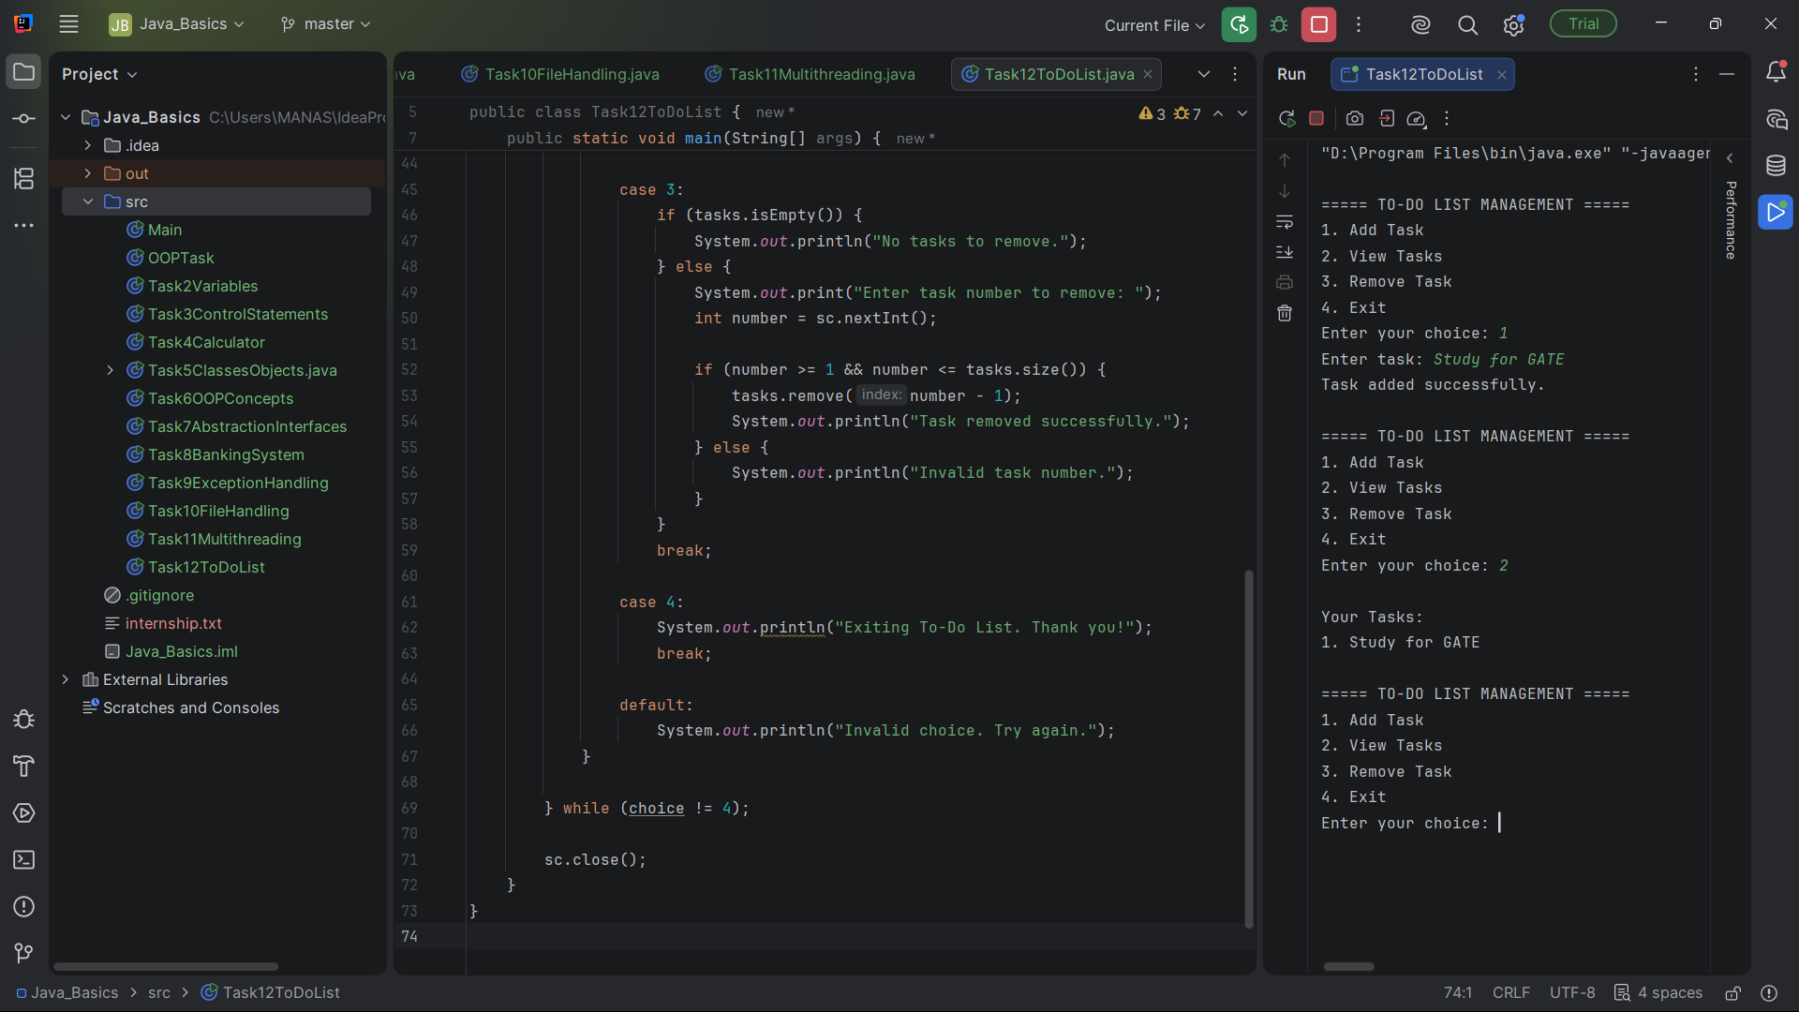
Task 12: To-Do List

Slide 13
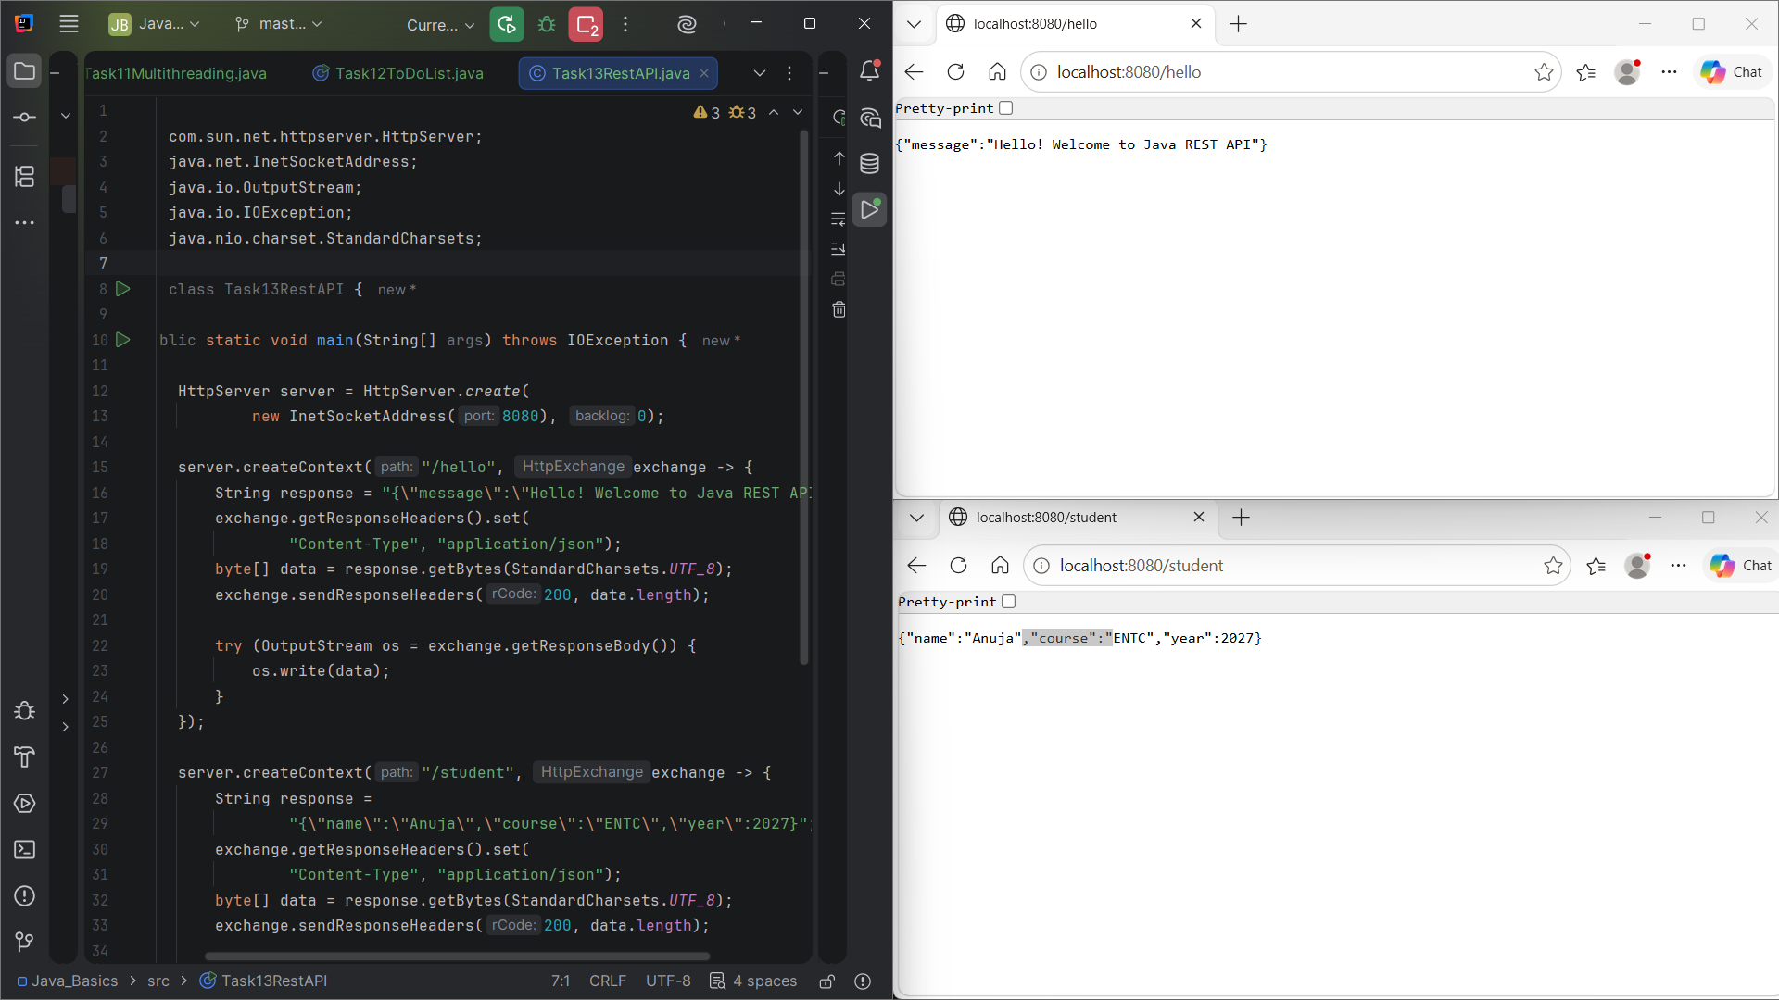
Task 13: REST API

Slide 14
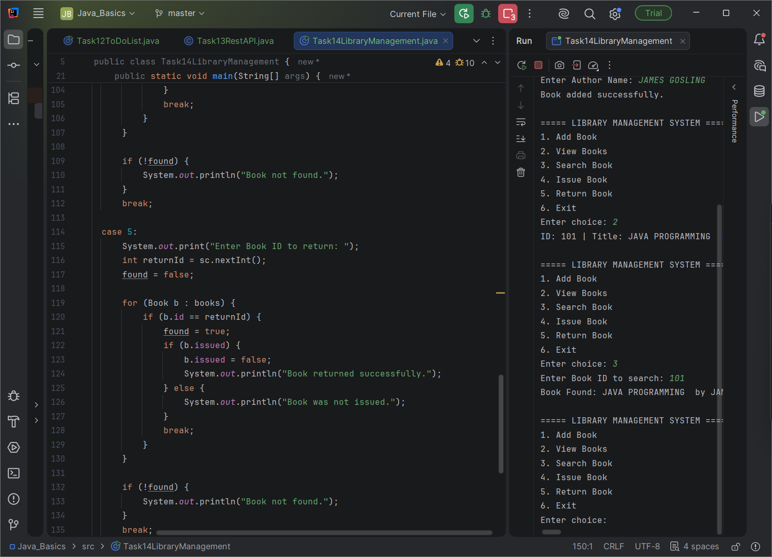
ask 14: Library Management

Slide 15
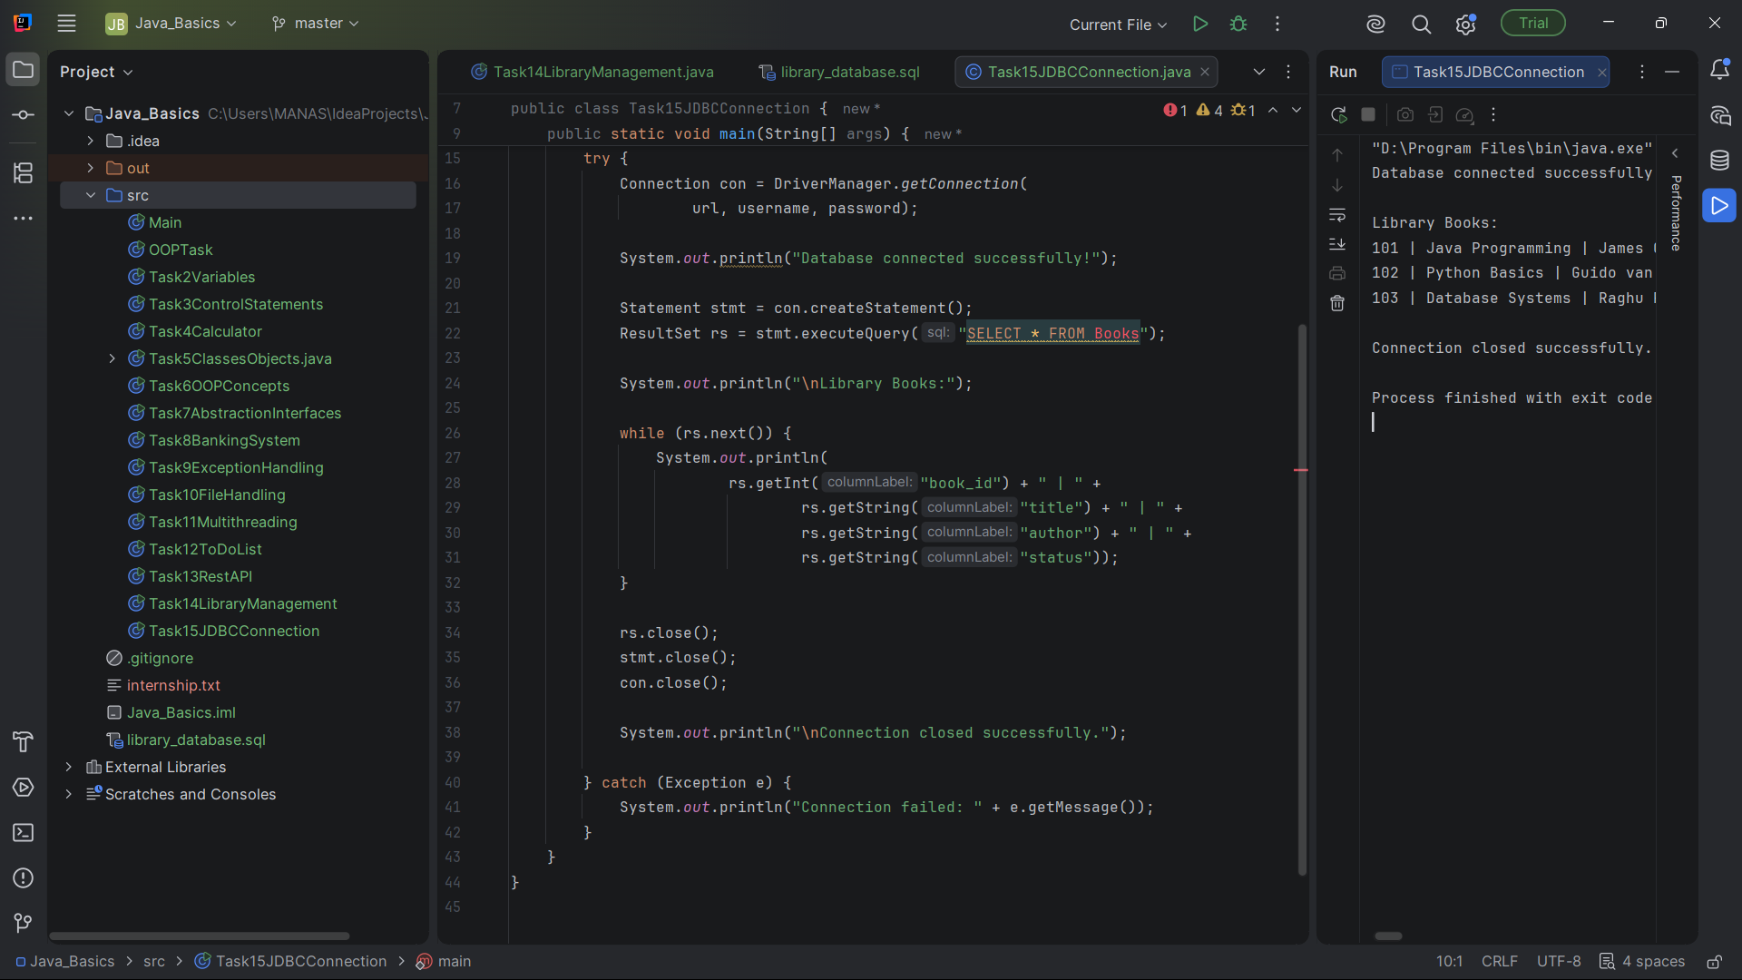
Task 15: JDBC Connection

Slide 16
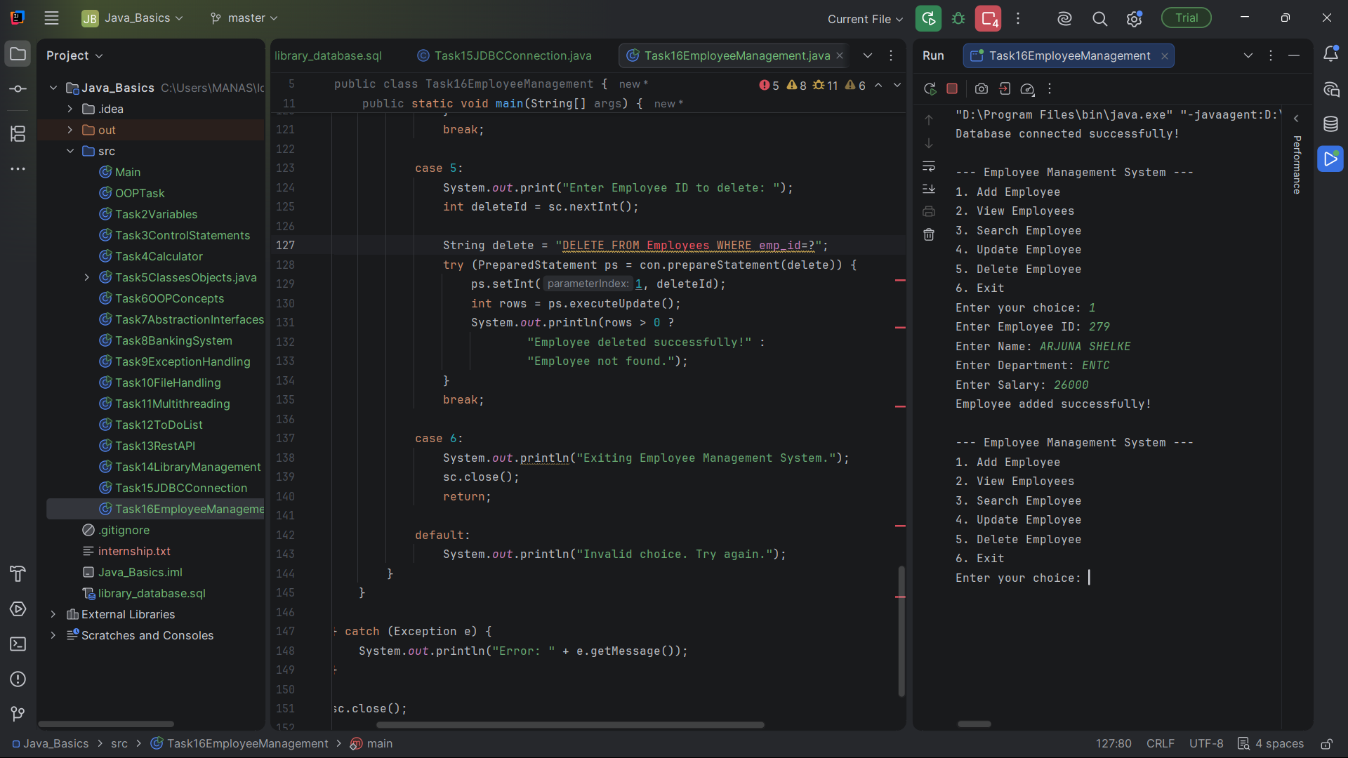
Task 16: Employee Management

